Slide 1
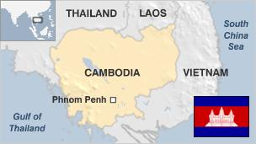
Key Findings
The Khmer Rouge movement, led by Pol Pot, peaked during the 1960s in the midst of American acceleration of military intervention in the region. Beginning as a small communist faction, Pol Pot’s forces grew to over 700,000 by 1975.
On April 17, 1975, the Khmer Rouge took control Phnom Penh and the country. They immediately began to enact their plans. People were marched out of their homes and former government officials were murdered.
From 1975-1979, the Khmer Rouge committed genocide, targeting intellectuals, educated people, professionals, monks, Buddhists, Muslims, Christians, Cham, ethnic Chinese, Vietnamese, Thai and Cambodians with Chinese, Vietnamese, or Thai ancestry.
Cambodians were forced to work from dawn to dusk on collective farms or infrastructure projects. Many fell victim to exhaustion, disease, or famine. Those incapable of the physical labor or who became inefficient were killed.
Aside from forced labor and massacres, the Khmer Rouge also committed cultural genocide by destroying Buddhist temples and works of art and by committing rape, arbitrary detention, torture, and forced medical experimentation.
An estimated 1.5 to 2 million, a quarter of Cambodia’s population, died during the genocide. More than 19,733 mass graves have been identified in the 'Killing Fields.'

Slide 2
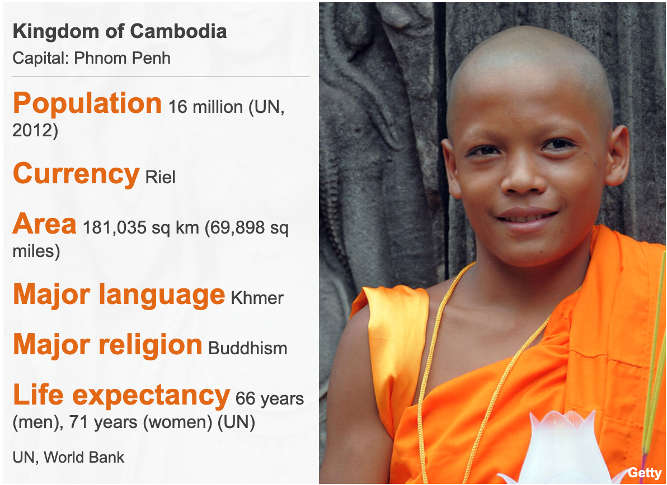
Cambodia country profile
1863-1953 - French colonial rule.
1941 - Sihanouk becomes king.
1941-45 - Japanese occupation.
1970 - Prime Minister Lon Nol mounts a successful coup against Sihanouk, who organizes a guerrilla movement from exile.
1975-79 - Lon Nol is overthrown by the communist Khmer Rouge under Pol Pot.
1981 - The pro-Vietnamese Kampuchean People's Revolutionary Party wins elections, but its rule is not internationally recognized and later faces mounting guerrilla resistance
1991 - Paris Peace Agreements are signed. Sihanouk becomes head of state.
1997 - Hun Sen mounts a coup against the prime minister, Prince Ranariddh, effectively taking sole power.

Slide 3
Ten Stages of Genocide
Dr. Gregory Stanton, Founding President of Genocide Watch, is the author of the Ten Stages of Genocide. The stages are:
1. Classification
2. Symbolization
3. Discrimination
4. Dehumanization
5. Organization
6. Polarization
7. Preparation
8. Persecution
​9. Extermination
10. Denial
Cambodia reached all ten stages of genocide. Though it is well documented that 1.5-2 million Cambodians died during the period 1975-1979, former Khmer Rouge officials, including Pol Pot, denied the extent of the genocide.

Slide 4
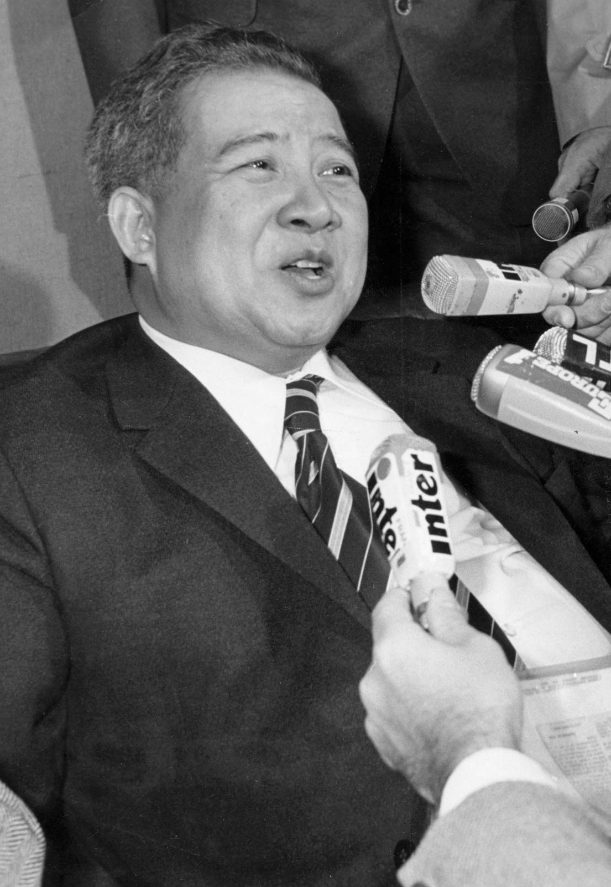
Kingdom of Cambodia
Nov 9, 1953 to Mar 1970
King Norodom Sihanouk led the country following Cambodia's independence from France on November 9, 1953. In 1955, he abdicated the throne to become Prime Minister. Sihanouk attempted to remain non-aligned during the Cold War, though he accepted military aid from the United States. However, as the US became increasingly involved in conflicts in Southeast Asia, Sihanouk distanced himself from the West. His authoritarian rule contributed to the formation of opposition groups like the Khmer Rouge.

Slide 5
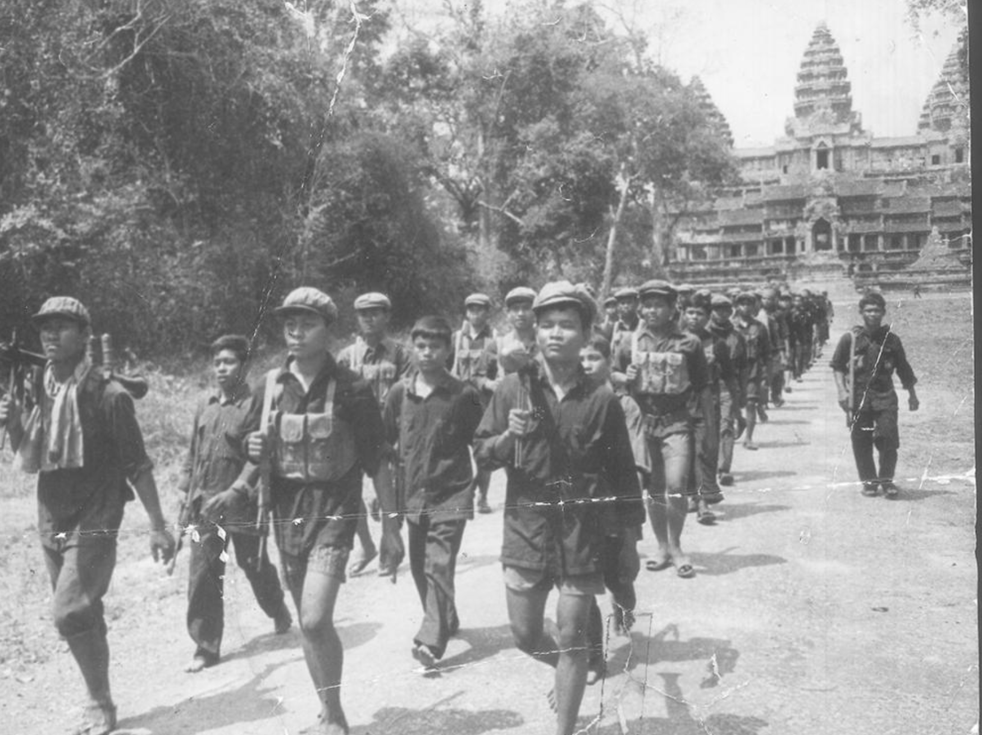
Khmer Rouge Launch Insurgency
1967
The Khmer Rouge, led by Pol Pot, launched an insurgency against Sihanouk from northwest Cambodia. It was met with brutal repression by the government, and as a result, the Khmer Rouge made very few gains in the early years of their military campaign.

Slide 6
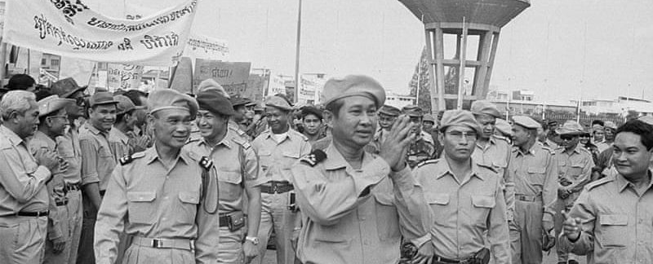
Lon Nol's Coup d'Etat
Mar 1970
Lon Nol led a coup d'etat to overthrow Sihanouk, who was out of the country at the time. Lon Nol became president, establishing a pro-American regime.
Sihanouk quickly moved to join his former enemies, the Khmer Rouge, and went on the radio to encourage all Cambodians to do the same. This helped the Khmer Rouge gain much more popular support, especially from rural areas.

Slide 7
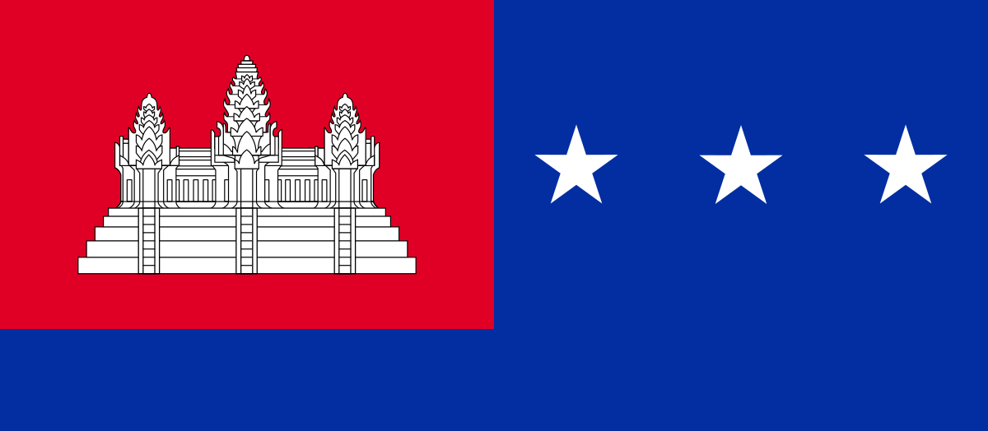
Khmer Republic
Mar 1970 to Apr 1975
Lon Nol overthrew Sihanouk, set up a US-backed regime known as the Khmer Republic, and established himself as President. Though the regime was initially popular, support waned as Lon Nol became increasingly dictatorial.

Slide 8
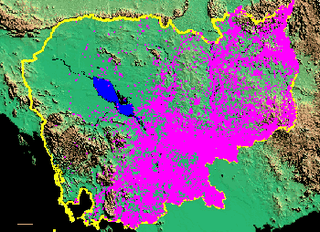
US Covert Bombing of Cambodia
1969 to 1974
Nixon ordered covert bombings on eastern Cambodia beginning in March 1969 in order to destroy North Vietnamese supply lines.
Up to 750,000 Cambodians were killed by napalm and cluster bombs dropped by American B-52 bombers between 1970-1974. Overall, the US dropped 2.7 million tons of bombs on more than 113,000 sites. This is believed to have contributed to increased support for the Khmer Rouge.

Slide 9
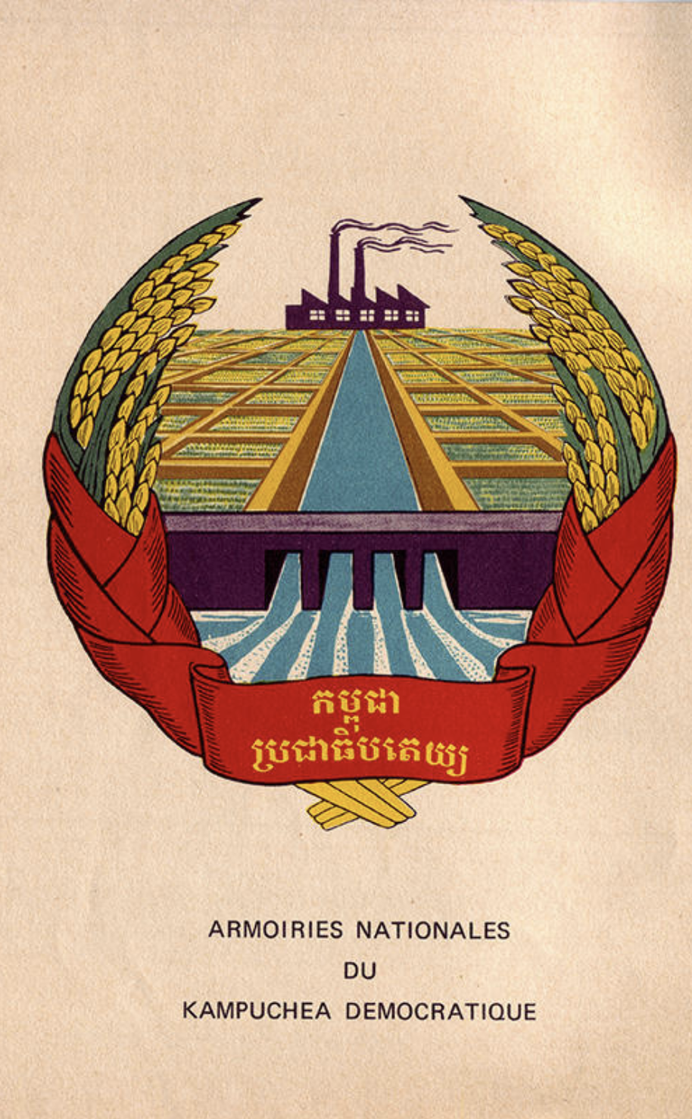
Khmer Rouge Beliefs and Plans
Pol Pot was educated in France and inspired by Maoist communism.
The Khmer Rouge's goal was to transform Cambodia into a classless, agrarian utopia.
Their rule was based on strict one-party rule, the rejection of urban and Western ideas, and the abolition of private property.
Pol Pot declared 1975 "Year Zero" and established a Four-Year Plan to rapidly increase rice production through collective farming to ensure self-reliance.
Demanded unquestioning loyalty to the nameless and faceless regime that people knew as Angkar (“the organization”)
The Khmer Rouge attempted to achieve their goals through forced labor, thought control, and mass execution.

Slide 10
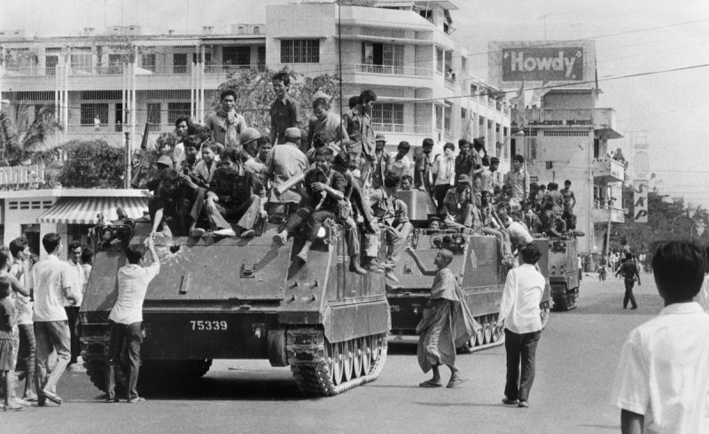
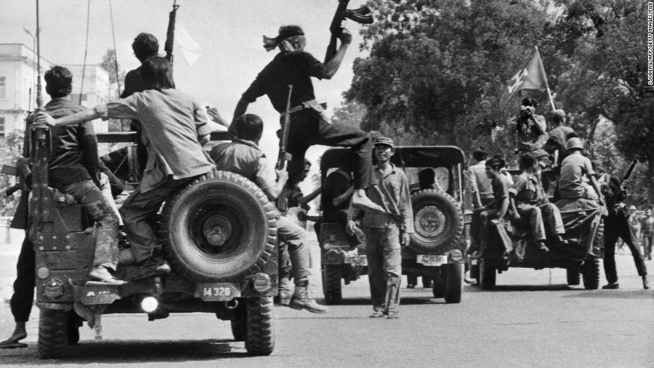
Khmer Rouge seize Phnom Penh
Apr 17, 1975
Khmer Rouge forces entered Phnom Penh and almost immediately began their plans to transform Cambodia into a rural, agrarian society. People were forced out of their homes, marched out of cities, and sent to labor camps, factories, or agricultural communes at gunpoint. Soldiers and officials of the Lon Nol government were executed.

Slide 11
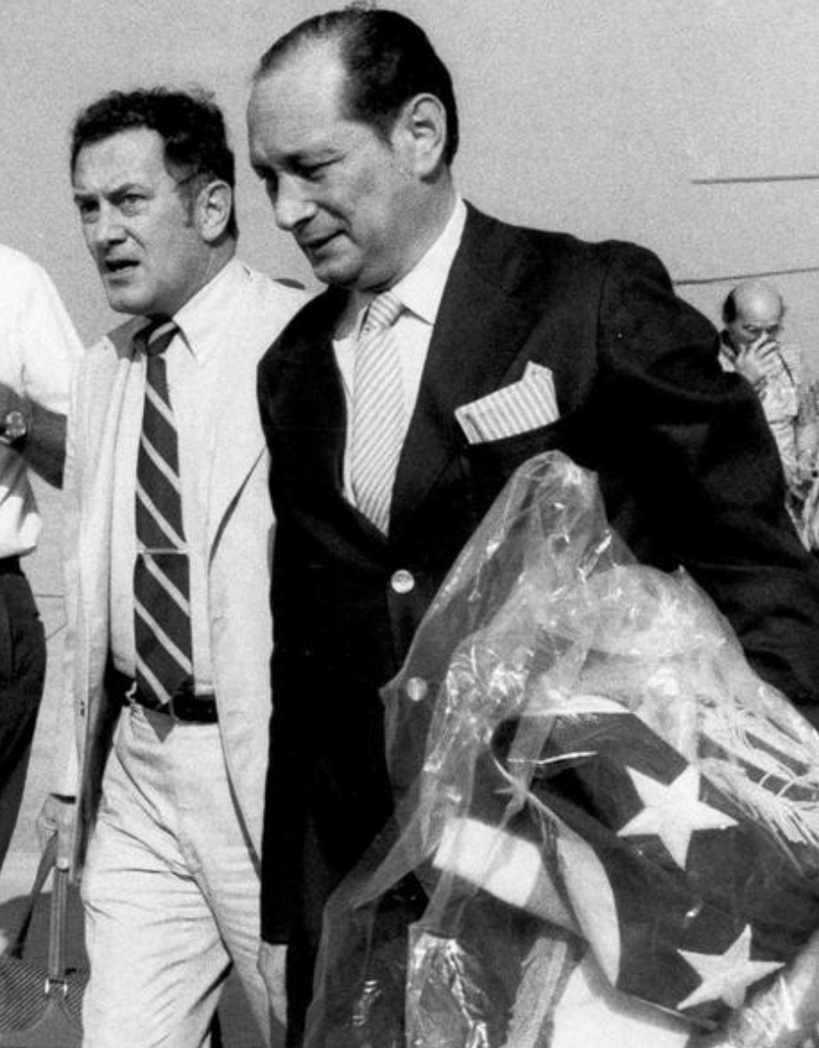
Democratic Kampuchea
1975 to 1979
When the Khmer Rouge took over the country, they established a new name: Democratic Kampuchea.

Slide 12
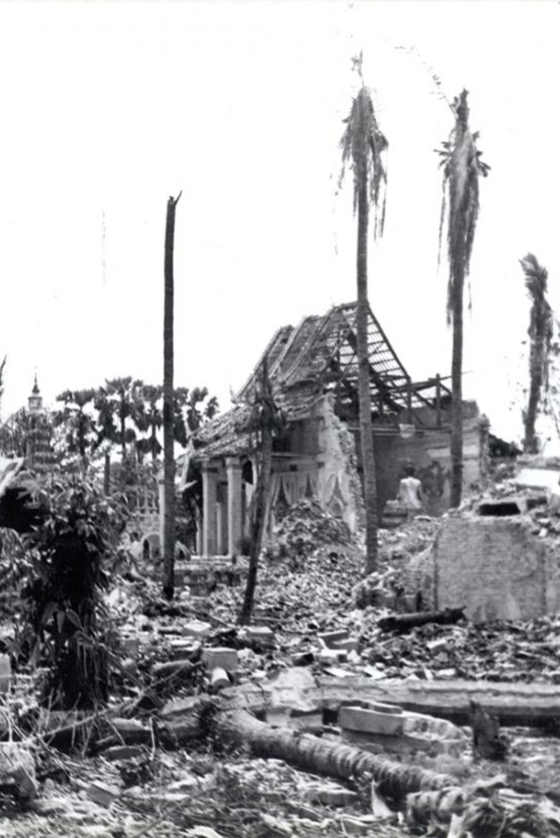
Religious Persecution
1975 to 1979
All Cambodians, including Christians, Buddhists, and Muslims were prohibited from religious and traditional practices. Religious facilities and works of art were destroyed. Religious leaders were murdered, including an estimated 50,000 Buddhist monks. The ‘Killing Fields,’ where bodies were dumped into mass graves, denied Buddhists cremation, their traditional burial practice.
Cham people, who are traditionally Muslim, were subjected to some of the harshest treatment by the Khmer Rouge. Cham women were forced to keep their hair short, and men were not allowed to wear their traditional sarong. Cham Muslim practitioners were forced to eat pork, in violation of their religious faith. Mosques were burned down, and religious leaders and teachers were killed. It is estimated that 70% of the Cham population were killed during the genocide.

Slide 13
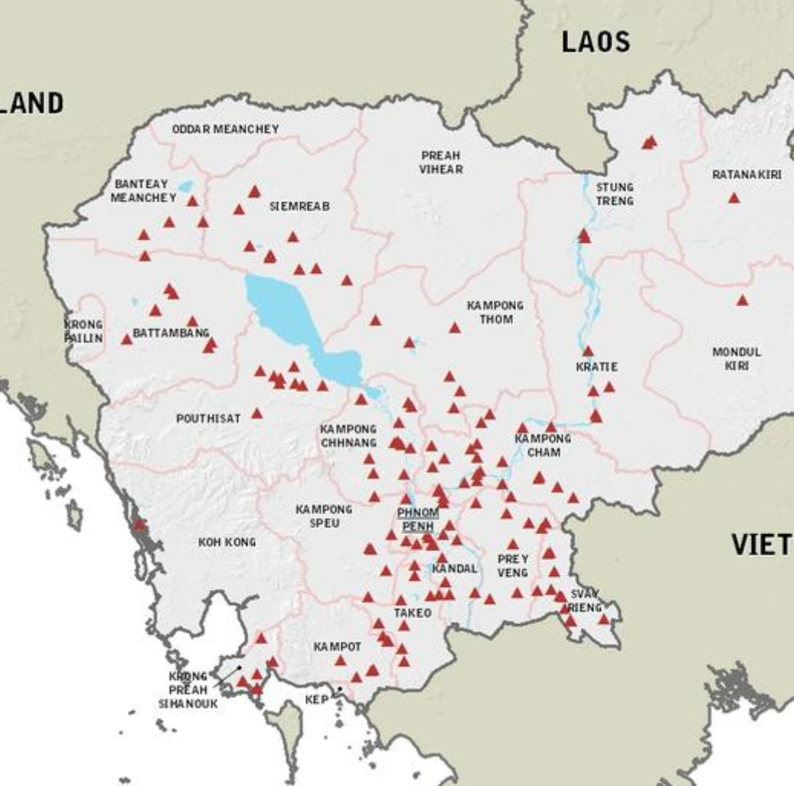
Interrogation Centers and Prisons
1975 to 1979
The Khmer Rouge used at least 189 interrogation centers to detain, interrogate, torture, and kill thousands of Cambodians, even including Khmer Rouge members and supporters. The most notorious of the prisons is S-21, or Tuol Sleng, which was controlled by Kaing Guek Eav. This prison detained mostly Khmer Rouge members. S-21 officials kept meticulous records by taking pictures of each inmate when they arrived. The prisoners were tortured, forced into giving confessions, and sometimes executed. Of the 14,000-17,000 people detained in S-21, only 12 survived.

Slide 14
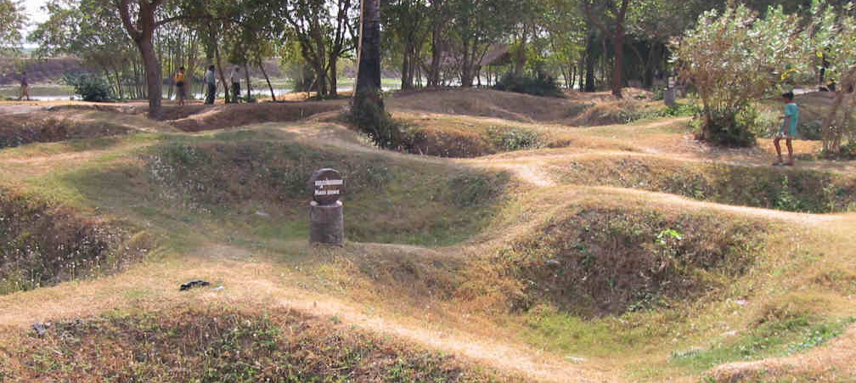
Mass Graves
1975 to 1979
Those who died of starvation, being overworked, illness, or were murdered were dumped into mass graves that became known as the 'Killing Fields." More than 388 sites with 19,733 mass graves have been identified. Scraps of clothing and bones are still being recovered at these sites.

Slide 15
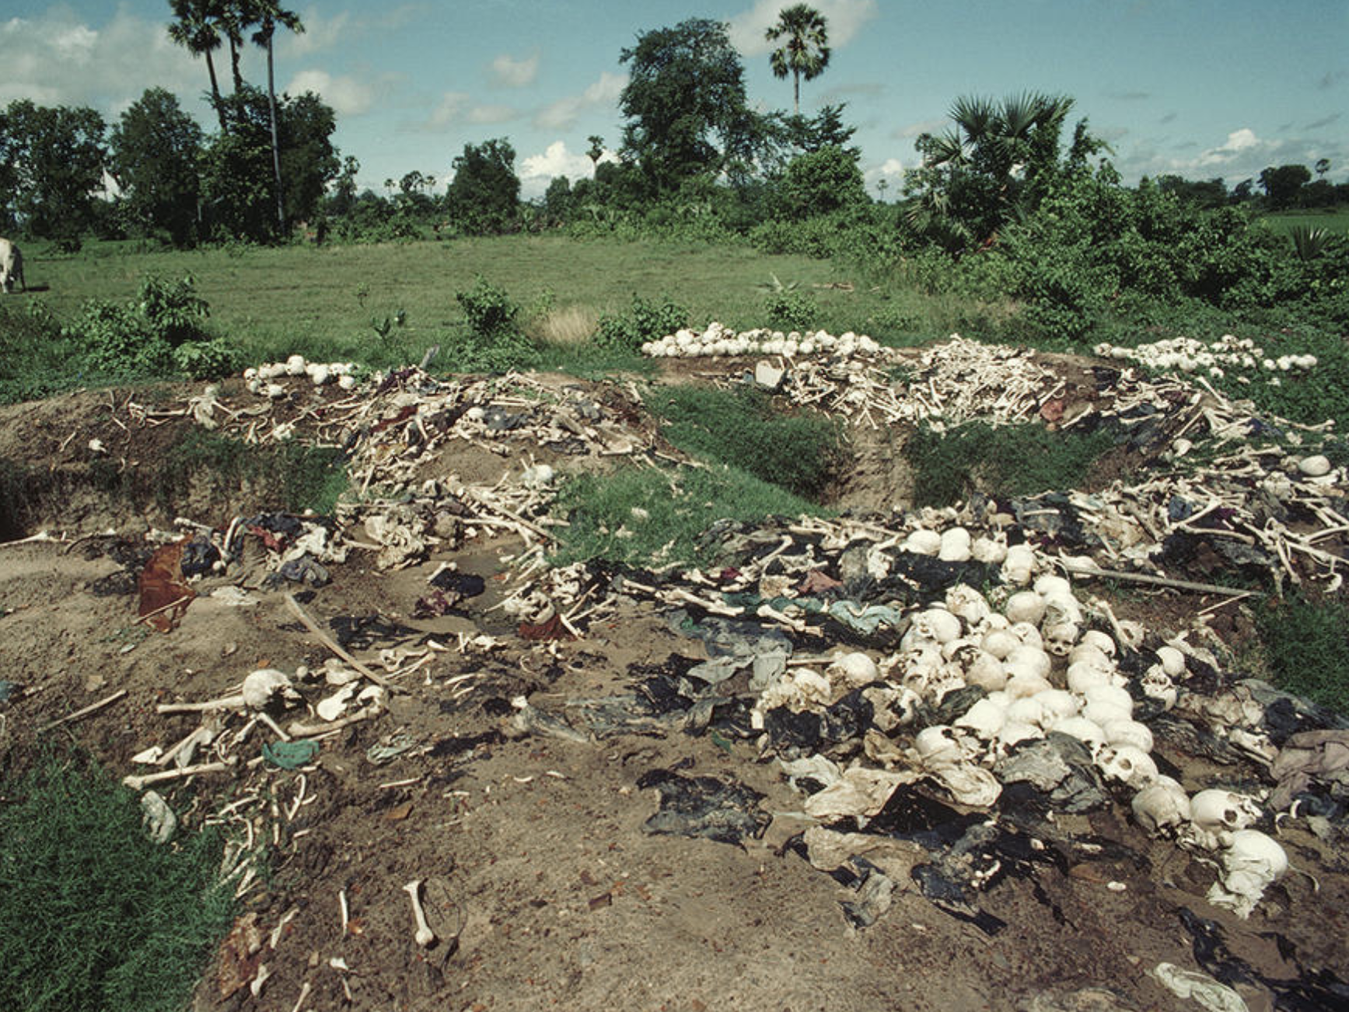
Second Wave of Persecutions
1977
Pol Pot led a second wave of massacres with the goal of eliminating dissident communists and other moderates. This violence spread to persecute the peasantry more generally and urban evacuees.

Slide 16
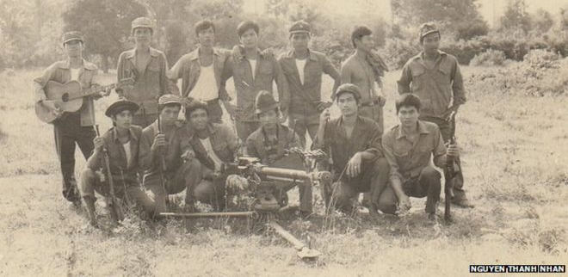
Vietnam Overthrows Khmer Rouge
Jan 7, 1979
Attempts to regain territory held centuries ago by the Khmer Empire through armed incursions into Vietnam, Thailand, and Laos beginning in 1977 ultimately led to the downfall of the Khmer Rouge regime. In late December 1978, Vietnam launched an invasion of Cambodia, quickly defeating Khmer Rouge forces. Vietnam forces entered Phnom Penh and officially overthrew the Khmer Rouge on January 7, 1979. Vietnam quickly put in place a new government of Khmer Rouge defectors and Cambodian sympathizers. Although the regime was toppled, Khmer Rouge forces continued to fight.

Slide 17

People's Republic of Kampuchea
1979 to 1989
The People's Republic of Kampuchea is the name adopted by the Vietnamese-installed government.
Vietnamese forces withdrew from Cambodia in 1989 to allow for political agreements to be made.

Slide 18
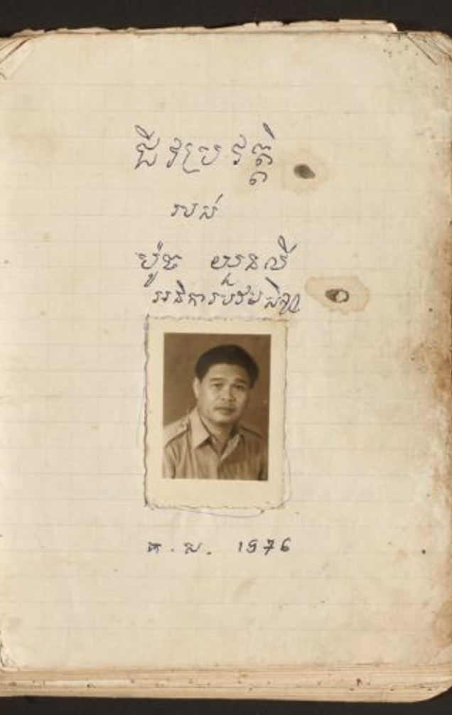
Death from Starvation and Disease
1975 to 1981
Although the Khmer Rouge planned to massively ramp up agricultural production, their plans failed, in part due to the lack of agricultural knowledge and skills of those forced out of urban areas and into collective farms. This resulted in mass starvation from 1976-1981. 50-70% of deaths under the Khmer Rouge are estimated to be due to starvation. Though international organizations offered aid, the Khmer Rouge government refused due to its ambition of self-reliance.
When Vietnam overthrew the Khmer Rouge regime, the suffering did not end for Cambodians. As Cambodians were able to move freely and violence continued, many fled to Thailand. Along the way, many Cambodians died of starvation or were killed by landmines that had been planted by Khmer Rouge soldiers to keep Cambodians from fleeting. They also suffered from malaria, typhoid, cholera, and other diseases. Around 650,000 Cambodians died in the year following the fall of the Khmer Rouge regime.

Slide 19
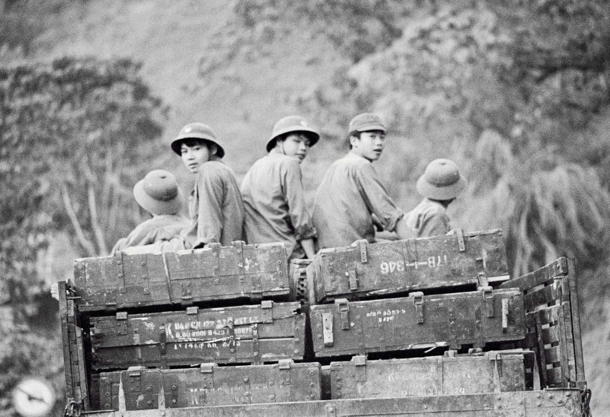
Sino-Vietnamese War
Feb 17, 1979 to Mar 16, 1979
In response to Vietnamese occupation of Cambodia, at least 200,000 Chinese forces invaded Vietnam. Though the war was short, an estimated 50,000 died.

Slide 20
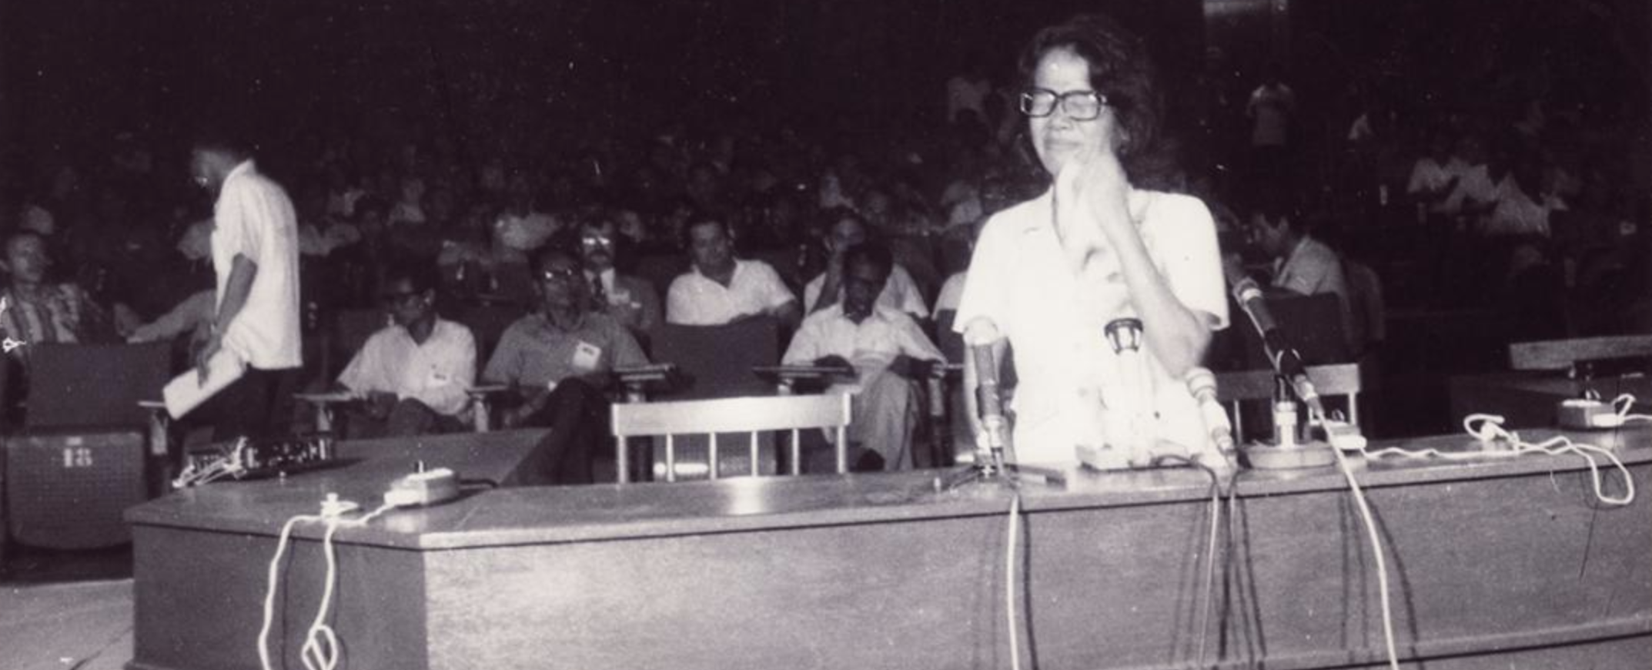
People's Revolutionary Tribunal
Aug 1979
The government installed by Vietnam formed the “People’s Revolutionary Tribunal” in August 1979 in the first attempt to bring perpetrators of the genocide to justice. It tried Pol Pot and Ieng Sary even though neither had been arrested and heard testimony about widespread torture and executions. Both were convicted of genocide and sentenced to death. However, the trial was extremely biased. Proceedings took only five days, failed to use internationally-accepted legal procedures and protections, and overall appeared to be a show trial in which the verdict was decided ahead of time.

Slide 21
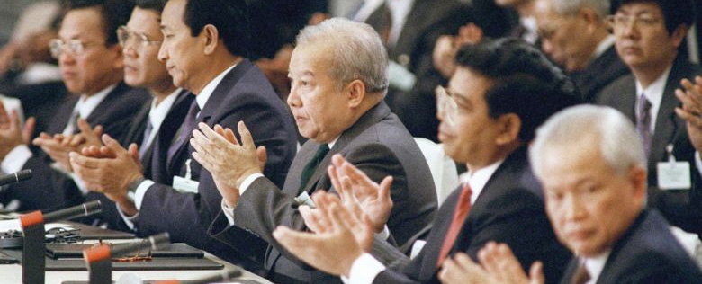
Paris Agreements on Cambodia
Oct 23, 1991
19 governments signed the Paris Peace Agreements on the Comprehensive Political Settlement of the Cambodia Conflict in order to end the ongoing conflict and set up fair and free elections. It also including setting up the United Nations Transitional Authority in Cambodia (UNTAC) to facilitate the Agreements.
The remaining Khmer Rouge forces rejected the agreements and continued to fight.

Slide 22
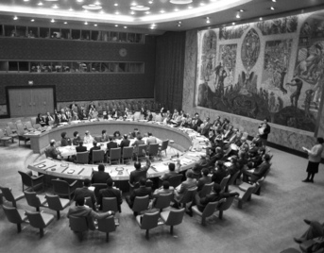
UNAMIC
Oct 1991 to Mar 1992
The United Nations Advance Mission in Cambodia was established to assist the ceasefire before UNTAC could be put in place. It also trained Cambodians in landmine detection and clearance.

Slide 23
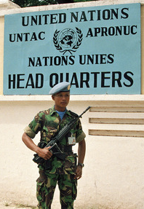
UNTAC
Mar 15, 1992 to Sep 1993
The UN Security Council approved the United Nations Transitional Authority in Cambodia (UNTAC) in February 1992, with deployment beginning a month later. UNTAC took control of Cambodia's key administrative departments: foreign affairs, defense, security, finance, and communications. UNTAC also oversaw the 2003 election, including the campaign and registration of voters.
Other UNTAC responsibilities included:
  supervising the ceasefire, the end of foreign military assistance, and the withdrawal of foreign forces
  regroup, divide, and disarm the armed forces of all Cambodian parties and ensure a 70% level of demobilization
  ensure and respect of human rights

Slide 24
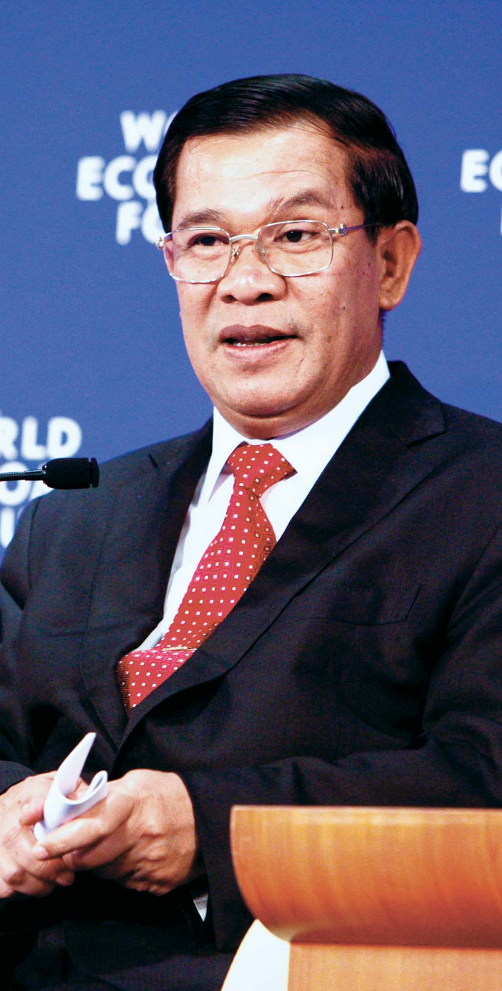
UN-Supervised General Elections
May 1993
UNTAC oversaw the 1993 elections in which Hun Sen, a former Khmer Rouge commander who had been the leader of the pro-Vietnamese government, and Sihanouk's son, Prince Norodom Ranariddh were elected as co-prime ministers. Sihanouk became king once again.
In order to monitor and protect human rights in the newly-democratic state, the UN established an office in Cambodia shortly after the elections.

Slide 25

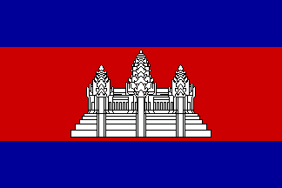
The Current Kingdom of Cambodia
1993 to 2020
With the first post-Khmer Rouge democratic elections having taken place in 1993, the monarchy has been restored and the country’s name was reinstated to the Kingdom of Cambodia. The name is still held today.

Slide 26
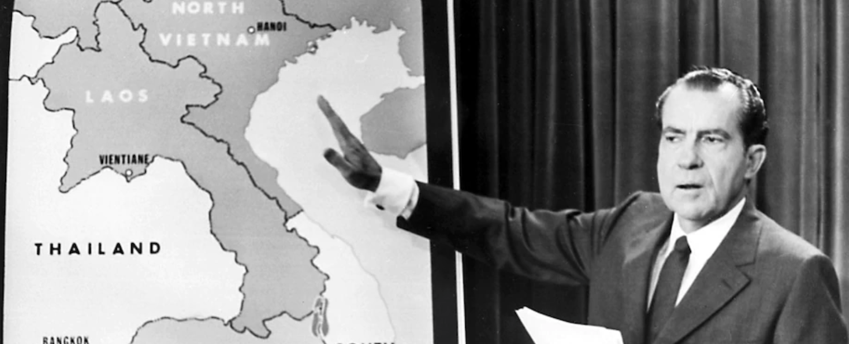
Role of the US in the 70s
Mar 1969 to 1979
The US’s role in the Cambodian Genocide is highly controversial. Covert US bombings in Cambodia, which killed thousands of Cambodians and inadvertently strengthened the Khmer Rouge, were defended as being in support of Lon Nol’s pro-American government.
The US also had detailed information about the genocide committed by the Khmer Rouge, but took little to no action, largely due to the recent context of failure in Vietnam. While President Carter called the Khmer Rouge “the worst violator of human rights in the world today” in April 1978, he still did nothing despite his commitment to human rights. Following Vietnam’s invasion of Cambodia and the installation of a pro-Vietnamese government, President Carter’s administration refused to accept this government as Cambodia’s UN representative, voting to keep the Khmer Rouge representative instead.

Slide 27
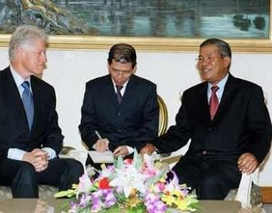
Role of the US in the 90s
1990 to 1999
The US record on Cambodia improved in the 1990s, with US humanitarian aid being resumed as relations between the two nations improved. In 1994, President Clinton approved the Cambodia Genocide Justice Act, calling for the main perpetrators to be brought to trial and providing $500,000 for collecting information about their crimes. 150,000 refugees were also permanently resettled in the US.

Slide 28
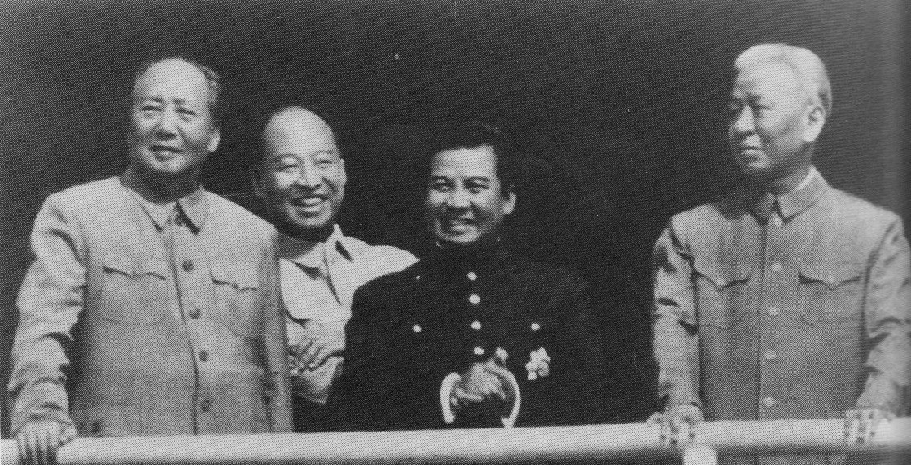

Chinese Support for Khmer Rouge
1967 to 2020
The amount of support China provided the Khmer Rouge is somewhat mysterious. Many have claimed that the Khmer Rouge relied on the aid and technical advisors provided by China both before and after the 1975-1979 regime despite Pol Pot's rhetoric of self-reliance. China has rejected claims that they provided significant military aid or technical assistance.
To this day, China is Cambodia's biggest investor, which limits the influence of Western investors who are increasingly wary of Hun Sen.

Slide 29
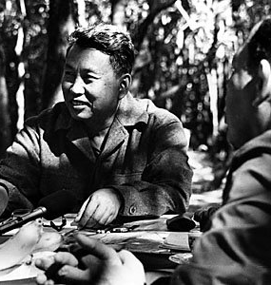
Pol Pot's Death
Apr 14, 1998
Pol Pot, leader of the Khmer Rouge, died while under house arrest at age 73. Though he was found guilty in the People's Revolutionary Tribunal, Pol Pot was never tried in an internationally-recognized court.

Slide 30
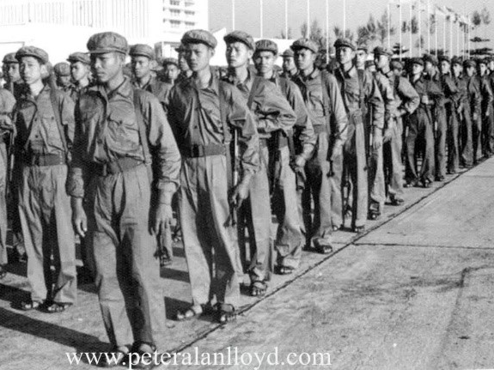
Khmer Rouge Disbands
1999
The remaining Khmer Rouge forces rejected the Paris Agreements and continued to engage in conflict. However, following the death of Pol Pot in April 1998, the last of the Khmer Rouge soldiers surrendered in 1999.

Slide 31
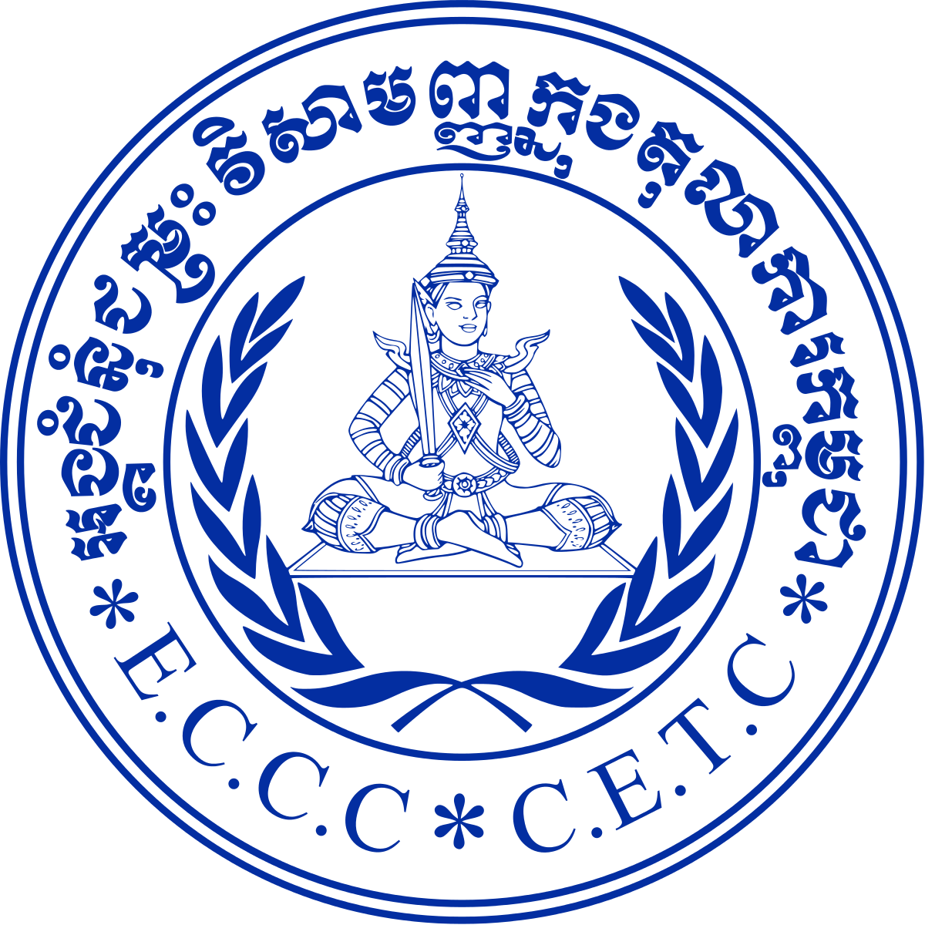
Cambodia and UN Agree on Tribunal
Jun 2003
In 1997, the Cambodian government requested assistance from the UN in prosecuting former Khmer Rouge officials. Following negotiations that began in 2001, the UN and Cambodia signed a final agreement to create the Extraordinary Chambers in the Courts of Cambodia.

Slide 32
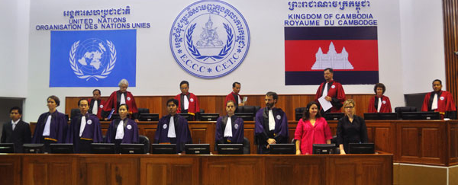
ECCC Structure
Jun 2003
The structure of the Extraordinary Chambers in the Courts of Cambodia (ECCC) was agreed upon in June 2003. It is a hybrid court composed of both Cambodian and international judges and is carried out within Cambodia, unlike previous tribunals. It has an official mandate to bring to trial “senior leaders of Democratic Kampuchea and those who were most responsible for the crimes and serious violations of Cambodian laws related to crimes, international humanitarian law and custom, and international conventions recognized by Cambodia, that were committed during the period from April 17, 1975 to January 6, 1979.”
The ECCC is made up of three Judicial Chambers (Pre-Trial and Supreme Court), two Judicial Offices (Co-Investigating Judges and Co-Prosecutors) and one Administrative Office, which includes a Victims Support Section (VSS). Through the VSS, victims can file complaints or become “civil parties,” through which they give testimony and directly question the accused in court.

Slide 33
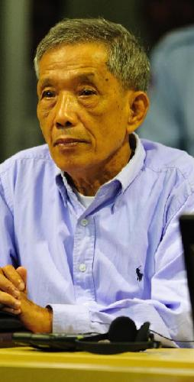
Case 001
2009 to Feb 2012
The subject of Case 001 is Kaing Guek Eav, the former commander of S-21, the notorious Khmer Rouge prison. He was the first of the former Khmer Rouge officials to come to trial in 2009.
In July 2010, he was found guilty of crimes against humanity and grave breaches of the 1949 Geneva Conventions and sentenced to 35 years of imprisonment. In February 2012, after both the prosecution and defense appealed the sentence, the Supreme Court Chamber increased the sentence to life imprisonment.

Slide 34
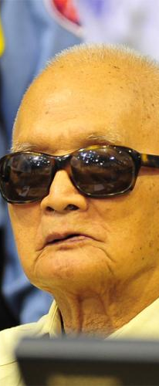
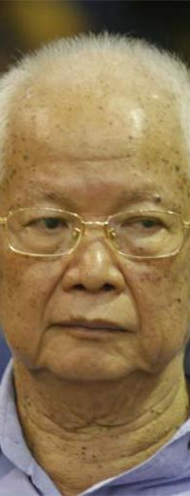
Case 002
2011 to Nov 2018
Case 002 was originally lodged against Khieu Samphan, the former head of state of Democratic Kampuchea; Nuon Chea, no. 2 in the hierarchy as the former deputy secretary of the Communist Party of Kampuchea; Ieng Sary, the former foreign minister; and Ieng Thirith, the former social affairs minister. Ieng Thirith was found mentally unfit to stand trial and was removed from the case in 2012; she died in August 2015. Her husband, Ieng Sary, died in March 2013 before he could be convicted.
Both Khieu Samphan and Nuon Chea were convicted on crimes against humanity, grave breaches of the 1949 Geneva Conventions, and genocide against the Cham, the Vietnamese, Buddhists, and former Khmer Republic officials. They were sentenced to life imprisonment. Nuon Chea died in prison in August 2019.

Slide 35
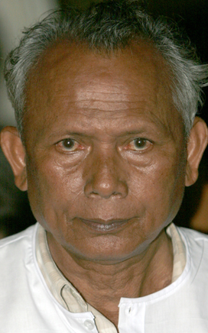
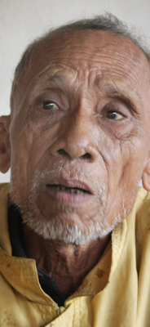
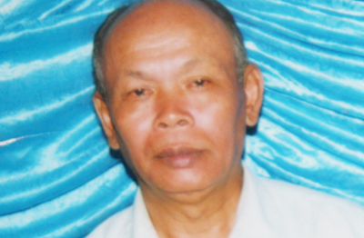
Case 003 and 004
2009 to 2020
In September 2009, investigations were requested in Case 003 against Sou Met (former Khmer Rouge air force commander) and Meas Muth (former Khmer Rouge navy commander), as well as Case 004 against Yim Tith (former district and zone official), Im Chaem (former district official), and Ao An (former deputy secretary in the Central Zone of Democratic Kampuchea).
The charges against Im Chaem were dismissed in early 2017 on the basis that she did not fall under the “most responsible” qualification. Sou Met died in June 2015. Meas Muth, Ao An, and Yim Tith all face charges of genocide, crimes against humanity, and violations of Cambodian criminal law. However, the cases have stalled as a result of the Cambodian government’s unwillingness to cooperate.

Slide 36
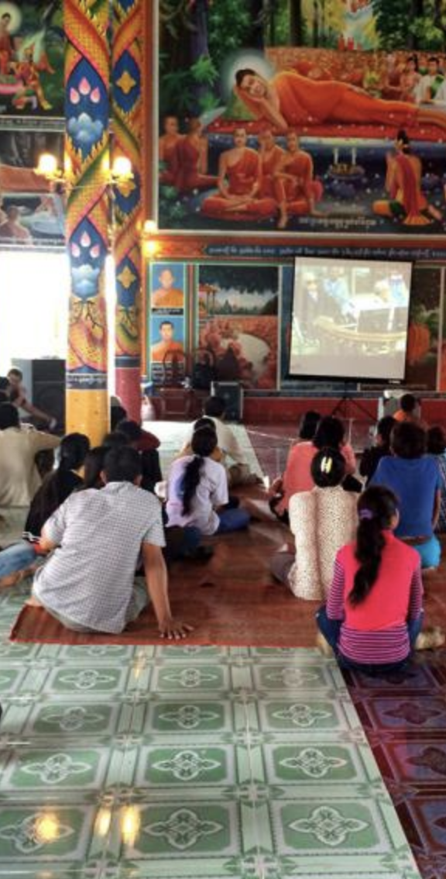
Summary
Under the Khmer Rouge regime, Cambodians were forced to leave their homes to live and work in factories and on communal farms or infrastructure projects.
1.5-2 million Cambodians were murdered or died of starvation, exhaustion, or illness.
In 2003, the United Nations and Cambodian government came to an agreement to form a joint tribunal called the Extraordinary Chambers in the Courts of Cambodia (ECCC) for the purpose of bringing to justice those "most responsible" for the Cambodian Genocide.
To date, only three former Khmer Rouge officials have been convicted by the ECCC. The court has faced challenges moving forward with further convictions due to disagreements between international and national officials, as well as reluctance of the Cambodian government to cooperate.
The ECCC has not only been criticized for its small number of convictions, but also its limited scope and enormous expenditure of $300 million. Some Cambodians, particularly younger generations who were not alive during the genocide, argue that the money would be better spent on development projects.
Despite its critiques, the ECCC has been a success in the sense that it was widely accessible to Cambodians and thus helped provide justice and a sense of healing. Additionally, continuing to pursue convictions over 40 years later sends a message that perpetrators of genocide will be brought to justice.

