Slide 1
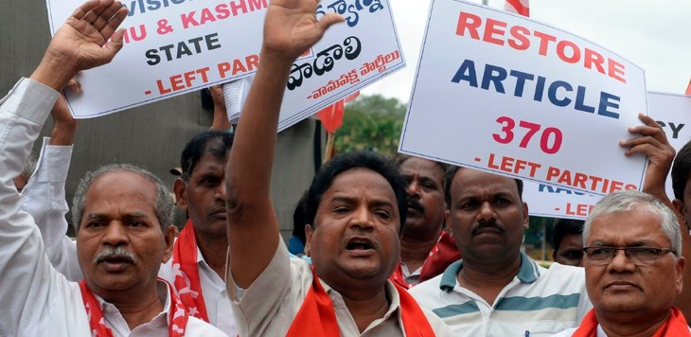
Summary Part 1
Three countries share control over different areas of Kashmir: China, India, and Pakistan.
Pakistan and India have fought over territory in Kashmir since the 1940s.
Pakistan and India signed the first formal ceasefire agreement in 2003, but violent conflicts between alleged Pakistani-funded militant groups and Indian authorities still continue.
In August 2019, India revoked Article 370 of their constitution, which will cause Indian-controlled Kashmir to lose its autonomy and split into two entities.

Slide 2
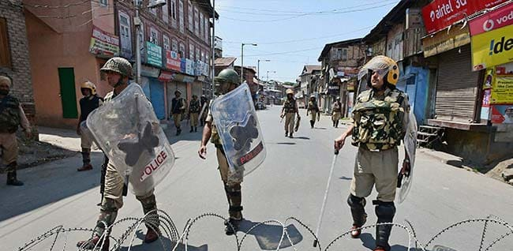
Summary Part 2
India has implemented a full communications blackout in Kashmir, cutting landline connections and suspending internet and mobile coverage, while also placing tens of thousands of troops in the region.
India's actions in Kashmir since announcing the revocation of Article 370 have drawn criticism from international human rights groups.
Pakistan's Prime Minister Imran Khan has already taken action against India for its decision to take away Kashmir's autonomy. Another war between Pakistan and India may begin over this.
The division of Jammu and Kashmir from Ladakh occurred in October of 2019.

Slide 3
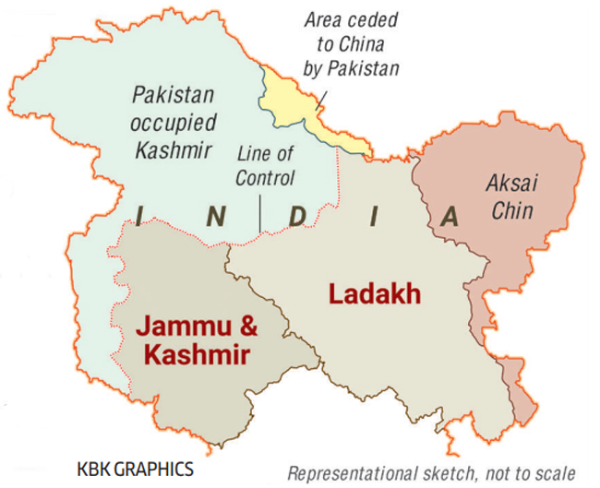
State of Jammu and Kashmir Forms
Dec 31, 1845

Slide 4
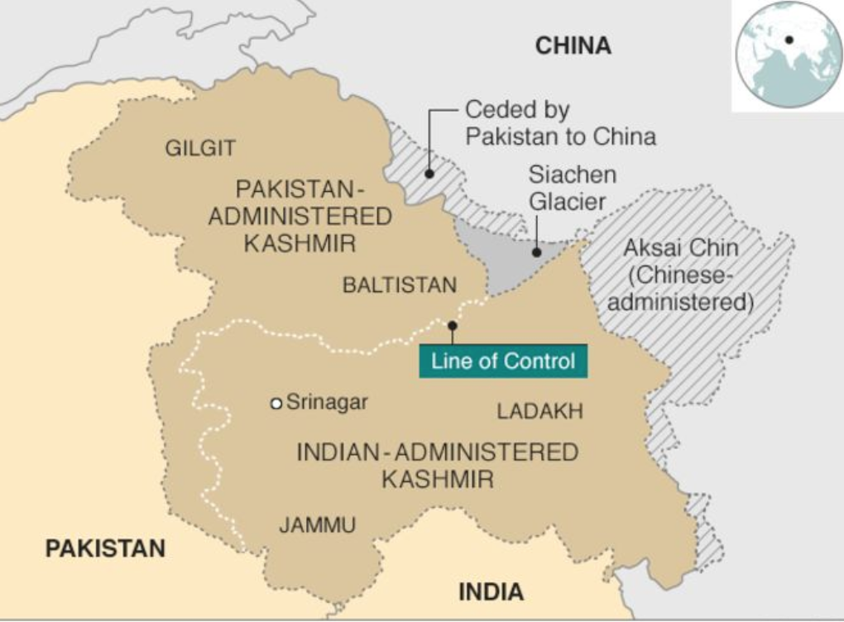
Jammu and Kashmir Profile
Jammu and Kashmir is an India-administered state covering 45% of the entirety of Kashmir.
According to the 2011 Indian Census, the population in Jammu and Kashmir was 12,541,302.
The majority of people in Jammu and Kashmir follow Islam, and the remaining are Hindu, Buddhist, and Sikhs. The official language is Urdu.

Slide 5
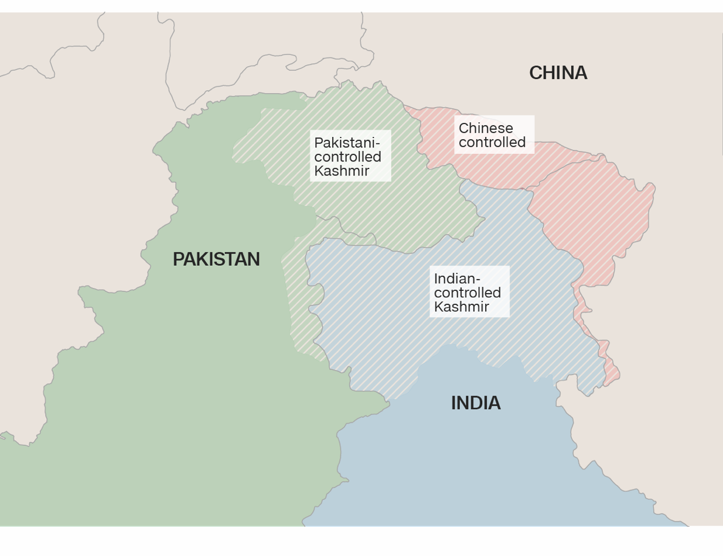
Who Controls Kashmir
Three countries claim Kashmir either fully or in part. India controls most of southern and eastern Kashmir, China controls a section in the northeast, and Pakistan controls the northwest.
Most of the fighting occurs in the Indian controlled region of Kashmir and along the border between Pakistan's and India's side.

Slide 6
India-Controlled Kashmir
India controls one state called Jammu and Kashmir, which "makes up the southern and eastern portions of the region, totaling about 45% of Kashmir."

Slide 7
China-Controlled Kashmir
China controls 20% of Kashmir. The area is called Aksai Chin and is in the northeastern part of the region.

Slide 8
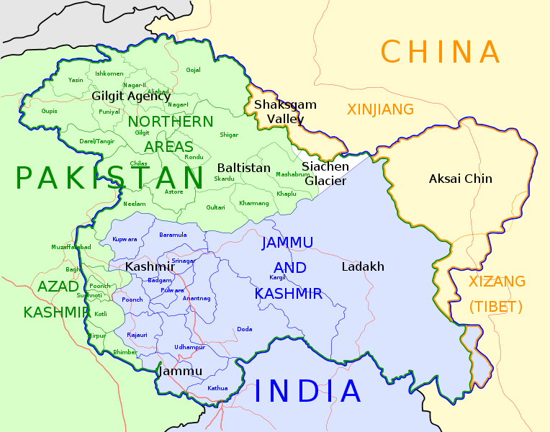
Pakistan-Controlled Kashmir
Pakistan controls three areas of Kashmir: Azad Kashmir, Gilgit and Baltistan. These three areas "make up the northern and western portions of the region, totaling about 35% of Kashmir."

Slide 9
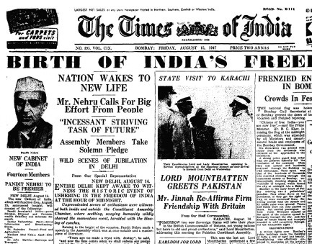
India Gains Independence from Britain
Aug 1947
India became independent from Great Britain in August 1947.

Slide 10
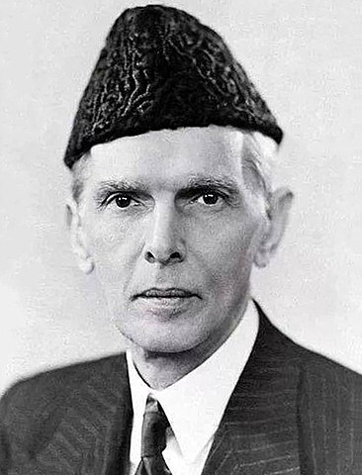
Pakistan Gains Independence From Britain
Pakistan became independent from Great Britain in August 1947.
Pictured right: Founder of Pakistan Mohammed Ali Jinnah

Slide 11
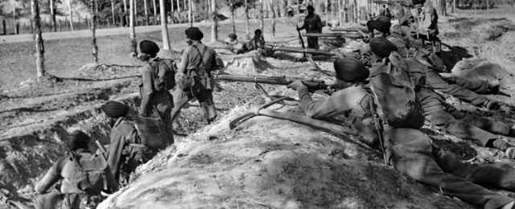
First Indo-Pakistani War
Oct 1947 to Jan 1949
The first Indo-Pakistani war began in response to an invasion of Pakistani tribesmen in Kashmir. The "Maharaja [of Kashmir] requested armed assistance from the government of India. In return he acceded to India, handing over powers of defense, communication and foreign affairs." The Indo-Pakistani war ended over a year later after a ceasefire was arranged by the United Nations. "A ceasefire line was established where the two sides stopped fighting and a UN peacekeeping force established."

Slide 12
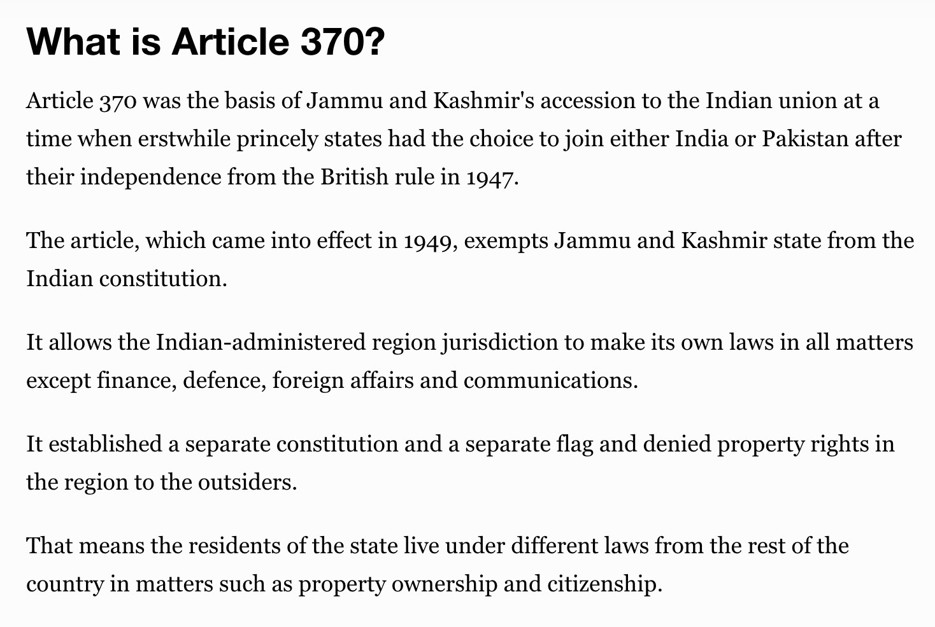
Article 370 Instituted
Jan 1949
Article 370 was written into India's constitution, exempting Jammu and Kashmir from adhering to its constitution and allowing the state its autonomy.

Slide 13
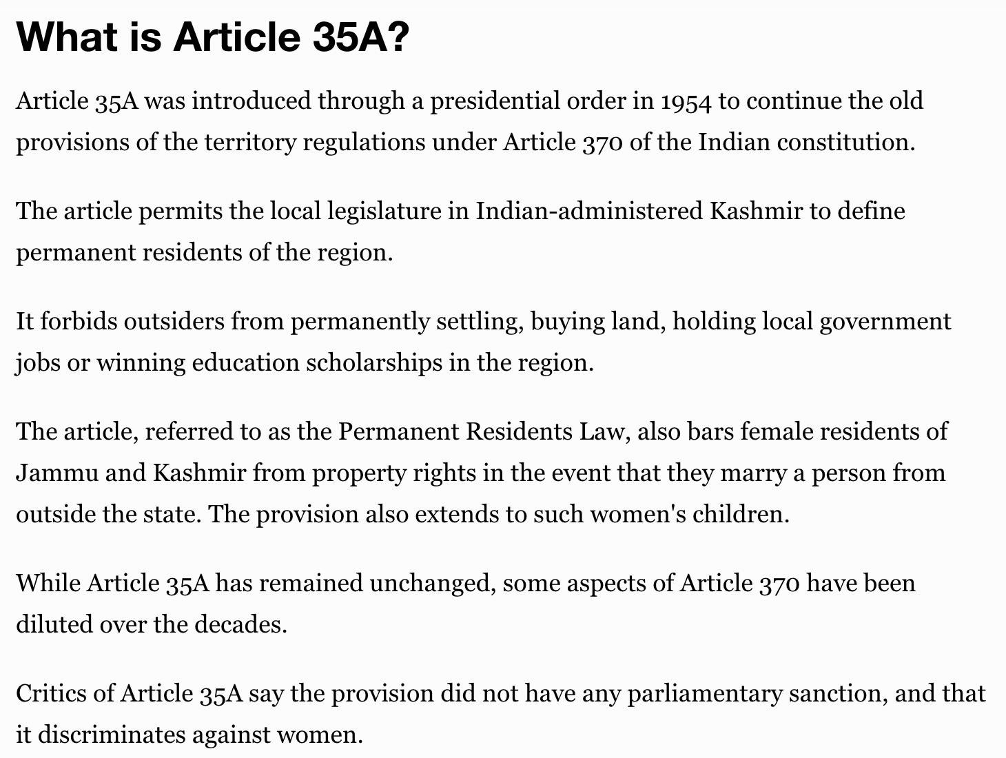
Article 35A
Jan 1954
Article 35A was added under Article 370 of India's constitution regarding Kashmir's status. This specific article allowed Jammu and Kashmir to decide who could be residents. It also kept outsiders from integrating into the state.

Slide 14
Jammu and Kashmir State Becomes Part of India
In 1957, the Indian constitution stated that Jammu and Kashmir was considered part of India.

Slide 15
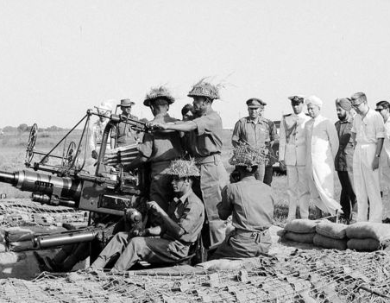
Second Indo-Pakistani War
Aug 5, 1965 to Sep 22, 1965
In January 1965, Pakistan reportedly sent forces into Indian-controlled Kashmir "believing the local population wanted to be out of Indian control." Months later, Pakistan tried to seize Jammu and Kashmir by force.
The war ended in a stalemate between Pakistan and India after thousands were killed.

Slide 16
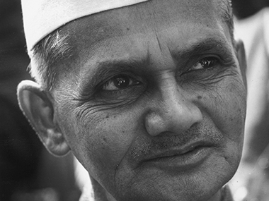
Tashkent Agreement
Jan 10, 1966
The Tashkent Agreement was signed after the UN negotiated a ceasefire to the second Indo-Pakistani war in 1965. It was "signed by India’s prime minister Lal Bahadur Shastri... and Pakistan’s president Ayub Khan," and was "mediated by Soviet premier Aleksey Kosygin, who had invited the parties to Tashkent (present-day Uzbekistan). The parties agreed to withdraw all armed forces to positions held before Aug. 5, 1965; to restore diplomatic relations; and to discuss economic, refugee, and other questions. "

Slide 17
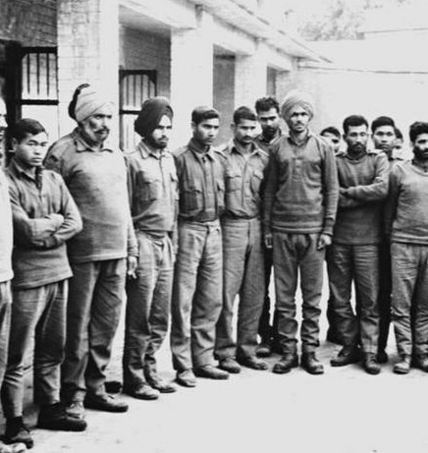
Indo-Pakistani War of 1971
Mar 1971
Political unrest between East and West Pakistan resulted in East Pakistan declaring independence as the new Bangladesh. West Pakistan responded with military force, causing a mass exodus of Bangladeshi civilians to India.
India intervened in the civil war to support an independent Bangladesh, igniting the start of the Indo-Pakistani war in December 1971.

Slide 18
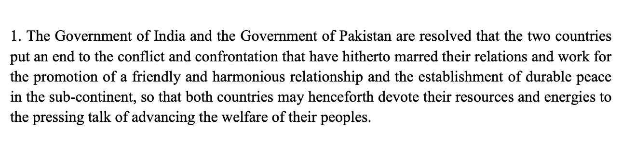
Simla Agreement
Jul 2, 1972
The Simla Agreement was meant to help improve relations between India and Pakistan following the Indo-Pakistani War of 1971. The agreement stated that the two countries would "settle their differences by peaceful means through bilateral negotiations."
"The agreement was ratified on July 28, 1972 and came into force from August 4, 1972."

Slide 19
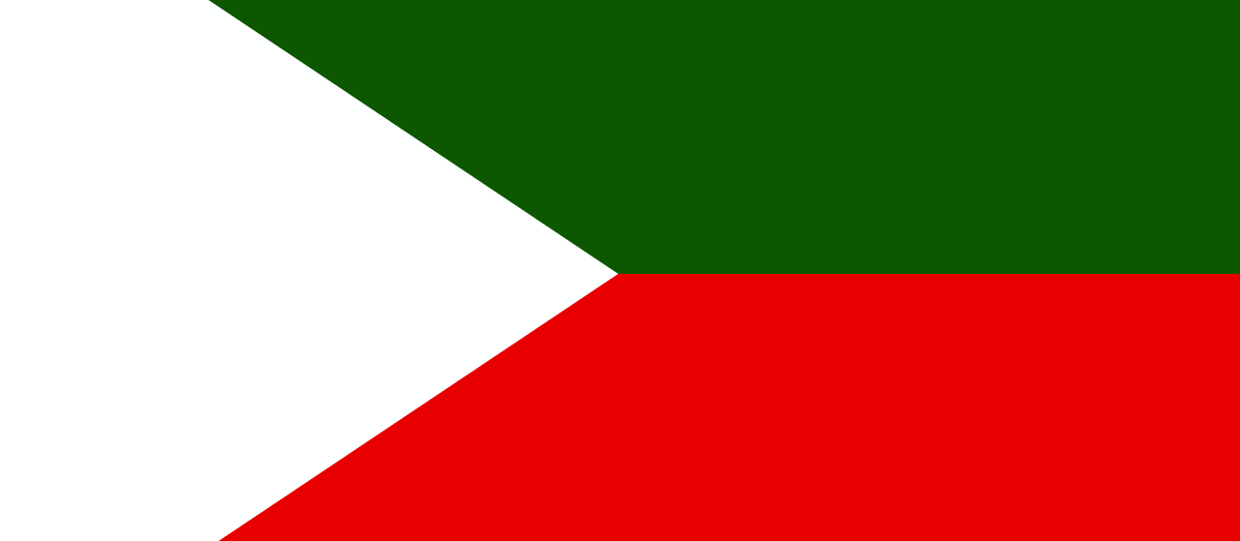
Jammu and Kashmir Liberation Front Insurgency
Jan 1987
In response to state elections in India-administered Jammu and Kashmir in 1987, a pro-independence movement formed JKLF.

Slide 20
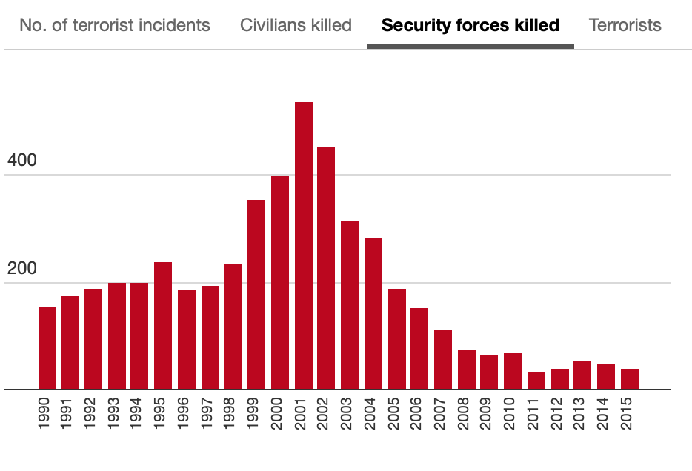
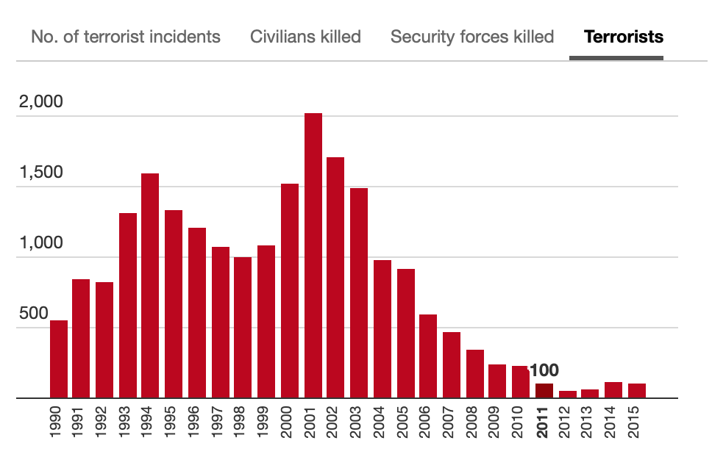
Increased Violence in Kashmir
1990 to 1999
There was an increase in violence in Kashmir during the 1990s. The Indian military fought primarily against the Jammu and Kashmir Liberation Front (JKLF), a Kashmiri militant group seeking to create an independent Islamic state.
In the late 1990s, another militant group, Hizb-ul Mujahideen (HM), overtook JKLF in dominance with many militants switching organizations. HM is aligned with Pakistan and seeks accession into Pakistan.

Slide 21
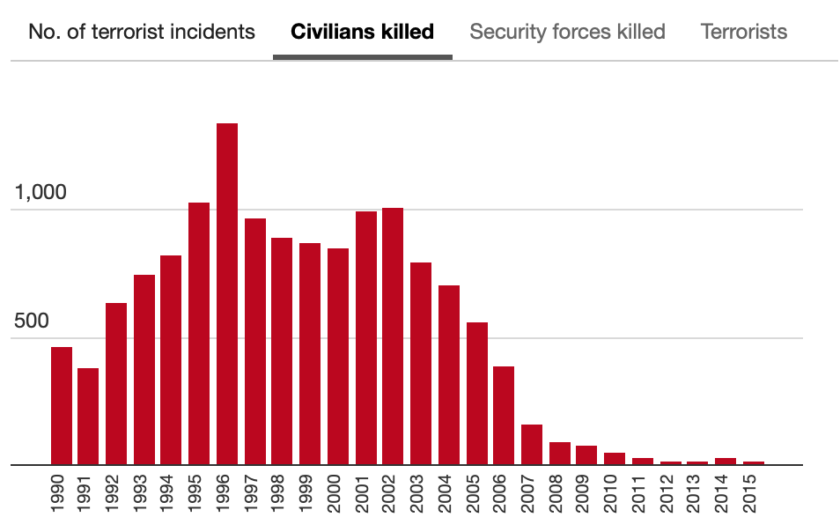
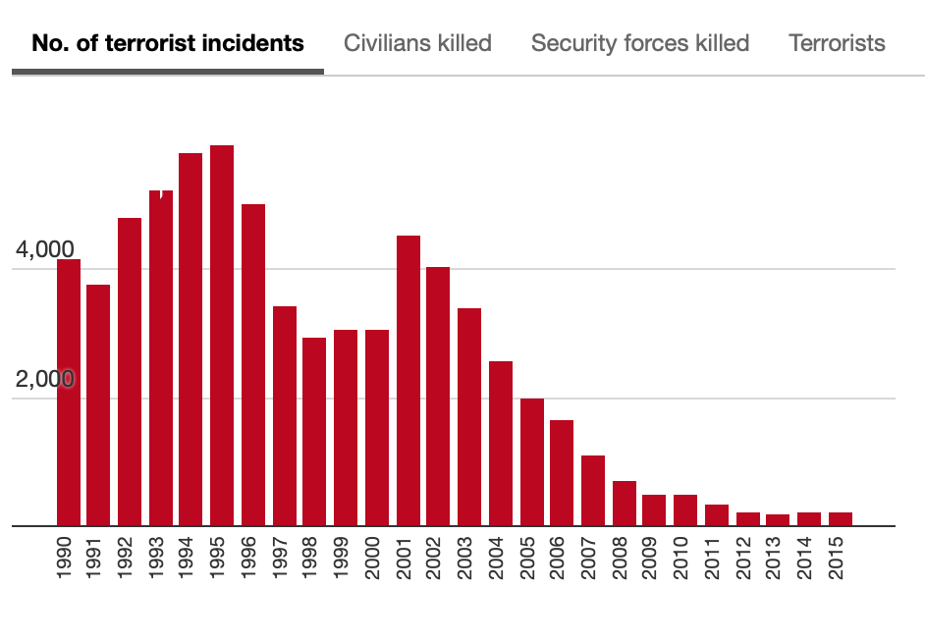

Slide 22
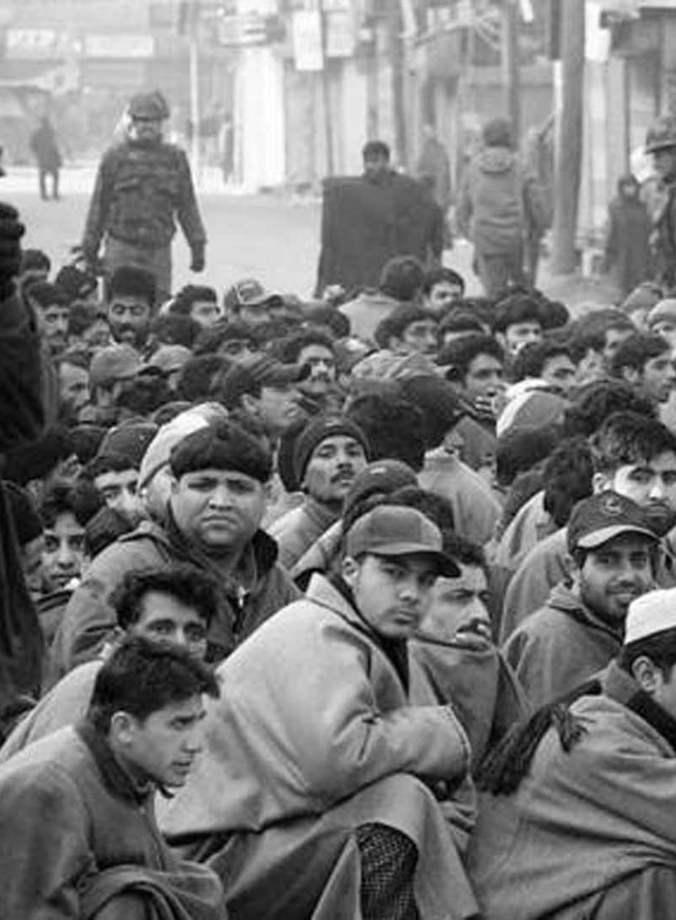
Gaw Kadal Massacre
Jan 21, 1990
On January 20, 1990, Indian paramilitary troops from the Central Reserve Police Force (CRPF) entered Jammu and Kashmir to put a stop to pro-independence protests.
The troopers reportedly rounded up civilians, arresting more than 100 people and molesting several women in the process.

Slide 23
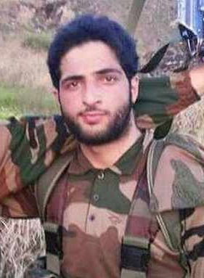
Burhan Wani
Jan 1, 1999 to Jul 8, 2016
Wani allegedly joined a militant group aligned with Pakistan after being beaten up by police when he was 15 years old. He is seen as a martyr and symbol of the modern Kashmiri militant movement.
He is noted for being one of the first militants to publicly show his face. Before then, Kashmiri militants tended to hide in the shadows. He and his associates heavily used social media to recruit and spread their message to other young people.

Slide 24
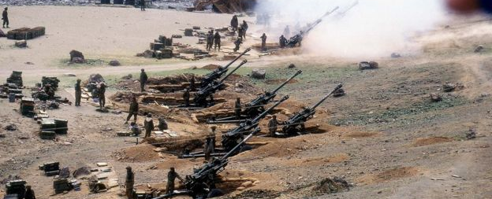
Indo-Pakistani War of 1999
May 1999 to Jul 1999
The Indo-Pakistani War of 1999 was also called the Kargil War, as it began when "Pakistan sent troops across the Kashmir border to join rebels in the Indian district of Kargil."
India immediately retaliated and reclaimed the Kargil district. Pakistan was forced to retreat from Kargil.

Slide 25
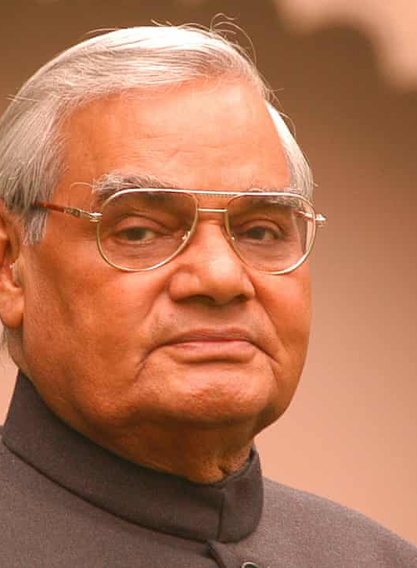
India Declares Ceasefire for Ramadan
Nov 27, 2000
The Indian government called for a unilateral ceasefire in Kashmir for the Muslim holy month of Ramadan.
The Indian army said it would "halt offensive operations but would retaliate if attacked.”
Pictured left: Atal Bihari Vajpayee, Prime Minister of India 1998-2004.

Slide 26
India's Ceasefire Lasts One Day
Nov 28, 2000
Muslim separatists in Kashmir "exploded a landmine under an [Indian] army truck, killing three soldiers and injuring 12."
"Another nine people died in an exchange of fire between Indian troops and separatists near the Pakistani border. Two soldiers and five separatists were killed, and two civilians died in the crossfire, the Indian army said. Five soldiers were injured."

Slide 27
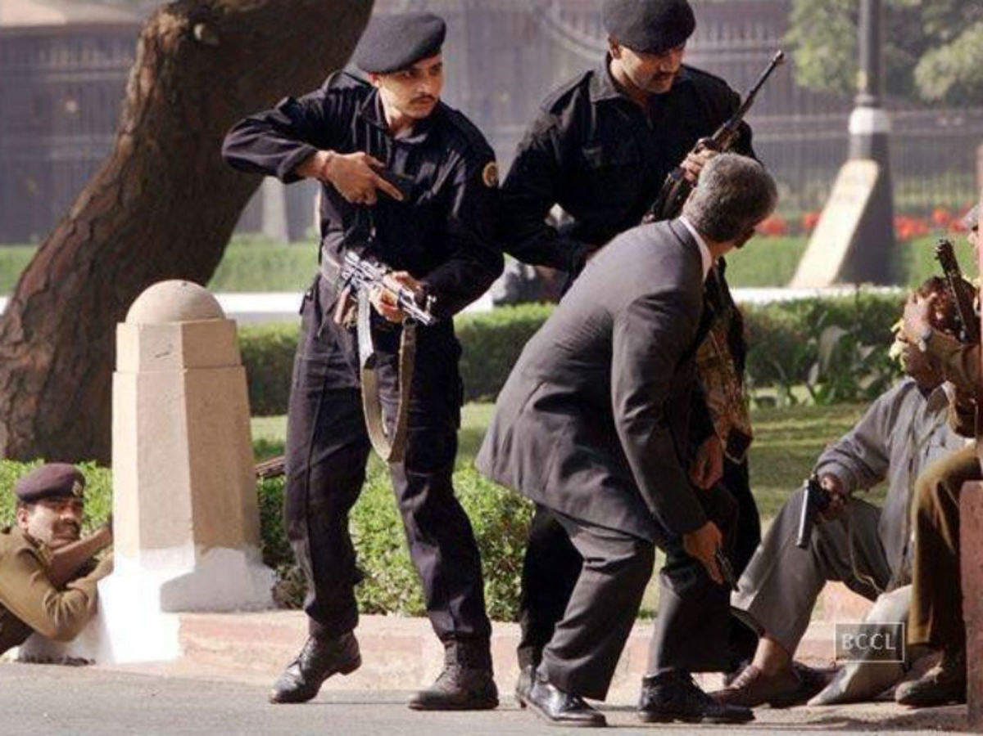
India Parliament Attack Kills 19
Dec 13, 2001
Five alleged Pakistani suicide bombers attacked India's parliament, killing 14 civilians and themselves.

Slide 28
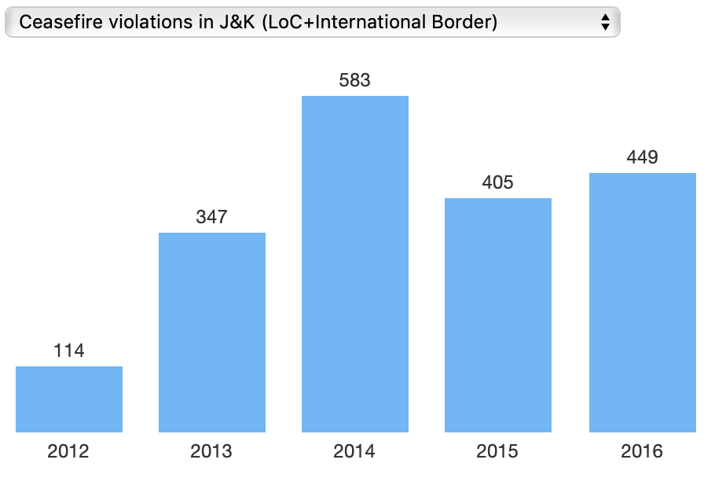
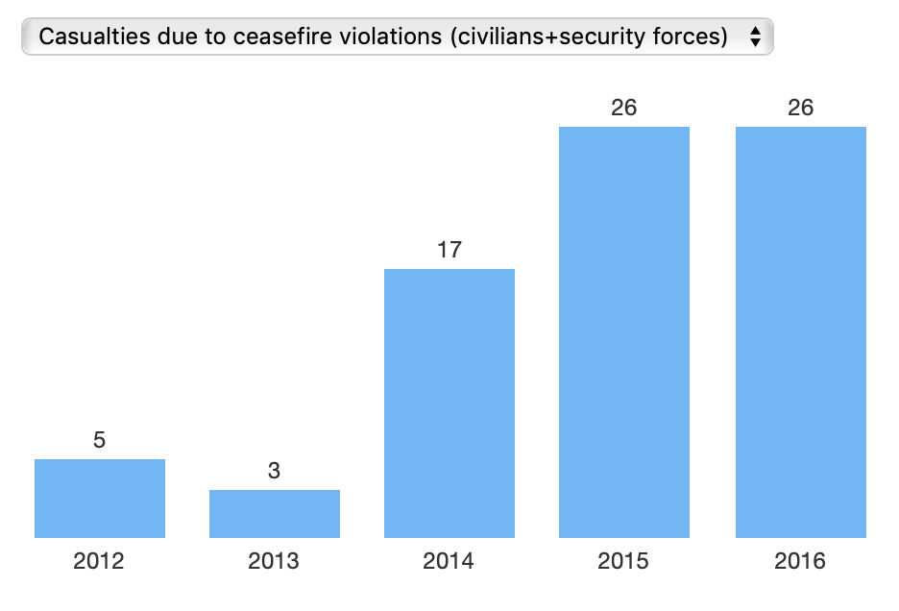
India and Pakistan Agree to Ceasefire
Nov 26, 2003
After 14 years of consistent conflict between India and Pakistan over Kashmir, the two sides agreed to a ceasefire.
"The ceasefire is significant because it [was] the first time in several years that the rivals [did not dismiss] an offer made by the other," said Husain Haqqani, a leading Pakistani journalist and visiting scholar at the Carnegie Endowment for International Peace in Washington.

Slide 29
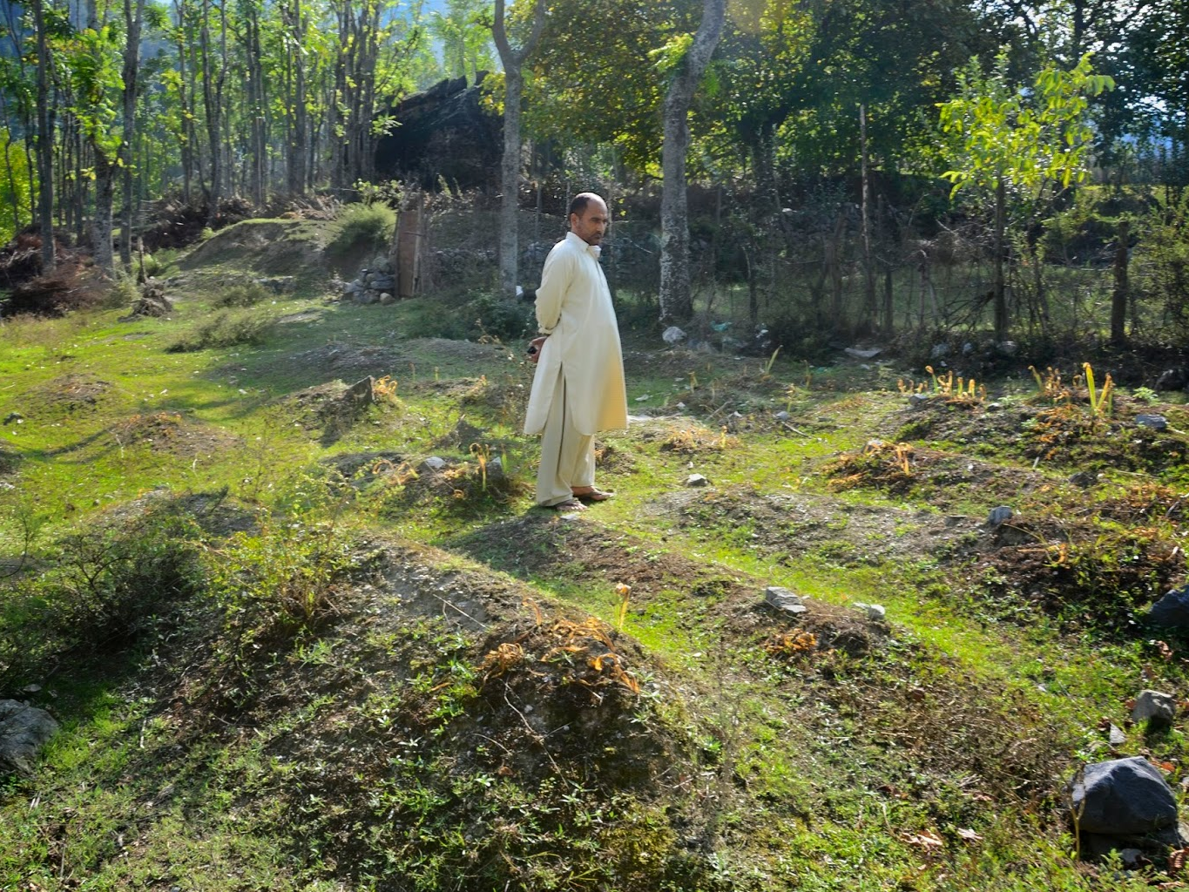
Over 3,000 Unmarked Mass Graves Found in Kashmir
Jan 1, 2008
The Association of Parents of Disappeared Persons (APDP), a human rights group in Kashmir, reported a total of 3,844 unmarked graves were discovered "in the region that lies along Line of Control (LoC) that divides the disputed territory between India and Pakistan."
ADPD also reported that there were over 8,000 missing people since the conflict over Kashmir began decades ago.

Slide 30
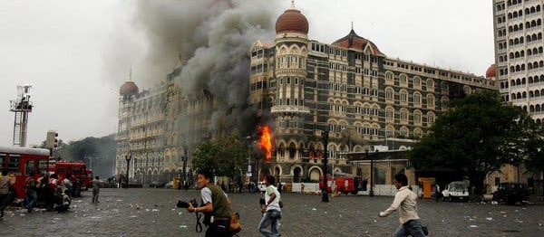
2008 Mumbai Terror Attack
Nov 26, 2008 to Nov 29, 2008
Ten men from the Pakistani terrorist group Lashkar-e-Tayyiba stormed six locations in Mumbai, killing a total of 164 people.
Nine of the ten gunmen were killed during the attacks. The surviving gunman was executed in 2012.

Slide 31
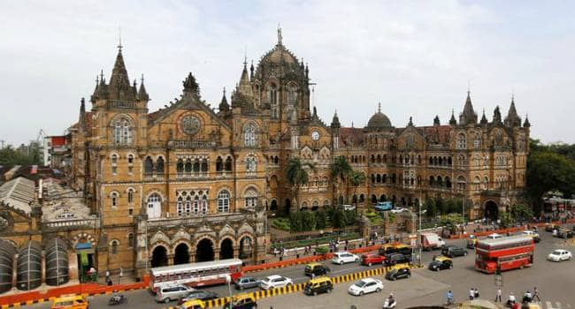
Location 1: Chhatrapati Shivaji Terminus railway station
Nov 26, 2008
The 90-minute attack in the Chhatrapati Shivaji Terminus railway station resulted in approximately 58 deaths. The terrorists also allegedly shot into the crowd outside of the train station, killing 10 more people.

Slide 32
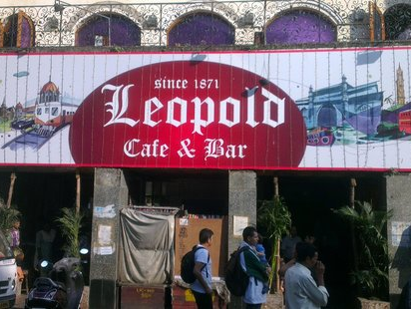
Location 2: Cafe Leopold
Nov 26, 2008
The 10-minute attack resulted in 10 deaths.

Slide 33
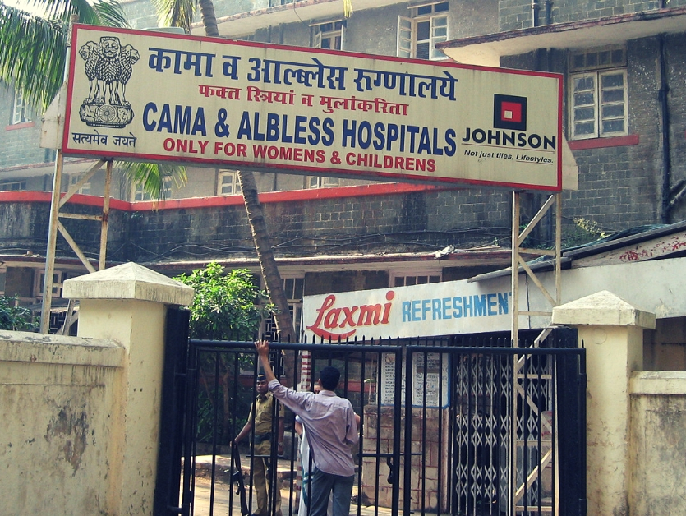
Location 3: Cama and Albless Hospital
Nov 26, 2008
The gunmen attacked and killed six policemen outside of the Cama and Albless Hospital in Mumbai.

Slide 34
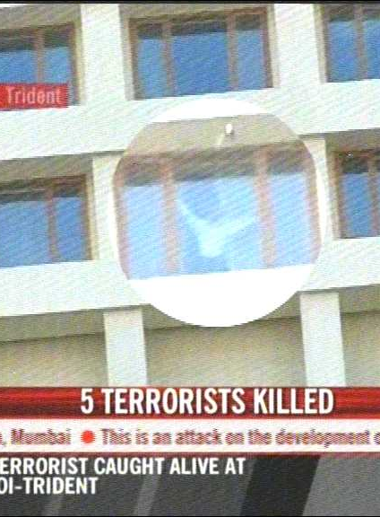
Location 4: Oberoi-Trident Hotel
Nov 26, 2008 to Nov 28, 2008
30 people were reported killed in the Oberoi-Trident Hotel.

Slide 35
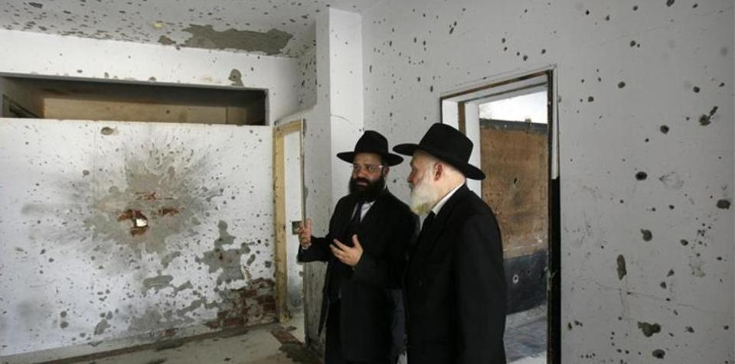
Location 5: Nariman House
Nov 26, 2008 to Nov 28, 2008
Seven people were killed at the Nariman House, a Jewish community center in Mumbai.

Slide 36
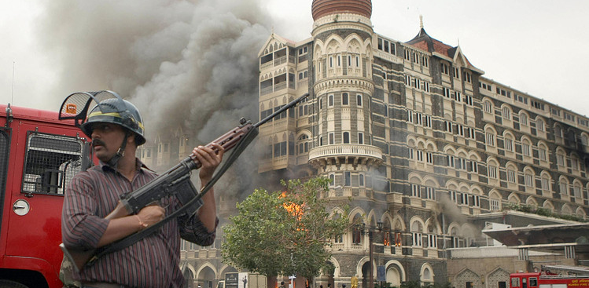
Location 6: Taj Mahal Palace and Tower Hotel
Nov 26, 2008 to Nov 29, 2008
During the four-day siege of the hotel, approximately 31 people were killed.

Slide 37
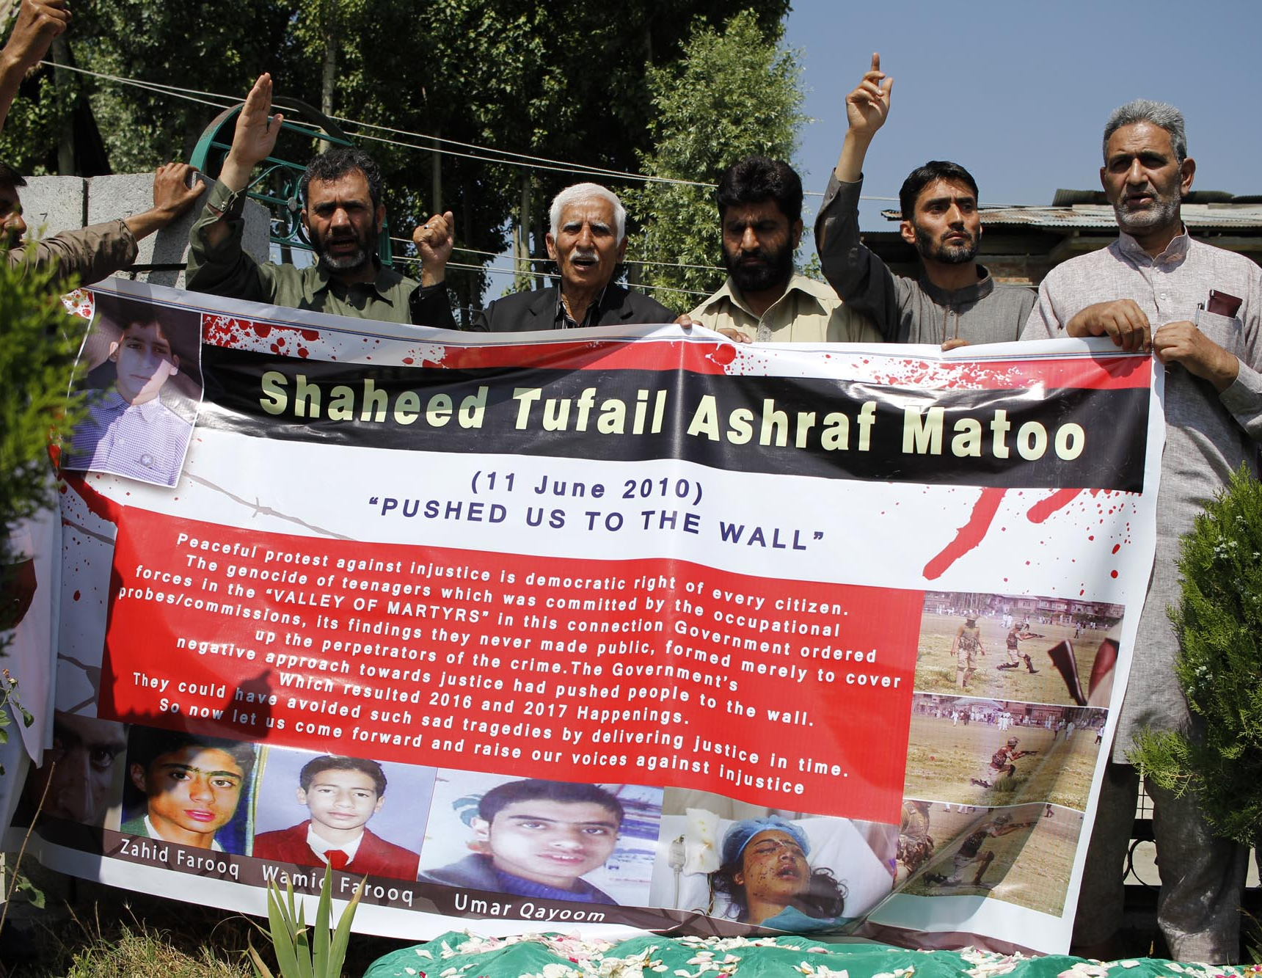
Kashmir Youth Killed
Jun 11, 2010
Indian security forces allegedly killed an innocent youth, Tufail Matoo, as he was walking home from school. This event reportedly ignited a new wave of anti-India protests in the Jammu and Kashmir state.

Slide 38
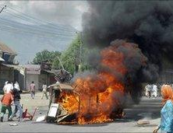
Nine Killed in Anti-India Protests
Aug 1, 2010
Four of the victims died from bullet wounds and "five others died in a blast after protesters set fire to a police station stored with explosives."

Slide 39
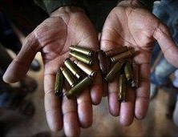
18 Civilians Killed in Police Clashes
Sep 13, 2010
According to BBC correspondent Altaf Hussan, in Kashmir, thousands of Kashmiris defied curfew and took to the streets in protest against India.
"Police fired live ammunition to break up the demonstrations and confirmed that 18 civilians had been killed."

Slide 40
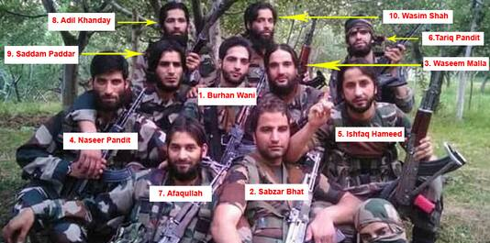
Adil Khanday Killed
Oct 20, 2015
Adil Kahnday, one of the rebels pictured with Burhan Wani in a viral photo, died in southern Kashmir. Large protests occurred after his death.

Slide 41
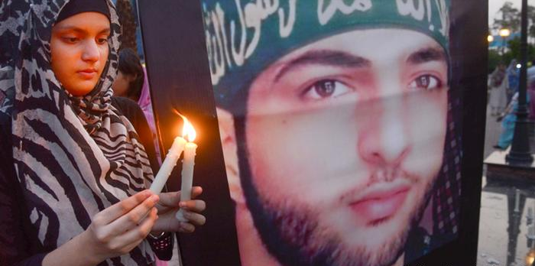
Burhan Wani Killed
Jul 8, 2016
Burhan Wani and two other fellow rebels died in southern Kashmir. Thousands of locals protested his death afterwards, resulting in 100 deaths.

Slide 42
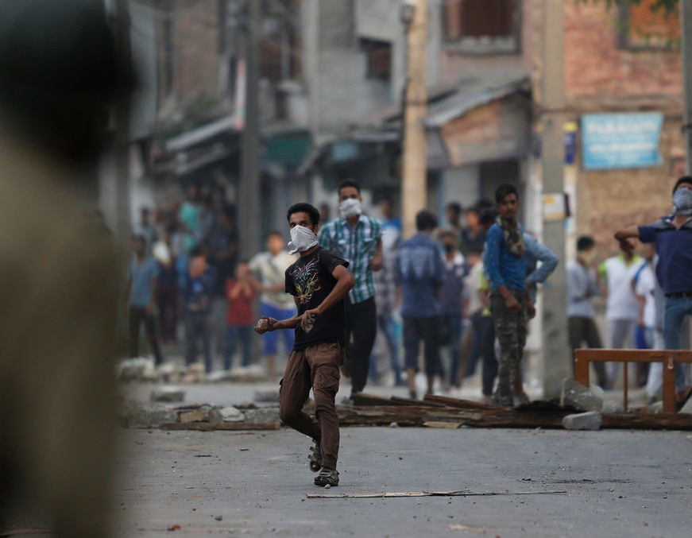
Four Kashmiris Die in Protests
Aug 16, 2016
Indian military officials killed four civilian protestors and injured 15. They fired bullets and pellets and threw tear gas at protestors. They allegedly fired after group of young Kashmiris threw rocks at officials.

Slide 43
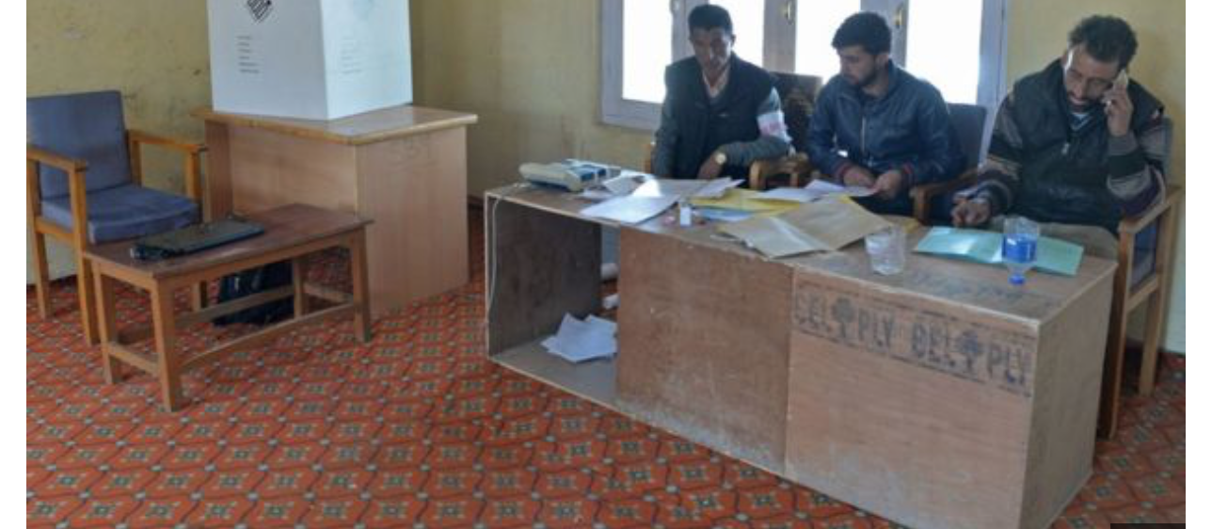
Deaths and Protest During By-Election
Apr 16, 2017
Eight people died and more than 100 people were injured at protests during an election in Kashmir. There was an extremely low turnout with only 2% of the people living in the Indian administered portion of Kashmir voting.

Slide 44
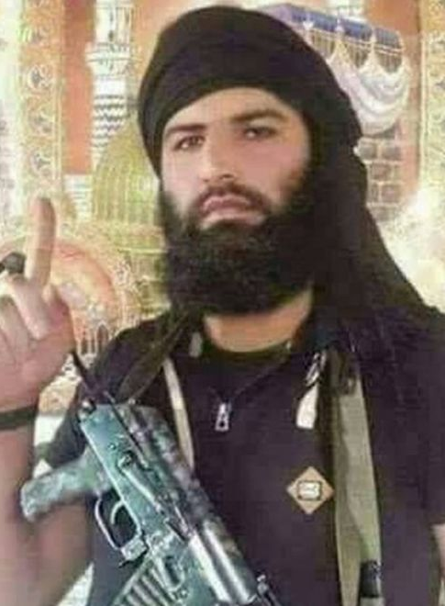
Sabzar Bhat Killed
May 27, 2017
Sabzar Bhat, Burhan Wani's successor, died in southern Kashmir in Pulwama. Bhat often used social media to convince younger people to join his group.

Slide 45
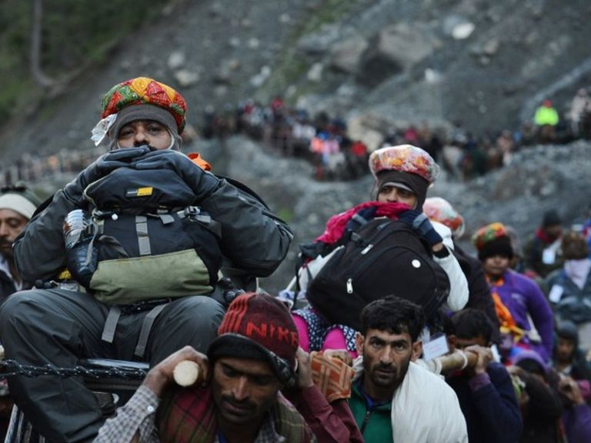
Militants Kill Seven Hindu Pilgrims
Jul 11, 2017
Seven Hindu pilgrims were allegedly killed by militants in Jammu and Kashmir as their bus was caught in the crossfire between militants and Indian police.
India accused Pakistan's rebel group, Lashkar-e-Tayyiba, of causing the attack. The group denied the accusations.

Slide 46
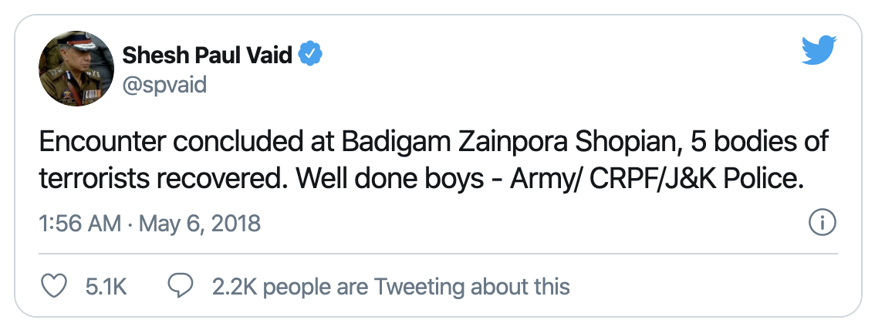
Saddam Paddar Killed
May 6, 2018
Indian police and military killed Saddam Paddar and five other Kashmir rebels.
Paddar was one of the rebels in the viral photo with Burhan Wani, a Kashmiri military commander.
Indian officials killed 5 civilians and injured 25 during a protest after the killings.

Slide 47
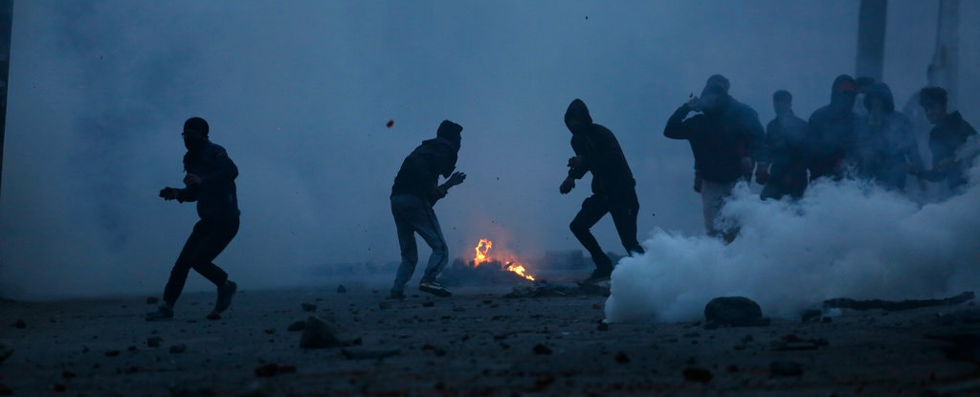
India Declares a Rare Ceasefire
In May 2018, the Indian government announced a ceasefire between the government forces and Jammu and Kashmir separatists.
The ceasefire took place during the Muslim holy month of Ramadan. "It was the first time in 18 years that the Indian government declared a ceasefire for Ramadan in the territory."

Slide 48
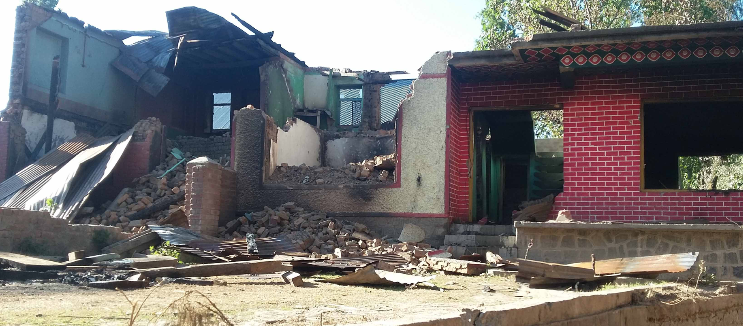
Mob Arrives Where Wani Died
Jul 14, 2018
An angry mob vandalized and set fire to nine homes in the residential area where Indian forces killed Wani. They also set ablaze an apple orchard and cut down trees. There was a rumor that the family hosting Wani the day he died had poisoned him and tipped the authorities.
The family who lived in the home said this was false; they wanted to host him and had positive views of Wani. According to News18, the villagers face social stigma when they tell others where they come from.

Slide 49
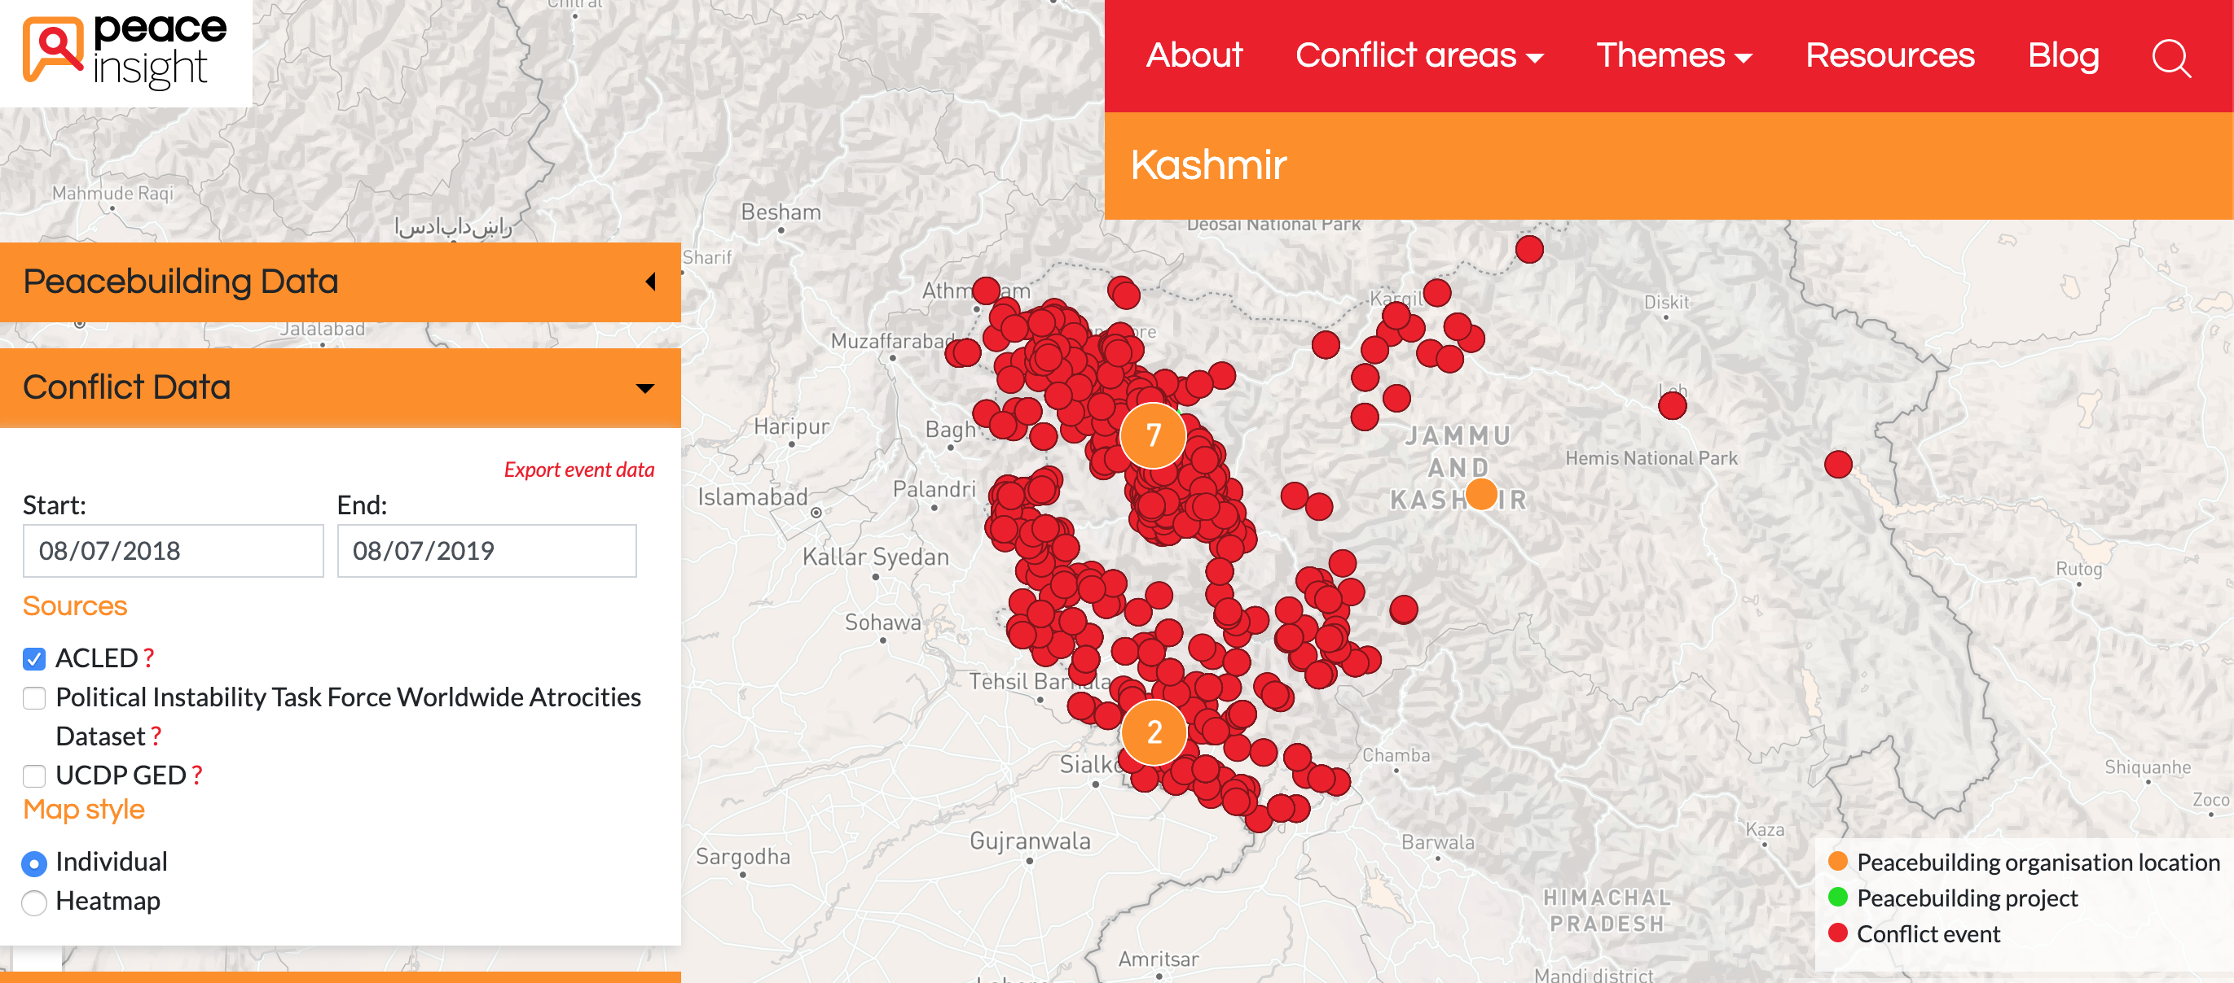
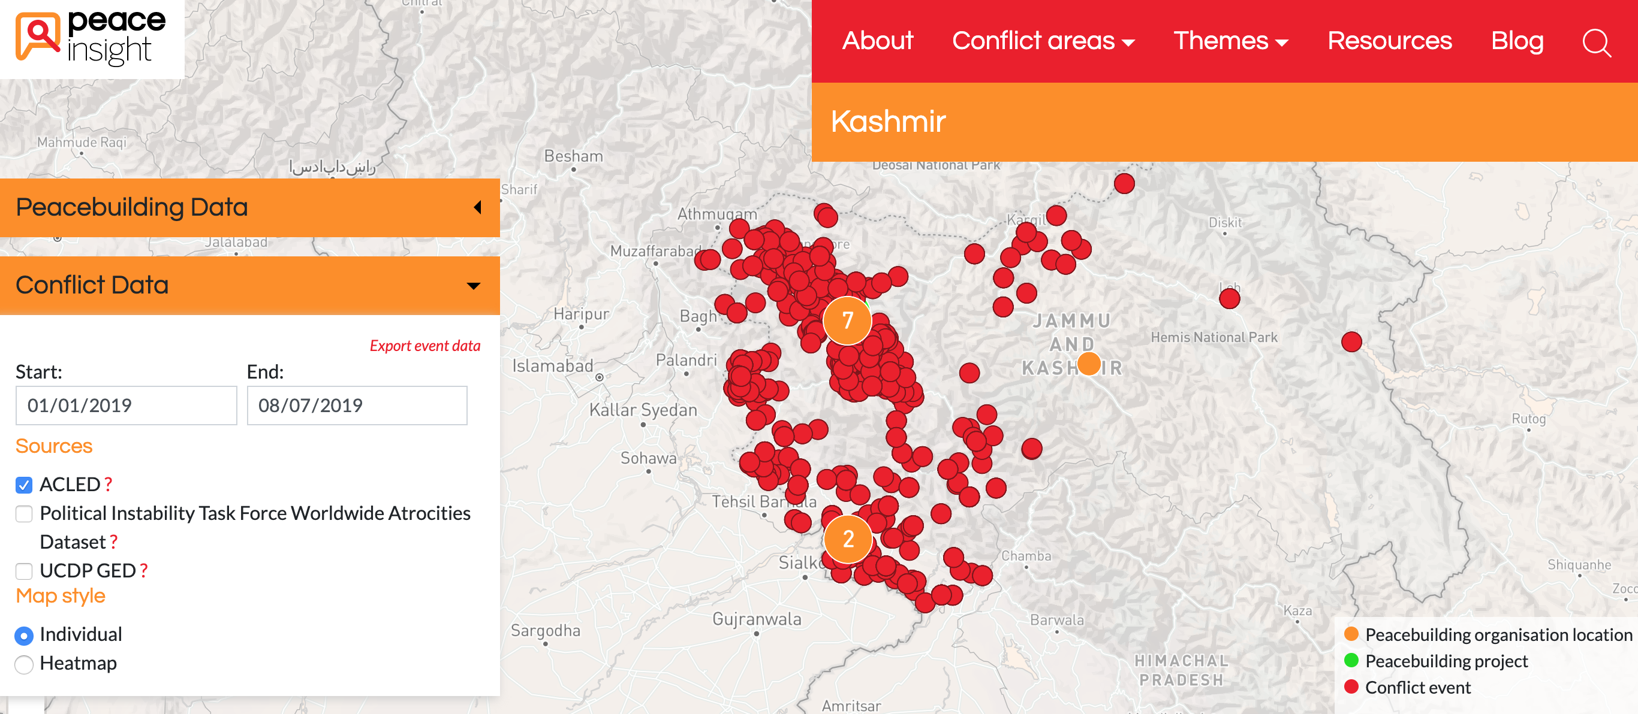
Over 5,000 Conflict Events in Past Year
Aug 7, 2018 to Aug 07, 2019
According to Peace Insight's ACLED data, there were 5,410 separate conflict events recorded in Jammu and Kashmir between 2018-2019.
Roughly half of these incidences occurred since January 1, 2019.

Slide 50
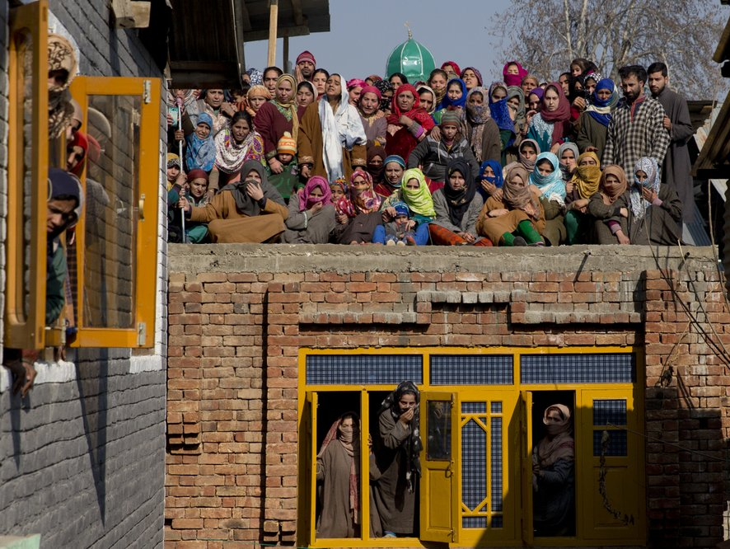
Kashmiris Protest Death of Rebel Fighter
Dec 29, 2018
Kashmiris protested after Indian soldiers killed four rebel militants in Kashmir. Hundreds of Kashmiris rushed to the scene of the fight to help the rebels escape.
The Indian military fired pellets and threw tear gas at protesters, who were throwing rocks at them.

Slide 51

40 Reportedly Killed in Suicide Bombing
Feb 14, 2019
It was reported that 40 Indian paramilitary police were killed in a suicide bombing. The attack was the deadliest in the region in the past three decades.
The "Pakistan-based Islamist group Jaish-e-Mohammad claimed responsibility for the attack."

Slide 52

Launches Air Strike Against Pakistan
Feb 26, 2019
India claimed to have targeted military bases in response for the deaths of 40 Indian paramilitary soldiers in Kashmir.
Pakistan denied that India caused any major damage or fatalities.

Slide 53

Shoots Down Two India Air Force Jets
Feb 26, 2019
Two days following India's air strike on Pakistan's military outposts, Pakistan shot down two Indian Air Force jets.

Slide 54

Modi Wins Landslide Majority in Election
May 22, 2019
In India's 2019 elections, Modi’s ruling Bharatiya Janata Party (BJP) won 303 seats in a landslide victory, only needing 272 seats to win a majority in parliament.
The opposition Congress party suffered a major defeat. This win mandated Modi to pursue his Hindu nationalist agenda, including revoking Kashmir's autonomy and marginalizing India's Muslim minority. He was first elected as Prime Minister in 2014.

Slide 55

President Trump Offers to Mediate in Kashmir
Jul 22, 2019
In a meeting with Pakistan's prime minister Imran Khan, President Trump said that India's prime minister Narendra Modi asked for mediation on the Kashmir issue. "If I can help, I would love to be a mediator," said Trump.
India denied asking Trump to mediate. India's foreign ministry spokesperson Raveesh Kumar posted on Twitter, "It has been India's consistent position that all outstanding issues with Pakistan are discussed only bilaterally."

Slide 56

India Rejects President Trump Mediation
Aug 5, 2019
President Trump offered to mediate on the Kashmir issue during a visit with Pakistan's Imran Khan, "but India rejected that, saying Kashmir was a domestic, not an international, issue."

Slide 57
Bill Passes: Jammu and Kashmir to Become Union Territory
Aug 5, 2019
In addition to revoking Article 370, the Indian government also voted to change Jammu and Kashmir's status from state to union territory.
"Under the plans, the remote mountainous region of Ladakh, currently part of the state of Jammu and Kashmir, will be separated and turned into a standalone union territory."

Slide 58


Indian Prime Minister Narendra Modi Revokes Article 370
Aug 5, 2019
The Indian government voted to revoke Article 370 of the Indian constitution in a 370-70 digital vote.

Slide 59
First Legal Challenge Against Article 370 Revocation
Aug 5, 2019
An Indian public interest lawyer, ML Sharma, filed the first legal challenge against the Article 370 revocation. He filed his petition in India's Supreme Court.

Slide 60


Indian Government Shuts Down Internet
Aug 5, 2019
Following the announcement of the voting results on Article 370, the Indian government shut down the internet in Kashmir, placed politicians under house arrest, and forced tourists out of the contested state.
Jammu and Kashmir's former chief ministers, Omar Abdullah and Mehbooba Mufti, were two of the high-profile politicians placed under house arrest.

Slide 61
Kashmiri Political Figures Arrested
Aug 5, 2019
Indian police arrested two former Chief Ministers of Kashmir, Omar Abdullah and Mehbooba Mufti. Chief Minister is the highest local government position in Kashmir. They were placed under house arrest.
Arrests were additionally being made under the Public Safety Act (PSA), which allows authorities to imprison people for up to two years without charge or trial. The PSA has been used to repress dissent and arrest 20,000 Kashmiris since 1978

Slide 62

Public Meetings Banned in Kashmir
Aug 5, 2019
In addition to restricting internet and cell phone access, adding a strict curfew, and arresting hundreds of protesters/political figures, India banned all public meetings in Kashmir.

Slide 63
Indian Army Allegedly Abusing Kashmiris With Electric Shocks and Beatings
Aug 5, 2019 to Sep 16, 2019
Residents from a dozen Kashmiri villages accused the Indian military of raiding their homes since August 5. They carried out a range of abuses - beatings, electric shocks, forcing residents to eat and drink dirt, killing livestock, and threatening to abduct and marry female relatives.
An army spokesperson dismissed the allegations, accusing some young people of being involved in terrorist and anti-national movements.

Slide 64

Minors Detained During Crackdown
Aug 5, 2019 to Oct 2, 2019
Boys as young as nine were detained unlawfully following the revocation of Article 370. Detainees were moved to jails in other Indian states, making it difficult for families to visit them.
The Supreme Court was informed at the end of September that 144 minors had been arrested since August 5, even though minors cannot be detained under the Public Safety Act (PSA).
Children were distressed and abused in jails and were even wrongly listed as adults.

Slide 65

Modi Deploys Thousands of Troops in Kashmir
Aug 6, 2019
In preparation for the revocation of Article 370, Modi deployed thousands of Indian troops to Kashmir. Prior to this, there was already a large Indian military presence in Kashmir.

Slide 66

Hundreds Arrested after Article 370 Revocation
Aug 7, 2019
Indian officials arrested over 100 people after the revocation of Article 370. India alleged the arrested individuals were a "threat to peace in the Himalayan valley".
A young protester died after jumping into a river while being chased by Indian police.

Slide 67

Hundreds Protest Article 370 Revocation in New Delhi
Aug 7, 2019
Hundreds of Kashmiris and Indians living in New Delhi protested the revocation of Article 370.
Observers expect similar protests to pop up across the country as well.

Slide 68


Pakistan Prime Minister Imran Khan Warns of War
Aug 7, 2019
Pakistan's prime minister, Imran Khan, warned that India's revocation of Article 370 could lead to war between the two countries and the 'ethnic cleansing' of Muslims in the region." However, Pakistan has also been criticized for not fully supporting Kashmir over time, including for allegedly backing anti-Indian terrorists and stripping Gilgit-Baltistan in Pakistan-administered Kashmir of its special status in 1974.

Slide 69

Pakistan Suspends Trade With India
Aug 7, 2019
Two days after India's proclamation of revoking Article 370, Pakistan announced "it will downgrade diplomatic relations and suspend bilateral trade with India."
India's High Commissioner was also to be deported from the country.

Slide 70

About 2,000 People Flee Border Villages Along Line of Control
Aug 8, 2019
Thousands of villagers living along the militarized Line of Control (LoC) between the Pakistan- and Indian-administered parts of Kashmir moved to avoid the violence.
Authorities estimated 20,000 people left their homes within a week in the Neelum Valley on the Pakistan side of the LoC. Many people lacked the resources to build bunkers or move somewhere safer.

Slide 71

Pakistan PM Imran Khan visits Kashmir
Aug 13, 2019
Pakistan's Prime Minister Imran Khan visited Pakistan-administered Kashmir to show solidarity with the Kashmiri people. He chose Pakistan's Independence Day as the date for this symbolic visit.
On the same day in Islamabad, Pakistan's President Arif Alvi attended a flag hoisting ceremony in Islamabad, calling India's revocation of Article 370 a violation of international law.

Slide 72

Statements from Pakistani PM: 'Genocide' and 'Bloodbath'
Sep 13, 2019 to Sep 27, 2019
Sep 14, 2019 - In a media interview, Imran Khan said India was trying to "divert attention from their illegal annexation and their impending genocide on Kashmir." He added that Pakistan would not start a war because he is an anti-war 'pacifist.'
Sep 27, 2019 - At the United Nations General Assembly, Khan warned of a "bloodbath" in Kashmir.
He has also likened ignoring Modi to appeasing Hitler.

Slide 73

Kashmir Leader Arrested Under Draconian Imprisonment Law
Sep 15, 2019
Pro-India, 82-year-old politician Farooq Abdullah, the former chief minister of Jammu and Kashmir was arrested under the Public Safety Act (PSA), which allows authorities to imprison people for up to two years without charge or trial.
Abdullah had been under house arrest since August 5. As a leader of the National Conference party for decades, he has often been viewed as a traitor by Kashmiri residents for being too close to Delhi, though he has been a vocal supporter of Article 370.

Slide 74

Mobile Services Are Restored After 72 Days
Oct 13, 2019
The Indian government restored connections for an estimated four million mobile phones, which were suspended following the revocation of Article 370. However, prepaid connections were yet been restored and internet services continued to be suspended. Families were able to reconnect between different regions, though the communications blockade had hurt Kashmir's economy as businesses struggled to operate effectively.

Slide 75

Militants Kill Eleven Migrant Workers in Two Weeks
Oct 13, 2019 to Oct 28, 2019
The victims of the attacks came from other states including West Bengal, Chhattisgarh, and Punjab. The attackers were suspected to belong to designated terrorist groups Hizbul Mujahideen and Lashkar-e-Taiba, which aim on integrating Kashmir with Pakistan.
Analysts linked the incidents to a wave of identity politics in Kashmir following the revocation of Article 370. Non-local workers were already being told to leave in August as residents feared a demographic shift.

Slide 76

Industries Reported Struggling During Lockdown
Oct 20, 2019
Farmers have reported being unable to find enough workers during the shutdown to support the apple industry, which makes up 12-15% of the region's economy. A number of other key industries suffered a serious skill shortage.

Slide 77

Report on Twitter Censorship in Kashmir
Oct 23, 2019
Twitter was accused of suppressing freedom of expression in Kashmir after a study by the media watchdog, Committee to Protect Journalists (CPJ), published on October 24. The report revealed nearly a million tweets had been removed since 2017.
Twitter's transparency reports showed that more accounts were withheld in the second half of 2018 in India than in the rest of the world combined.

Slide 78

Protests and Clashes During EU MP Visit
Oct 27, 2019 to Oct 30, 2019
Clashes erupted and police fired tear gas at protesters as mainly far-right members of the European Parliament visited Indian-administered Kashmir. This was the first foreign delegation to visit the region since the revocation of Article 370, though it was not an official European Union delegation. The government was accused of staging a positive portrayal of the situation in the region. Pellets had already injured and killed a number of civilians since August 5.

Slide 79

India Formally Divides Jammu & Kashmir
Oct 30, 2019
India formally divided the state into two new federally-administered territories under the Jammu and Kashmir Reorganization Act. Jammu and Kashmir, home to 98% of the state's population, became one territory. Ladakh, which borders China, became a separate territory. Both new union territories are now directly ruled by Delhi. The act struck down legal provisions restricting ownership of private property to permanent residents.

Slide 80

Kashmir WhatsApp Users' Accounts Expire
Dec 5, 2019
The BBC learnt that WhatsApp accounts of people in Indian-administered Kashmir were expiring as a result of the internet shutdown. WhatsApp said that accounts expire after 120 days to "maintain security and limit data retention."

Slide 81

Text Messaging Services Restored in Kashmir
Dec 30, 2019
Authorities decided to restore text messaging services in Kashmir almost five months after the imposition of the security and communications lockdown. Broadband internet and mobile internet services remained restricted, limited to government-run hospitals only. The government has said that communications restrictions were “in the interest of maintenance of public order,” suggesting they feared the internet being used to start protests.

Slide 82

Internet Restored as Social Media Ban Stays
Jan 14, 2020
Internet was partially restored for institutions providing “essential services”, including hospitals, banks, government offices, hotels, and travel companies. Social media and media sites, however, remained banned, and access to websites was still limited. The shutdown was now longest ever imposed in a democracy. The supreme court had ruled that the indefinite suspension of the internet was illegal and said a review should be carried out.

Slide 83

Indian General Suggests Deradicalization Camps for Kashmiris
Jan 16, 2020
India’s top military commander, Gen. Bipin Rawat, chief of India’s defense staff, unsettled people in suggesting sending Kashmiri residents to “deradicalization camps.” It was unclear what he meant and whether there were plans to create large-scale re-education camps in Kashmir. However, rights groups compared his idea to camps detaining Muslim Uyghurs in China.

Slide 84

Top Kashmir Political Figures Charged
Feb 5, 2020
Six months after being detained, Omar Abdullah and Mehbooba Mufti were charged under the Public Safety Act (PSA). An anonymous police official reported that the PSA was "slapped on them" because the government was "running out of options" as their six-month detention came to an end.

Slide 85

Authorities File Case Against Social Media User for Defying Bans
Feb 17, 2020
Social media users allegedly defied the ban by using proxy servers. A first information report (FIR) was filed against unnamed users under the Unlawful Activities Prevention Act (UAPA), which can result in offenders being jailed for months without bail. The police said offenders were propagating "secessionist ideology and promoting unlawful activities".
India's top court had struck down FIRs for violating free speech in 2015.

Slide 86

Internet and Social Media Ban Temporarily Revoked
Mar 3, 2020 to Mar 17, 2020
Authorities temporarily restored access to social media and full internet access in Indian-administered Kashmir for two weeks. However, internet access over mobile devices remained restricted to slow speeds. The authorities did not give an explanation for the time limit.

Slide 87

Announcement of Delimitation
Mar 5, 2020
The Indian government has begun the redrawing of boundaries in electoral constituencies, a process known as delimitation. This could give more seats to Hindu-majority Jammu, reshaping local politics. The Delimitation Commission was announced on March 6 and a data collection process began immediately. A former advisor to the Electoral Commission noted that the move violates a 2008 presidential order stalling delimitation.

Slide 88

Farooq Abdullah Released After 7 Months
Mar 12, 2020
No reason was given for Abdullah's release from detention. As a leader of the National Conference party for decades, he has often been viewed as a traitor in Kashmir for his closeness to Delhi.
The arrests of Abdullah and a dozen other Kashmiri politicians, therefore, suggested that they were becoming enemies of India instead. This has marked the erosion of the middle ground in Kashmir's politics between calling for complete integration with India and full independence.

Slide 89

Indian Troops Kill Rebels During COVID-19 Lockdown
Apr 20, 2020
Indian government forces killed four rebels in a battle in the Shopian district of Indian-administered Kashmir. Police and soldiers raided a house where rebels were hiding as India was conducting counterinsurgency operations during the coronavirus lockdown.
Residents on social media said the rebels were local. Yet, human rights groups said thousands were buried in unmarked graves in Kashmir, with the Indian authorities calling the fighters foreigners.

Slide 90

Repression of Journalists and Media
Apr 21, 2020 to Jul 31, 2020
In April, the police opened criminal investigations against journalists Gowher Geelani, Peerzada Ashiq, and Masrat Zahra for social media posts and reports considered to be “anti-national.”
In June, the government announced a policy with vague provisions in Jammu and Kashmir allowing the authorities to decide what can be considered punishable “fake news, plagiarism and unethical or anti-national activities.”
On July 31, editor Qazi Shibli was questioned and detained.

Slide 91

Indian Troops Kill Rebel Commander Riyaz Naikoo
May 4, 2020
Indian troops killed four rebel fighters in gun fights, including Riyaz Naikoo, the senior commander of the region's largest separatist group fighting New Delhi, Hizbul Mujahideen. Naikoo's death was seen as a victory for India’s counterinsurgency efforts, though was also expected to worsen India-Kashmir relations.

Slide 92

Internet Shutdown Impacts Coronavirus Efforts
May 5, 2020 to May 20, 2020
The Indian government reimposed the internet shutdown on May 6 after the killing of Riyaz Naikoo, saying it was necessary because of the "likelihood of misuse of data services by anti-national elements." Medical experts said that consultation between colleagues and contact tracing was not possible with the communication blockade, undermining efforts to tackle COVID-19.

Slide 93

Cross-border Shelling and Sexual Assault in Pakistan-controlled Kashmir
May 14, 2020 19:00
Cross-border shelling along the Line of Control between Pakistan and India intensified over the months following the revocation of Article 370. This has caused more families to take shelter in community bunkers during attacks, particularly on the Pakistani side of Kashmir.
However, cases of sexual assault in the bunkers have led girls and young women from some families to risk their lives and stay home during the blasts. This dilemma many girls face demonstrates the wider impact of the Kashmir crisis on civilians.

Slide 94

25,000 Domicile Certificates Granted Cause Fears of Demographic Shift
May 17, 2020 to Jun 28, 2020
Between May 18 and the end of June, up to 25,000 people were granted domicile certificates in Indian-administered Kashmir. The certificate entitles a person to residency and government jobs in the region, a right previously reserved for the local, majority Muslim population.
In April, the law changed to allow anyone who has lived in the region for 15 years, or studied for seven years and passed certain exams, to be eligible. Officials have been threatened with penalties for opposing any applications.

Slide 95

Anti-India Protests Follow Killing of Rebels
Jun 6, 2020 to Jun 8, 2020
Indian forces killed at least nine rebels, including three commanders, in separate gunfights in Shopian district, sparking anti-India protests in Indian-administered Kashmir. Four rebels were killed in the Pinjora area and five others in the Reban area of Shopian district. The state police said that the rebels belonged to Hizbul Mujahideen.

Slide 96

Outrage Over Viral Photo of Dead Kashmir Man and Toddler
Jun 29, 2020 to Jul 1, 2020
A viral photo of a three-year-old child sitting on the dead body of his grandfather, Bashir Ahmed Khan, in Sopore district sparked outrage in the region. The man's family accused the security forces of killing the 65-year-old man during a gunfight, an allegation the police rejected. They claimed the man's vehicle got caught in a gun battle between rebels and security forces. The photo was allegedly a staged photo-op portraying the police as rescuers.

Slide 97

Rebels Kill Pro-India BJP Politician
Jul 7, 2020
Unidentified gunmen shot pro-India politician Sheikh Wasim Bari, a leader from Modi's BJP party in the town of Bandipora, the first significant attack on the Bharatiya Janata Party. They also shot his father and brother. Police blamed rebels for the attack, though no rebel group claimed responsibility at the time. Bari helped the BJP strengthen its base in the region.

Slide 98
India Relaxes Rules for Security Forces to Acquire Land
Jul 27, 2020
The Indian administration of Jammu and Kashmir lifted a rule from 1971 requiring Indian security forces to obtain a special certificate to acquire land in the region. This marks an extension of the 2013 Right to Fair Compensation and Transparency in Land Acquisition, Rehabilitation and Resettlement Act to Jammu and Kashmir.

Slide 99

Anniversary of the Revocation of Article 370
Aug 4, 2020
The authorities imposed a two-day curfew in Indian-administered Kashmir the day before the first anniversary of the revocation of Article 370, which locals observed as "black day." The authorities cited reports of expected protests. Meanwhile, Modi marked the date with a ceremony for the construction of a Ram temple on a disputed plot of land in Ayodhya, north-eastern India. Hindus claim the original temple was replaced by a mosque in 1526. A Hindu mob damaged the mosque in 1992.

Slide 100

Conclusion
Aug 4, 2020
Since revoking Jammu and Kashmir's special status under Article 370, the Indian government has taken significant steps to further Prime Minister Narendra Modi's Hindu nationalist agenda. It has incrementally attacked the rights and livelihoods of the country's Muslim minority, creating much anger, fear, and misery among the majority Muslim population of Kashmir.
Kashmiri residents have faced ongoing repression, violence, and human rights abuses by the Indian authorities. They have also been prevented from freely criticizing the government via communications networks, and they fear becoming increasingly marginalized by India's Hindu majority.

