Slide 1
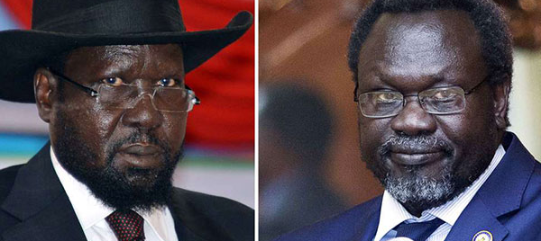
Key Findings
The violence in Sudan prior to South Sudan's independence in 2011 left lingering rivalries between the Dinka and Nuer ethnic groups in the newly founded country. This ultimately resulted in violent clashes, the killing and displacement of thousands of civilians, and the development of a devastating famine.
Despite numerous attempts at peace agreements, which were signed by both the ethnic Nuer former Vice President Riek Machar, and ethnic Dinka President Salva Kiir, peace was not attainable.
Kiir's government forces and Machar's rebel group have allegedly used child soldiers in their war against each other.
The indiscriminate targeting of civilians in this "civil war" has been classified as a genocide emergency by Genocide Watch.

Slide 2
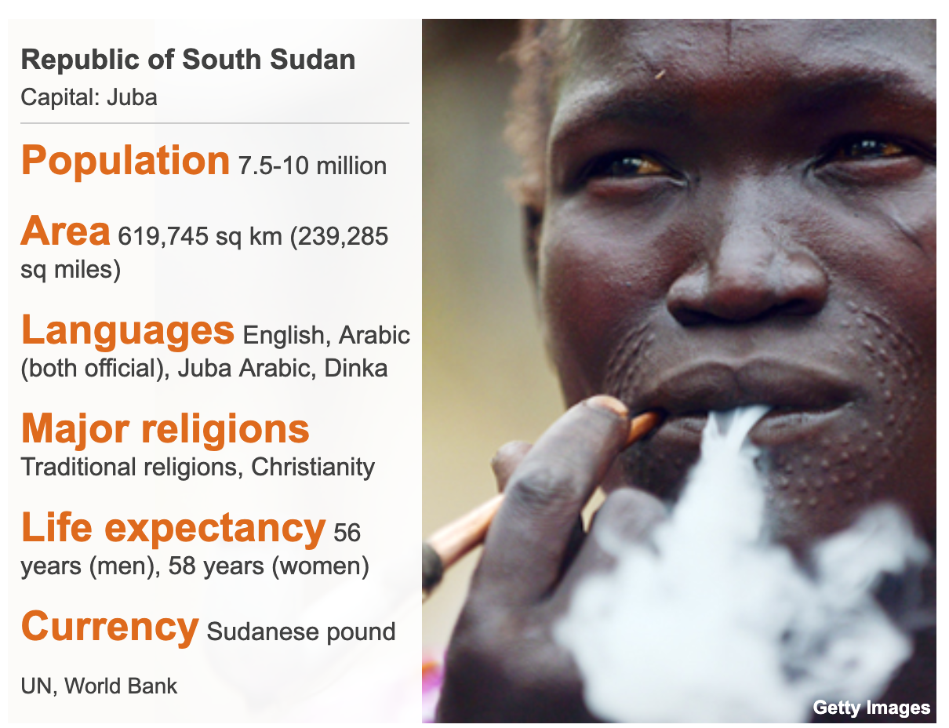
South Sudan Country Profile
1899-1955: Under joint British-Egyptian rule.
1956: Gained independence, but not recognized as autonomous by the northern Arab-Muslim Sudan.
1983: Sudan's President Gaafar Mohamed al-Nimeiri introduced Sharia Islamic law on the country, including the Christians and animists in the south, leading to the Second Sudanese Civil War.
Main ethnic groups are Dinka 35.8% and Nuer 15.6% (2018).
It is home to over 60 different major ethnic groups, most following the Christian faith (2018).

Slide 3
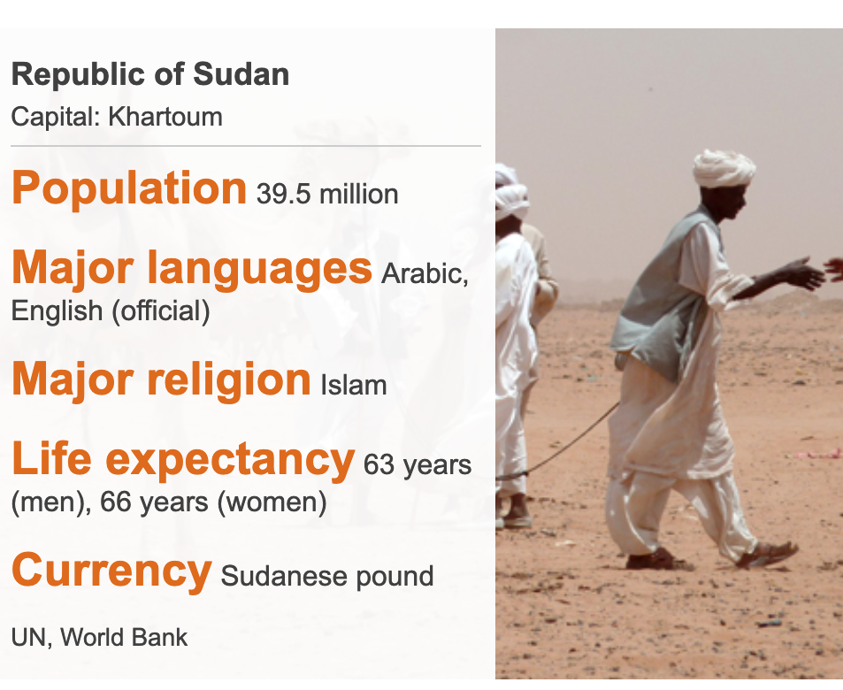
Sudan Country Profile
1821: Conquered by the Ottoman Empire.
1899-1955: Under joint British-Egyptian rule
1956: Gained independence.
1983: President Gaafar Mohamed al-Nimeiri introduced Sharia Islamic law on the country, including the Christians and animists in the south.

Slide 4
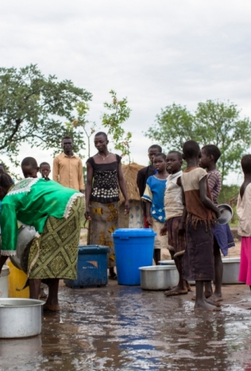

Rhino Refugee Camp
1980
The Rhino Refugee Camp first opened in 1980 at the start of the South Sudanese Civil War. As of January 2018, the camp had roughly 116,000 South Sudanese refugees.

Slide 5
General Omar al-Bashir Leads Coup
Jun 30, 1989
Omar al-Bashir led a coup against the Prime Minister of then-Sudan, Sadiq al-Mahdi.
Al-Bashir proclaimed himself "chairman of the Revolutionary Command Council." Once taking control, he dissolved "the government, political parties, and trade unions."

Slide 6
Attempted Coup of Al-Bashir
Apr 24, 1990
The Sudanese military crushed an attempted coup, arresting more than 30 officers.
"Sudan's Information Minister, Mohammed Khogli Salhein, said... the coup attempt had been led by a retired army major general, Abdul-Kader al-Kadro, and a retired air force brigadier, Mohammed Osman Hamed Karar."

Slide 7
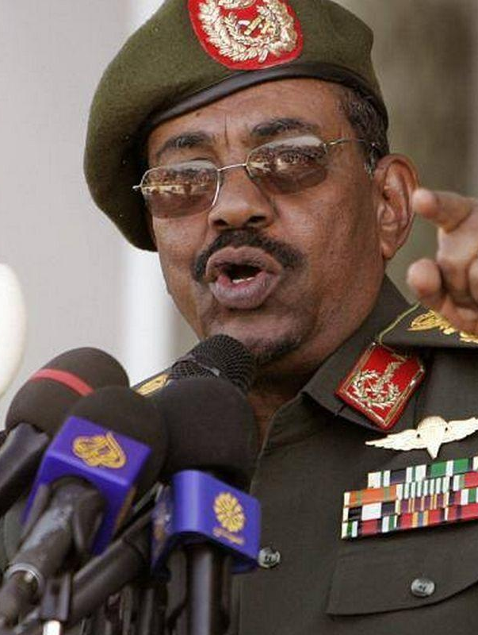
Omar al-Bashir Self-Appointed President
Oct 16, 1993
A few years after the 1989 coup of former Sudan Prime Minister Sadiq al-Mahdi by Omar al-Bashir, he appointed himself as President of Sudan.

Slide 8
Omar al-Bashir Re-elected
Mar 1996
Omar al-Bashir was re-elected president with more than 75% of the vote.

Slide 9
U.S. Imposes Sanction Against Sudan Goverment
Beginning in 1993, the U.S. designated Sudan as a state sponsor of terrorism, then later imposed an economic sanction that restricted certain financial transactions. In 1997, Bill Clinton issued an order imposing a trade embargo on Sudan which froze its government's assets in the U.S.

Slide 10
Omar al-Bashir Re-elected
Dec 2000
Omar al-Bashir was re-elected president with over 85% of the vote.

Slide 11
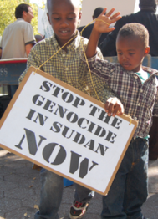
Darfur Genocide Begins
Feb 2003
In response to a rebellion of non-Arab Sudanese peoples in the Darfur region, the Sudanese government, led by Al-Bashir, took immediate action and launched a genocidal campaign against Darfur's civilians.
The Sudanese government also reportedly "used Arab militias known as the Janjaweed ('evil men on horseback') to carry out attacks on villages and destroy communities.”
"Janjaweed attacks were notoriously brutal and invoked a slash and burn policy that included killing and severely injuring the people, burning homes, stealing or burning food and livestock, and poisoning water wells. While these attacks would happen from the ground, the government would also attack civilians from the sky with indiscriminate aerial bombings wreaking havoc on villages."

Slide 12
U.S. Declares Genocide in Sudan
Sep 9, 2004
In 2004, then-Secretary of State Colin Powell announced the ongoing crisis in Sudan to be a genocide.
"In Powell's testimony before the Senate Foreign Relations Committee, he said, 'We concluded—I concluded—that genocide has been committed in Darfur and that the Government of Sudan and the Janjaweed bear responsibility—and that genocide may still be occurring.'"

Slide 13
Comprehensive Peace Agreement
Jan 9, 2005
After signing the Comprehensive Peace Agreement, the "First Vice-President of the Sudan (Ali Othman Taha) called on the international community to support efforts aimed at reconstruction and development, so that the people of the Sudan could enjoy the peace dividend. "
"Taha urged the Council to call on all countries to lift any economic and trade restrictions or sanctions and to initiate active partnerships with the Sudan. He also urged the writing off completely of all foreign debt owed by the Sudan to international institutions and States, so that the country could channel resources for the provision of social services, the rebuilding of infrastructure and improving the capabilities of its population and institutions."

Slide 14

Darfur Peace and Accountability Act of 2006

Slide 15
George Bush Imposes Sanctions on Sudan
May 2007
Bush imposed additional sanctions on Sudan and asked for support for an international arms embargo to end what he labeled a genocide.

Slide 16
AU Peace and Security Council Call A Panel
Jul 2008
The panel was called to examine the Darfur crisis and to formulate recommendations on how to best reconcile the region. The panel was led by South African President Thabo Mbeki. Ultimately, this panel accomplished nothing.

Slide 17
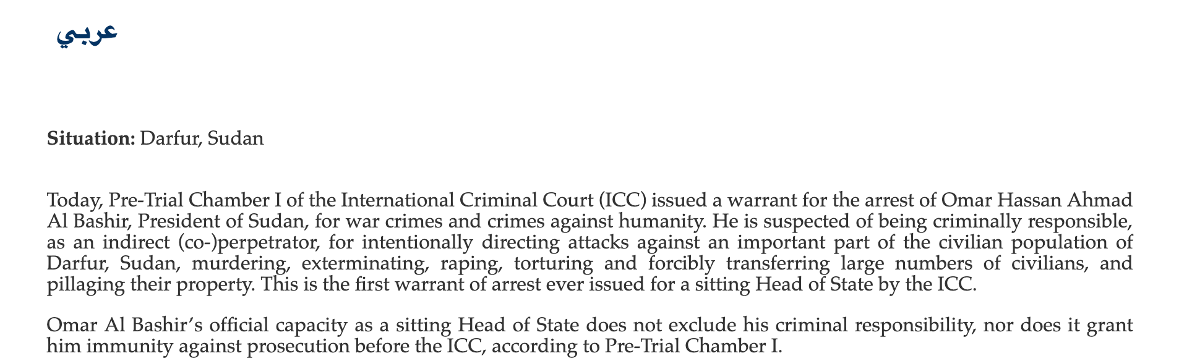
ICC Issues Warrant For Al-Bashir's Arreset
Mar 4, 2009
The International Criminal Court (ICC) issued an arrest warrant for South Sudan's President Omar al-Bashir "for atrocities committed in Darfur, but Sudanese officials swiftly retaliated, ordering Western aid groups that provide for millions of people to shut down their operations and leave.”
Al-Bashir has been formally charged with "war crimes and crimes against humanity for playing an 'essential role' in the murder, rape, torture, pillage and displacement of large numbers of civilians in Darfur. But the judges did not charge him with genocide, as the prosecutor had requested."

Slide 18
Darfur To be "De-emphasized" in Sudan Policy
Aug 2010
"The Obama administration signals that Darfur will be “de-emphasized” in U.S. Sudan policy. At the same time, Khartoum begins to promulgate its “New Strategy for Darfur,” a blatant attempt to create the pretext for eliminating an international humanitarian presence in Darfur. “Development,” the regime argues, will replace humanitarian services, despite a vast population still in desperate need of food, clean water, shelter, and primary medical care. Thabo Mbeki, chair of the African Union High-Level Panel on Implementation, and U.S. envoy Scott Gration “strongly support” the “New Strategy.” "

Slide 19
"New Strategy for Darfur"
Sep 16, 2010
"The Khartoum’s National Congress Party (NCP) regime officially ratified their “New Strategy for Darfur,” a document that will serve as a blueprint for consolidating the results of more than seven years of genocidal counterinsurgency warfare in Darfur."
"For there can be little doubt about what the “New Strategy” entails: massive, forced relocation of Internally Displaced Persons (IDPs); denial of the need for a continuing international humanitarian presence in Darfur; refusal to participate seriously in an internationally mediated peace process; and the establishment of a more robust “security” presence that will eventually compel the withdrawal of the current UN peacekeeping mission in Darfur."

Slide 20
Wildfire Kill Dozens of South Sudanese
2011
"At least 33 people have been killed by a wildfire in South Sudan's Western Bahr el Ghazal region, a spokesman for the country's president has said.
Sixty people are also in a critical condition after the fire, which was fanned by gusty winds, gutted four villages on Sunday."

Slide 21
Sudan Referendum
Jan 9, 2011 to Jan 15, 2011
Voters participated in a referendum determining whether South Sudan would become autonomous or remain part of Sudan.

Slide 22
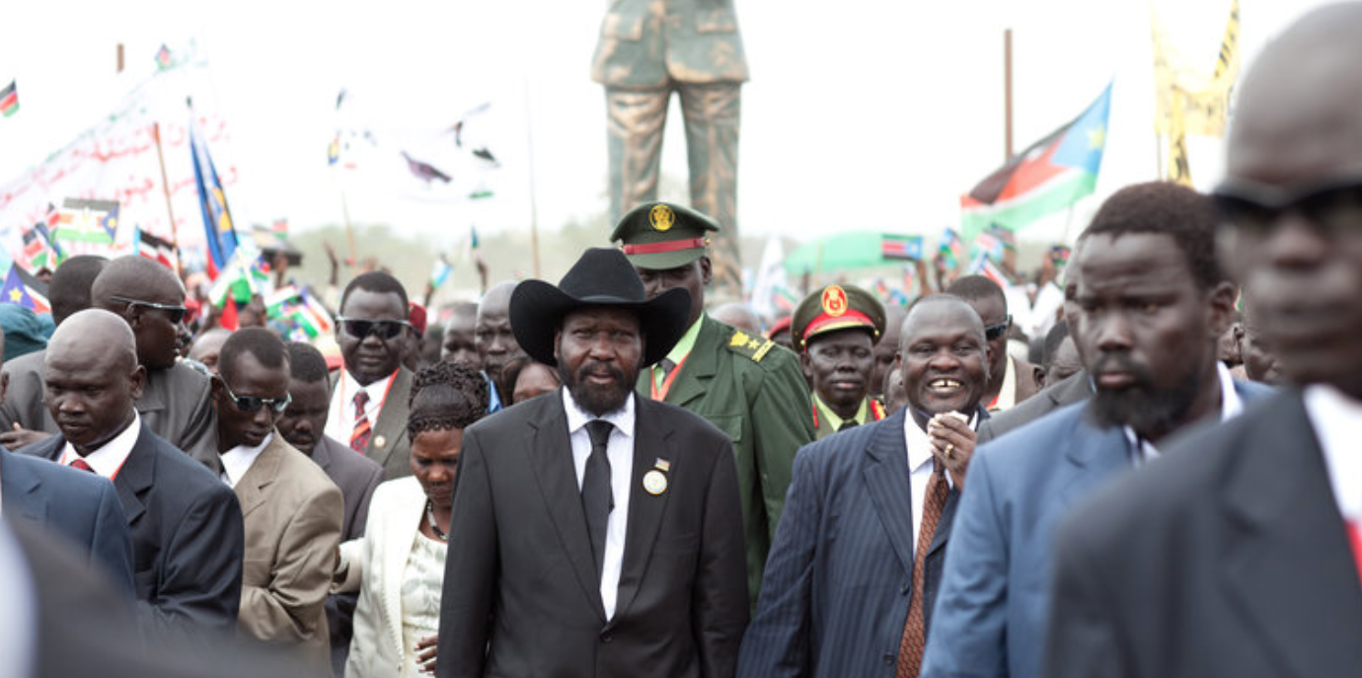
South Sudan Becomes Independent Nation
Jul 9, 2011
The Republic of South Sudan became Africa's 54th state when it declared its independence. The effort took over five decades, and two million lives were lost in the process.

Slide 23
Sudan and South Sudan Sign Nonaggression Pact
Feb 10, 2012
During talks mediated by the African Union, Sudan and South Sudan signed a nonaggression pact aiming to bring peace to the border region.

Slide 24
ICC Issues Second Arrest Warrant For Al-Bashir
Jul 11, 2012
The International Criminal Court (ICC) issued a second arrest warrant for Al-Bashir for genocide.
"ICC spokesperson Sonja Robla said, 'The judges of the court think that there are reasonable grounds to believe that al-Bashir is responsible for three counts of genocide committed against the Fur, Masalit, and Zaghawa ethnic groups.'"
In the first arrest warrant, the ICC had omitted the charge of genocide because of insufficient evidence.

Slide 25
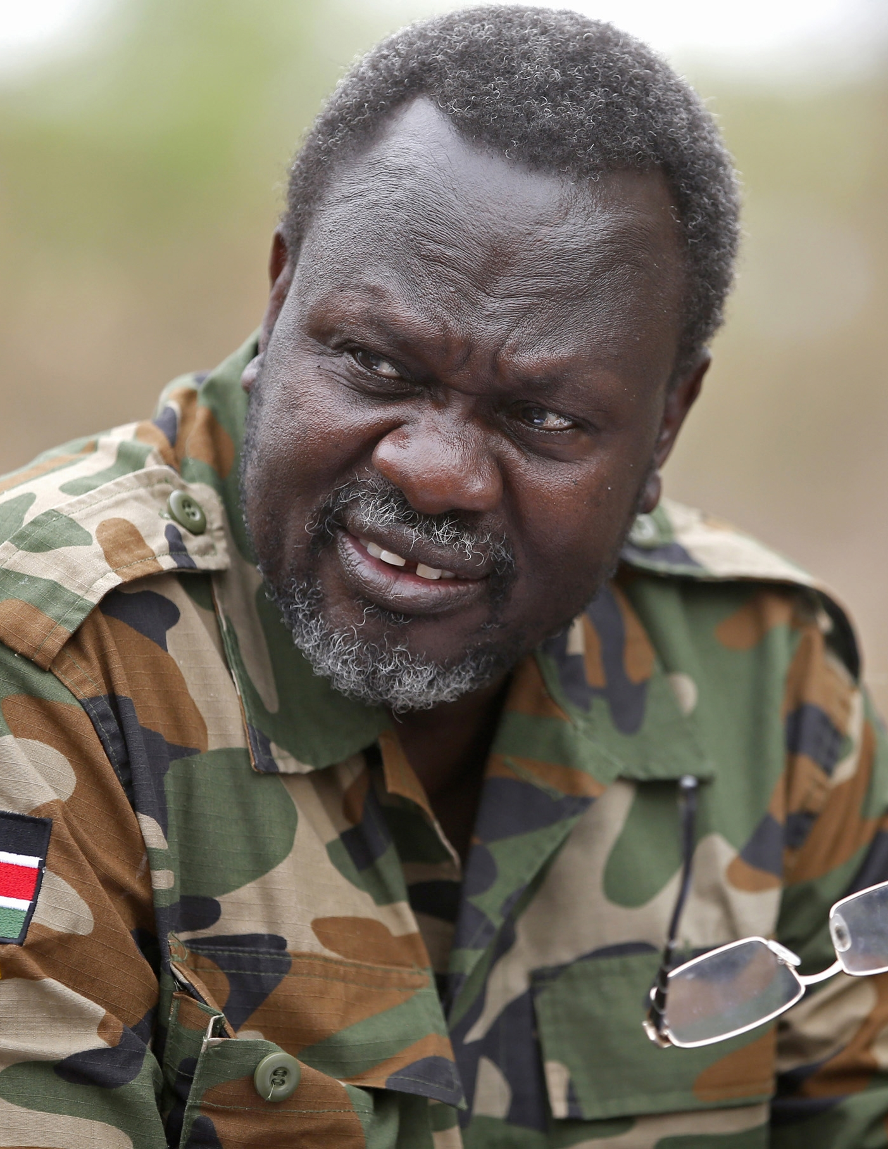
Dismissal of Riek Machar
Jul 2013
The dismissal of the former Vice President of South Sudan, Riek Machar, an ethnic Nuer, by President Salva Kiir, an ethnic Dinka, functioned as a catalyst for mass violence resulting in the deaths of thousands. Machar was dismissed on allegations of organizing a coup against Kiir.

Slide 26
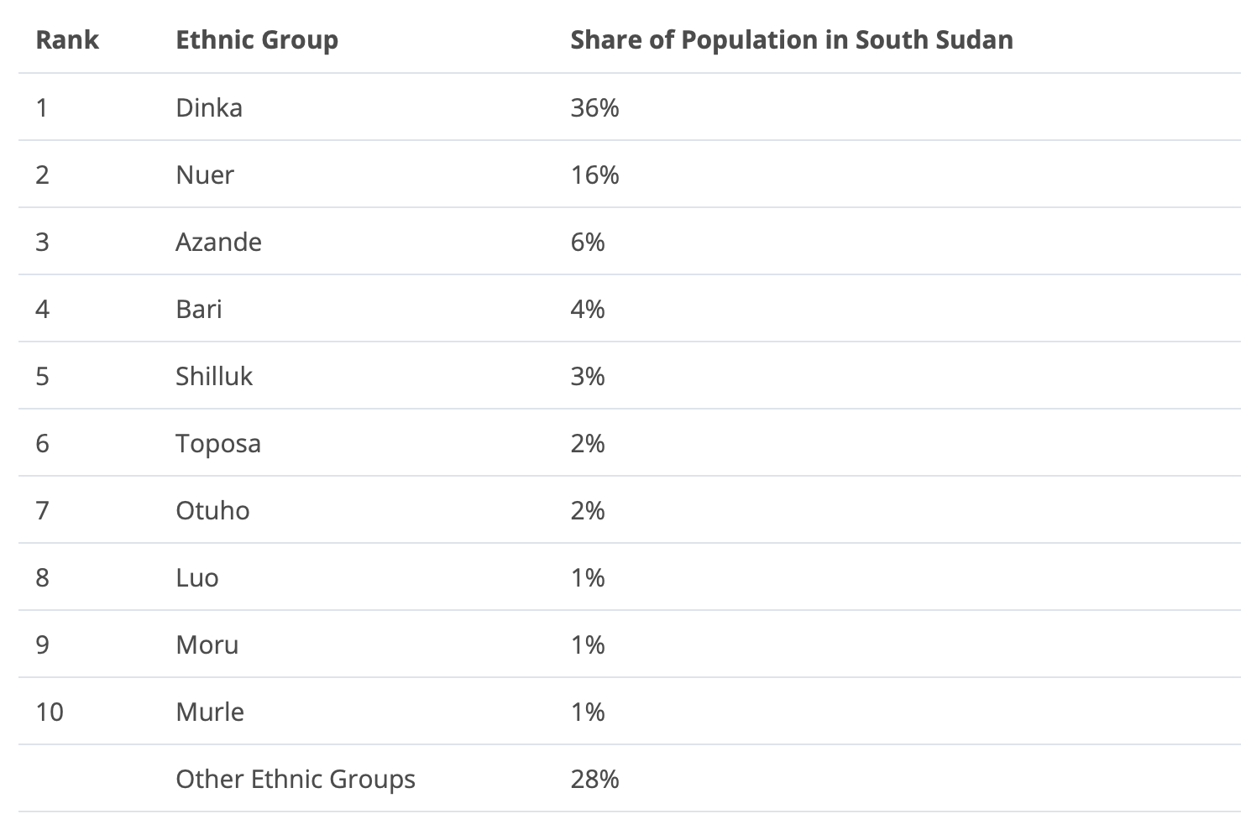
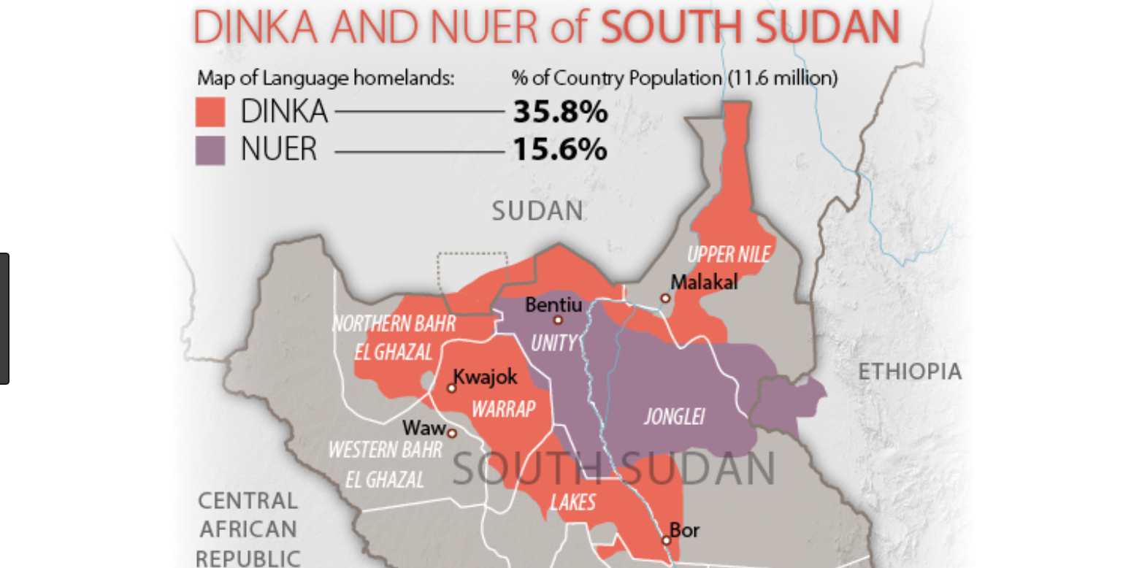
Dinka and Nuer
In the early 21st century, the Dinka numbered 4.5 million, and they formed many independent groups of 1,000 to 30,000 persons.
There is a long history of conflict between the Dinka and Nuer tribes over cattle, pastures, and wells. During the ongoing war in South Sudan, most of the killings were between the Dinka and Nuer, and this is because the war brought large quantities of weapons to the area.
The tension between the two groups escalated in 2013 after Salva Kiir (Dinka) dismissed Riek Machar.

Slide 27
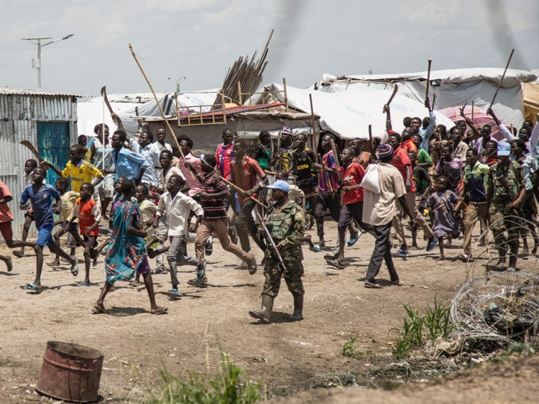
South Sudanese "Civil War" Begins
Dec 15, 2013
In late 2013, South Sudan’s civil war erupted "when troops loyal to then-Vice President Riek Machar clashed with forces loyal to President Salva Kiir.”
"The two men represented rival ethnic groups with longstanding tensions and a history of violence, morphing the political violence into an all-out ethnic conflict, with people loyal to both sides taking up arms and slaughtering each other. "

Slide 28
Agreement to Resolve the Conflict in the Republic of South Sudan (ARCSS)
Jul 17, 2015
"The United States supported the Intergovernmental Authority on Development (IGAD) in its mediation efforts between [South Sudanese President Kiir and former Vice President Machar], which resulted in the signing of the Agreement to Resolve the Conflict in the Republic of South Sudan (ARCSS)."
IGAD states decided to move forward with the U.S. plan for South Sudan, "whereby Kiir retained the presidency and Machar again became first vice president."
However, the ARCSS deal "had two fatal flaws: first, Kiir never truly accepted the final product, proclaiming his resistance to the deal even as he signed it; and secondly, mediators, at the last minute and at Museveni’s behest, stripped out provisions for a demilitarized Juba protected by a third-party force, leaving the two sides to eventually negotiate shared control of the capital."
Further, the deal fell apart in July 2016 when "Kiir’s military clashed with Sudan People’s Liberation Movement/Army-In Opposition (SPLM/A-IO) units loyal to Machar in Juba."

Slide 29
The African Union Release a Report Indicting Cannibalism and Gang Rape
Oct 27, 2015
The African Union released a report indicating militants had committed such atrocities as forced cannibalism and gang rape.
"The Commission found cases of sexual and gender-based violence committed by both parties against women. It also documented extreme cruelty exercised through mutilation of bodies, burning of bodies, draining human blood from people who had just been killed and forcing others from one ethnic community to drink the blood or eat burnt human flesh,"

Slide 30
Rally Against Darfur Genocide in DC
Apr 30, 2016
On April 30th, 2016, Barack Obama spoke at a rally against genocide in Darfur. The aim of the rally was to raise awareness and prevent the atrocities in Darfur by putting pressure on U.S. politicians to take action on the matter.
Obama stated the atrocities were committed by the Sudanese government against its own citizens. In one example, a woman was gang-raped while gathering firewood, 300,000 people were killed, and children were slaughtered.
This rally was a pinnacle event in the Save Darfur Movement.
"Save Darfur marked one of the first times in U.S. history that a campaign to prevent genocide in a distant country entered the political mainstream. The Save Darfur movement grew beyond anyone’s expectations, with clubs forming in high schools across the country, letter-writing campaigns by Americans, and grand celebrity support. Yet Darfur was not saved."

Slide 31
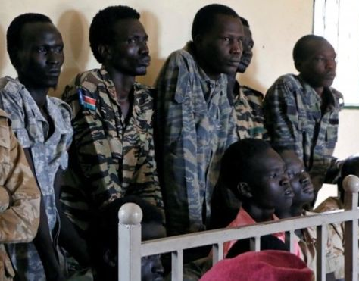
Terrain Hotel Attack
Jul 11, 2016
According to victim accounts, South Sudanese troops "shot dead a local journalist while forcing the foreigners to watch, raped several foreign women, singled out Americans, beat and robbed people and carried out mock executions."

Slide 32
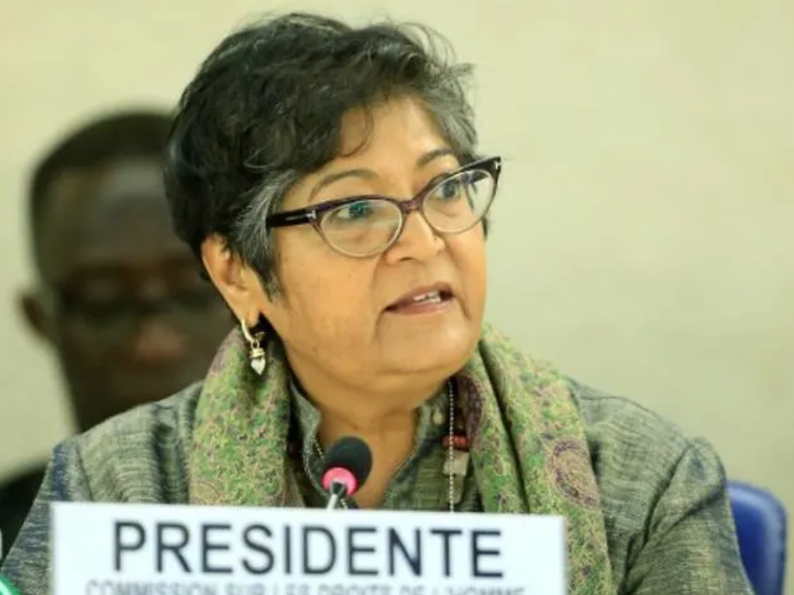
UN Experts: South Sudan on Path to Genocide
Nov 30, 2016
According to the UNHCR members who spent 10 days in South Sudan, “The stage is being set for a repeat of what happened in Rwanda and the international community is under an obligation to prevent it.”
“As the UN Special Representative for the Prevention of Genocide said, many of the warning signals of impending genocide are already there – an existing conflict, resort to polarized ethnic identities, dehumanization, a culture of denial, displacement based on ethnicity, and in some places indications of systematic violations and planning – but the important thing is there is still time to prevent it,” said Yasmin Sooka, Chair of the UNHCR.

Slide 33
Refugee Camps

Slide 34
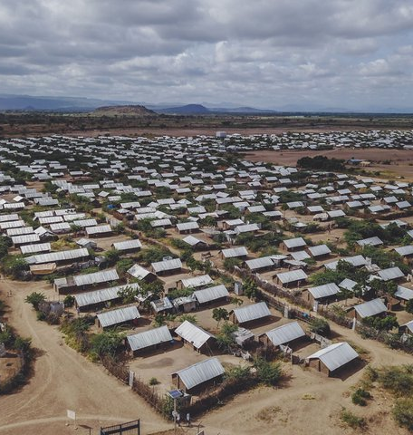
Kakuma Refugee Camp
1992
The Kakuma Refugee Camp opened in 1992 to accommodate 23,000 Sudanese escaping the Second Sudanese Civil War.

Slide 35
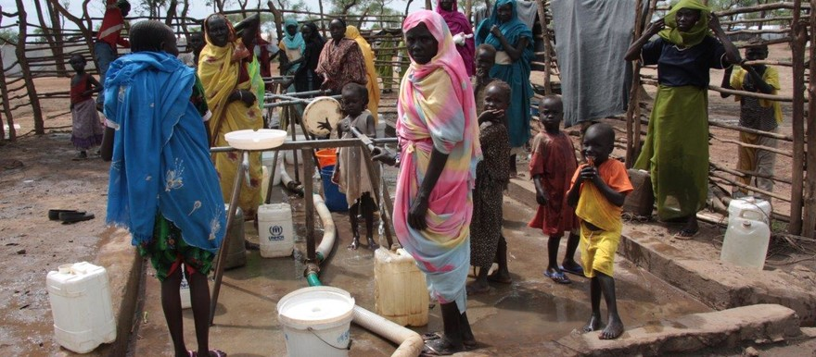
Yusuf Batil Refugee Camp
May 2012
As of March 2018, the Yusuf Batil Refugee Camp had roughly 43,000 Internally Displaced Persons (IDPs).

Slide 36
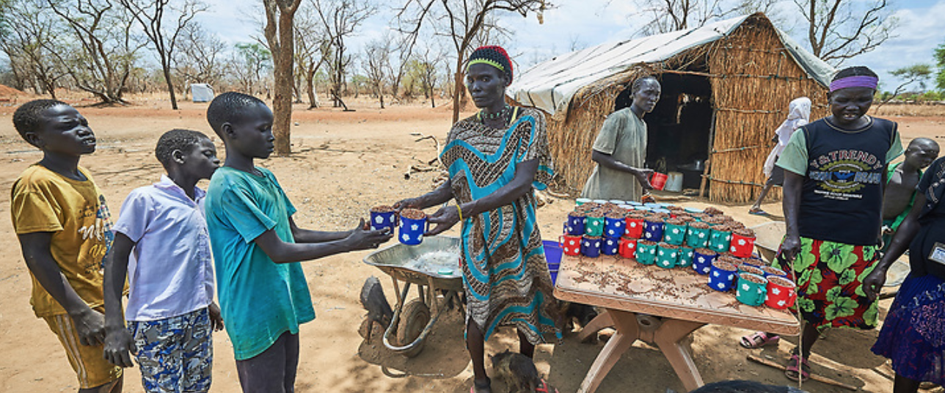
Kaya Refugee Camp
Jun 2013
As of March 2018, the Kaya Refugee Camp reportedly had 23,000 IDPs.

Slide 37
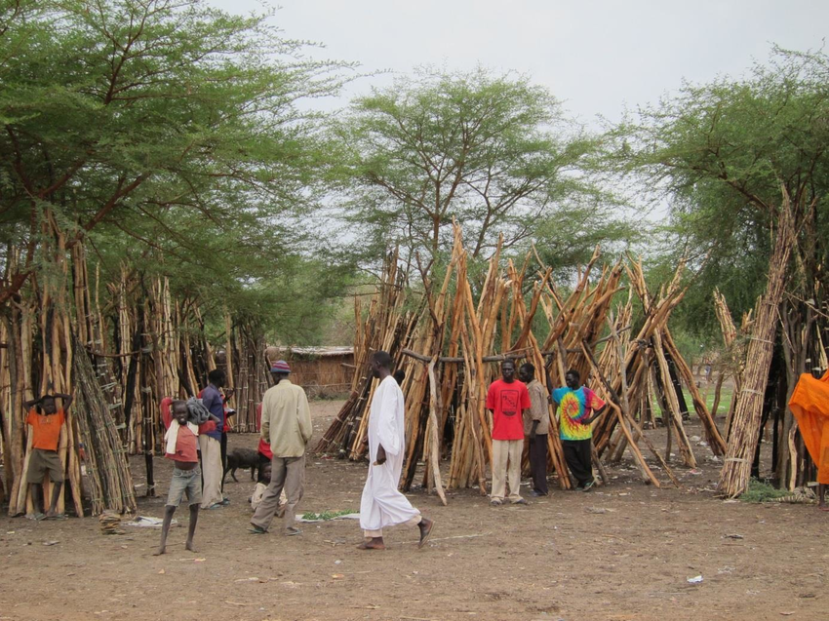
Doro Refugee Camp
Nov 2013
As of March 2018, the Doro Refugee Camp in South Sudan hosted over 58,000 IDPs. 52% of the population in the camp were women.

Slide 38
Gendrassa Refugee Camp
According to the 2014 Gendrassa Refugee Camp Profiling report, "Gendrassa Camp is one of four camps in Maban County, Upper Nile State, South Sudan that house over 125,000 refugees who fled from conflict in Blue Nile State in Sudan. The current population of Gendrassa Camp stands at 17,481 people, most have been refugees for two to three years."

Slide 39
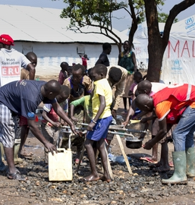
Imvepi Refugee Camp
Feb 2017
The Imvepi Refugee Camp was built to accommodate the influx of South Sudanese refugees after the first camp, Paloryina, reached capacity.
The Imvepi camp was reported to have over 127,000 refugees in January 2018.

Slide 40
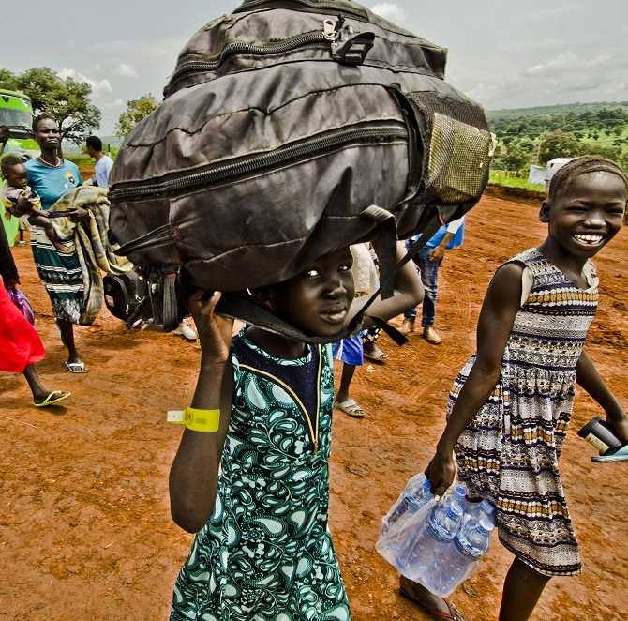
Gure-Shombola Refugee Camp
According to the UNHCR database report on December 31, 2017, the camp hosted nearly 4,000 South Sudanese refugees. 85% of the refugees were women and children.

Slide 41
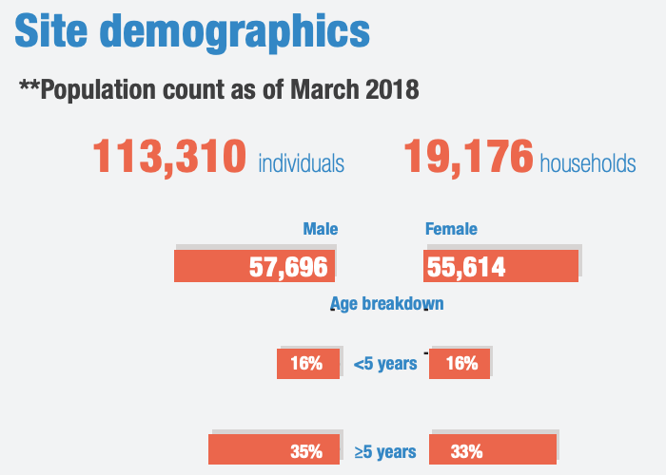
Bentiu PoC (Refugee Camp)
As of March 2018, the Bentiu PoC (Protection of Civilian) in South Sudan had more than an estimated 113,000 people living in the camp.

Slide 42
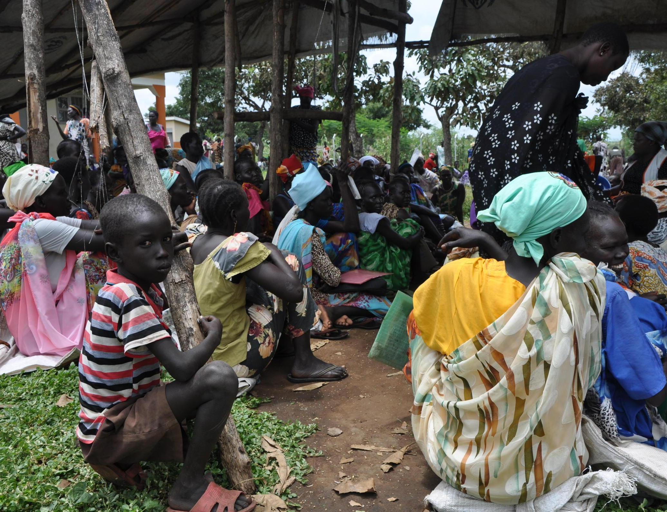
Palorinya Refugee Camp
As of May 2018, the UNHCR reported approximately 166,000 South Sudanese refugees living in the Palorinya Refugee Camp in Uganda.

Slide 43
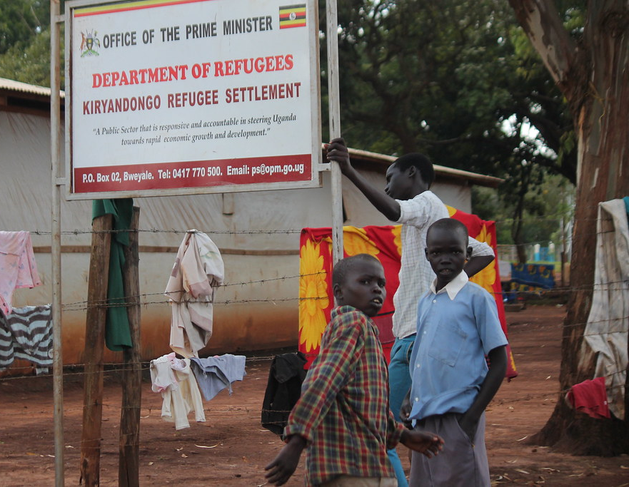
Kiryandongo Refugee Camp
According to UNHCR's June 2018 report on Kiryandongo Refugee Camp, nearly all 57,000 refugees in the camp were South Sudanese.

Slide 44
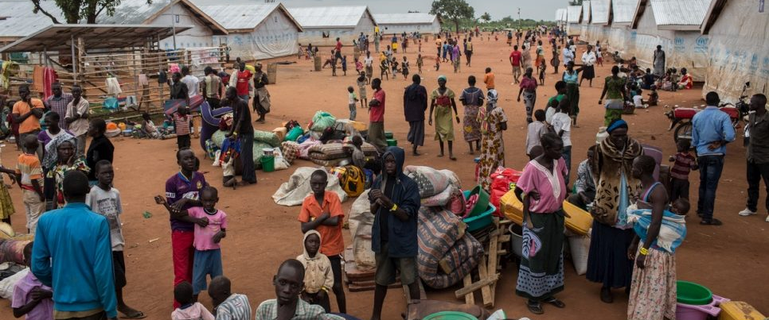
Palabek Refugee Camp
The newest refugee camp in Uganda, Palabek hosted roughly 38,000 South Sudanese refugees in June 2018.

Slide 45
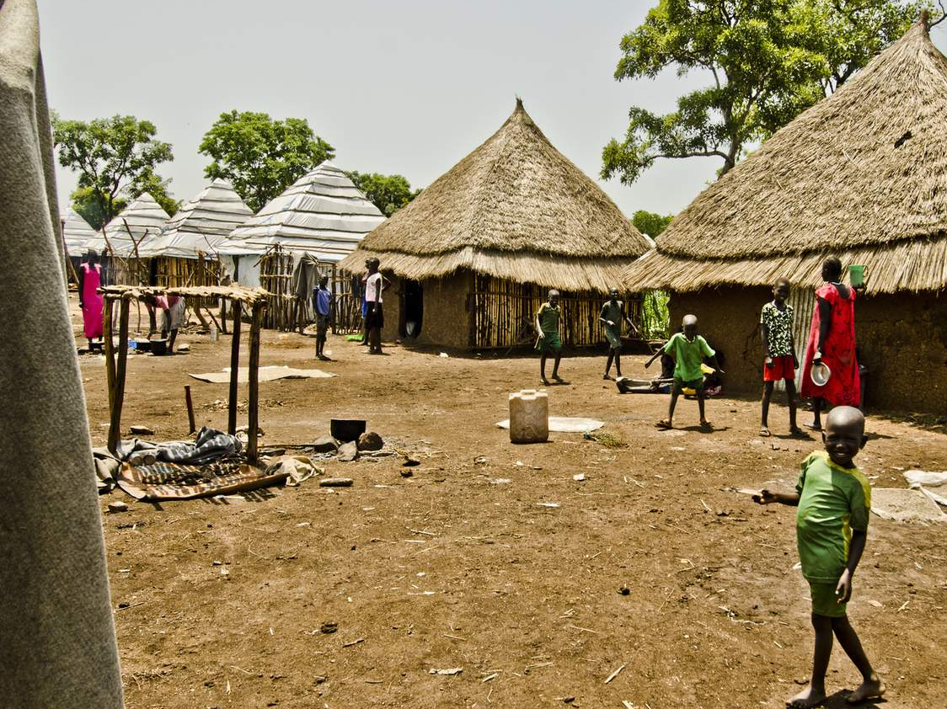
Nguenyyiel (Gambella) Refugee Camp
The Nguenyyiel Refugee Camp was the newest camp built to accommodate the South Sudanese refugees in Ethiopia. As of August 31, 2018, there were an estimated 74,000 refugees in the camp. 69% of these refugees were under 18 years old.

Slide 46
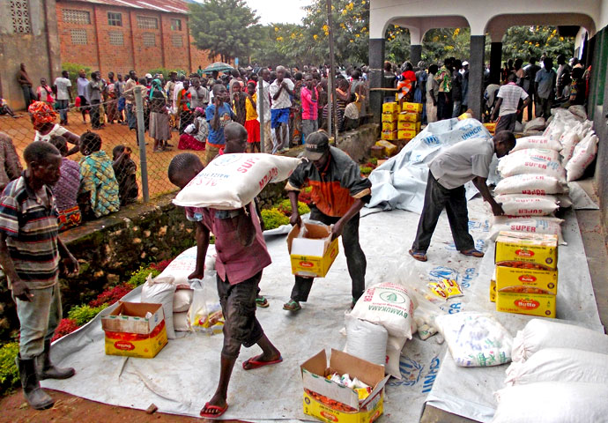
Biringi Refugee Camp
In February 2019, UNHCR transferred 985 South Sudanese refugees to the Biringi Refugee Camp, where more shelters and facilities were available.

Slide 47
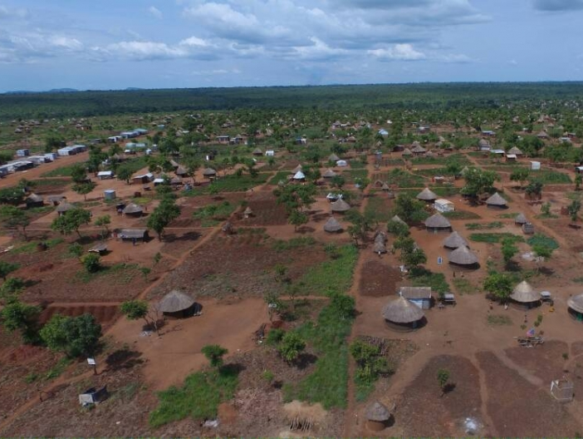
Bidi Bidi Refugee Camp
As of May 2019, Uganda's Bidi Bidi Refugee Camp housed roughly 250,000 South Sudanese who fled civil war in their country. Until recently, it was the largest refugee camp in the world.
National Geographic reported that “When refugees started coming over the border with Uganda in late 2016, they were more or less entering a forest ... that had to be immediately adapted to fit the tens of thousands of people who were coming to stay... So, they ended up clearing acres and acres of land, and the first thing they did was make 250 miles of roads going through.”

Slide 48
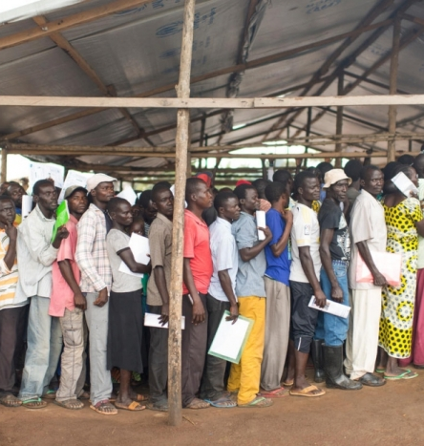
Meri Refugee Camp
As of May 31, 2019, there were an estimated 35,000 South Sudanese refugees in the Meri Refugee Camp. The camp was built to hold only 20,000 people.

Slide 49
UN Statement on Genocide in South Sudan
Feb 16, 2017
The Special Adviser of the Secretary-General on the Prevention of Genocide, Adama Dieng, "expressed grave concern at the continued level of violence in several areas of South Sudan."
“President Salva Kiir has made a commitment to end the violence and bring about peace, yet we still see ongoing clashes, and the risk that mass atrocities will be committed remains ever-present,” said the Special Adviser.
President Kiir has failed to end hostilities in South Sudan despite peace efforts declared in the government's National Dialogue.
It was estimated that more than 52,000 people fled South Sudan in January 2017 alone. Many of these people reported "killings of civilians, destruction of homes, sexual violence, and looting of livestock and property."

Slide 50
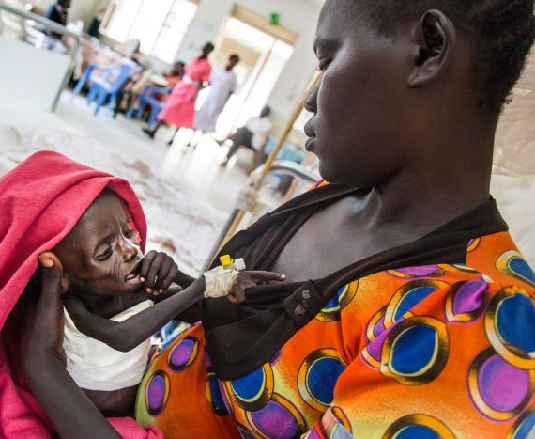
UN Declares Famine in South Sudan
Feb 20, 2017
The UN announced that about 4.9 million people in South Sudan were "in need of urgent food, agriculture, and nutrition assistance," and expected to rise.
“More than one million children [were] estimated to be acutely malnourished across South Sudan; over a quarter of a million children [were] already severely malnourished. If we do not reach these children with urgent aid many of them will die,” said a UNICEF representative in South Sudan.

Slide 51
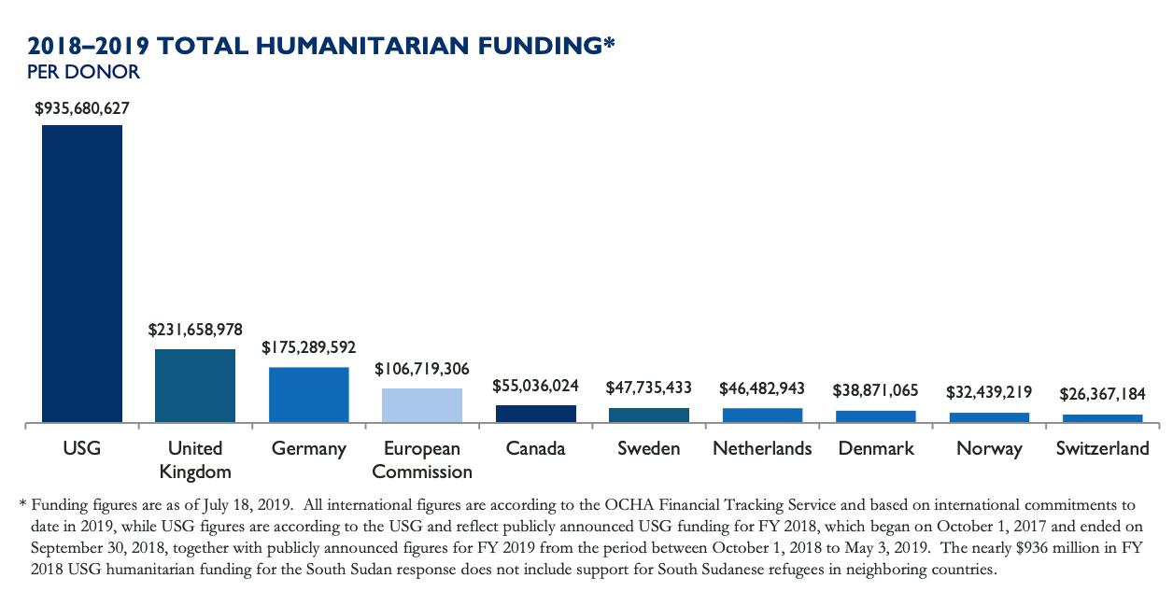
US Provides Over $935 Million in Aid
Jan 1, 2018 to Jul 18, 2019
USAID, the U.S. government's disaster aid branch, provided over $935 million in aid to South Sudan within the last 18 months, earning the status as the largest donor to the country.

Slide 52

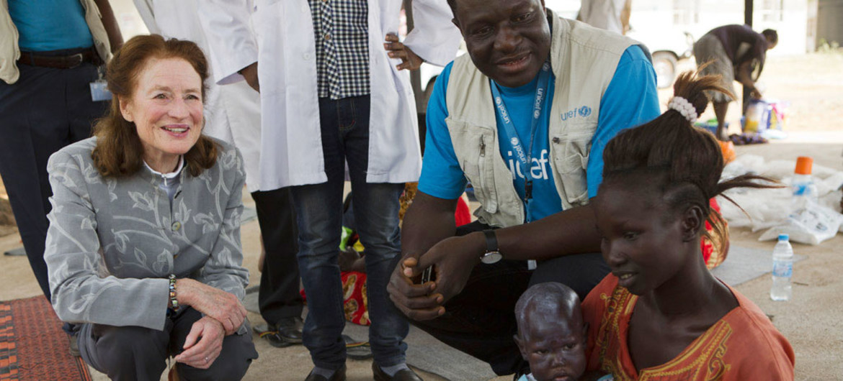
19,000 Children Recruited in Fighting
Jan 19, 2018
According to Executive Director of UNICEF, Henrietta Fore, "2.4 million children were forced to flee their homes and more than a quarter of a million children were severely malnourished and at imminent risk of death.”
"Over 19,000 children were recruited into the conflict. At least one in three schools were damaged, destroyed, occupied, or closed. More than 1,200 cases of sexual violence against children were documented."

Slide 53
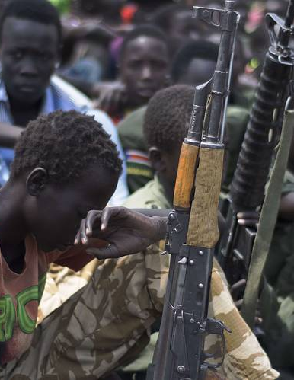
Over 900 Child Soldiers Freed
In 2018, roughly 900 child soldiers in South Sudan were released to UNICEF. However, the UN estimated 19,000 remaining child soldiers are still being used in the country.

Slide 54
10 Aid Workers Reported Missing
Apr 26, 2018
Alain Noudehou, the United Nations Humanitarian Coordinator for South Sudan, said ten South Sudanese aid workers were reported missing from their convoy that was headed to Yei.
"Aid workers are often targeted by armed groups operating in South Sudan, which has been in the grip of war between supporters of President Salva Kiir and those of his former deputy Riek Machar since 2013."
Of the ten missing individuals, "one was working for the humanitarian office UNOCHA, two for UNICEF, one for the South Sudanese Development Organization, two for aid group ACROSS, three for Plan International and one for Action Africa Help."

Slide 55
South Sudan Soldiers Reportedly Attacks Civilians
Jun 12, 2018
A report released by Human Rights Watch (HRW) stated that South Sudan "soldiers attacked civilians and civilian property in counterinsurgency operations."
The alleged attacks sent thousands of people fleeing.

Slide 56
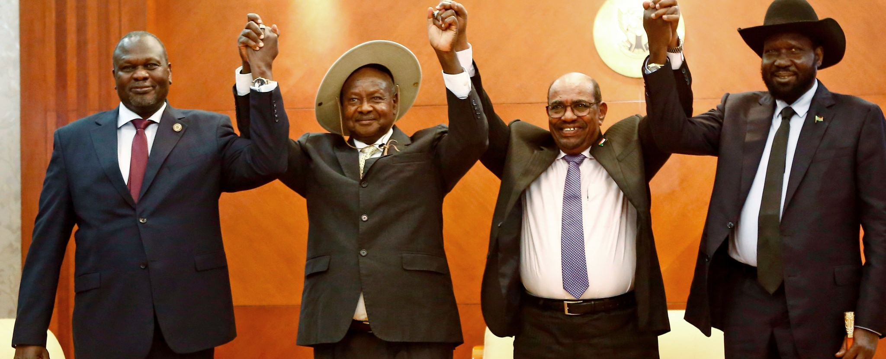
2018 "Revitalized" Peace Agreement
Sep 12, 2018
South Sudan President Kiir and former Vice President Machar met in Ethiopia to sign yet another peace agreement to bring an end to the five-year civil war in the country.
The three countries that oversaw the peace efforts in South Sudan were the U.S., U.K., and Norway.

Slide 57
UN Peacekeeping Envoy Attacked
Sep 15, 2018
UNMISS announced that one of their peacekeepers was shot and wounded in South Sudan, allegedly by the SPLA.
It was reported that an SPLA soldier shot directly at one of the vehicles in the UNMISS convoy, "hitting the Nepalese peacekeeper in the leg."
“This direct attack on UN peacekeepers here to help the people of South Sudan is unacceptable. The perpetrator must be found and held accountable by Government authorities,” said the Special Representative of the Secretary-General and Head of UNMISS, David Shearer.

Slide 58
UN OHCHR Calls For Release of Abducted Civilians
Oct 18, 2018
The UN released a report which "documented the immense suffering of civilians in the Western Equatoria region of South Sudan where 900 people were abducted and 24,000 forced to flee their homes during a surge in violence between April and August 2018."
According to victims and witnesses, young girls were abducted and "lined up for commanders to choose as 'wives'. Those who were not chosen were left for other fighters who subjected them to repeated rapes." The abducted boys were reportedly used as fighters and porters.

Slide 59
Council Issues Press Release
Dec 2018
"A press statement was released condemning "the heinous incidents of sexual and gender-based violence against women near Bentiu in northern South Sudan” and calling for accountability. "
"The statement also reiterated the Council’s willingness to impose targeted sanctions against individuals or entities responsible and called for the establishment of the Hybrid Court for South Sudan."

Slide 60
South Sudan Government Allegedly Abuses Civilians
Dec 2018 to Mar 2019
According to Human Rights Watch (HRW), South Sudan "government soldiers carried out extensive abuses against civilians during counter-insurgency operations in South Sudan between December 2018 and March 2019 in Yei River state."
HRW interviewed 72 displaced people and heard consistent stories of civilians being fired upon, raped, and killed. Their homes were looted and destroyed as well.

Slide 61
UN Condemns Sexual Violence Against Women
Dec 8, 2018
The UN Security Council condemned sexual violence against women and girls in South Sudan. According to reports, there were 150 victims "who were attacked by armed men in military and civilian clothing."
The UN also called on the government to condemn and investigate the attacks "to break the cycle of impunity for sexual and gender-based violence."

Slide 62
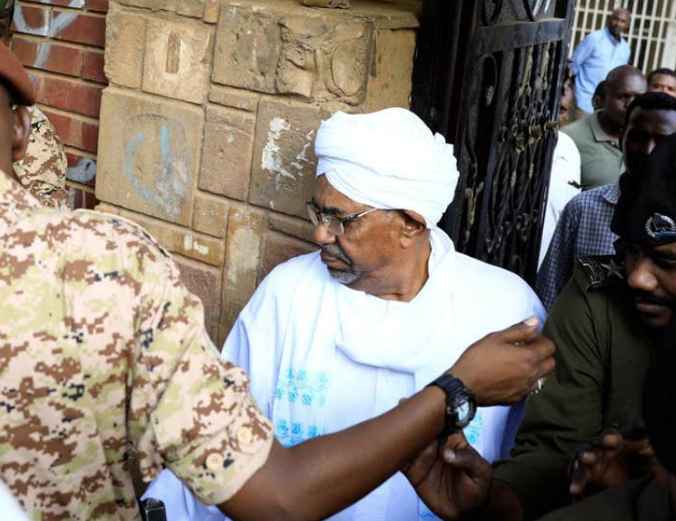
Accusations Against Omar al-Bashir
Omar al-Bashir was accused of committing the following:
Genocide.
  Killing members of the Fur, Masalit, and Zaghawa ethnic groups.
  Causing individuals from these groups serious bodily or mental harm.
  Inflicting conditions of life calculated to bring about these groups' physical destruction.
Crimes against humanity.
  Murder.
  Extermination.
  Forcible transfer.
  Rape.
  Torture.
War crimes.
  Attacks on civilians in Darfur.
  Pillaging towns and villages.

Slide 63
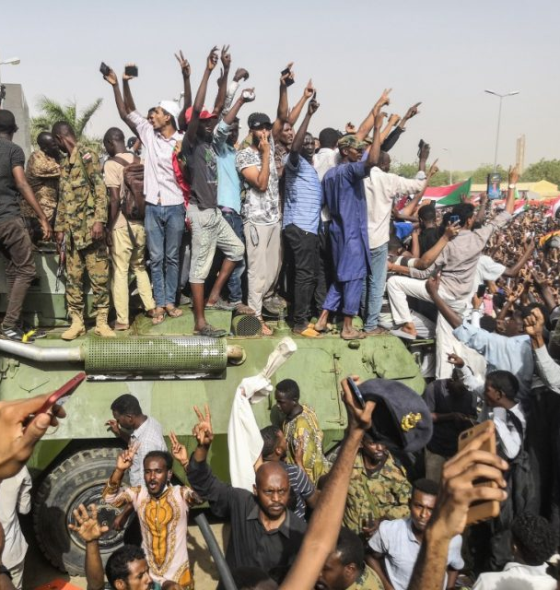
Al-Bashir Ousted in Coup
Apr 11, 2019
President Omar al-Bashir was "arrested and forced from power in a military coup.”
A military council was temporarily established once Al-Bashir was removed from power. The council will have control for a two-year period until power is transitioned.

Slide 64
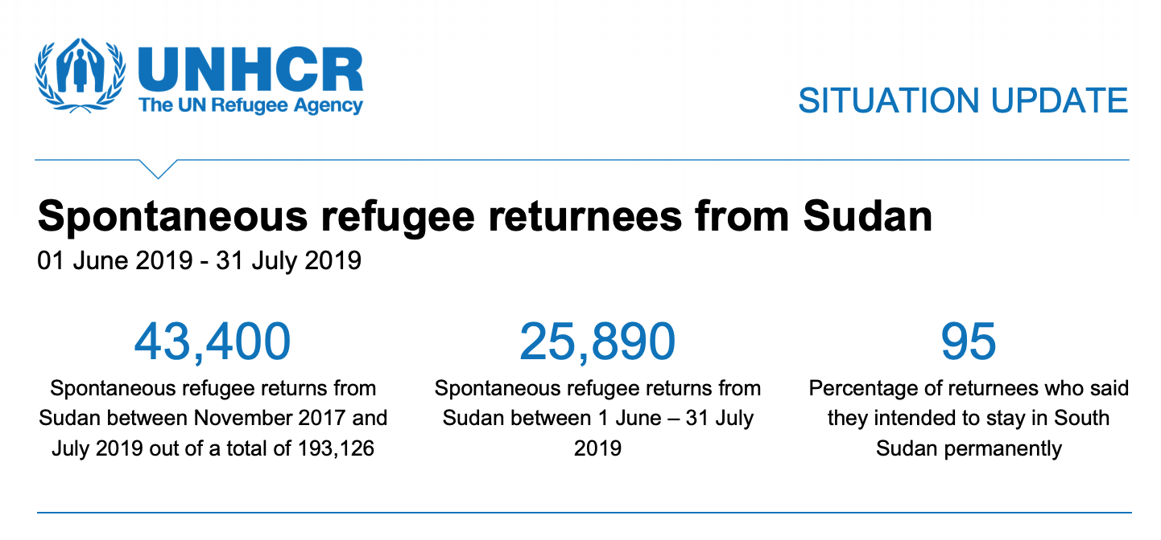
Refugees Return to South Sudan
According to UNHCR, nearly 26,000 South Sudanese refugees migrated back to their country from Sudan between June 1, 2019, and July 31, 2019.
UNHCR surmised this was due to the fall of Omar al-Bashir in April 2019 and the increased insecurity for refugees in Sudan.

Slide 65
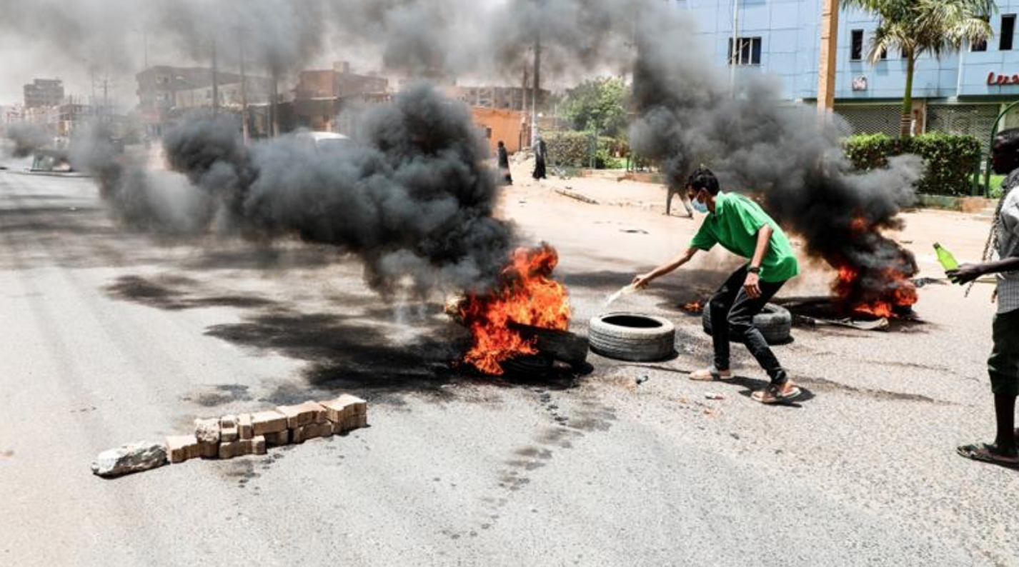
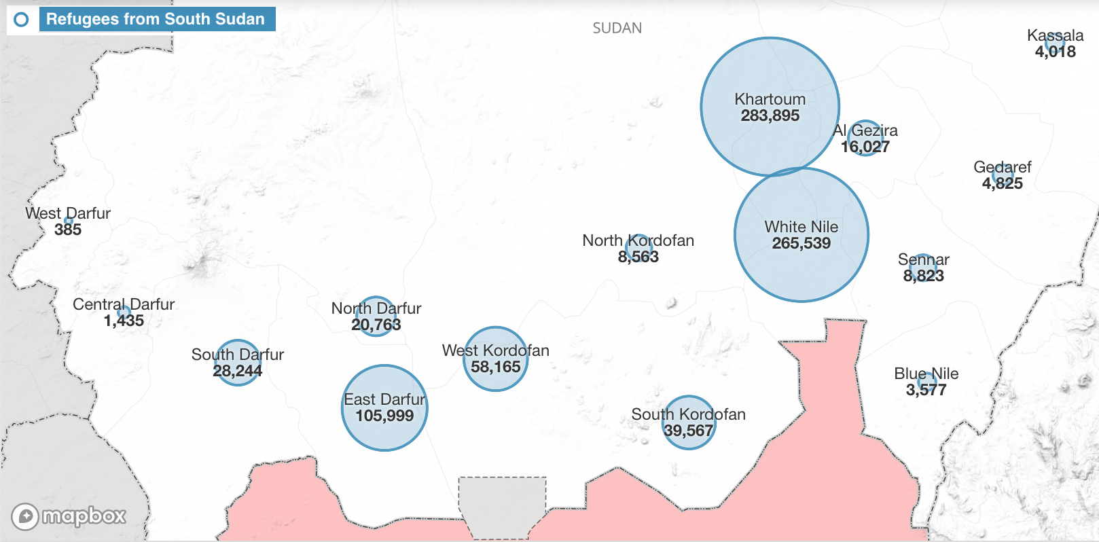
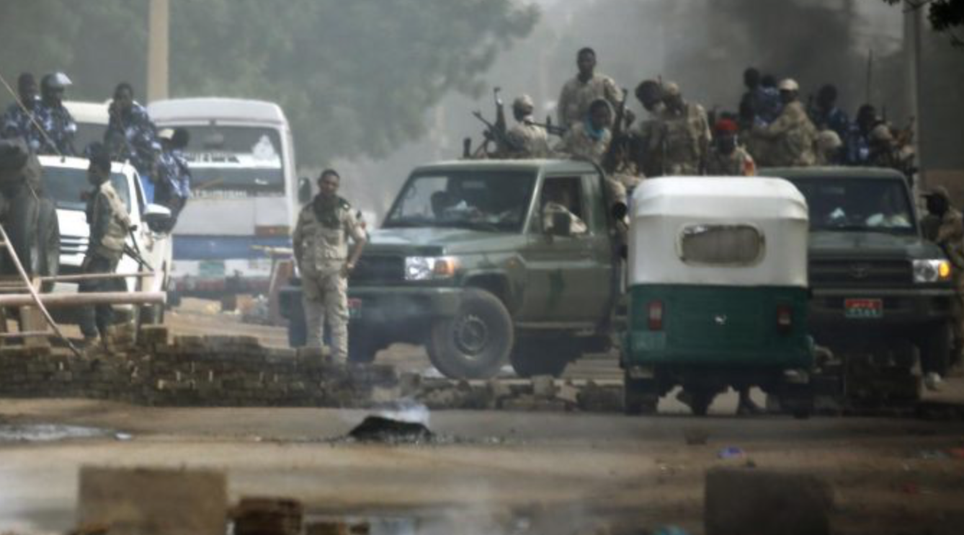
Bloody Massacre in Khartoum
Jun 3, 2019
Protestors in Khartoum faced a violent and bloody attack from the government's Rapid Support Forces (RSF), a paramilitary group mostly comprised of Janjaweed militia members, in which an estimated 118 civilians were killed.

Slide 66
Sudan Accepts Ethiopian PM as Mediator
Jun 7, 2019
"Sudan's main alliance of opposition groups and protesters says it accepts Ethiopia's Prime Minister Abiy Ahmed as a mediator in their political deadlock with the Transitional Military Council (TMC) under certain conditions."

Slide 67
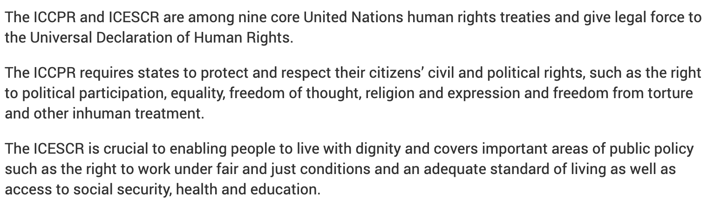
South Sudan Ratifies ICESCR and ICCPR
Jun 7, 2019
The UN Mission in South Sudan (UNMISS) worked with 165 members of the South Sudan Transitional National Legislative Assembly (TNLA) to ratify the International Covenant on Economic, Social and Cultural Rights (ICESCR) and International Covenant on Civil and Political Rights (ICCPR). The TNLA voted unanimously to ratify the covenants.

Slide 68
Four People Killed
Jun 9, 2019
On the first day of the civil disobedience campaign, four people were killed.
The Central Committee for Sudanese Doctors (CCSD) announced that two people are shot dead in Khartoum and Omdurman, and two others died in the hospital in Omdurman after being stabbed and beaten.

Slide 69
Protesters in Sudan Agree to Resume Talks with Military
Jun 11, 2019
Protesters in Sudan agree to suspend the strike in the campaign of civil disobedience in exchange for concessions from the military.
"The strike brought a lot of activity to Khartoum to a standstill, as the Declaration of Freedom and Change Forces (DFCF) alliance tried to pressure Sudan's military council to relinquish power."
"Demonstrators called off a nationwide civil disobedience campaign and agreed to new talks with generals."

Slide 70
UNSC Condemns Sudan Violence
Jun 12, 2019
The United Nations Security Council called for an immediate end to the violence against civilians in Khartoum and expressed the importance of human rights.
The UN Security Council called on Khartoum's military leaders and the protest movement to find a solution to the crisis.

Slide 71
US Names Special Sudan Envoy
Jun 13, 2019
Washington nominated Donald Booth as a special envoy to create a "peaceful political solution" in Khartoum between the generals and protestors.
Booth has experience dealing with disputes in Africa, as he has previously served as a special envoy to Sudan and South Sudan.
Booth was already in Khartoum with Assistant Secretary of State for Africa Affairs, Tibor Nagy, to "engage with parties."

Slide 72
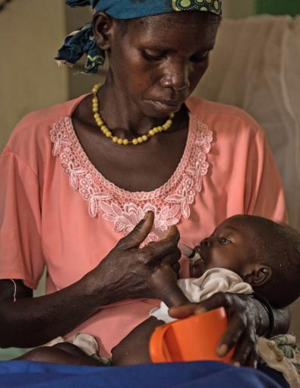
UN Reports Critical Food Emergency
Jun 14, 2019
According to three UN agencies -- Food and Agriculture Organization of the United Nations (FAO), the United Nations Children's Fund (UNICEF), and the World Food Programme (WFP) -- South Sudan is facing a food crisis, with roughly 61% of the population suffering from food insecurity.
According to the Integrated Food Security Phase Classification (IPC), "an estimated 6.96 million South Sudanese will face acute levels of food insecurity or worse (IPC Phases 3, 4 and 5) by the end of July [2019].”
"An estimated 21,000 people will likely face a catastrophic lack of food access (IPC Phase 5, the highest level in the five-step classification), while about 1.82 million will face Emergency (IPC Phase 4) and another 5.12 million people will face Crisis (IPC Phase 3) levels of food insecurity."

Slide 73
Rebel and Government Forces Allegedly Kill Over 100 Civilians
Jul 3, 2019
According to a report released by the Human Rights division of the United Nations Mission in South Sudan (UNMISS), 104 civilians were killed and "almost the same number of women and girls were raped or suffered other sexual violence."
The report documented "95 separate incidents of violations and abuses in the period from September 2018 until April 2019. These incidents included 30 attacks on villages and led to the killing of 104 civilians and wounding of another 35 as well as the abduction of 187 people."
UNMISS alleged the groups responsible for the brutal violations as: "opposition armed groups who are not signatories to the R-ARCSS (such as the National Salvation Front (NAS), the South Sudan National Movement for Change (SSNMC) and affiliated armed groups/elements); Government armed forces; and the pro-Riek Machar Sudan People’s Liberation Army in Opposition (SPLA-IO/RM)."

Slide 74
Sudan Military and Civilians Sign Peace Deal
Jul 17, 2019
The Sudanese military and civilians have signed a deal to end deadly turmoil after the military ousted President Omar al-Bashir.
According to the BBC, under the deal, the following has been agreed to "The two sides have agreed to rotate control of the sovereign council for just over three years. That council will be made of five civilians, five military figures, and an 11th civilian, to be chosen by the 10 members. A military general will be in charge of that council for the first 21 months, then a civilian will lead for the following 18 months, followed by elections. They also agreed that there will be a cabinet in which the prime minister will be chosen by the protesters and two key posts - defence and interior minister - will be nominated by the military. The military has been pushing for immunity from prosecution after protesters' deaths, but this is absent from the signed deal. It does, however, promise an investigation into the violence."

Slide 75
"Militiamen" gang-rape two Darfur girls
Jul 18, 2019
Allegedly, two girls were gang-raped by government militiamen when returning home from work. The girls were found by a rescue team, immediately taken to a hospital, and a complaint was filed with the police station.

Slide 76
First Ebola Case Detected in South Sudan
Jul 20, 2019

Slide 77
Protestors Arrested in South Darfur
Jul 22, 2019
"The Darfur Bar Association condemned the arrest of six people from Katila in South Darfur for organising a protest in front of the locality building. The protestors demanded the removal of the leaders of the former regime in the locality. The six protestors have been taken to the state capital of Nyala."

Slide 78
Five Children Killed in South Darfur Armed Raid
Jul 24, 2019
Five children were killed, others injured, and three were abducted by gunmen. The gunmen were alleged to have stolen cash, property, goods, and 11 donkeys.

Slide 79
32 Children Released From Opposition Groups in South Sudan
Jul 24, 2019
"Yesterday, 32 children were released from armed opposition groups in Leer county, in northern South Sudan. This is the first formal release in former Unity State, one of the areas hardest hit by the conflict. The children are all boys aged between 13 and 17."
"The children were formally separated from the armed group during a ceremony in Leer, witnessed by parents and community members. Some of the children have been used by the armed groups since the conflict flared up in 2016 and have not seen their parents since."

Slide 80
South Sudan To Pursue Criminals In Refugee Camps
Jul 24, 2019
"South Sudan army’s 7th Division commander in Torit State, Brig Gen Khulang Jarif Chuol, has requested the Ugandan authorities to allow South Sudanese security operatives to pursue criminals hiding in Uganda refugee camps."
The request was made to address issues with deteriorating border security that was being infiltrated by criminals.

Slide 81
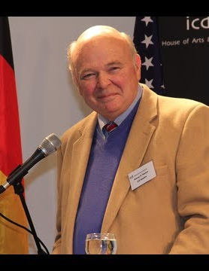
Dr. Stanton on South Sudan's Genocide
In a 2017 TEDx Talk, Dr. Stanton, founder of Genocide Watch, stated:
"Genocide is the crime of crimes. It is the intentional destruction, in whole or in part, of a national, ethnic, racial, or religious group. It is the worst crime against all of humanity because it literally diminishes the diversity of the human race."

Slide 82
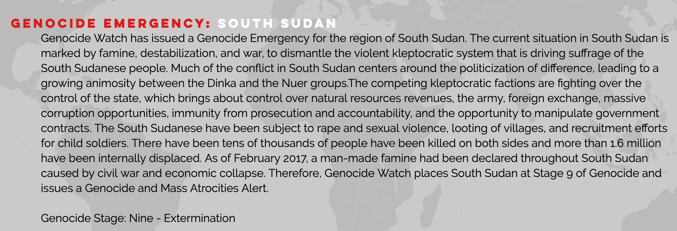
Ten Stages of Genocide
Dr. Gregory Stanton, Founding President and Legal Director of Genocide Watch, created the Ten Stages of Genocide. The stages are:
1. Classification
2. Symbolization
3. Discrimination
4. Dehumanization
5. Organization
6. Polarization
7. Preparation
8. Persecution
​9. Extermination
10. Denial

Slide 83
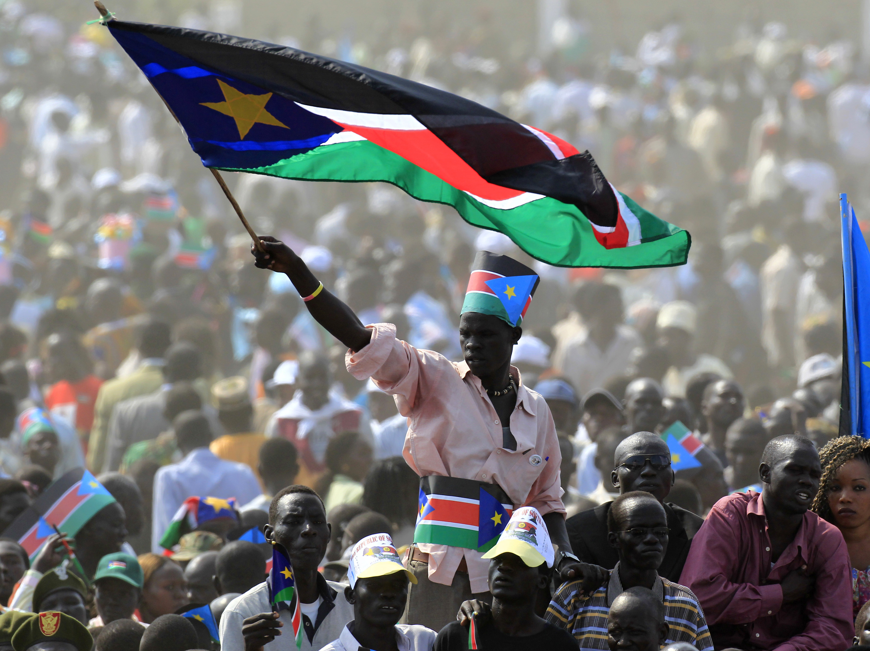
Summary
South Sudan's "Civil War" began in 2013 after Riek Machar, the former Vice President and an ethnic Nuer was dismissed by President Salva Kiir, an ethnic Dinka which resulted in many violent clashes from both the Nuers and Dinkas.
In 2016, the UNHCR declared the situation in South Sudan to have many indicators that pointed to what could develop into a genocide.
Many peace agreements have been signed between the rival parties in South Sudan, but violence still continues.
Due to the continued targeting of civilians, the situation in South Sudan has been classified as a genocide emergency.

