Slide 1
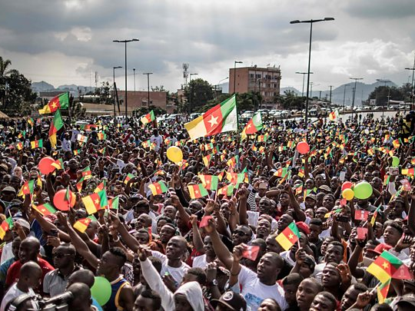
Cameroon’s Anglophone Crisis
Since late 2016, fighting between government security forces and armed separatist groups has raged in Cameroon's Anglophone regions. What began as peaceful civil rights demonstrations by the country's Anglophone minority has transformed into a violent conflict after security forces cracked down on the protests. The violence that ensued has killed at least 3,000 people and displaced another 700,000 Anglophones. The Anglophone crisis has already progressed into all Ten Stages of Genocide and the conflict shows no signs of abating.

Slide 2
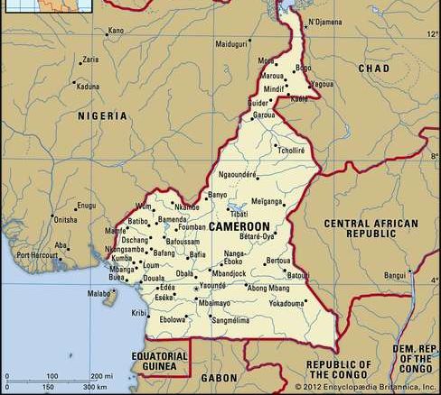
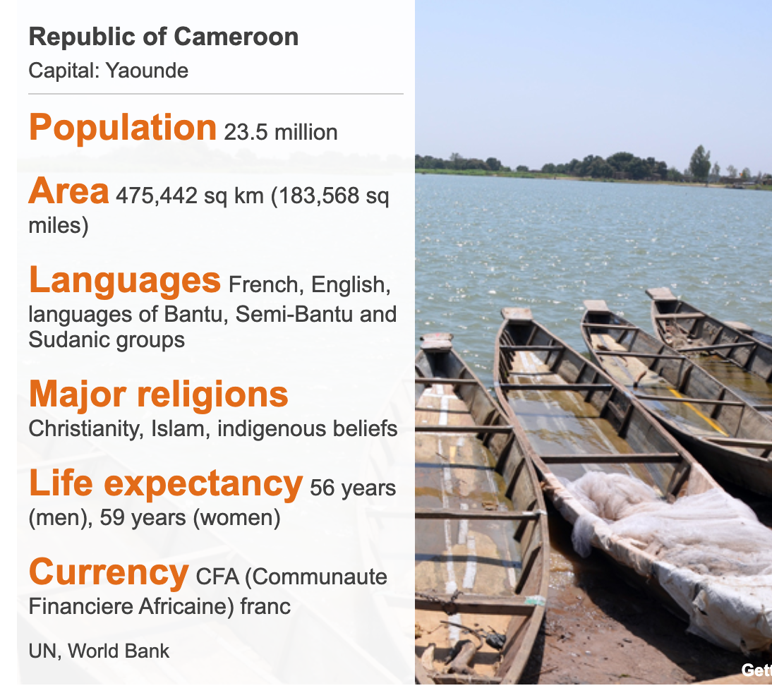
Country Profile
1884 to Present
Kamerun became a Germany colony in 1884. In 1919, after World War I, Cameroun was ceded to, and partitioned by, France and Britain. This colonial legacy has had a lasting impact, as present-day Cameroon is divided along cultural, political, and linguistic lines based on the colonial powers that oversaw Francophone and Anglophone Cameroon.
Today, ~80% of Cameroonians are French-speakers (Francophones), and live in Eastern Cameroon. The remaining 20% are English-speakers (Anglophones) and live in Western Cameroon.

Slide 3
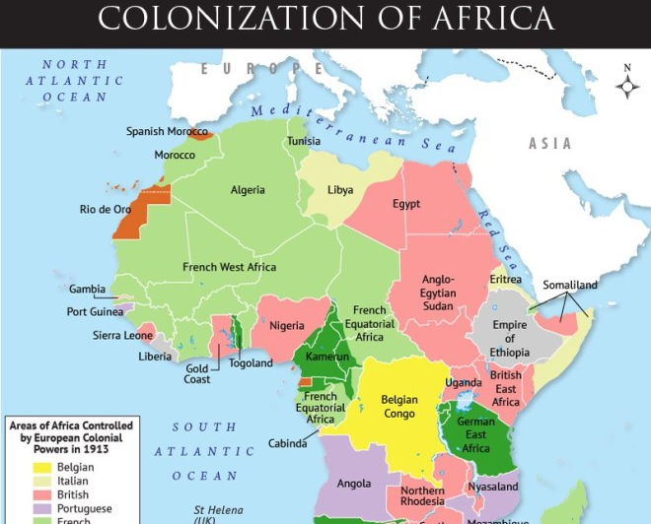
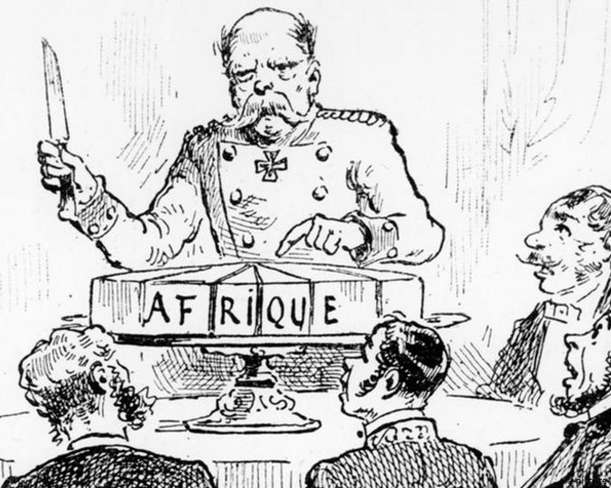
Kamerun Becomes a German Colony
June 1884 to February 1916
Kamerun came under the rule of the German Empire in 1884 during a renewed period of European colonialism known as the “Scramble for Africa.
Kamerun, as it was known then, remained a German colony until 1916 when losses in World War I forced Germany to cede the territory to France and Britain.

Slide 4
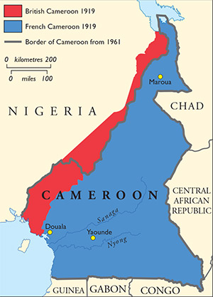
The League of Nations Partitions Cameroon Between Britain and France
June 1919 to December 31, 1960
The League of Nations ceded Kamerun to Britain and France to jointly govern. Instead, they divided the territory.
After the partition, the region bordering Nigeria became British Cameroons and the remainder of the territory became French-administrated Cameroun.

Slide 5
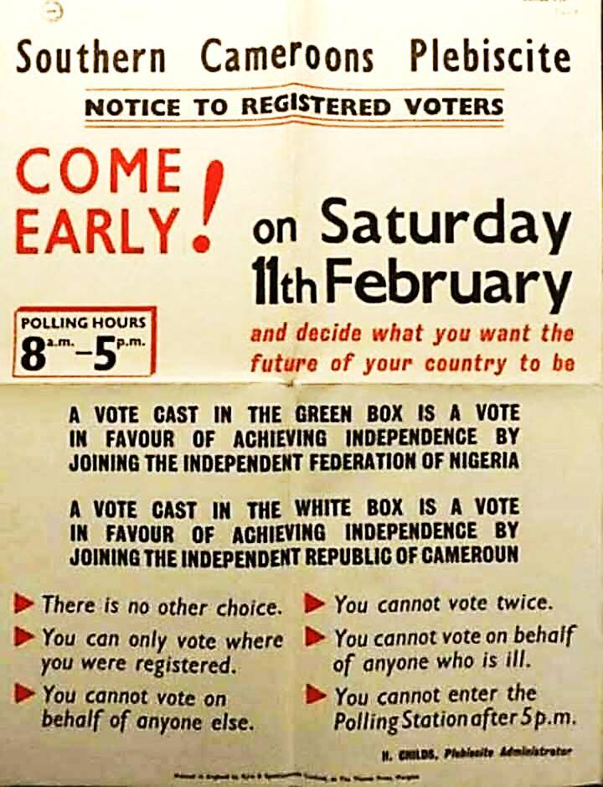
Independence for French Cameroun and British Cameroons
January 1, 1960 to February 11, 1961
Cameroun gained independence from the French on Jan 1, 1960.
On February 11, 1961, an UN-backed plebiscite was organized to decide on the fate of British Cameroons. Southern Cameroon voted for unification with French Cameroun. Northern Cameroon voted to become part of Nigeria.

Slide 6
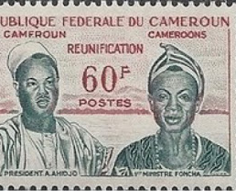

Reunification and Formation of the Federal Republic of Cameroon
October 1, 1961
Southern Cameroon joined the Republic of Cameroon, creating the Federal Republic of Cameroon.
The Federal Republic of Cameroon was founded on the principles of bilingualism, multiculturalism, and autonomy for both the English-speaking and French-speaking regions.
Stage 1 and 2: Classification and Symbolization

Slide 7

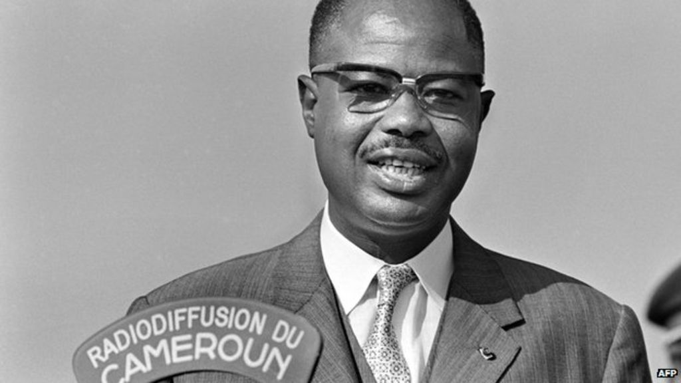
Abolition of the Federal System
May 1972
Cameroon's first President, Ahmadou Ahidjo, ended the country's federal system in favor of a unitary republic. This decision effectively stripped the country’s 20% English-speaking minority of the autonomous status promised to them in 1961. English speakers lost any power over decisions by the French-speaking majority in the capital, Yaoundé.
In 2017, President Paul Biya imposed French-speaking judges and administrative officials on English-speaking Western Cameroon. Trials and official busines were conducted in French, a language very few Western Cameroonians could speak.
Stage 3: Discrimination

Slide 8
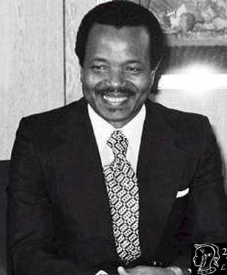
Paul Biya Becomes President
November 1982
Ahidjo stepped down on November 4, 1982. He was succeeded by Prime Minister Paul Biya. Though Ahidjo resigned, he intended to remain a powerful influence over the government by retaining control over the sole political party in the country, UNC. Biya then turned on Ahidjo, accusing him of plotting a coup. This forced Ahidjo into exile.
Biya was formally elected president in 1984, winning 99.98% of the vote as the only candidate. Biya has remained in power ever since, winning highly flawed elections in 1992, 1997, 2004, 2011, and 2018.

Slide 9
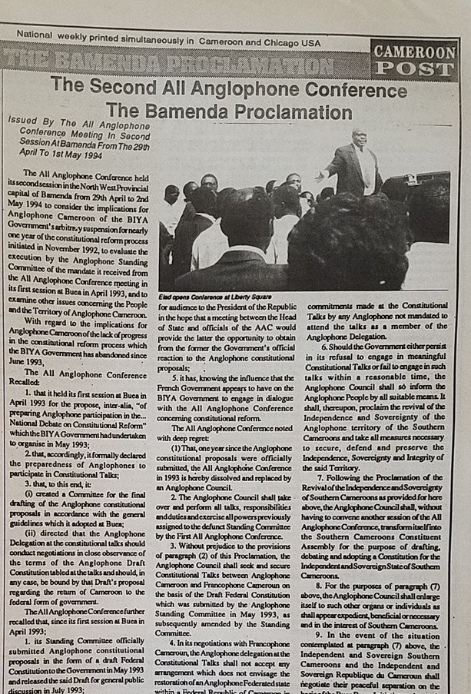
All Anglophone Conference Demands Return to Federalism
March 1993 to May 1994
Leaders of the Anglophone community met to outline their demands for a return to federalism. This meeting laid the foundation for future secessionist activity. The AAC threatened to take more extreme measures if the Francophone-led government did not uphold their rights.

Slide 10
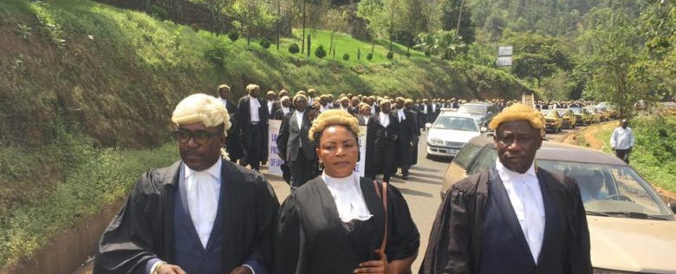
Anglophone Lawyers Renew Call for Federalism
May 2015
Citing attempts by the government to prioritize the French language and legal system in the courtroom, Anglophone lawyers took to the streets to demand the restoration of the federal system to protect the "history, heritage, education, and cultural values" of the Anglophone community.
Stage 3: Discrimination

Slide 11

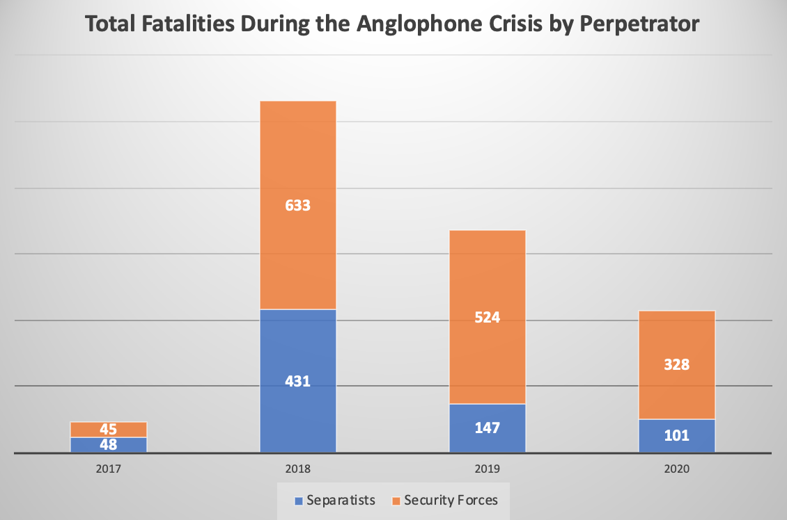
Anglophone Crisis Summary
August 2016
Western Cameroonian lawyers, government officials, and other citizens organized demonstrations, which were suppressed by French-speaking federal police.
Western Cameroonian separatist groups organized to seek secession from Cameroon. They obtained weapons from private sources in Nigeria.
Fighting between separatists and security forces escalated in late 2017 in Cameroon’s Anglophone regions. Between 2017 and 2020, more than 3,000 people in Western Cameroon have been killed and nearly 700,000 Anglophones have been forced to flee from their homes.
What started as peaceful protests over the central government’s lack of recognition of the cultural, political, and linguistic rights of Anglophones has become violent.

Slide 12
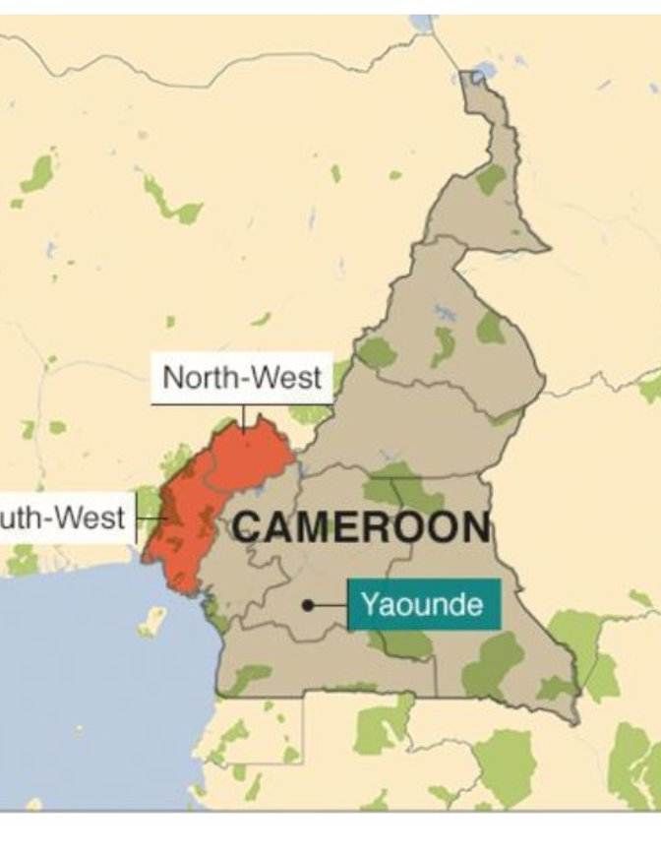
Protests Begin
September 2016
Anglophone lawyers protested cuts to the civil court system in Western Cameroon.
Cuts included a reduction in English translations in courts, replacement of English-speaking judges with Francophone judges, and cuts in budgets for the Anglophone legal system.
Teachers joined the protest over cuts to budgets for English-speaking schools in Western Cameroon.

Slide 13
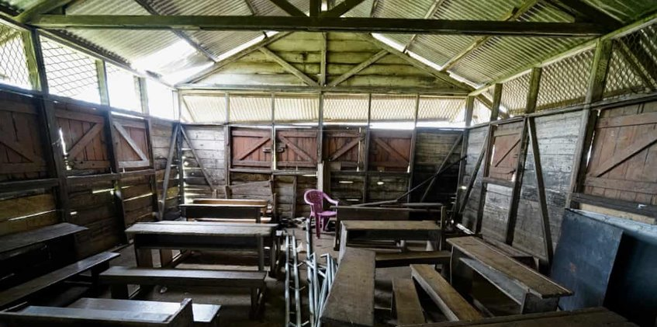
School Shutdowns
November 2016 to Present
Most schools in the Anglophone regions have closed during the last 3 years, amid continuous attacks from separatists. More than 855,000 children remain out of school.
The largest incident occurred on February 16, 2020 when 176 students and staff members were kidnapped in Kumbo.
Stage 8: Persecution

Slide 14
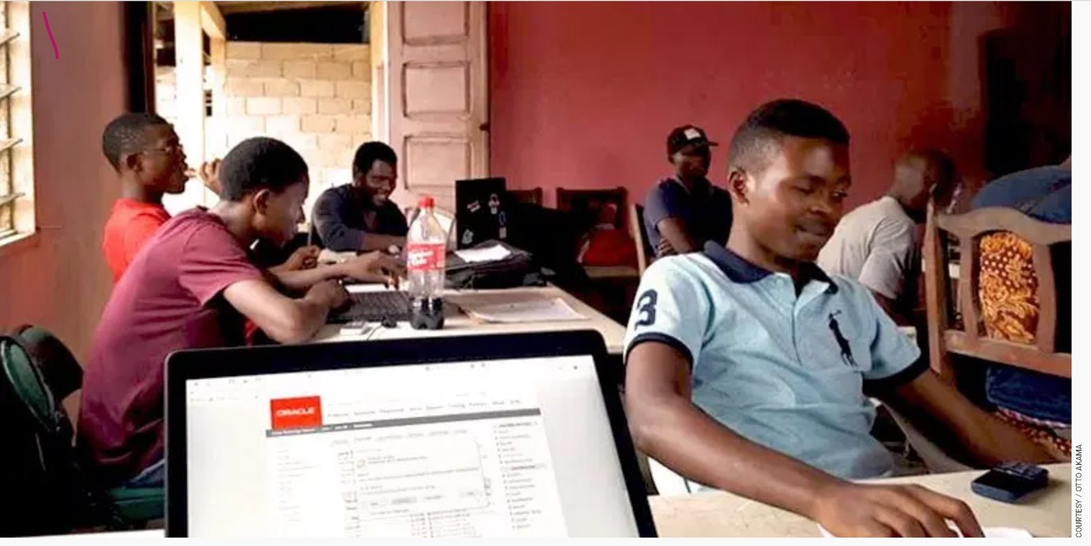
Bans & Internet Shutdown
December 2016 to April 2017
The government moved to ban the Cameroon Anglophone Civil Society Consortium by arresting members and activists and instated a ban on the internet in the north-west and south-west regions of the country that lasted until April 2017.
Stage 6: Polarization

Slide 15
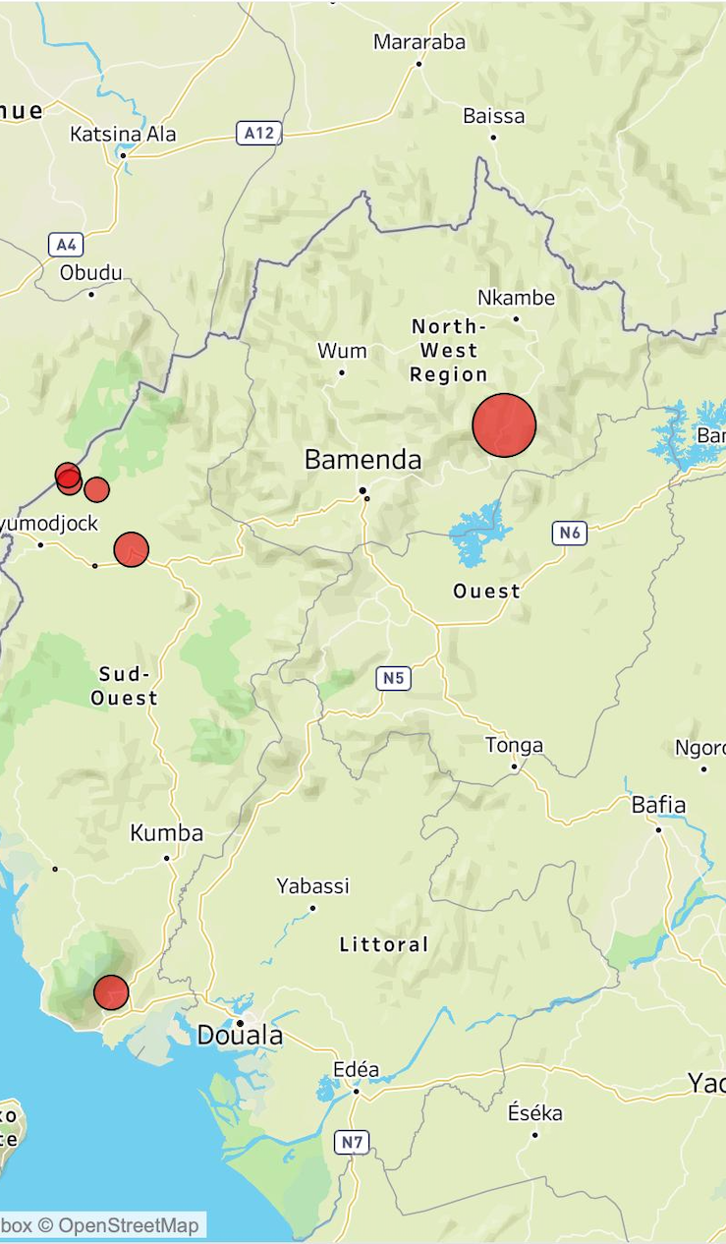
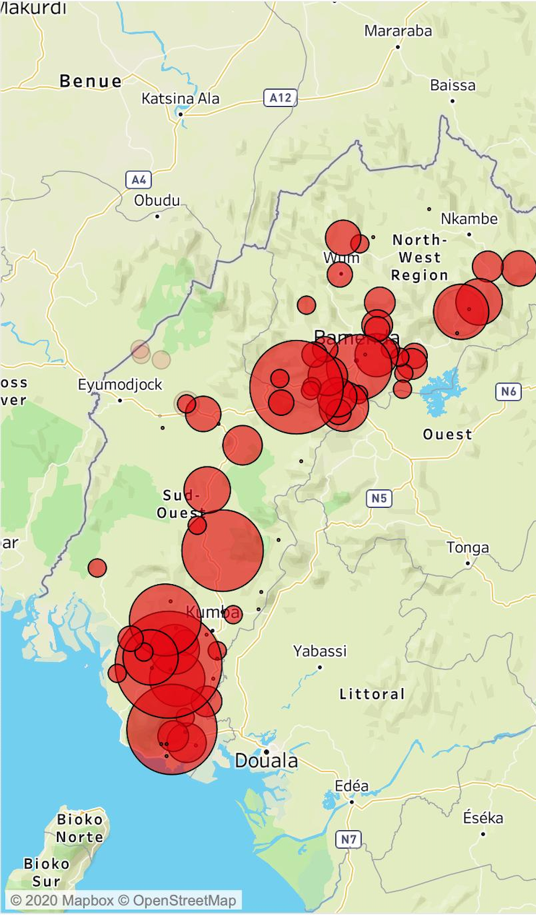
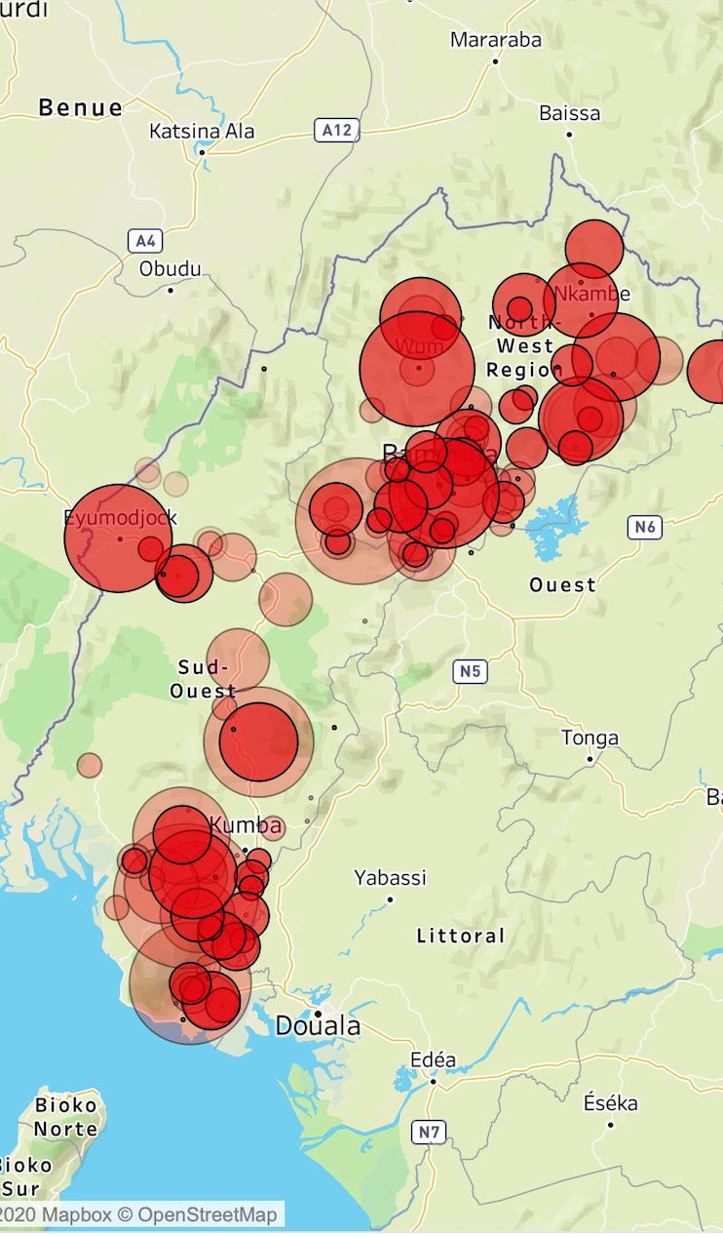
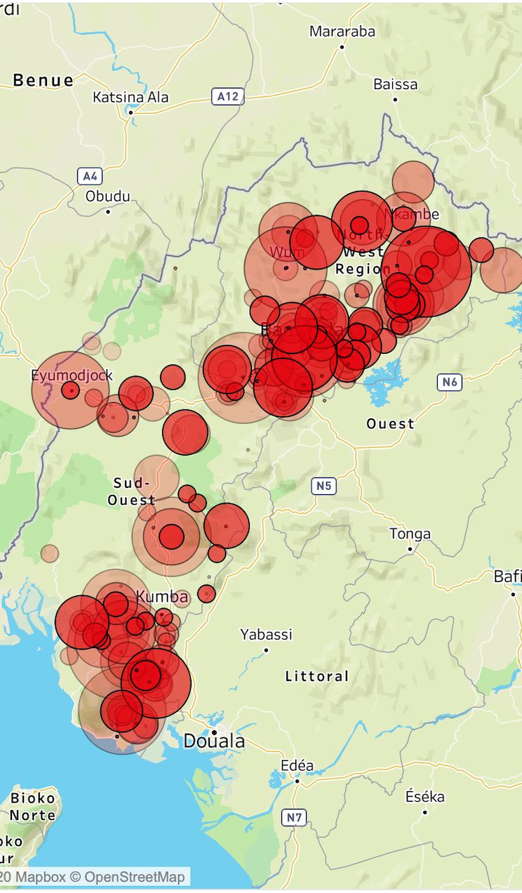
Civilians Killed During the Crisis
January 2017 to June 2020
Deadly fighting has ensued between security forces and armed separatists.
Separatists have committed atrocities against the federal police.
Police have brutally killed at least 900 Anglophone civilians. The death toll has climbed every year.
This number of deaths is almost certainly an undercount because the instability in the Anglophone region has rendered it largely inaccessible to journalists and rights groups.

Slide 16
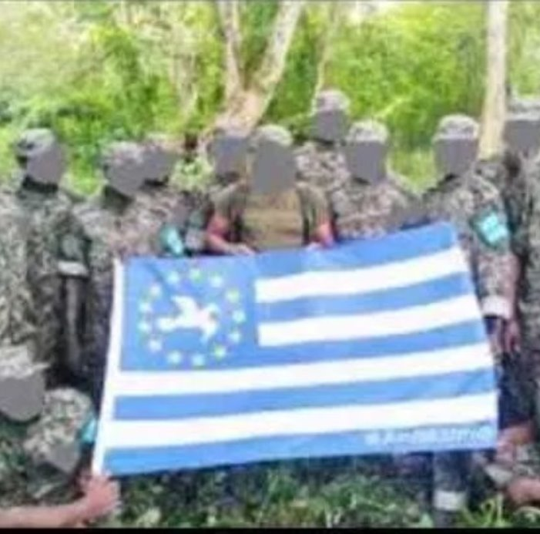
Creation of the Ambazonia Defence Forces
August 2017
The Ambazonia Defence Council announced the establishment and deployment of the Ambazonian Defence Forces (ADF) on September 9, 2017.
The ADF carried out a guerilla attack against a Cameroonian military base in Besongabang, Manyu Division.
The ADF claimed responsibility for a bomb that targeted Cameroonian security forces.
On September 21, an ADF bomb wounded 3 Cameroonian soldiers in Bamenda. The regional governor referred to the attack as an act of terrorism.
Stage 5: Organization

Slide 17
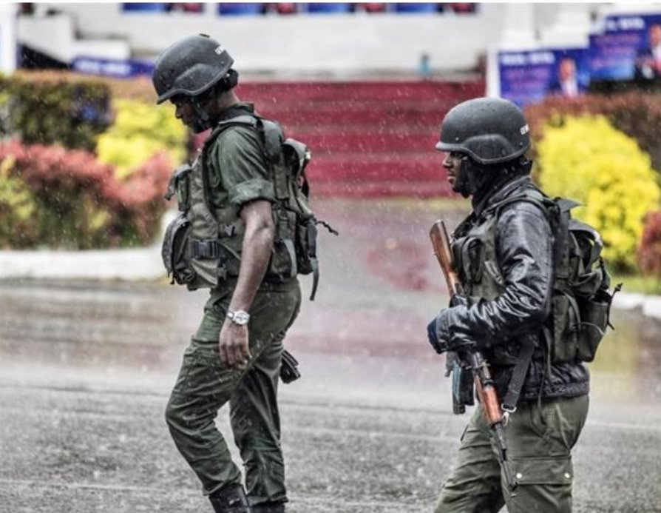
Use of Anti-Terror Law to Restrict Journalists
September 2017
In September 2017, the Committee to Protect Journalists issued a statement accusing the Cameroonian government of using anti-terror laws enacted in 2014 to fight Boko Haram to intimidate media and prevent them from being critical of the regime. Under the act, at least 4 foreign journalists covering the Anglophone Crisis were imprisoned and beaten for their critical stance on the government's actions. Dozens of English journalists were also imprisoned.
Stage 5 and Stage 7: Organization and Preparation Stage 5 and Stage 7: Organization and Preparation

Slide 18

Anglophone Groups Declare Independence
September 2017 to October 31, 2017
Armed separatist groups, including the Ambazonia Restoration Forces (ARF), declared independence from Francophone Cameroon on October 1, 2017.
The government labeled the separatist groups as “terrorists.”
On a radio show, President Paul Biya declared war on the separatist groups.
Stages 4, 5, and 6: Dehumanization, Organization, and Polarization.

Slide 19
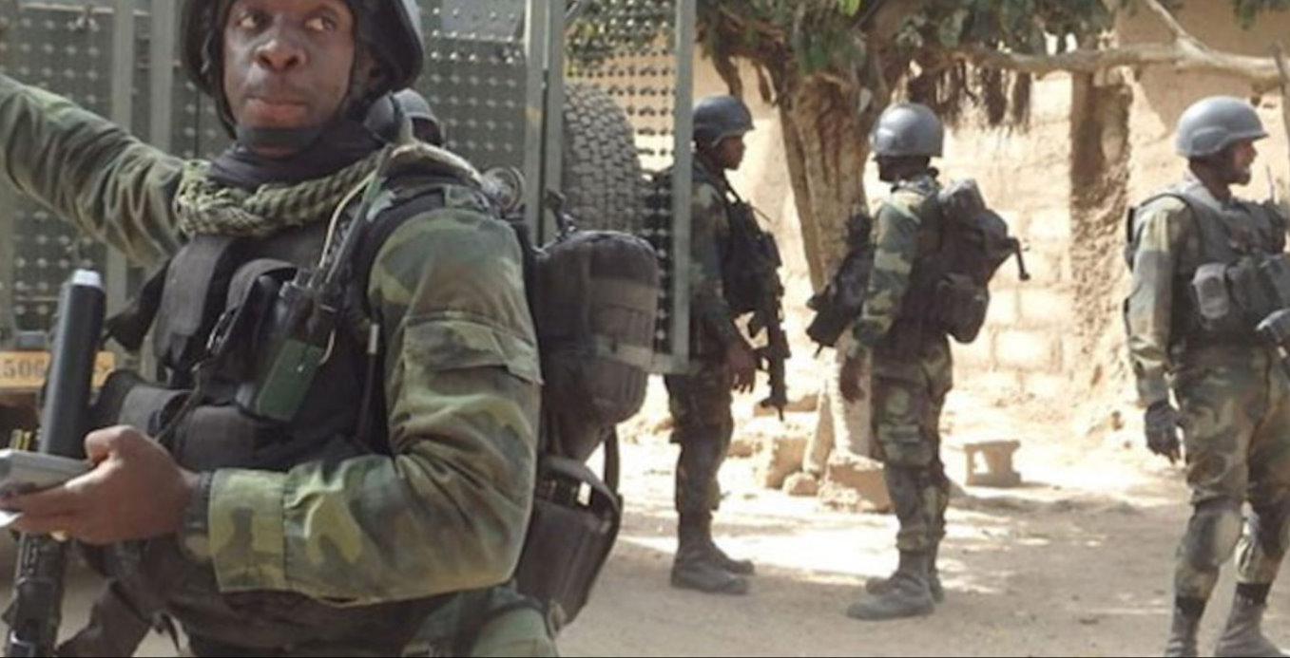

Shooting of Separatist Protesters
September 30, 2017 to October 2, 2017
In October 2017, the Cameroonian army fired tear gas and live rounds from helicopters into separatist crowds in the Anglophone regions.
Amnesty International reported more than 20 killed during these events from October 1- October 2, 2017.
The government denies these claims.
Stage 7 and 10: Persecution and Denial

Slide 20
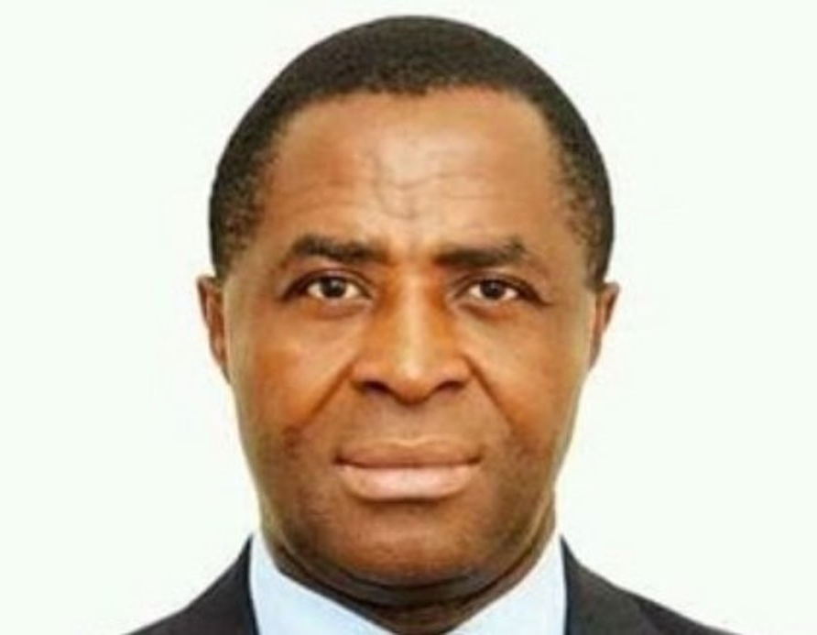
Arrest Warrants Issued for Separatist Leaders
October 2017
Cameroon issued international arrest warrants for 15 separatist leaders, including the president of the Anglophone consortium, Sisiku Ayuk Tabe, who was later sentenced to life in prison.
November 2017 brought conflicts between Cambodian and separatist groups, with violent acts committed by both sides. Throughout the month, 8 soldiers, 14 civilians, and 5 fugitives were killed in conflicts, however, news reports indicate more fatalities than those recorded. Stage 6: Polarization

Slide 21
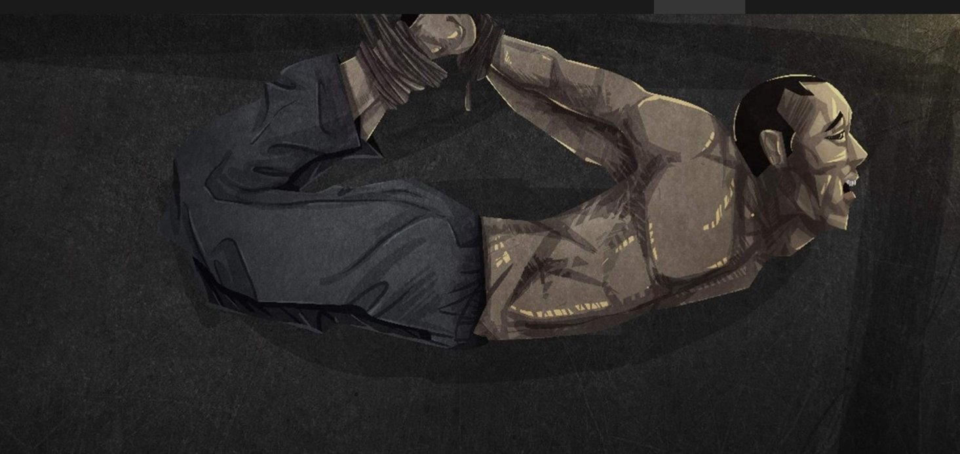
Violence and Arrests in Dadi
December 12, 2017 to December 16, 2017
Approximately 23 civilians were arrested in Dadi and held for 3 days, during which time they were taken from their homes, blindfolded, beaten, and tortured. They were charged with secession, incitement to commit violence, and terrorism.
Stage 6 and Stage 8: Polarization and Persecution

Slide 22
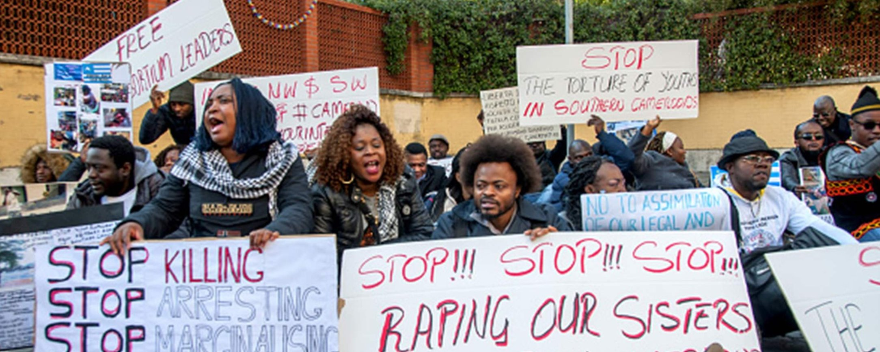
Village Raid, Arson, & Executions in South West Region
December 13, 2017
In the first half of 2017, Cameroonian troops went into the Bodam region and the village of Kajifu where they conducted raids, burnt or destroyed property, and committed unlawful killings in response to resistance movements that had been occurring.
Stage 8: Persecution

Slide 23
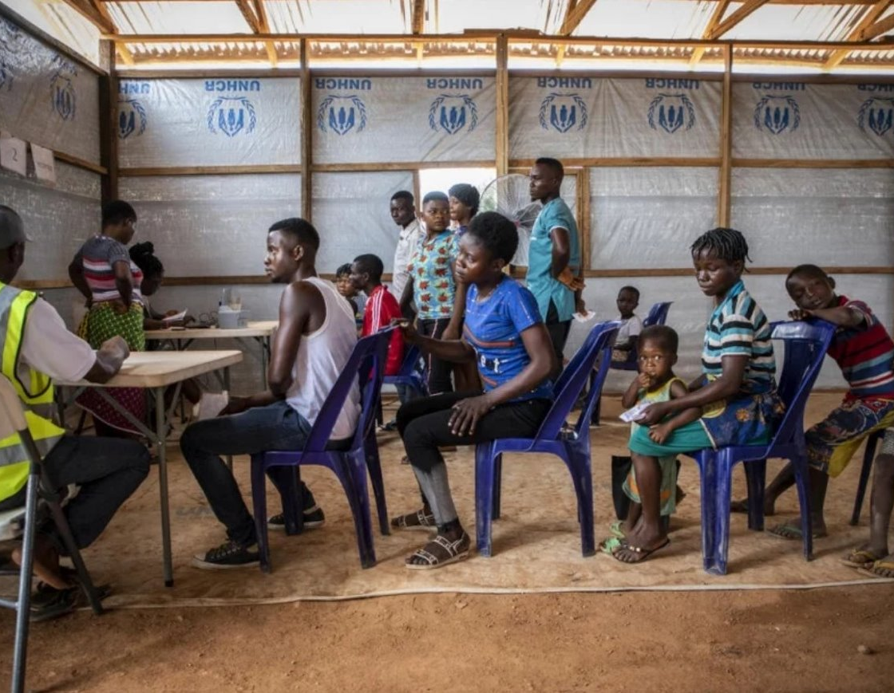
Displacements in First 18 Months of Conflict
April 2018
160,000 people have been internally displaced in the first 18 months of the conflict. 80% of displaced people have found refuge in the forest. More than 21,000 Cameroonians have also been registered as refugees in the Cross River, Benue and Akwa Ibom States in Nigeria. Displacements have affected their ability to access food and clean drinking water, health services, shelter, education and protection.
Stage 8: Persecution

Slide 24
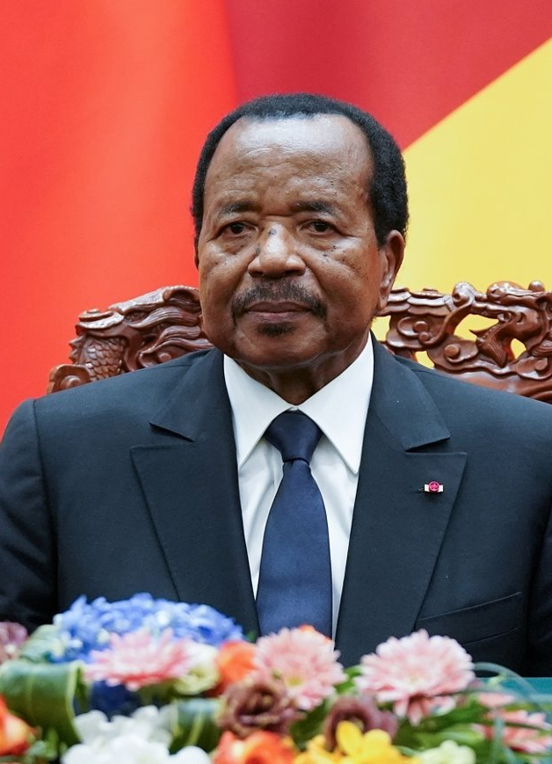
Re-Election of President Biya
October 2018
In October 2018, the re-election of President Biya was announced for his 7th term in office. The election had a very low voter turnout, particularly within Anglophone communities due to threats of violence. Some activists were placed on house arrest in advance of the elections to ensure they could not participate. Opposition groups were also silenced in advance of the elections.

Slide 25
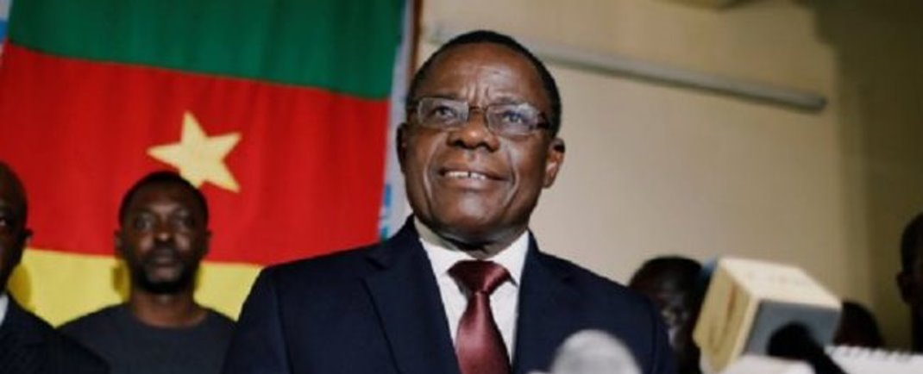
Opposition Leader's Arrest
January 25, 2019
After the presidential elections, Maurice Kamto, leader of the Cameroon Renaissance Movement (MRC), claimed that the official results were rigged. His party organized several mass demonstrations across the country. The protesters’ demands included ceasing the violence in the anglophone regions. Hundreds of members of the opposition were arrested and Kamto was prosecuted for eight different charges, including sedition.
Stage 6: Polarization

Slide 26
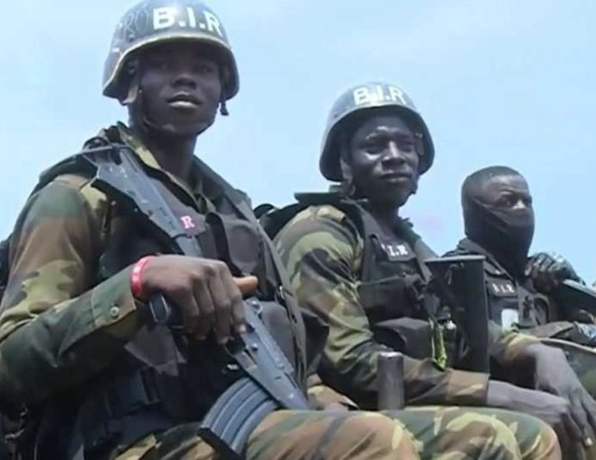
New BIR Attacks
January 2019 to Present
There have recently been numerous reports of killings, destruction of property, and torture perpetrated by security forces, notably the Rapid Intervention Battalion (BIR), an elite unit supported by the US. The government maintained a dismissive public attitude towards the crimes but failed to investigate and punish them.
Stage 9: Extermination

Slide 27
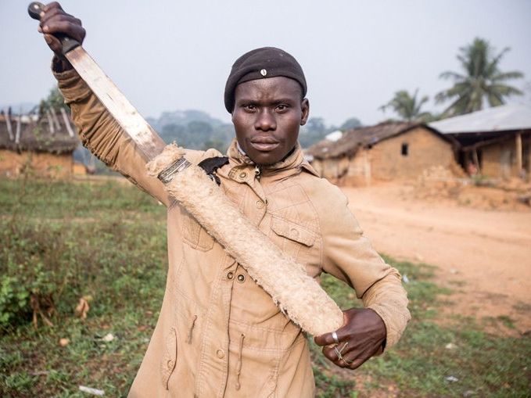
New Armed Separatists Attacks
January 2019 to Present
Human rights groups have accused armed separatists of attacking security forces and burning down schools, among other abuses. Abduction has become one of their main weapons since the beginning of the conflict. Their victims include students, teachers, clergy and politicians.
Stage 9: Extermination

Slide 28

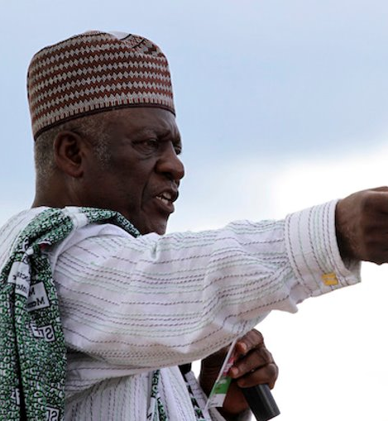
Fru Ndi Kidnapped
April 27, 2019 and June 28, 2019
On April 27, John Fru Ndi, historical leader of the Social Democratic Front (SDF) party, was kidnapped by the separatists, who apparently just wanted to talk with him. However, he was again abducted and beaten on June 28, after being accused of not supporting the cause.
Stage 6: Polarization

Slide 29
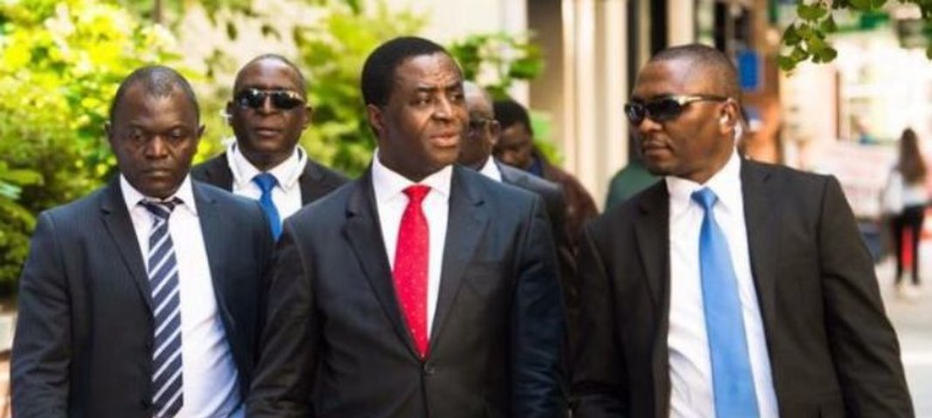
Life Sentence for Separatist Leaders
July 2019
Ten separatists' leaders were handed life sentence by a military court. They were found guilty of several charges, including terrorism and secession. Julius Ayuk Tabe, head of the movement and first self-proclaimed president of Ambazonia, was among them.
Stage 6: Polarization

Slide 30
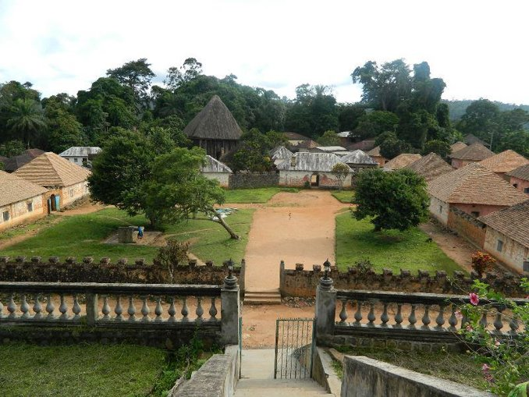
World Heritage Site Attacked
September 24, 2019
BIR soldiers attacked and looted the Royal Palace in Bafut, a UNESCO World Heritage site. They shot and wounded one man and took several precious artifacts from the museum.
Stage 9: Extermination

Slide 31
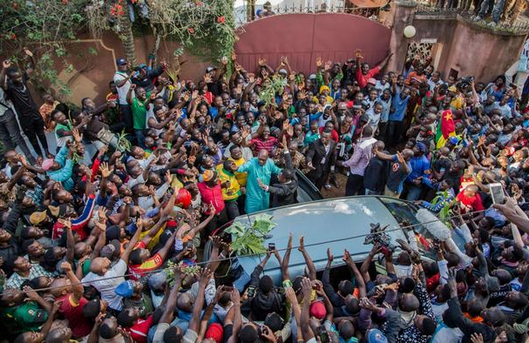
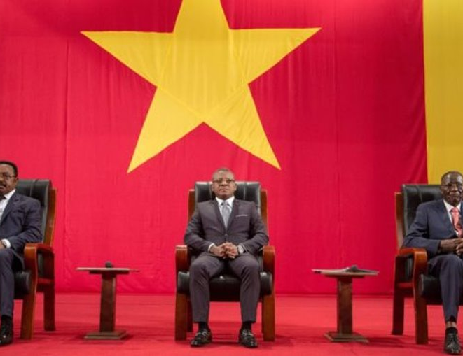
The National Dialogue
September 2019
Amid increasing violence and ongoing international pressure, President Paul Biya called for a national dialogue. The initiative achieved several proposals, including the adoption of a special status for the Anglophone regions. However, the separatists refused to attend the meetings and the interactions were severely controlled by the government. Nevertheless, the charges against hundreds of MRC members, including its leader, as well as individuals in connection with the Anglophone Crisis, were dropped.

Slide 32
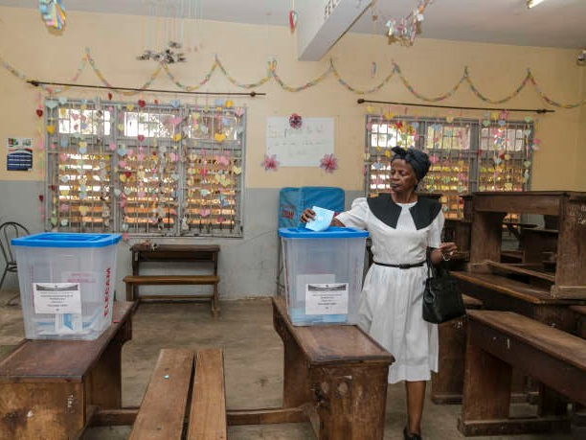
Legislative and Municipal Elections: Rise of Violence
February 8, 2020
Parliamentary and municipal elections were held on February 9, 2020. Since the announcement in November 2019, armed separatists called for a boycott of the vote in the Anglophone regions and proceeded to target those who challenged their decision. Therefore, participation in the Anglophone regions was very low. Security forces have continued perpetrating unlawful killings of civilians and the burning of villages.
Stage 7: Preparation

Slide 33
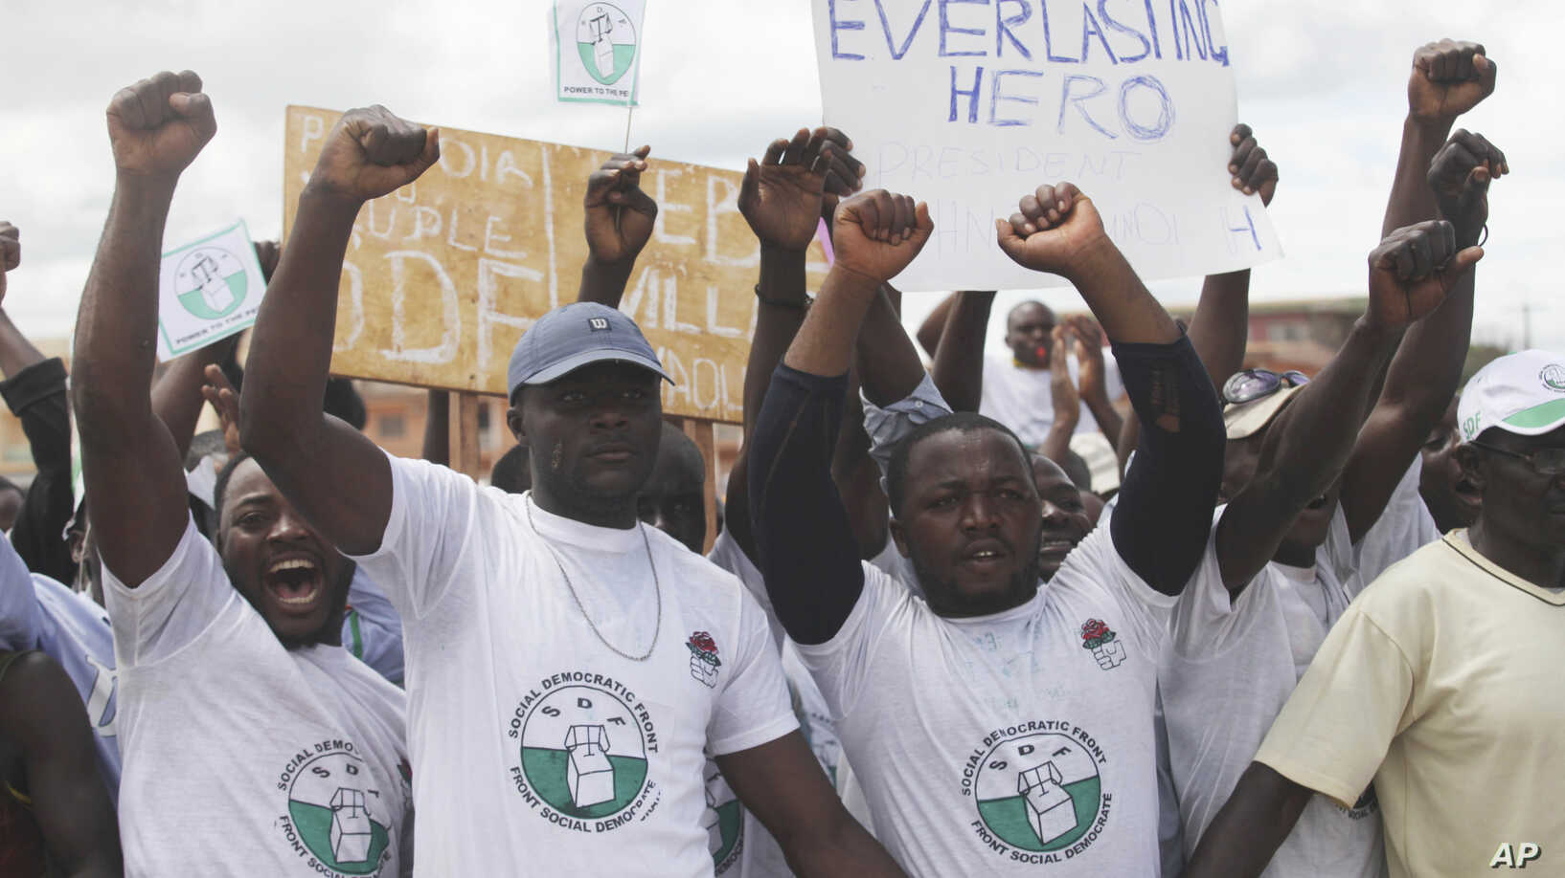
SDF Members Targeted
February 8, 2020
The SDF, a non-separatist advocate for the Anglophone cause, did not uphold the boycott of the elections. Its members and supporters were threatened and kidnapped, and some of their homes were burned.
Stage 7: Preparation

Slide 34
Ngarbuh Massacre
February 14, 2020
Government troops, along with Fulani armed groups, slaughtered at least 21 civilians, including 13 children and 1 pregnant woman in Ngarbuh village. The authorities initially denied the accusations but admitted in April that soldiers committed the murders, which is an important step in accountability.
Stage 9: Extermination

Slide 35
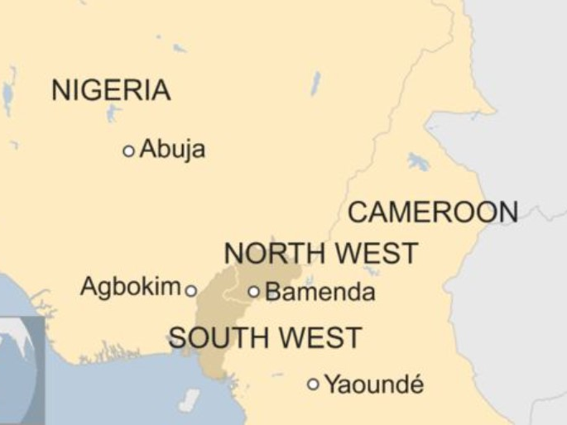
Status of Refugees
February 2020
By February 2020, the number of displaced persons has drastically increased; more than 679,000 people have been internally displaced in Cameroon’s Northwest and Southwest regions. Almost 60,000 people have crossed the border to seek asylum in Nigeria.
Stage 8: Persecution

Slide 36
UNSG Calls for Global Ceasefire to Help Combat COVID-19
March 23, 2020
UN Secretary-General released a plea to parties to conflict worldwide, to implement a ceasefire to more effectively work together and respond to the global COVID-19 pandemic. The Southern Cameroons Defense Forces announced on March 26 that they would observe the temporary ceasefire.

Slide 37
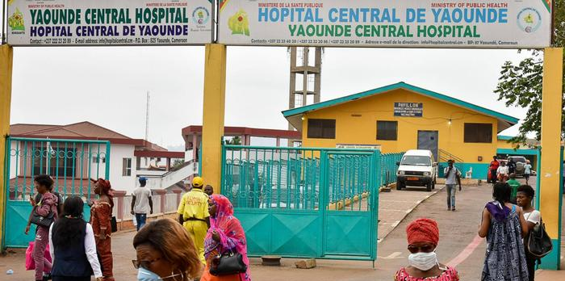
COVID-19: Reactions
The Southern Cameroons Defense Forces (SCDF), one of the active secessionist groups, unilaterally declared a ceasefire at the beginning of the COVID-19 crisis. However, none of the other militias followed this path, so the violence kept growing. President Paul Biya did not join the truce either and has banned all flights that carried humanitarian aid to the conflict areas. Donations and initiatives launched by the opposition are also forbidden.

Slide 38
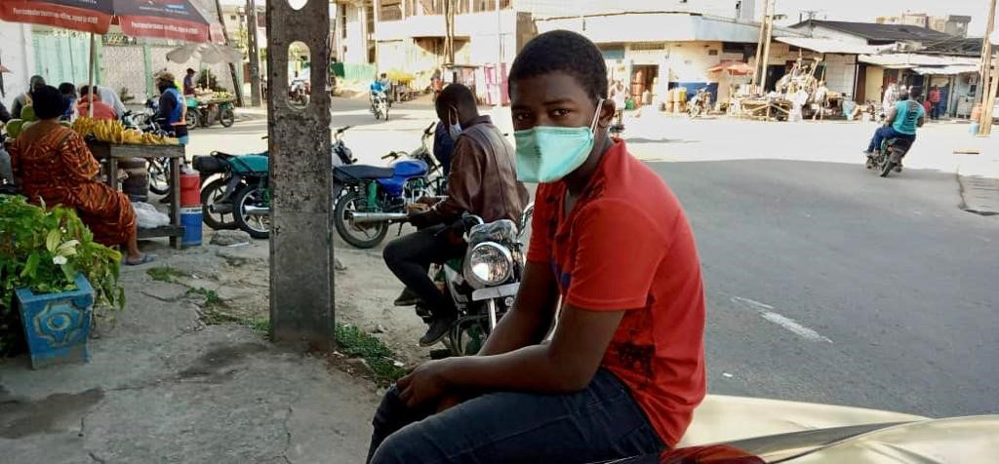
COVID-19: Resources and Victims
While Cameroon has reported the highest caseload of the virus in Central Africa, the risks are significantly higher for the Anglophone civilians: 34% of health facilities are non-functional or partially functional and medical personnel and supplies are limited. Among the most vulnerable are approximately 700,000 IDPs.

Slide 39

International Response & Mediation Attempts

Slide 40
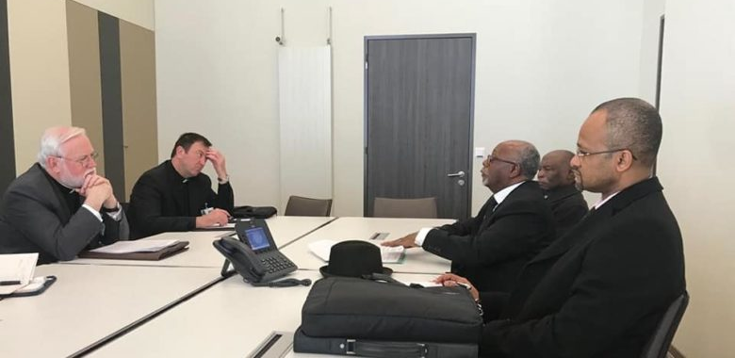
Vatican Mediation Efforts
February 2019
The Secretary for Relations with States offered the services of the Vatican to help mediate in the conflict during an audience with the Minister of External Relations of Cameroon.

Slide 41
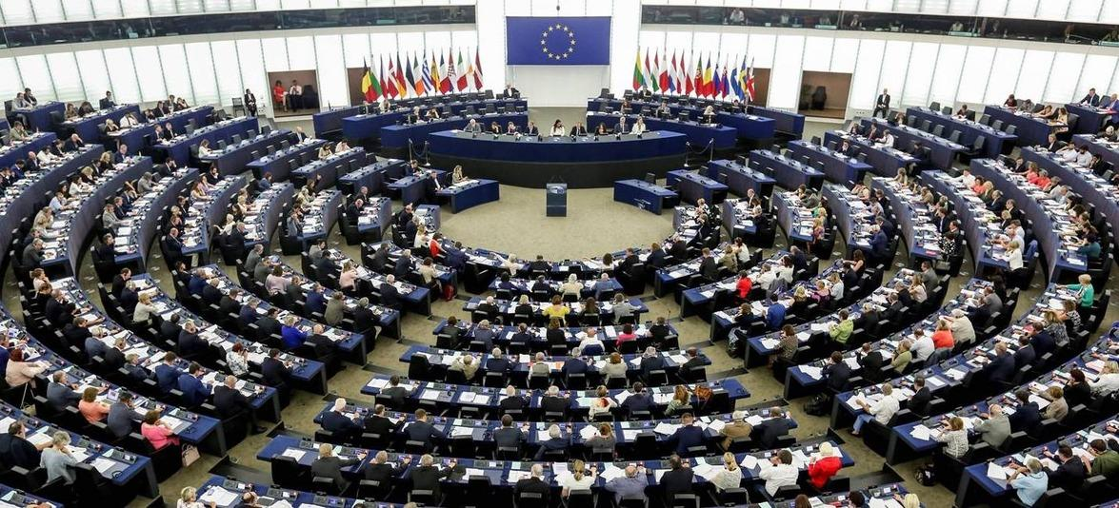
European Parliament Resolution
April 4, 2019
The European Parliament passed a resolution condemning the crimes, urging the authorities to adopt all necessary measures, and calling for the release of Maurice Kamto and other detainees.

Slide 42
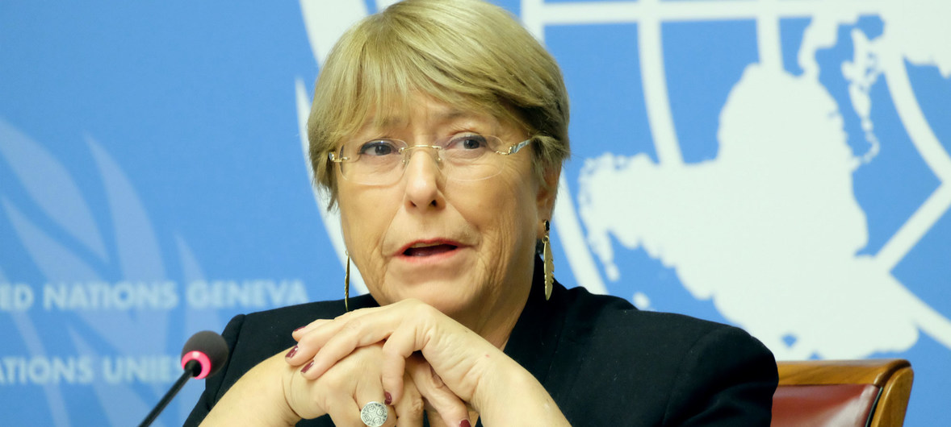
UN High Commissioner Visits Cameroon
May 2019
The UN High Commissioner for Human Rights Michelle Bachelet visited Cameroon in May 2019. She with reunited the President to address the challenges of the country and welcomed the government's willingness to cooperate with the UN.

Slide 43
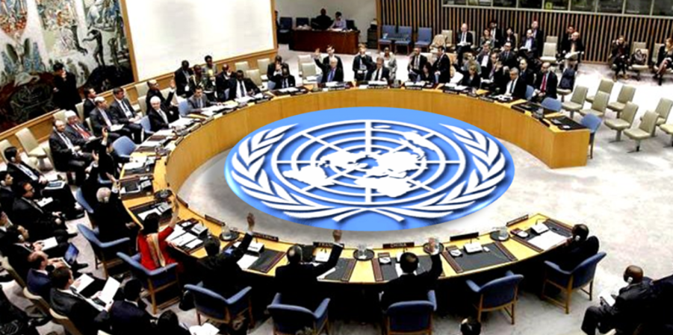
UNSC Informal Meeting
May 13, 2019
The United Nations Security Council held an informal meeting on the humanitarian situation in Cameroon.

Slide 44
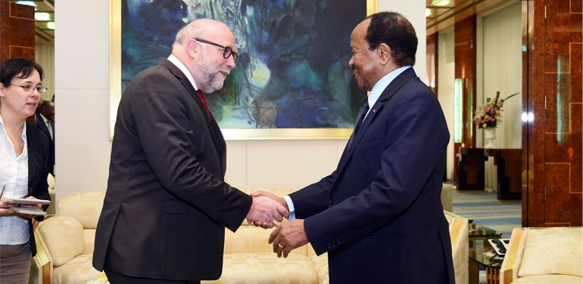
Germany Breaks Military Cooperation
July 2019
Germany announced the end of its military mission in Cameroon.

Slide 45
Swiss Mediation Efforts
June 27, 2019
Switzerland agreed to mediate talks between the government and the separatists in an attempt to reach a diplomatic solution to the crisis. Despite this offer, the two sides never agreed to come to the table.

Slide 46
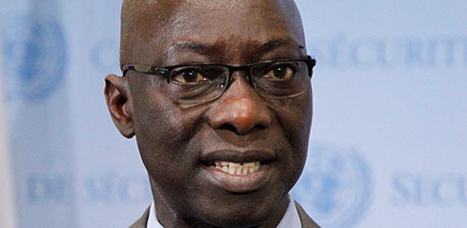
Senior UN Officials Raise Alarm
February 18, 2020 to February 21, 2020
After the horrific details of the Ngarbuh massacre by government security forces and allied militia members were publicized, UN officials, including Special Adviser on the Prevention of Genocide, Adama Dieng, and Secretary-General António Guterres, responded by condemning the actions and calling for civilian protection.

Slide 47
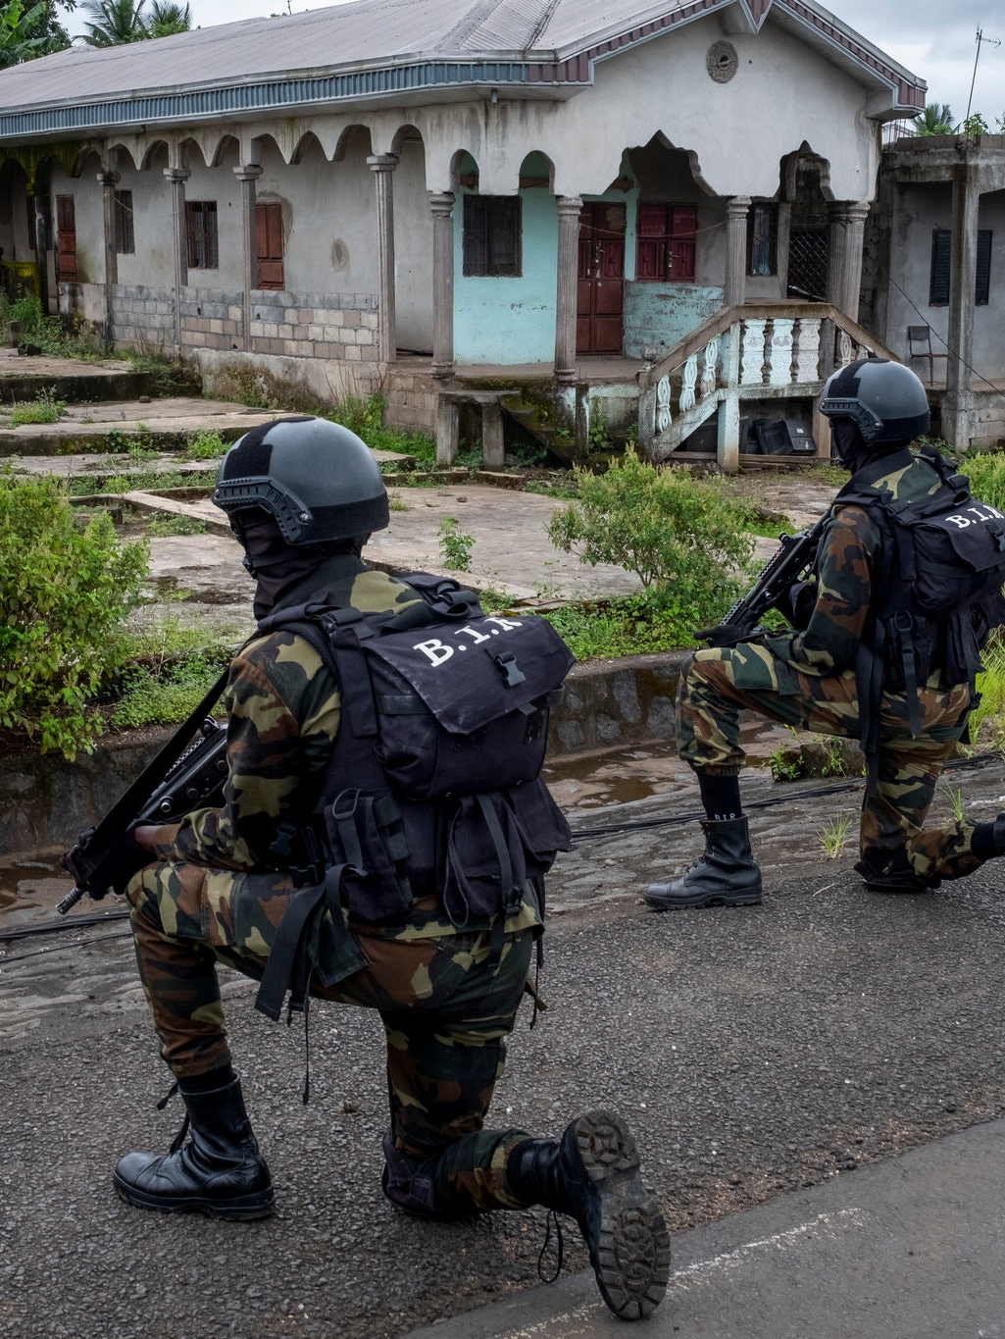
US Cuts Military Aid to Cameroon
February 7, 2019
Since 2013 the US has provided significant military aid and tactical support to assist Cameroon's efforts in the fight against Boko Haram. In response to widespread accusations of human rights abuses, many of which were taking place against Anglophones, the US cut $17 million in aid.

Slide 48
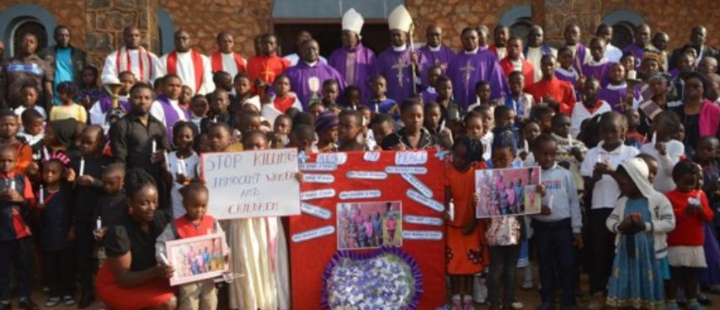
International Research/Investigations
January 2020
The UN and Human Rights Watch conducted research into killings related to the conflict. When they reviewed the findings of Cameroon's Joint Commission of Inquiry, they found that it diverged from the facts of the events at Ngarbuh established by Human Rights Watch and others. Additionally, the report established that Cameroonian soldiers attempted to cover up the truth around the killings.

Slide 49
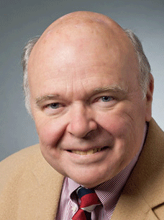
Ten Stages of Genocide
Dr. Gregory H. Stanton, Founding President of Genocide Watch, uses the Ten Stages of Genocide to describe and explain the genocidal process. The stages are:
1. Classification
2. Symbolization
3. Discrimination
4. Dehumanization
5. Organization
6. Polarization
7. Preparation
8. Persecution
​9. Extermination
10. Denial
The Anglophone crisis has advanced to:
Stage 9: Extermination, with massacres being perpetrated by both government security forces and armed separatist groups.
Stage 10: Denial, as the the government alleges, despite widespread evidence to the contrary, that it is only conducting operations against "terrorists" and not targeting civilians.

Slide 50

Conclusion and Policy Recommendations
To prevent genocide in Cameroon's Anglophone regions, Genocide Watch recommends that:
National, regional, and international actors recognize the urgency of the Anglophone crisis and exhaust all means available to encourage the government of Cameroon and the separatist groups to reach a diplomatic resolution.
Both the government and separatists end attacks on civilians and agree to a ceasefire, following the model of the Southern Cameroon Defense Forces who put down their weapons in March 2020 in accordance with UN Secretary General Guterres’ call for a global ceasefire to help combat COVID-19.
Both the government and separatists agree to participate in mediation efforts, sponsored by a third-party, aimed at achieving meaningful dialogue and realistic compromise.
An investigation is launched in conjunction with the AU or UN into crimes against humanity and other atrocities committed during the Anglophone crisis to end the ongoing cycle of impunity.

