Slide 1
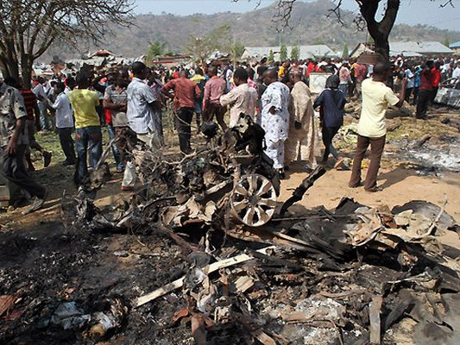
Summary of Events
The Fulani is the fourth largest ethnic group in Nigeria with over 18 million people and 270 clans. The Fulani are traditionally Muslim.
Historically, Fulani herdsmen enjoyed a symbiotic relationship with farming communities. Conflicts that arose between the groups were settled by community leaders.
In recent years, the Fulani have increasingly engaged in a violent land-grabbing policy motivated by extremist Islamic ideology, advanced through sophisticated weaponry.
Fulani jihadists have targeted Christian farmers in Northern and Middle Belt of Nigeria and committed mass rapes, murders, and torture.
After massacring Christian villagers and permanently displacing them, they occupy their homes and farmland with cattle.
Christian pastors and community leaders have been targeted, hundreds of churches destroyed, and the death toll of Christians continues to climb.

Slide 2
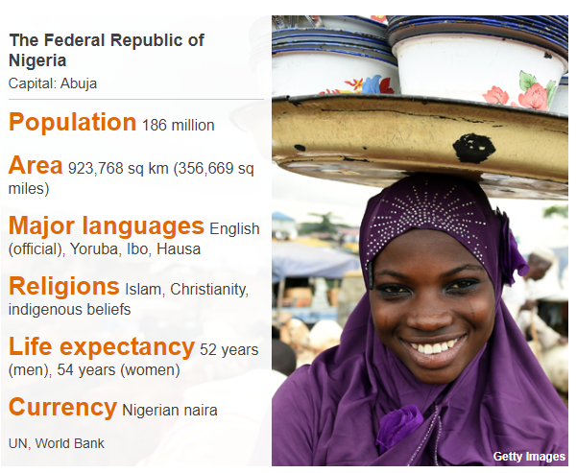
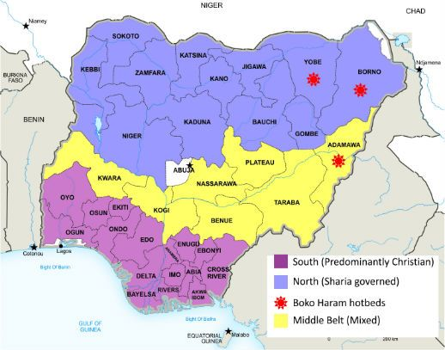
Nigeria Country Profile
The Federal Republic of Nigeria, informally known as Nigeria, is located in West Africa. Nigeria is a major political and economic force in the continent and one of the largest oil producers in the world. It is the most populous country in Africa with over 270 ethnic groups who speak more than 370 languages. It is estimated that half of the population is Muslim, 40-45% is Christian, and 5-10% practice indigenous religions. The population of Northern States is majority Muslim and Southern States is majority Christian.

Slide 3
Christian background
In the 19th century, the Sokoto Caliphate was established under Uthman dan Fodio. At this time, there were violent raids, many non-Muslims were enslaved from smaller tribes and the land was annexed for Fulani pastoral clans.
When the British conquered the Caliphate in 1903, it was the world's largest slave polity, with Fulani leaders preying on smaller tribes to feed the slave trade. The smaller tribes abandoned their traditional religions and turned to Christianity, but still remember the violence they experienced.

Slide 4
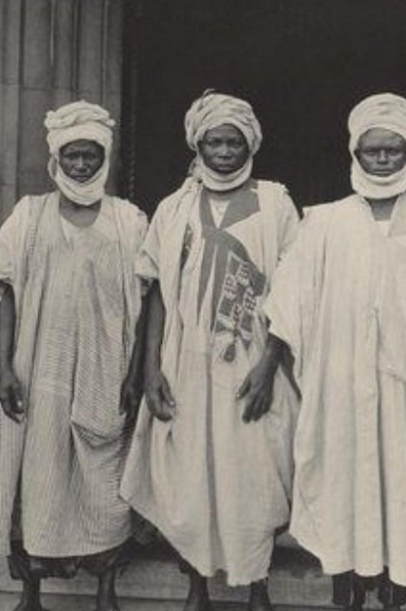
Key Events Timeline
1804-1903: The Sokoto Caliphate was an independent Sunni Muslim Caliphate in West Africa that was founded by Usman dan Fodio. During this time, Fulani jihads spread Islam across Northern Nigeria.
1903: The Sokoto Caliphate was abolished when the British conquered the area in 1903 and established the Northern Nigeria Protectorate.
2006-2014: Between 9,000 and 11,500 Christians were killed. More than a million were affected, with many driven from their homes and 13,000 churches destroyed or abandoned. The Fulani Jihadists rank fourth on the Global Terrorism Index.
2015: Muhammadu Buhari becomes the first opposition candidate to win a presidential election in Nigeria. He is an ethnic Fulani.
2018: According to the Global Terrorism Index (GTI), 2,040 Christians were killed by Fulani militia in 2018 alone.
2019: There were between 1000 and 1,200 Christian deaths in 2019.
Jan-Mar 2020: Over 400 Christians were murdered by Fulani militia.
At least 7,400 Christians have been massacred by Fulani militia since the Buhari Government of Nigeria came to power in 2015.

Slide 5

10 Stages of Genocide
Stage 3: Discrimination
In some Northern states, many Christians dress like Muslims to reduce the chances of being attacked. Christians are frequently denied access to higher education and are sometimes asked to give up their faith in order to get work.
Stage 6: Polarization
According to the expansionist principle of Dar al Islam (house of Islam), everything belongs to Allah directly and to his followers indirectly, including the land where the Fulani want to let their cattle graze.
Social media has been used to portray attacks from other countries as attacks occurring in Nigeria between Fulani and Christians, leading to heightened tensions.
Stage 8: Persecution
Christians in Northern Nigeria and the Middle Belt are facing extreme persecution by Fulani Jihadists and ISWAP. Twelve of the northern states are under Sharia law, and persecution has increased since the 2015 election of President Muhammadu Buhari. During attacks, Christian pastors and leaders are targeted, and survivors have reported hearing "Allah u Akbar," "destroy the infidels," and "wipe out the infidels" from their attackers.
Stage 9: Extermination
Christians in Nigeria are being killed because of their religion. Christian villages are targeted, and Christian homes and churches are burnt down. Christian girls and women have been kidnapped and enslaved as sex slaves, forced to convert to Islam.
Stage 10: Denial
Massacres against Christians are being explained away as disputes between farmers and herders despite clear group persecution based on religion.

Slide 6
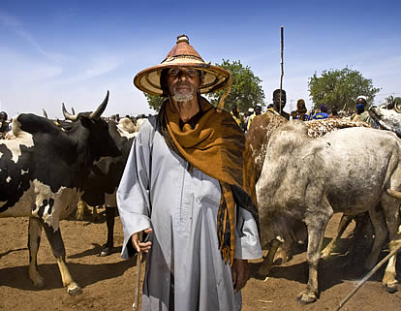
Relationship of Fulani Herders and Farming Communities
For centuries, Fulani herders benefited from symbiotic partnerships with farming communities. The nomadic herders kept land fertile for farmers through cattle grazing.
Despite this interdependent relationship, disputes would arise when herders seasonally migrated their cattle onto farming land for water and grazing.
Leaders would resolve these land disputes through arbitration mechanisms which compensated losses.

Slide 7
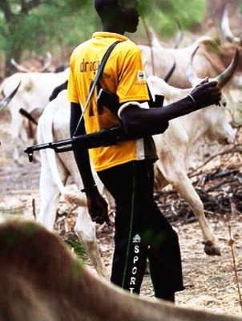
Key Drivers of Farmer-Herder Conflict
Over time, the conflict between herders and farmers became exacerbated by rapid population growth, climate change, poor resource management, desertification, religious sectarianism, and insecurity - all of which led to enormous pressure on resources and decreased available land.
Herders were forced to drive their cattle to find available resources, which in many cases, was limited to the land of settled farming communities.
Historically, village chiefs and herder leaders kept the peace, but the increasing extremism of Fulani herders has strained the capacity of these leaders to reduce tensions.
The conflict is now turning into a genocide against Christian farmers by Fulani jihadists.

Slide 8
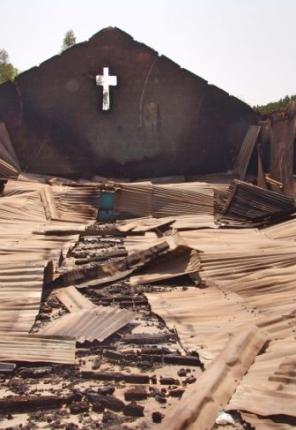
Extremist Ideology of Fulani Herders and ISWAP
For decades, there has been an ongoing conflict between Fulani herders and Christian farmers. However, since 2015, this conflict has evolved to a dangerous degree.
Now, the conflict can no longer be simply explained as a confrontation between nomadic herders and farmers, rather it must be explained as a genocidal campaign committed against Christians.
The escalation of violence is due to growing Islamic extremism across the Sahel and use of modern weapons. Ideologies of groups such as the Islamic State in West Africa Province (ISWAP) have been spread to and partially adopted by Fulani herders.
Although Fulani herders lack a structural organization like Boko Haram and ISWAP, they have demonstrated a clear intent to target Christians and their places of worship.

Slide 9
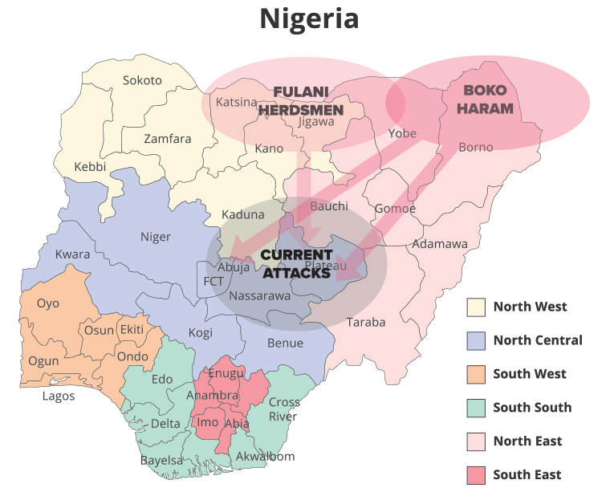
Impacted Areas in Nigeria
The regions in Nigeria most impacted by Fulani militia attacks are Northern Nigeria and the Middle Belt states.
The worst-affected areas include Benue, Plateau, Taraba, Adamawa, Kaduna, Kwara, Borno and Zamfara.
The Fulani militia target Christian Local Government Areas (LGA) and villages in each state.
According to one report, 99% of the persecution against Christians is of a violent nature. 100% of the victims of Fulani militia have been Christian.

Slide 10
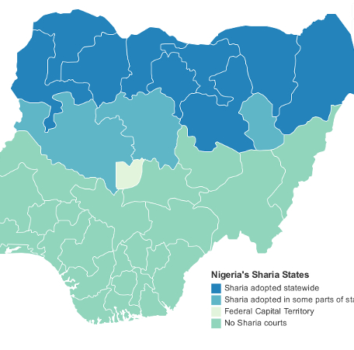
Summary of Events 1999-2015
Dec 1998 to Dec 2015
1999: 12 Northern states in Nigeria adopt Shari'a Law.
2013-2015: Over 1,484 Christians are killed in just seven LGAs in Taraba State.
2014: Over 1,229 deaths are caused by the Fulani militia.
2014: 200 People are killed in Zamfara State
Social media is used to spread misinformation, causing more violence.

Slide 11
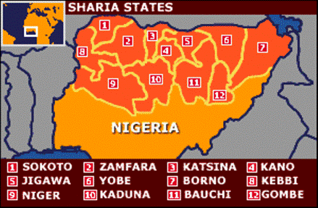
Adoption of Shari'a Law
1999
The violence and fear associated with the adoption of Shari'a law by 12 Northern states in 1999 created a divided society in which actions by the Fulani were seen as a continuation of historical violence and imperialism.
Many Christian farmers claim that the attacks against them can be seen as a continuation of jihad to establish an Islamic state in Nigeria.

Slide 12
Mali and the Transition to Jihad
Jan 2013 to Dec 2013
There is fear that the Fulani in Nigeria will become jihadi like some Fulani in Mali. Already militarized, some Malian Fulani tribes became radicalized, joining the Movement for Unity and Jihad in West Africa (MUJWA).
Other Fulani tribes in Mali have not turned jihad. Instead, these groups, such as the "Alliance nationale pour la sauvegarde de l’identité peule et la restauration de la justice” (ANSIPRJ), claim they are oppressed by the state and are militarizing in self-defense.

Slide 13
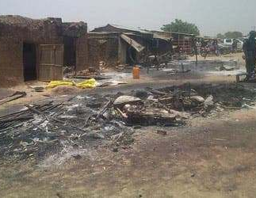
200 People Killed in Zamfara State
2014
Considered one of the largest single attacks in 2014, over 200 people were slaughtered at a meeting in Unguwar Galadima, Zamfara State.
Community leaders had planned on discussing ways to discourage attacks by armed robbers and cattle thieves.
Attackers obtained intelligence of the meeting and invaded the town on motorbikes, each carrying three men with guns and other weapons.
Men, women, and children were indiscriminately attacked. Houses and shops were burnt down. These attacks have continued to grow since 2014.

Slide 14
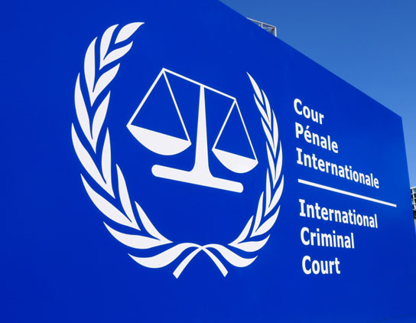
ICC 2016 Situation Report on Fulani Crisis
2013 to 2016
The 2016 Situation Report of the International Criminal Court (ICC) on the Fulani Crisis provided statistics of the reported attacks in the Middle Belt Region of Nigeria.
According to the report, in 2014 69% of the killings took place in Plateau, Kaduna, Benue, Taraba and Nasarawa States
In 2014, there were over 1,229 deaths caused by the Fulani militia.
Between 2013-2015, over 1,484 Christians were killed and 2,388 injured in just seven LGAs in Taraba State.

Slide 15
Summary of Events 2016-2018
Jan 2016-Oct 2018: Amnesty International documents 3,641 deaths and 182,530 displaced people.
Feb 2016: 300 Idoma Christians are killed in Agatu, Benue State.
Sept 24-25 & Oct 16, 2016: 30 people are killed in attacks on Godogodo village, Kaduna State
Jan-Feb 2017: The Benue State Governor receives the Country Representative of the United Nations High Commissioner on Refugees to address the Fulani crisis.
Jan 6-25, 2017: Peace Agreements are broken 20 days after signing
2017: Over 330 Irigwe people found to have been killed since 2017.
2018: 73 people killed by Fulani herdsmen in Benue State.
2018: The Nigerian Government creates the National Livestock Transformation Plan (NLTP) to address the "herder-farmer" crisis.
Jul 4, 2018: The Nigerian House of Representatives declares the crisis a genocide

Slide 16
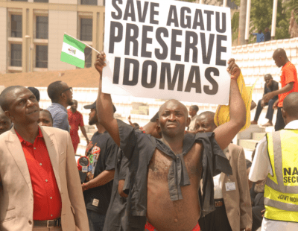
300 Idoma Christians Killed in Agatu Massacre
Feb 2016 to Apr 2016
In late February 2016, alleged Fulani herders reportedly massacred over 300 Idoma Christians in Agatu, an LGA in Benue State.
These herders, supported by Boko Haram, occupied the farmers' land, using it as a grazing area for their cows.
The Fulani herder gunmen claimed this was a retaliatory act, but no evidence was found of an initial strike.

Slide 17
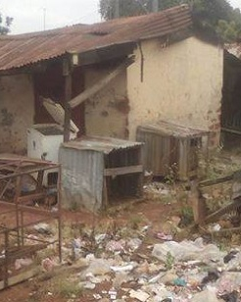
30-40 People Killed in Godogodo, Kaduna Attacks
Sep 24, 2016 to Oct 15, 2016
On September 24-25 and October 15, 2016, Fulani gunmen attacked the Christian Godogodo Village in Kaduna State, killing at least 30-40 people and injuring 16 others. In addition, more than 300 houses were burnt.

Slide 18
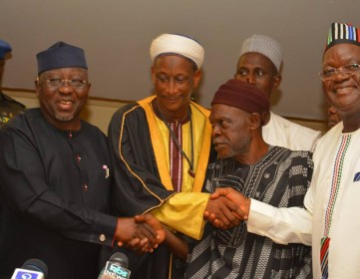
Peace Agreements Broken 20 Days after Signing
Jan 6, 2017 to Jan 24, 2017
On January 6, 2017, Mike Inalegwu, Sole Administrator of Agatu LGA, Benue State, came to peace agreements between the Fulani herdsmen and Christian Agatu community in Benue.
This peace agreement allowed unarmed Fulani herdsmen from the neighboring Nasarawa state to allow their cows to graze safely.
On January 24th, violence erupted again with 13 villagers and two herdsmen killed during an attack by Fulani herders.

Slide 19
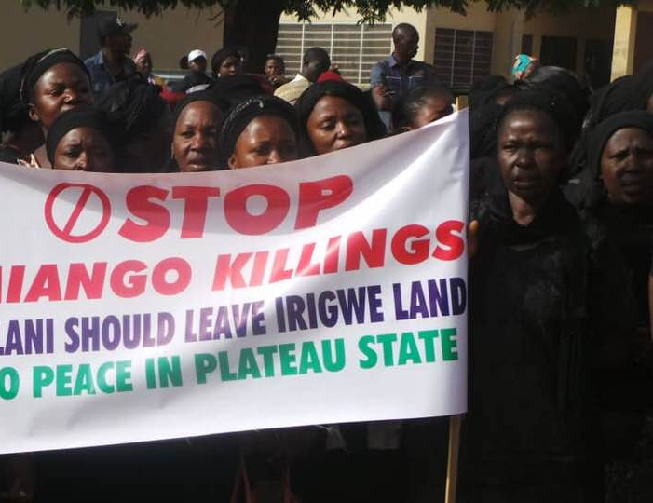
Over 330 Irigwe People Killed
2017
The Irigwe people have lived in Nigeria for centuries and are predominantly Christian.
They are a small people group with a population between 100,000. They reside in Plateau State, located in the Middle Belt region of Nigeria.
In the past few years, they have been under attack by Fulani militants.
Since 2017, over 330 Irigwe people have been killed, over 4,000 homes burnt down, and 2,600 farms destroyed.

Slide 20
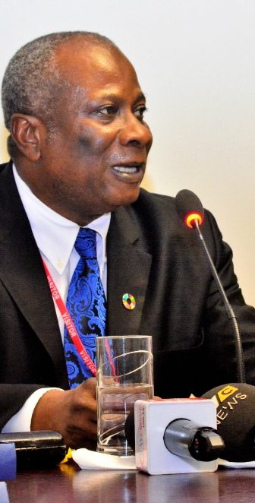
Benue Governor Acknowledges Genocide on International Stage
Jan 2017
The Governor of Benue State, Samuel Ortom, received in his office Edward Kallon, Country Representative of the United Nations High Commissioner on Refugees for Nigeria, and addressed the Fulani herder crisis.
Ortom claimed to the international community that over 1,878 people had been killed by Fulani herdsmen, 750 people were critically injured, and 200 people were missing.
He also stated that the Fulani attacks on farms posed a serious threat to food security in Nigeria.

Slide 21
The Christian Narrative
Jul 5, 2017
The narrative of predominantly Christian farmers is that crop damages from herds which are led by the Fulani are perceived as deliberate acts against farmers. This has continually triggered farming communities to see the Fulani herdsmen as competitors for natural resources and killers.
The religious clerics immediately attribute the conflict to religion because of the audio and videotapes being distributed and played in markets in Nigeria of Muslim clerics attacking, discriminating, and denigrating the Bible and Christians.

Slide 22
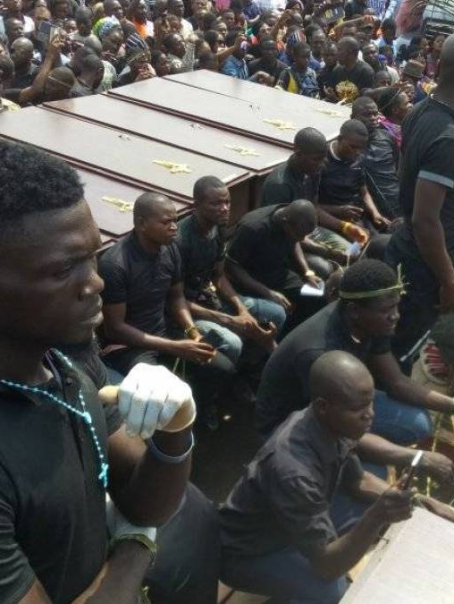
Benue State Buries 73 Killed By Fulani Herdsmen
Jan 11, 2018
In 2018, 73 people were killed in Guma and Logo LGAs in Benue State by Fulani Militia. Farmers and villagers were targeted during the attack.

Slide 23
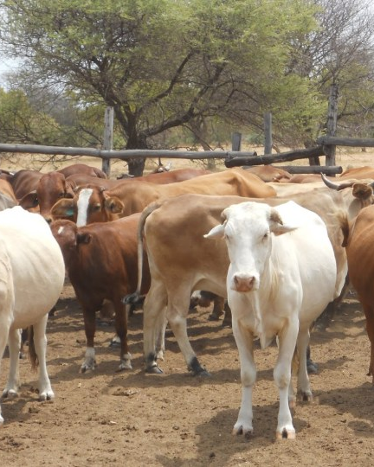
National Livestock Transformation Plan addresses socio-economic drivers of Fulani crisis
2018 to 2020
The National Livestock Transformation Plan (NLTP) was created by the Nigerian government to address the "herder-farmer" crisis, especially the socio-economic drivers.
The NLTP has 6 pillars: economic investment; conflict resolution; law and order; humanitarian relief; information, education and strategic communication; and crosscutting issues.
The 10-year plan is expected to cost at least N179 billion ($496 million).

Slide 24

Reprisal Attacks Due to Social Media Misinformation
Jun 23, 2018
Fake news and videos of violence in other countries in Africa are being spread on social media, specifically on Facebook, a platform used by 24 million Nigerians.
The content that is spread online is falsely labelled as herder/farmer violence, even though events may have occurred in another country or several years ago.
The Nigerian police reported that more than a dozen killings in Plateau State in Nigeria are the direct results of misinformation.
In a recent case, an innocent Fulani man was killed after graphic images were spread online, falsely attributed to a massacre in the Gashish district of Plateau State, Nigeria.
Although a massacre against the region's Berom ethnic people had occurred, with an estimated death toll between 83 and 238, many of the images had no link to the violence. The graphic images spread online provoked reprisal attacks against Fulani.

Slide 25
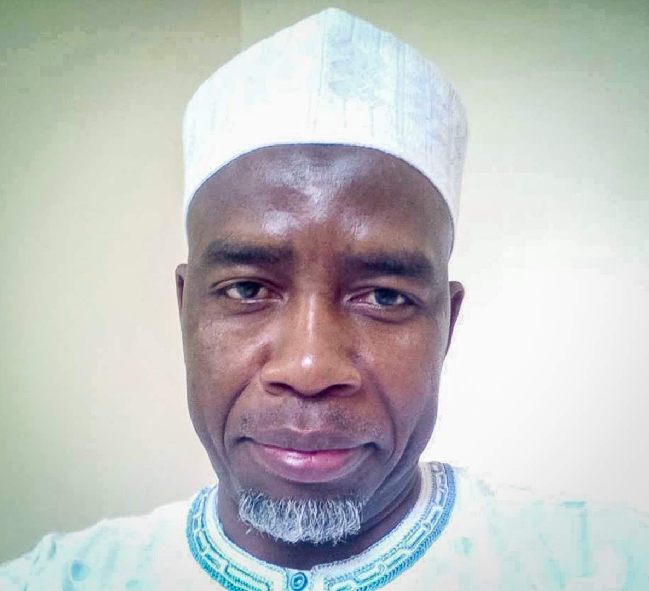
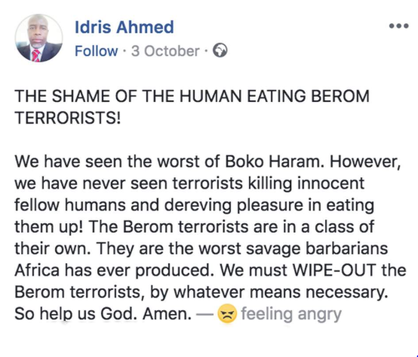
Hate Speech Spread on Social Media
2018
One particularly divisive figure on Nigerian social media is Dr. Idris Ahmed. Ahmed is based in the UK but was born in Nigeria and identifies as Fulani.
On Facebook, he instigates fear and animosity against the Berom ethnic people in Jos by calling them "savages," "barbarians," and "terrorists." He also called for the annihilation of Berom people.

Slide 26
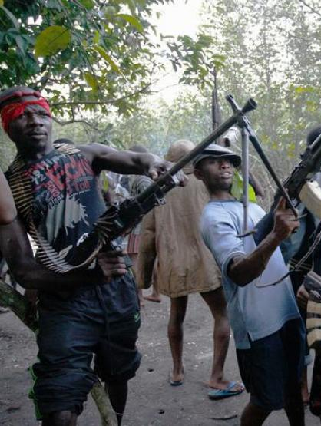
Fulani Militia Pose Greater Threat than Boko Haram
Between January and June 2018, there were 47.5% more attacks by Fulani Militia than by Boko Haram, but President Buhari had not addressed this growing threat.
In the first half of 2018 alone, Fulani Militia killed 1,700 people, six times more Christians than Boko Haram that year.

Slide 27
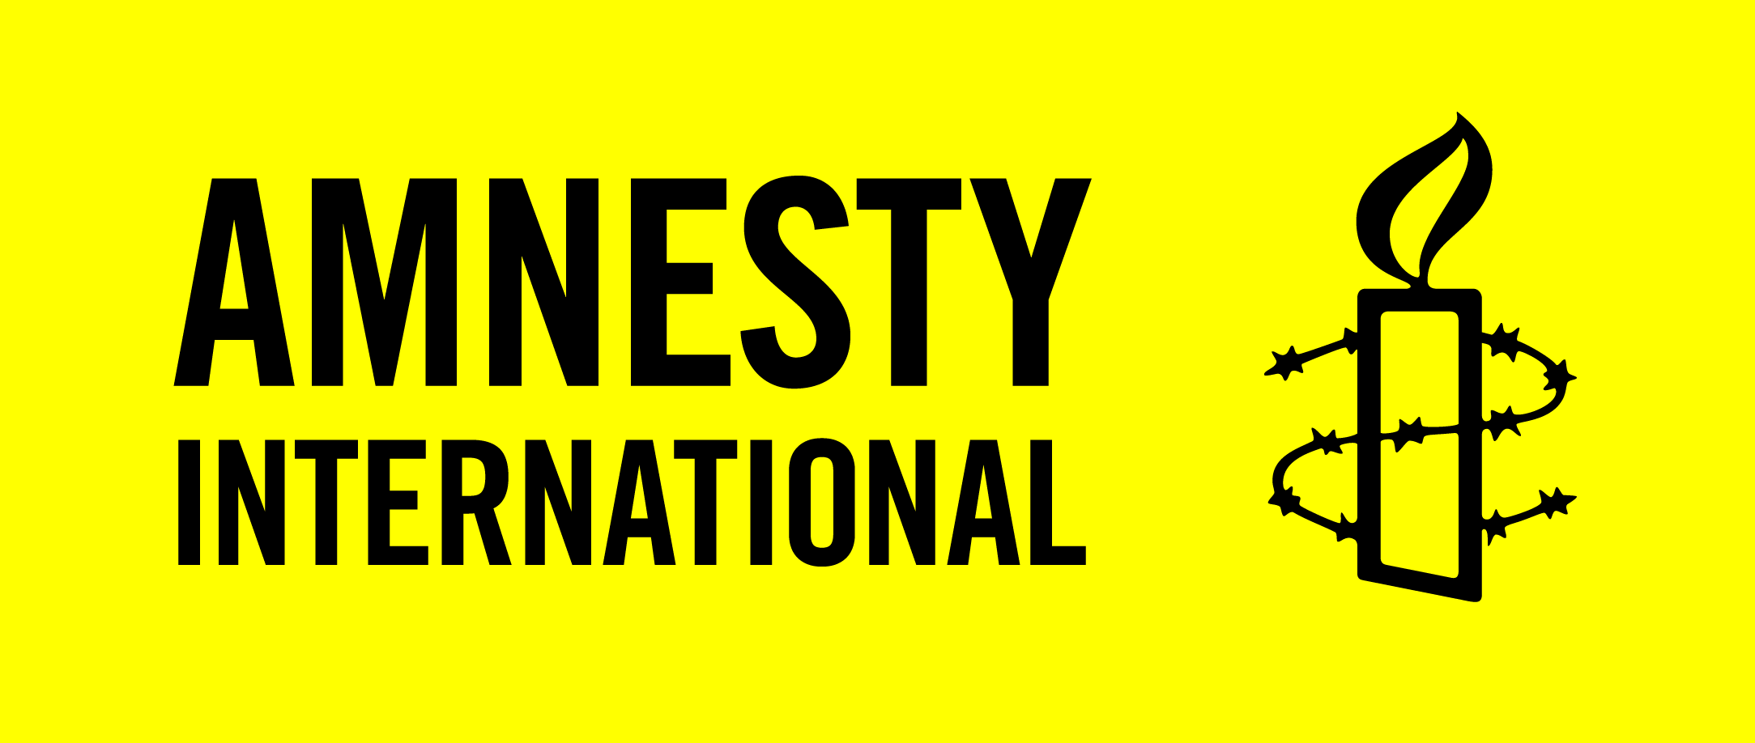
Amnesty International Reports 312 Incidents
Jan 2016 to Oct 2018
Amnesty International documented 312 incidents of attacks and reprisal attacks in 22 states and Abuja between January 2016 and October 2018.
As a result of these attacks Amnesty International estimates that at least 3,641 people may have been killed, 406 injured, 5,000 houses burnt down, and 182,530 people displaced.

Slide 28
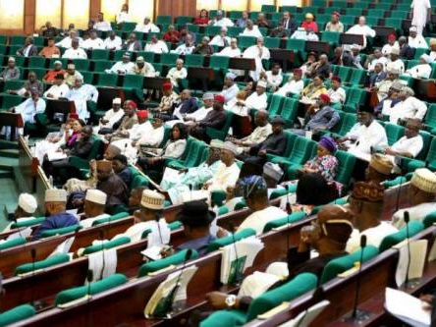
Nigerian House of Representatives Declare Genocide
On July 4, 2018, the Nigerian House of Representatives declared the massacres in Christian villages in Plateau State to be a genocide.
They urged the Federal Government to stop the killings and establish orphanages in areas impacted by violence.
Early in June 2020, Nigerian President Muhammadu Buhari's office announced that soldiers killed 1,400 fighters over the past two months.
After several killings, Buhari's spokesman, Garba Shehu, said the president condemned the violence.

Slide 29
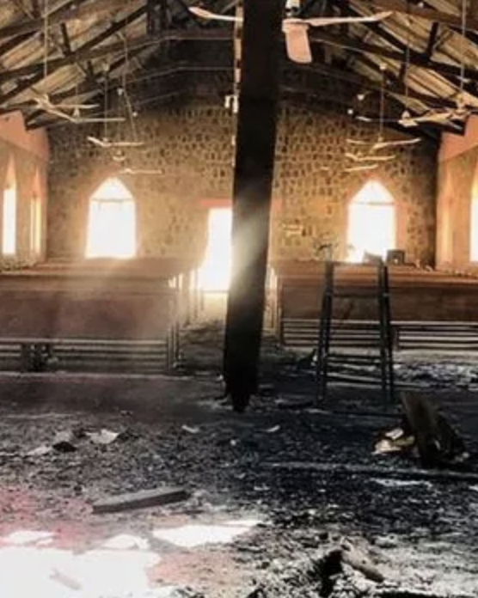
Summary of Events: 2019-2020
Mar 8-9, 2019: At least 85 people are killed in attacks on three communities in Kaduna State.
Jul 19, 2019: Attackers in Kaduna State amputate a pregnant woman's arm as they kill her four children.
Dec 20, 2019: Nigeria is added to the U.S. Special Watch List for countries believed to have engaged in or tolerated "severe violations of religious freedom."
Jan-Apr 2020: Over 400 Christians were killed between January and the start of April 2020, including seven elderly people who burned alive in a house.
Apr 23-25, 2020: 13 killed and 13 others kidnapped in five villages in Kaduna State.

Slide 30
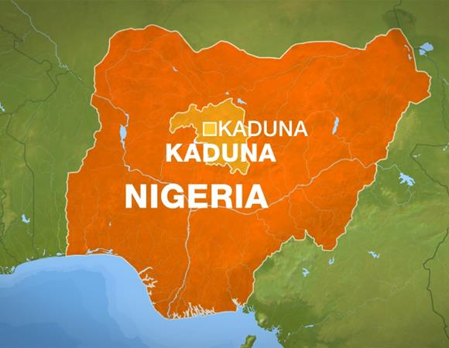
At Least 85 Killed in Attacks on 3 Communities
Mar 7, 2019 to Mar 9, 2019
At least 85 people were killed in attacks on 3 communities in Kaduna State by suspected Fulani herdsmen. The communities affected were Anguwan Barde and Gamu villages in Kajuru Local Government Area (LGA) and Gerti, Kaninkon Chiefdom in Jama’a LGA.
The attack in Anguwan Barde killed 35 people. A Kaduna police spokesperson confirmed only 16 deaths.
The attack on Anguwan Gamu village killed 46 people and burned 100 houses. In Gerti, Jama’a LGA, four people were reportedly killed.

Slide 31
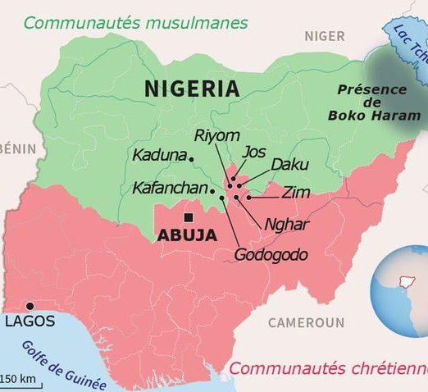
Pregnant Woman's Arm Amputated as Attackers Kill Her 4 Children
Jul 18, 2019
In Godogodo, Kaduna State, a young evangelical woman, Jumai Victor, was attacked by Fulani at night, who arrived shouting "Allah u Akbar" ("God is greatest").
They burned her house and killed her 4 children. When they saw that she was pregnant, they amputated her arm with a machete.
This was just one example of a number of stories French intellectual Bernard-Henri Lévy learned about during a trip to Nigeria in 2019 to shed light on the issue.

Slide 32
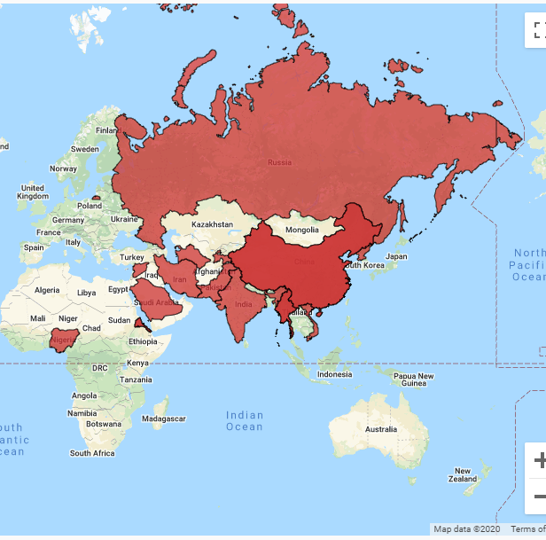
Nigeria Added to U.S. Special Watch List
On December 20, 2019, Secretary of State, Mike Pompeo, added Nigeria for the first time to the State Department's special watch list.
Countries added to the special watch list are believed to have engaged in or tolerated "severe violations of religious freedom."
Nigeria was added to the list as a result of escalating violence in the Northeast and Middle Belt and lack of effective government response.
The U.S. Commission on International Religious Freedom (USCIRF) has called for Nigeria to be designated as a "Country of Particular Concern (CPC)" since 2009 but the State Department has yet to do so.
CPC is a designation above special watch list and would include potential sanctions and diplomatic actions.

Slide 33
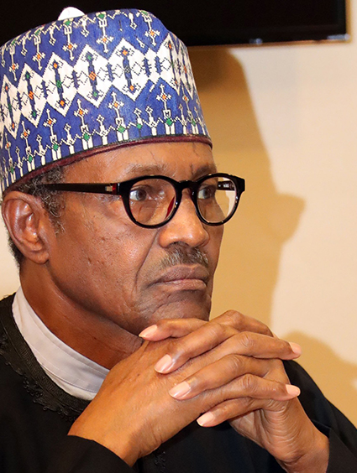
President Buhari's Response to Fulani Attacks
2020
Since President Buhari came to power in 2015, Fulani Militia attacks against Christians in Nigeria have only gotten worse.
In the past he has denied the genocide of Christians by saying, "The problem of cattle herders is a very long historical problem. Before now, cattle herders were known to carry sticks and machetes… but these ones are carrying AK-47s."
Although he believes it is unjust to blame him for the attacks, he has failed to hold the perpetrators accountable through arrests.

Slide 34
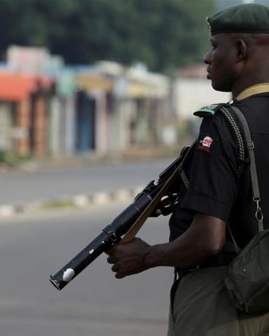
Failed Security Forces
2017 to 2020
Along with lack of arrests by the national government, security forces have continuously failed to protect villages, and the government has done little to investigate why.
After growing tension between the Koh village in the Girei local government area of the Adamawa state, 66 people were killed across several villages.
In Koh, after an hour of gunfire, police and soldiers retreated, and Fulani gunmen killed villages. In Dong and other villages, police left 3 days before attacks.
In the Taraba state, soldiers sent to protect Lua local government area citizens told the villagers that the Fulani attackers were after other villages. At least 68 residents died between January 6 and 15th, 2018.

Slide 35
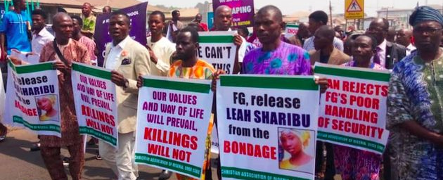
Christians in Nigeria Protest Against Buhari
Jan 29, 2020 to Feb 2, 2020
On Feb 2, 2020, five million Nigerians from 28 of Nigeria's 36 states marched to protest the beheading of Pastor Lawan Andimi and the Nigerian government's lack of action.
Andimi was the chairman of a regional Christian Association of Nigeria (CAN) chapter in Adamawa state.
CAN called on Nigerians to participate in a three-day fast, followed by a prayer walk. Several high-profile church leaders were in attendance.

Slide 36
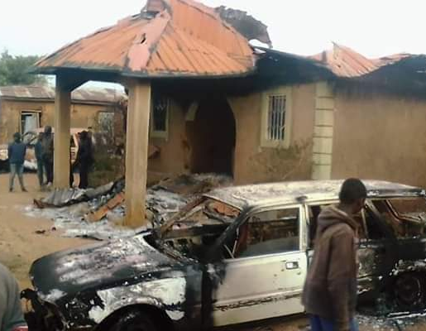
Over 400 Christians Killed in First Three Months of 2020
Jan 1, 2020 to Apr 3, 2020
Christian NGO Intersociety reported that Fulani herdsmen killed at least 50 Christians in March and ten at the start of April. An estimate of over 400 Christians were killed in the first three months of 2020.
In April, 300 Fulani herders reportedly attacked the village of Hukke, Plateau State, burning down 23 houses and killing seven senior citizens who were unable to escape.

Slide 37
13 Killed and 13 Others Kidnapped in 5 villages
From April 23 to 25, 2020, Fulani herdsmen killed 13 Christians and kidnapped 13 others in 5 villages in Kaduna. More than 1,000 villagers were displaced in the attacks.
Those killed included Baptists, Catholics, and members of the Evangelical Church Winning All, the United Church of Christ in Nations and Assemblies of God churches.
As others fled the village, the militants stole their livestock and much of their food.

Slide 38
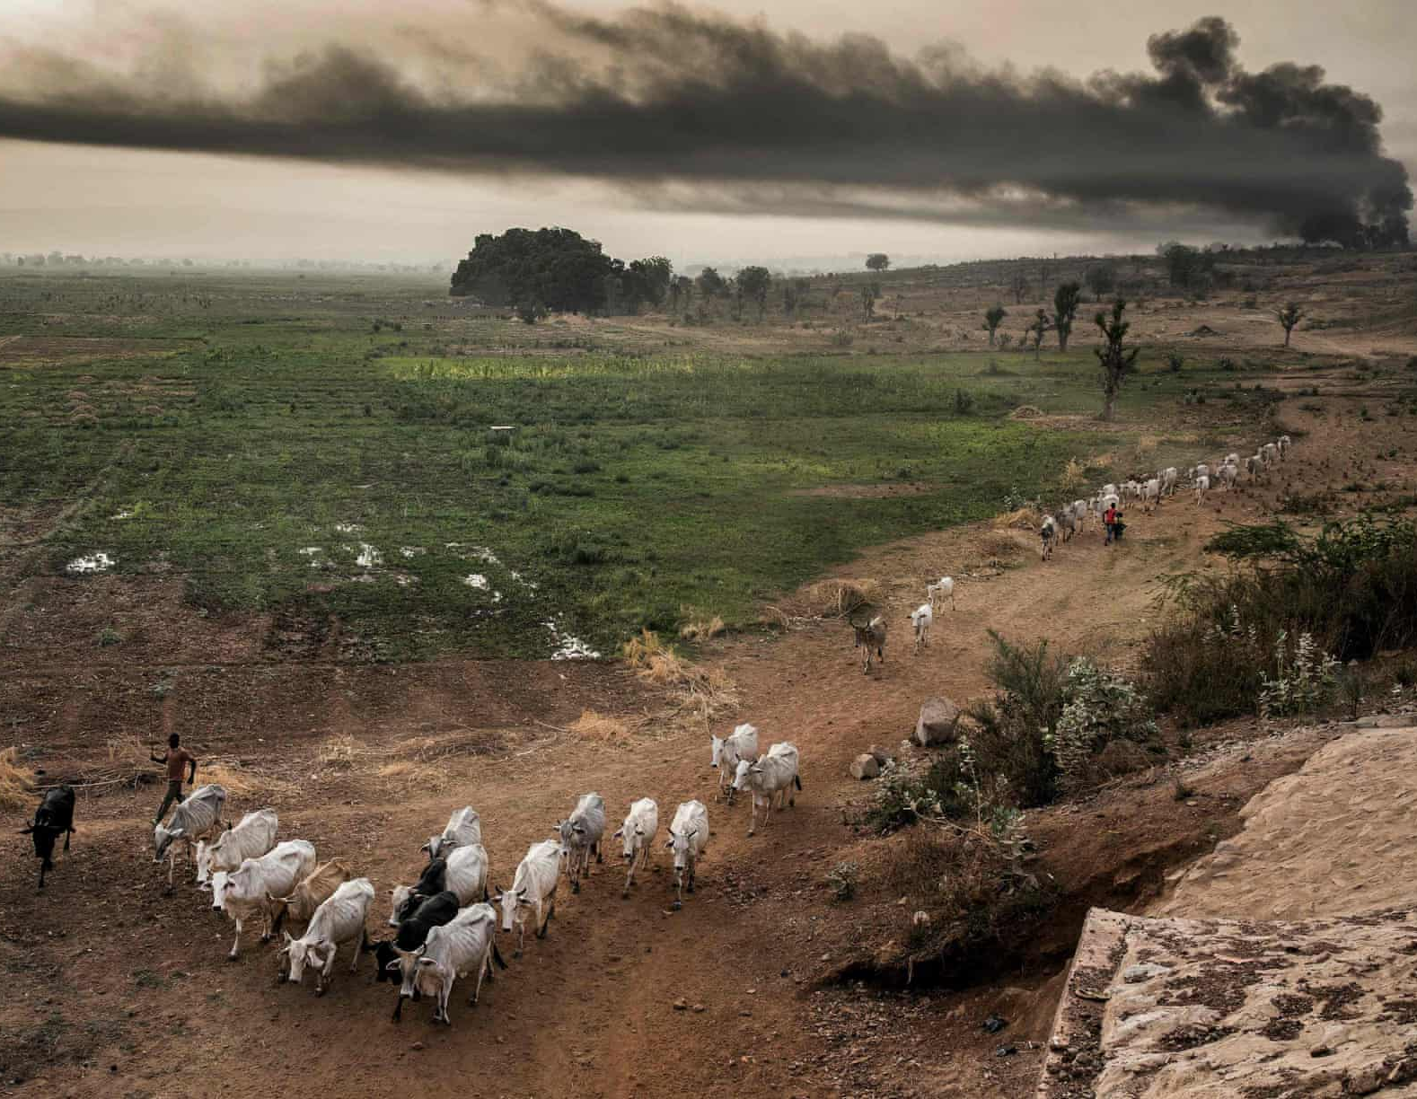
Over 70 killed in 5 villages in Sokoto State
May 26, 2020
More than 70 people were killed in five villages in Sabon Birni district, Sokoto State on May 26, 2020.
Over 100 armed assailants on motorbikes came from camps in the nearby Isah forest to shoot the village residents and destroy their property.
The Guardian reported the motives for the attack to be unclear but linked the incident to other massacres fueled by competition for land and resources between ethnic Fulani herders and local farmers.
Many of the recent, larger attacks have reportedly been carried out by suspected Fulani groups.

Slide 39
Nine Christians killed and Seven kidnapped in Kaduna State
Jun 3, 2020
Nine Christians were shot or hacked to death in an attack on Wednesday June 3 in north-central Nigeria.
Muslim Fulani herdsmen attacked the predominantly Christian village of Tudun Doka, Kajuru County in Kaduna state.
Seven other people were reportedly kidnapped. More than 30 Christians had been killed in nearby villages during previous attacks.

Slide 40
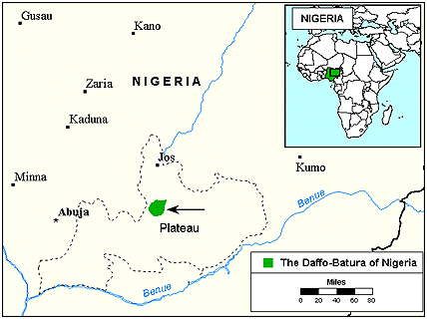
Fulani Land Grab in Daffo Village
Daffo village is a small village in Plateau State. Fulani militants have launched several attacks in this region, along with land grabs.
After homes, churches, and farms are destroyed and people displaced, Fulani invaders occupy the land with their cattle.
So far, 11,169 acres have been occupied by Fulani militants. It is estimated that each family farms a minimum of one acre, which means over 10,000 families are without income or sustenance.
Similar reports have come from two other states, Benue and Taraba.

Slide 41
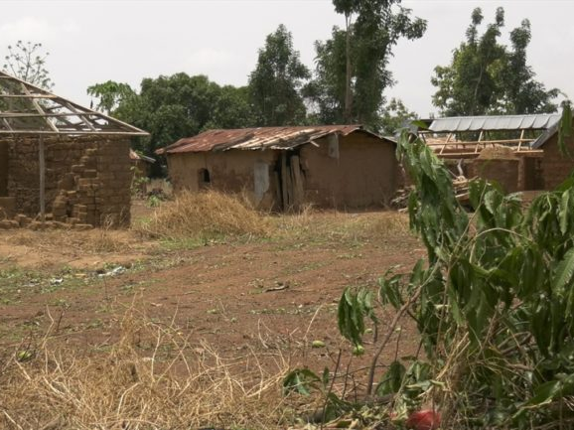
Denial Through Farmer-Herder Myth
There has been an effort by the Fulani Jihadists and the international community to explain the massacres against Christians as simple famer-herder conflicts.
However, since 2015, the attacks against Christians in Nigeria have become deadlier. Fulani militants use AK47's and are heavily armed when they destroy villages.
They have specifically targeted Christian people, homes, and churches.

Slide 42
Recommendations
Dr. Gregory Stanton, the Founder and President of Genocide Watch, has proposed options for investigating the Christian massacres in Nigeria:
Organize and carry out training for Nigerian Law Enforcement Investigators
  Train Nigerian law enforcement, armed forces, and political and legal sectors in investigating massacres.
Support a Nigerian Strike Force to investigate and prosecute genocidal massacres
  Create a trained Nigerian Strike Force from dedicated government personnel, independent from local police to investigate and prosecute genocidal massacres.
Lobby President Buhari, Nigerian Army, and police to prevent Fulani jihadist massacres
  Put diplomatic pressure on Nigerian government from US, European, and African embassies to stop the massacres.
Train Nigerian church leaders in human rights documentation, establish Human Rights Centers in existing church facilities
  Train Nigerian church leaders to document human rights abuses to support early warning and record keeping.

