Slide 1
China’s Genocide of Uyghurs and Turkic Muslims

Slide 2
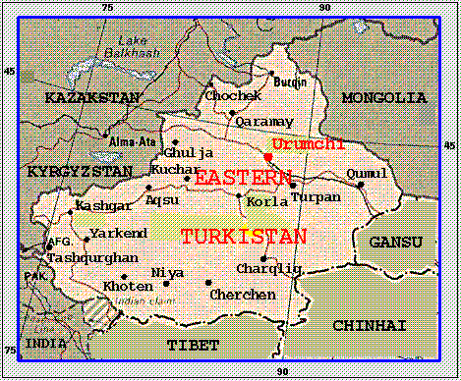
Pre-Chinese History of Uyghurs in East Turkestan
1000 - 1884
The Uyghurs are an ethnic Turkic people (similar to many central Asian ethnic groups), that have lived in East Turkestan (modern-day Xinjiang) for more than 1,500 years.
In the 11th century, Sufi Islam became the primary religion among the population and the region was ruled according to a system of Islamic city states run by local caliphs.

Slide 3
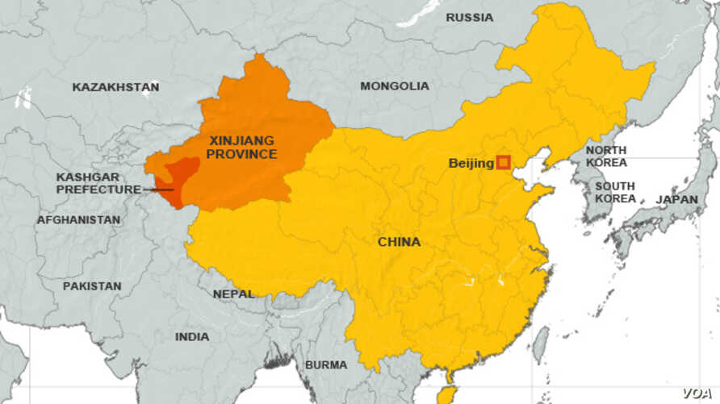
Xinjiang Province
November 1884
After violently subduing local rebellions, the Qing Dynasty incorporated the region into the Manchu Empire as Xinjiang ("New Frontier") Province. The Qing invasion and occupation of the territory ended centuries of Uyghur self-rule in the region.
In 1955, the province officially became Xinjiang Uighur Autonomous Region, although the actual level of autonomy in the region has been largely non-existent.

Slide 4

East Turkestan Independence Movements
1933 - 1949
To quell rebellions in Xinjiang, Beijing has turned to "Sinicization" campaigns. In response, a Uyghur independence movement emerged to combat the attempts to erase their culture. In this effort, Uyghur nationalists achieved brief successes, forming the First East Turkestan Republic (1933-1934) and the Second Republic (1944-1949) before once again falling under Chinese rule.

Slide 5
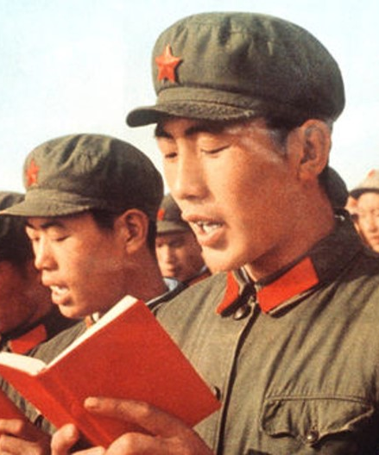
CCP Crackdown on Religious Freedom
1949 - Present
Since its inception, the Chinese Communist Party (CCP) has aggressively pushed for secularism in an effort to root out religion in the country.
The CCP has systematically persecuted Christians, Muslims, Buddhists, and the Falun Gong, among others.
While these hardline policies were eased in the 1980s, religious minorities are once again subject to severe persecution by Beijing.

Slide 6
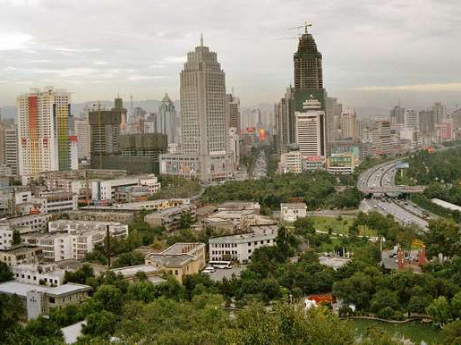
Planned Demographic Shifts in Xinjiang
1949 - 2000
From 1950-1970, the CCP launched a "systematic and organized effort" to increase the Han population of Xinjiang by economically incentivizing Han migration.
This process has continued more naturally in recent decades but has had the same effect of marginalizing the native Uyghur population. Immigration to Xinjiang Province has diluted the Uyghur population from 6.7% in 1949 to 40% by 2008.

Slide 7
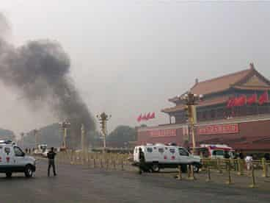
East Turkestan Islamic Movement (ETIM)
1997 - Present
In the late 1990s, a small group of hardline and militant Uyghur separatists formed the ETIM. While the ETIM remained a fringe group, its goals were both "both Islamist and nationalist".
By 1999, a small number of ETIM militants traveled from Xinjiang to Afghanistan and Pakistan to fight alongside Al-Qaeda. China has accused the ETIM of committing terrorist attacks within the country, killing a total of 162 people.

Slide 8
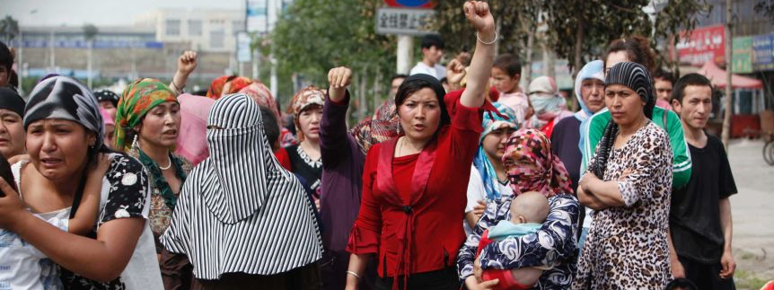
Ürümqi Riots
July 05, 2009
Rioting in Ürümqi left 197 mostly Han residents of the city dead after peaceful Uyghur protest turned into a violent clash between Uyghurs and Han. In response, Beijing deployed security forces to repress the protests and quell the violence. The government also cut phone and internet access to the region for nearly a year to crackdown on dissent.

Slide 9
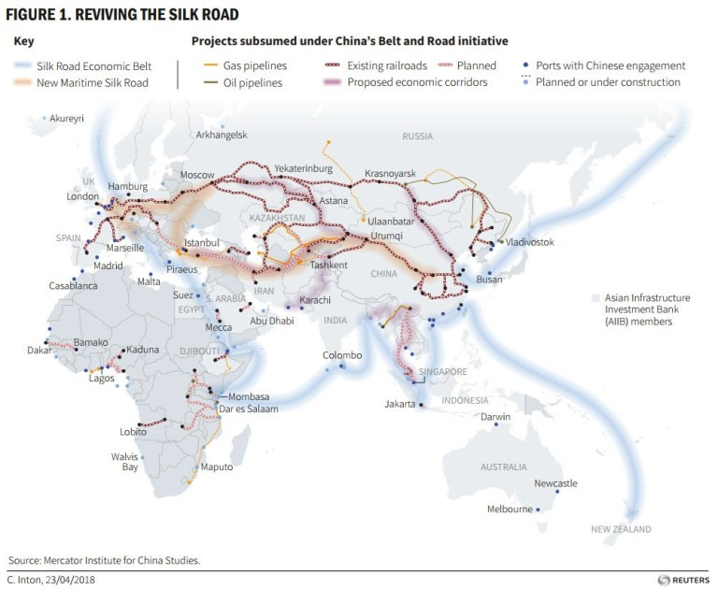
Belt and Road Initiative (BRI) and Xinjiang
2013 - Present
In 2013 Beijing unveiled its plans for a massive global trade, infrastructure, and development project (BRI). As part of the $1 trillion long-term endeavor, Xinjiang features heavily in connecting China to central Asia.
CCP officials believe that Uyghur autonomy could stand in the way of the successful implementation of this economic plan, increasing the importance according to Beijing to pacify, or even eliminate, the Uyghurs in Xinjiang.

Slide 10
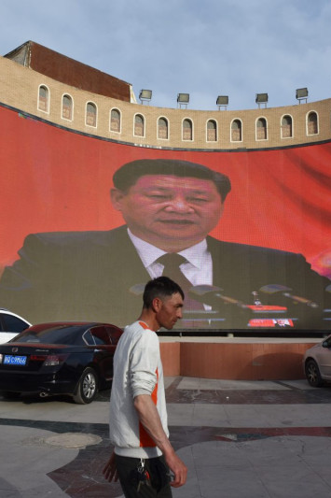
Beijing's Policy of 'Preventive Repression'
2014 - Present
Reports of Uyghur foreign fighters participating in jihadist conflicts exacerbated Beijing's fears. From 2014-2016, Uyghur militants engaged in fighting in Southeast Asia and the Middle East.
President Xi warned that Uyghur militants could also strike in China and that Uyghurs might now be "infected by an extremist virus" and must be "inoculated" to prevent internal threats from surfacing.

Slide 11
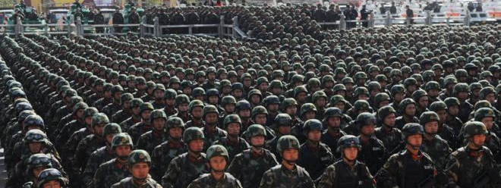
Strike Hard Campaign Against Violent Terrorism
May 2014 - Present
As part of the policy of "preventive repression", Beijing launched a new initiative to root out radicalization. The CCP campaign included mass surveillance and arbitrary detentions. This Orwellian crackdown, veiled in the rhetoric of counterterrorism, laid the foundation for the "re-education" internment camps and genocide of the Uyghurs in Xinjiang.

Slide 12
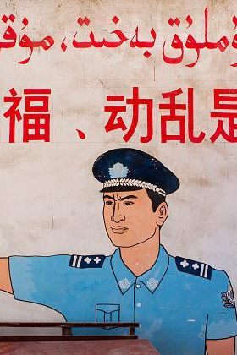
Biometric Data Collected from Millions in Xinjiang
February 2017 - Present
After initiating the "Population Registration Program,” Chinese officials began collecting the biometric data of Xinjiang residents ages 12-65.
The program "Physicals for All" took off in July under the guise of free annual physical exams in the Xinjiang region. During the exams, DNA samples and blood types were collected and sent to police.
Police officers participated in data collection by requesting pictures, fingerprints, iris scans, and personal information during home visits or at checkpoints.
These physical exams are mandatory, and residents are not told how their medical data will be used. In 2017 alone, 18.8 million people participated in the annual exam.

Slide 13
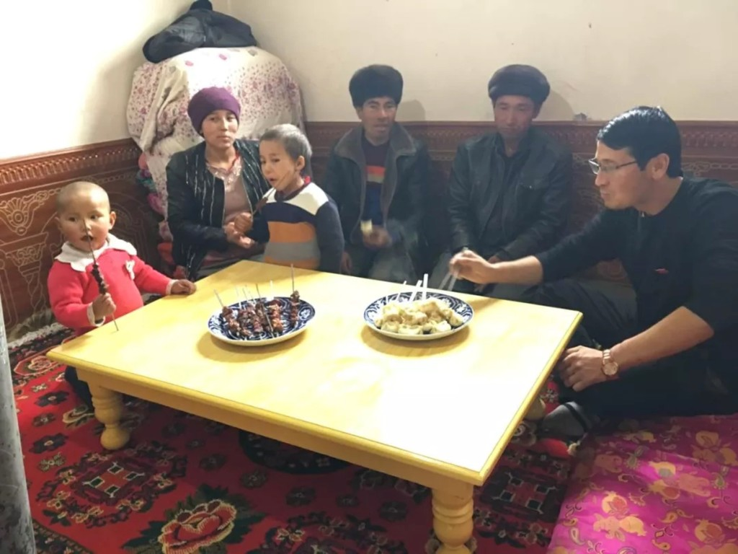
Forced "Home Stay" Program
2018 - Present
As part of China's "Strike Hard Campaign," CCP authorities imposed "home stays" on Uyghur families in the Xinjiang region since early 2018.
Uyghur families are forced to open their homes to Chinese officials at least five days every two months. More than a million officials have visited Uyghur homes in Xinjiang.
During visits, families must provide information about their personal lives and political views. Officials enforce political indoctrination and report on any suspicious behavior.
Reportedly, Uyghur women whose husbands have been detained must share a bed with the government officials monitoring them.

Slide 14
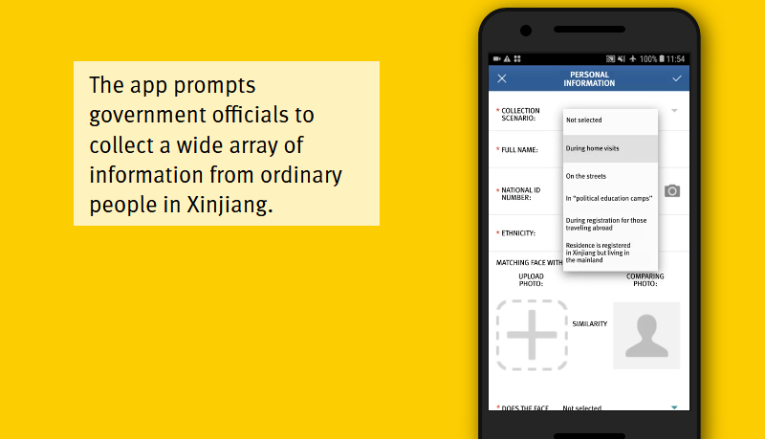
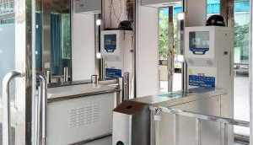
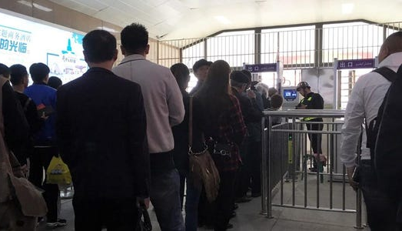
Integrated Joint Operations Platform (IJOP)
February 2018 - Present
The Integrated Joint Operations Platform (IJOP) is the central system for mass surveillance in Xinjiang. Officials have been using a mobile app connected to IJOP to track Uyghurs and other Muslims.
The app is used by authorities to collect personal data and identify suspicious individuals. Residents are asked about their political views, use of birth control, communications with relatives abroad, etc.
"Data doors" set up at thousands of checkpoints around Xinjiang passively collect information from the phones of residents and send the information to IJOP. Mostly Uyghurs are stopped at these checkpoints.
The data sent to IJOP allows it to categorize residents according to how suspicious or "abnormal" their behavior is. Once a suspicious individual has been identified, IJOP prompts local officials to visit the individual and detain them.

Slide 15
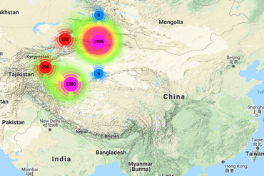
Massive Database Discovered of GPS Surveillance
February 13, 2019
In February 2019, Victor Gevers, a security researcher, found a massive Uyghur database monitored by the Chinese firm SenseNets.
The database included highly sensitive information on residents of Xinjiang including their names, ID numbers, addresses, dates of birth, and employers. The database also tracked the GPS coordinates of over 2 million individuals with public cameras. In a single 24-hour period, as many as 6.7 million GPS coordinates were recorded.
When Gevers notified SenseNets of this data breach, the company restricted the database from being accessed by non-Chinese IPs.

Slide 16
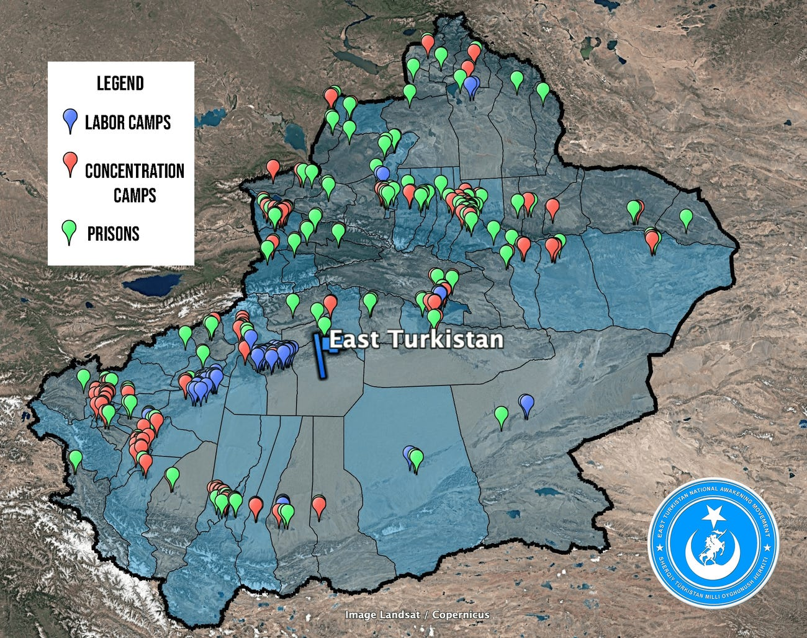
"Re-Education" Internment Camps
2017 - Present
Since 2017, authorities in Xinjiang have arbitrarily detained an estimated 1-3 million Uyghurs.
CCP propaganda claims that the vast network of internment camps are voluntary "vocational schools" in an outrageous and loosely veiled attempt to deny their genocidal campaign.

Slide 17
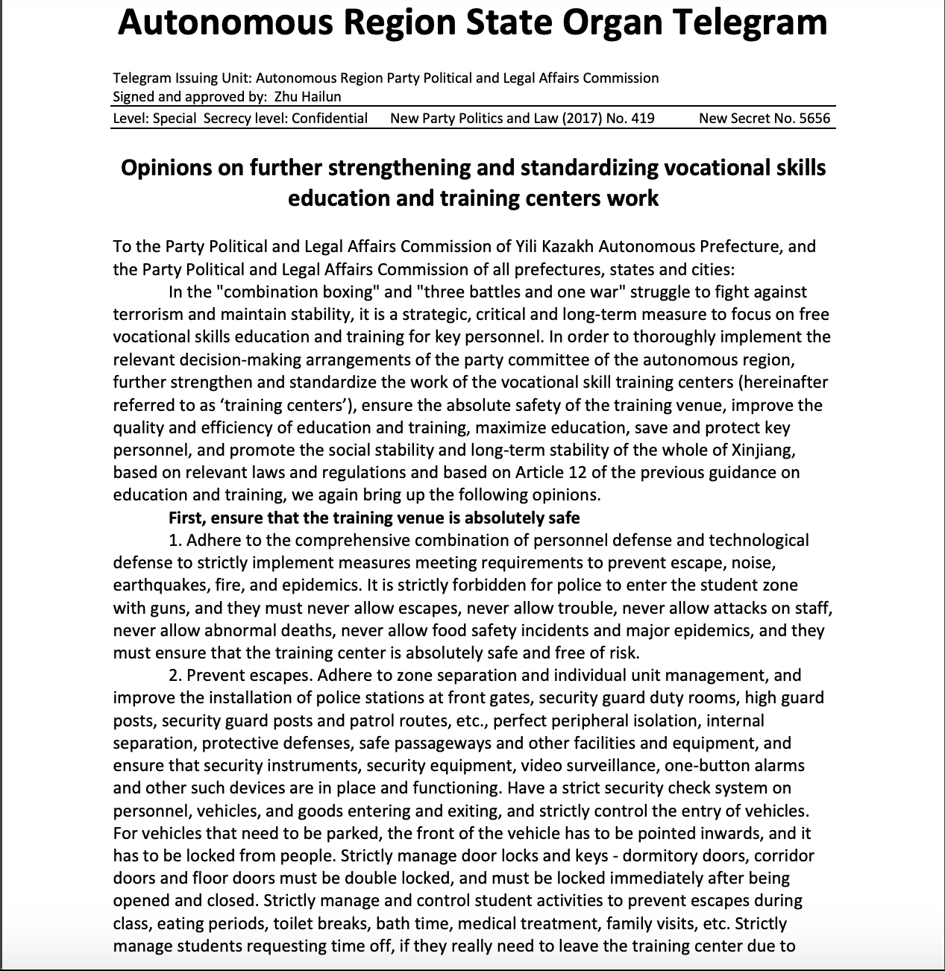
China Cables
November 2017 – November 2019
The "China Cables", China's Operating Manual for Uyghur "re-education", were released to the International Consortium of Investigative Journalists.
These directions include: "never allow escapes", "increase discipline and punishment of behavioral violations", "promote repentance and confession", "make remedial Mandarin studies the top priority", "encourage students to truly transform", and "[ensure] full video surveillance coverage of dormitories and classrooms free of blind spots."

Slide 18
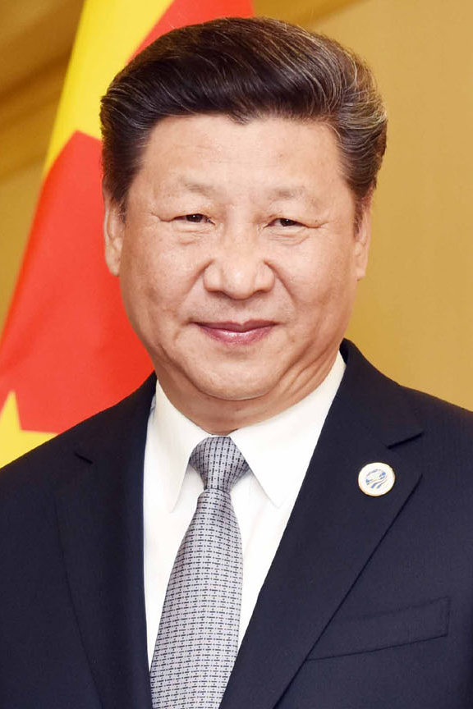
The Xinjiang Papers in the New York Times
November 2019
The "Xinjiang Papers", released to the New York Times, describe private speeches by President Xi Jinping that further his rhetoric of labeling his campaign against Uyghurs as a campaign against Islamic Terrorism, demanding "absolutely no mercy".

Slide 19
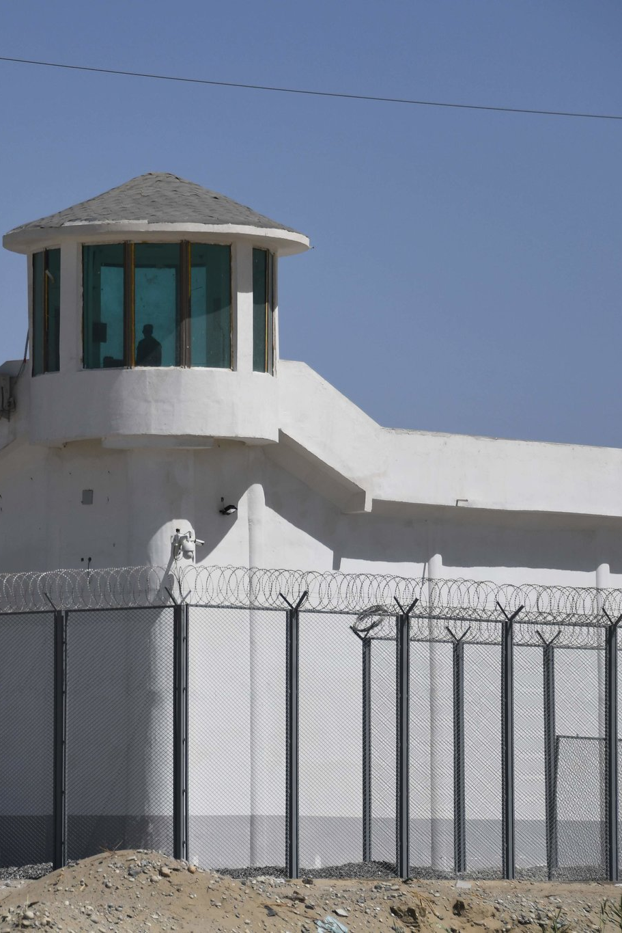
Directives by the CCP on Dealing with Students
November 2019
Included in the "Xinjiang Papers" are directives on how to deal with "students" who have been taken to "re-education" camps. Students are told to appreciate the CCP for providing free education.
The CCP also makes it clear that those who are in the camps are being "cured" from extremism and cannot leave the camps of their own volition.

Slide 20
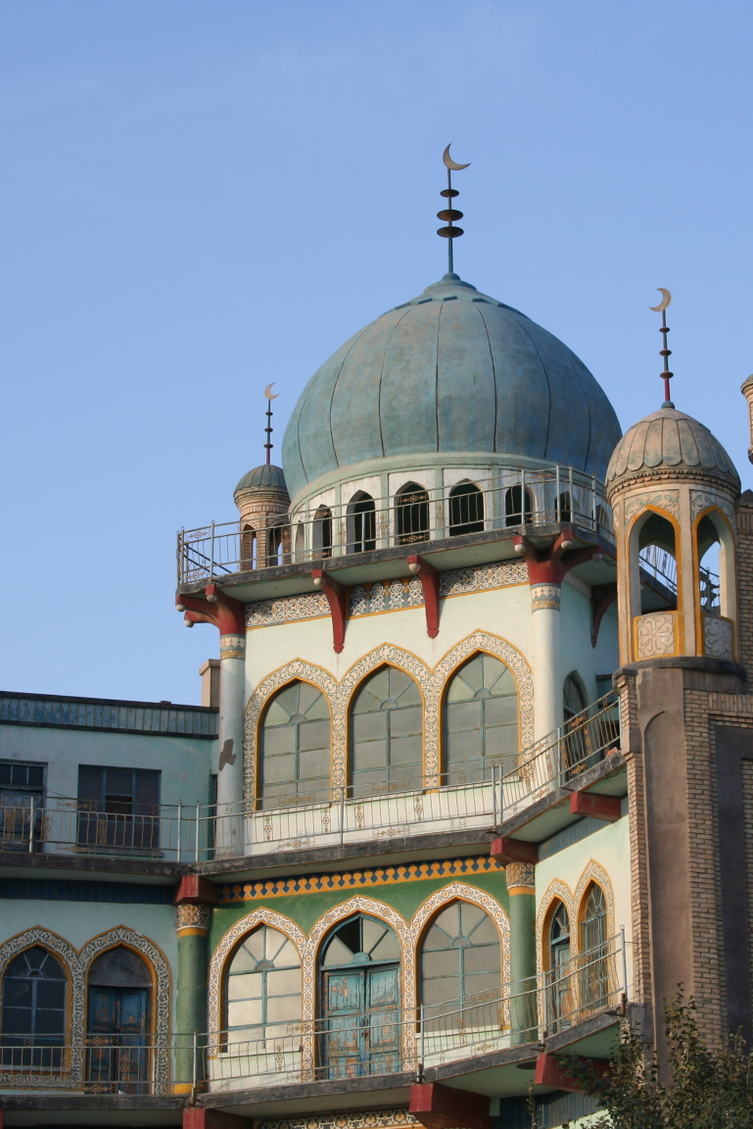
BBC Investigation into Camps
October 2018
A BBC investigation into Xinjiang showed a culture of fear, with family disowning each other to prevent being sent to camps.
Citizens said those in the camps "have some problems with their thoughts" and the BBC reports the camps are designed to treat extremism and separatism as part of Uyghur culture, and more broadly, a part of Islam.

Slide 21
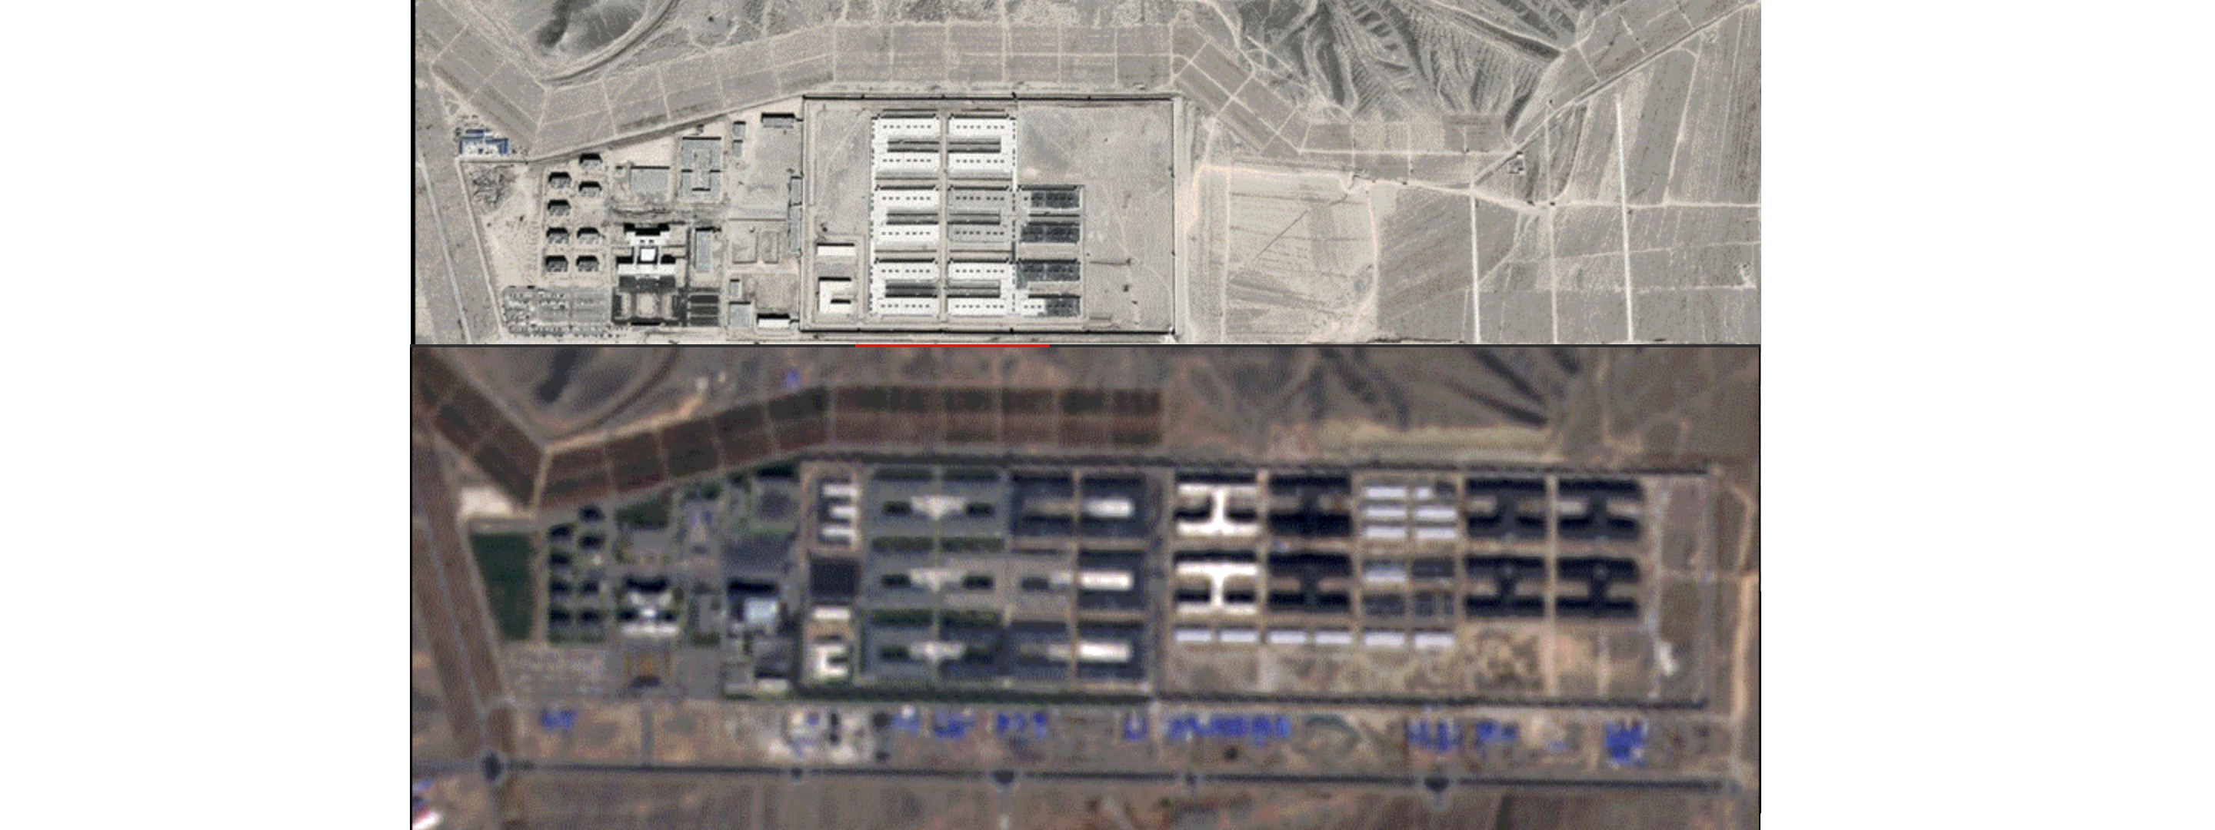
Increase in Security Facility Construction
2018 - Present
Using satellite imagery, the BBC reported the expansion of security facilities across Xinjiang.
Prior to 2016, an average of four new detention centers were built each year, but in 2017, Xinjiang officials built 15 facilities and in 2018, they constructed another 10 to build the infrastructure necessary for their internment campaign.

Slide 22
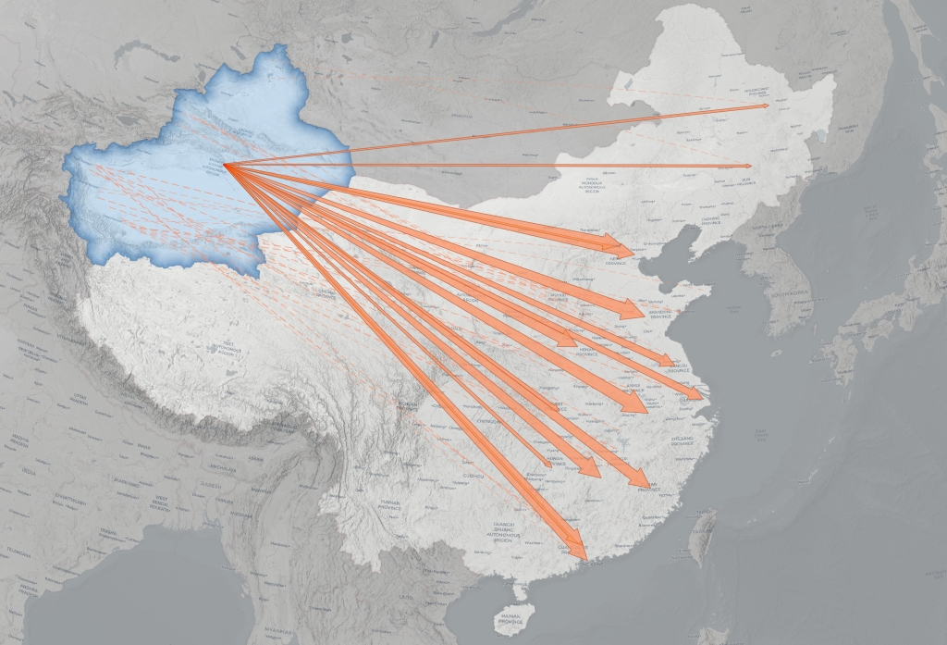
Labor Transfer Program
2017 - Present
The labor transfer program relocated Xinjiang's Uyghurs. More than 80,000 Uyghurs have been transferred out of Xinjiang between 2017 and 2019. The labor transfer program is not consensual and is forced migration.
Companies advertise transferable Uyghur workers to other Chinese companies. Uyghur transfers spiked in 2017 and 2018.

Slide 23
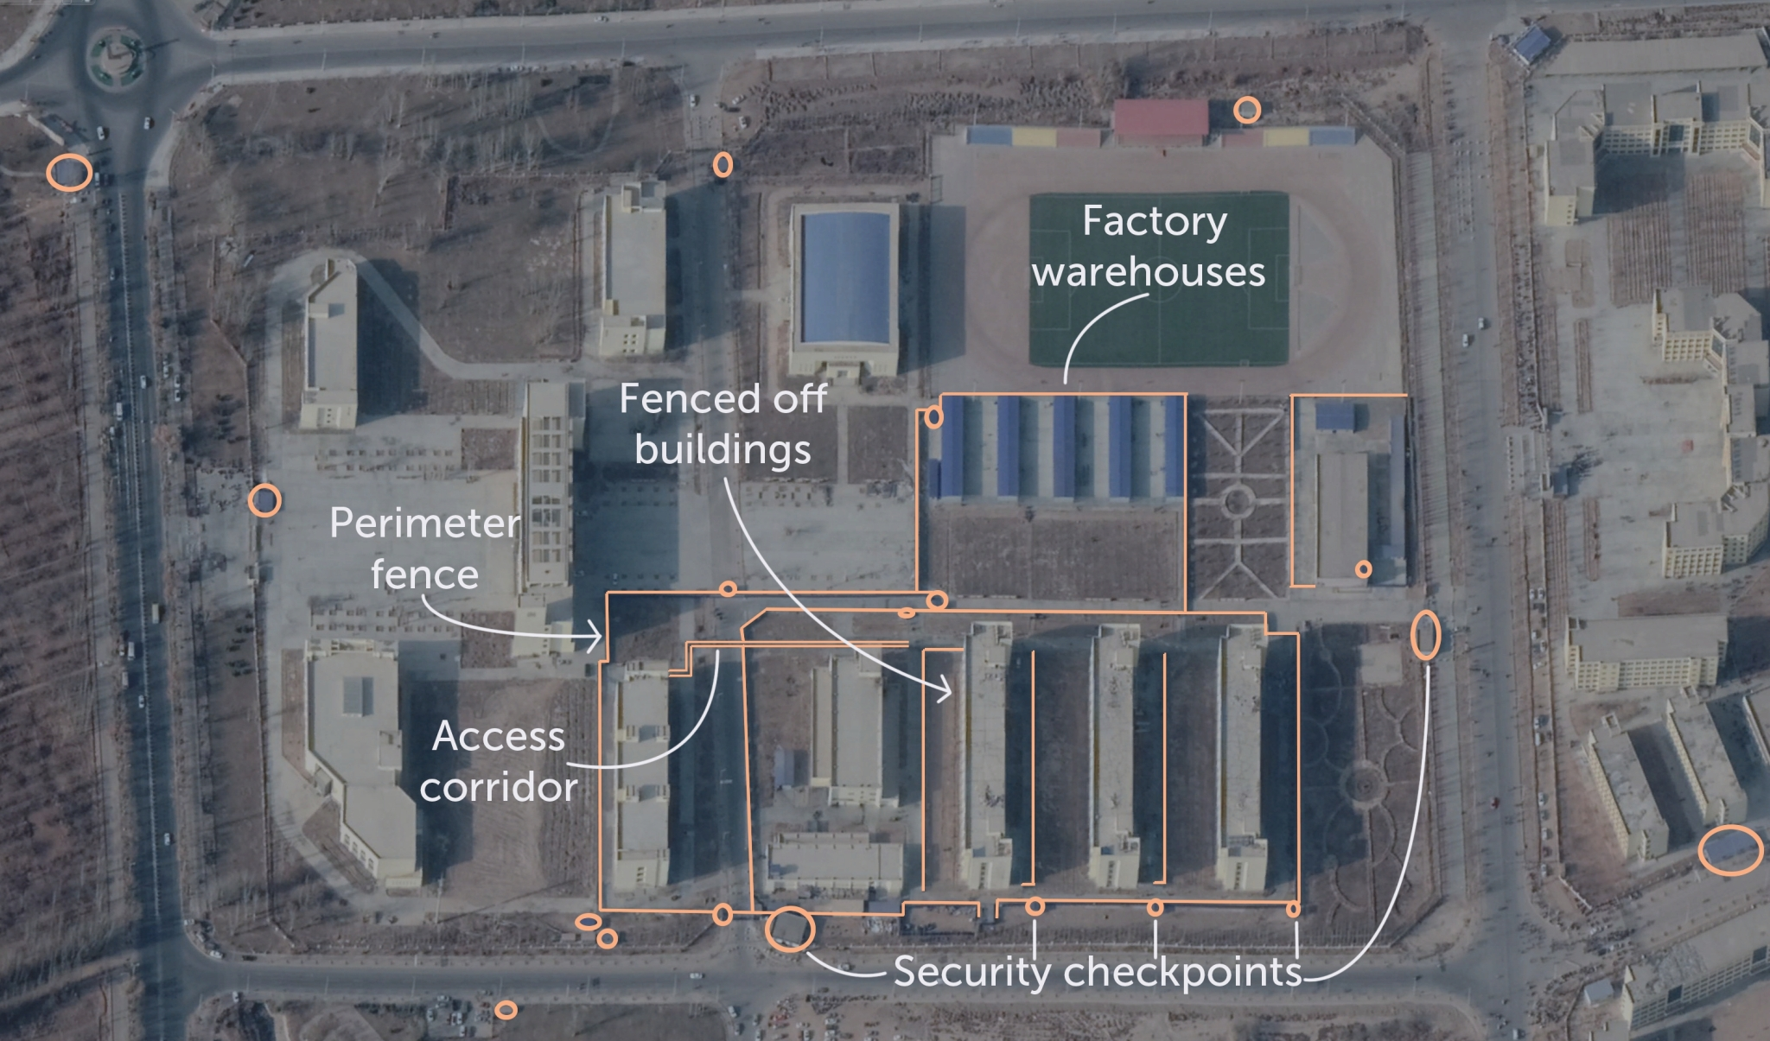
Uyghur Forced Labor
2017 - Present
Of the 11 International Labour Organization (ILO) indicators of forced labor, the Australian Strategic Policy Institute identified 6 relevant indicators for Uyghurs:
Being subjected to intimidation and threats, through arbitrary detention and invasive surveillance
Being placed in a position of dependency and vulnerability, such as by threats to family members
Having freedom of movement restricted, such as by fences, high tech surveillance, living in segregated dormitories, and being transported in dedicated trains
Abusive working conditions, such as political indoctrination, police guard posts in factories, ‘military-style’ management, and a ban on religious practices
Excessive hours, such as after-work Mandarin language classes and political indoctrination sessions that are part of job assignments

Slide 24
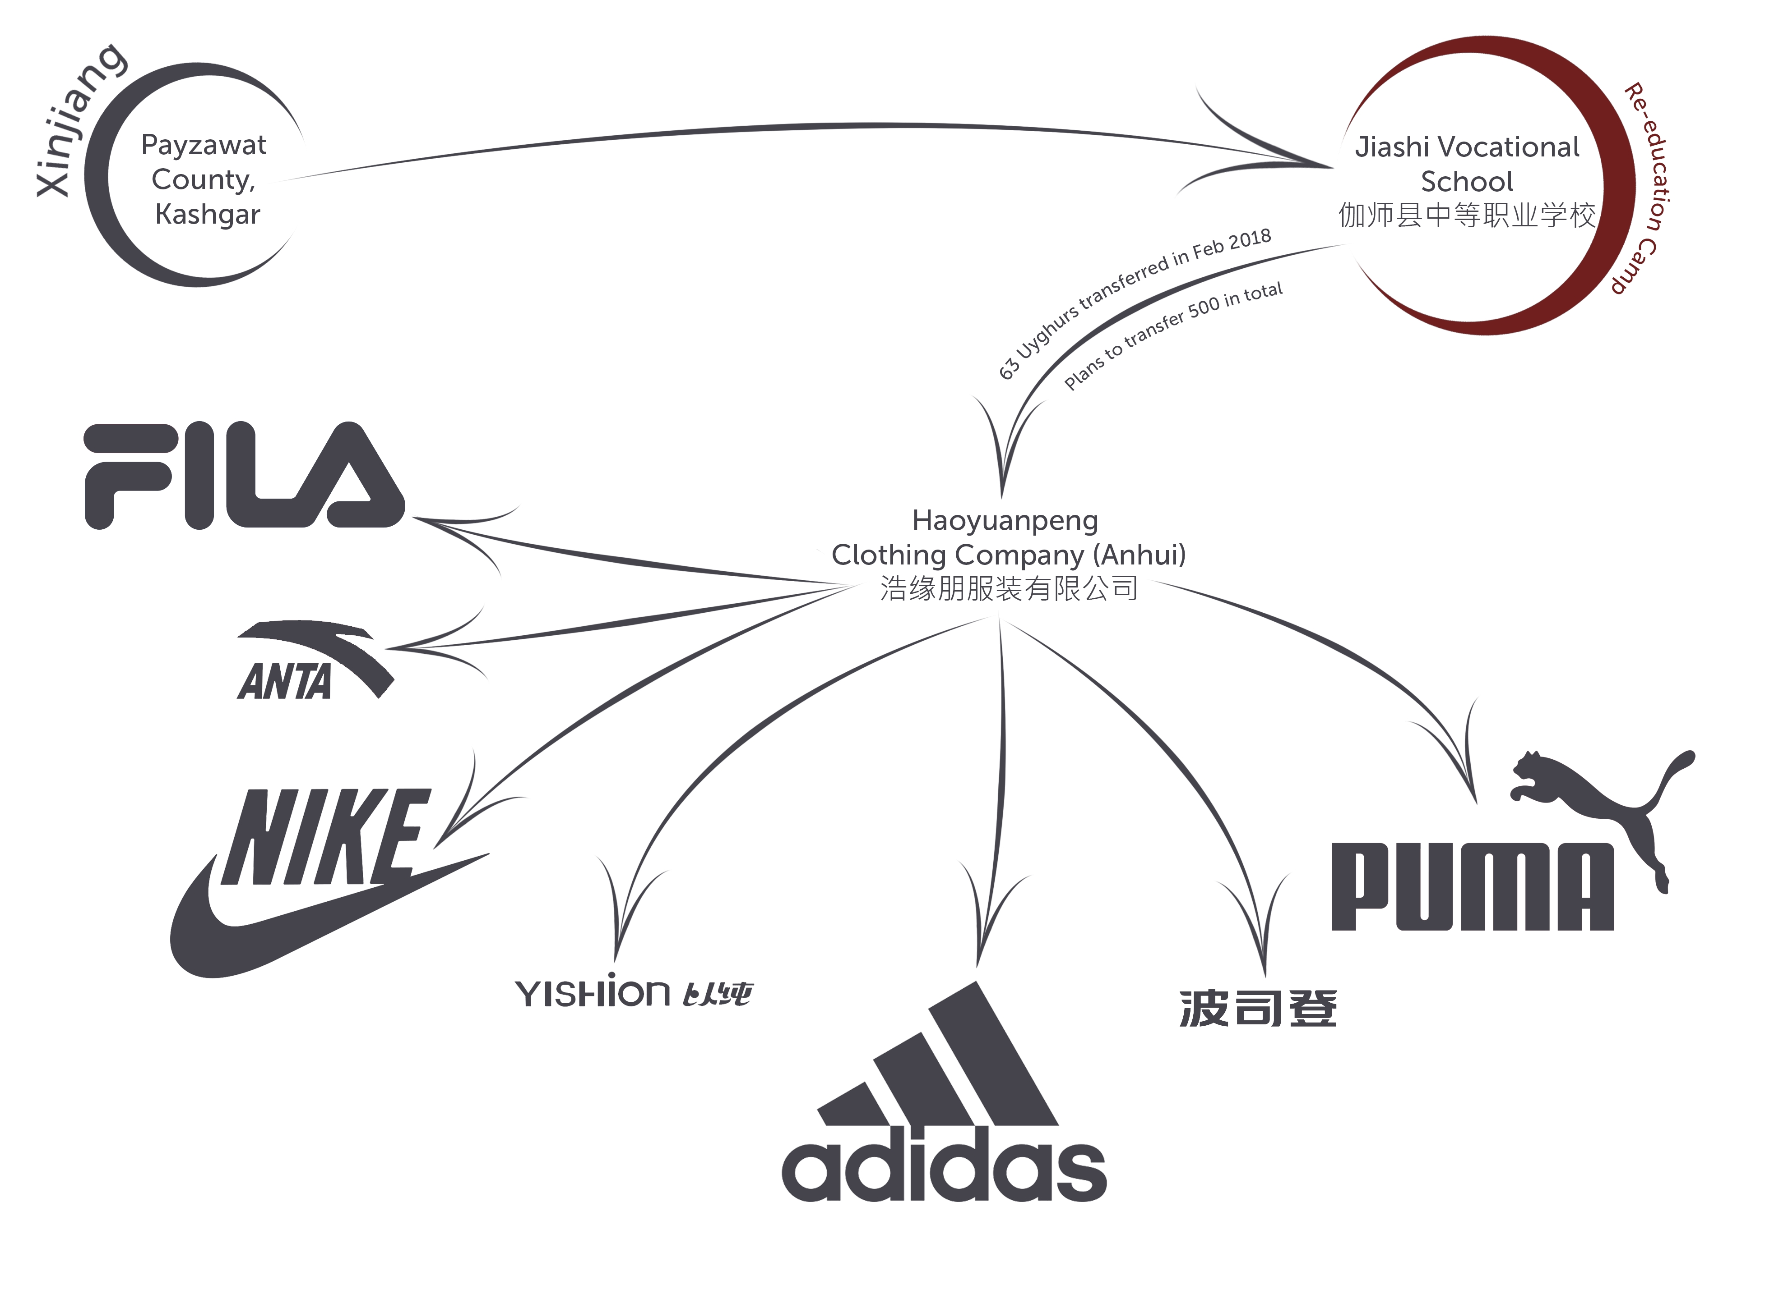
Uyghur Forced Labor Supply Chain
2019 - Present
At least 82 well-known brands use forced Uyghur labor, including Apple, BMW, Gap, Nike, Sony, Samsung, and Volkswagen.
Once Uyghurs "graduate" from "re-education camps", many are sent to factories outside of Xinjiang.
American companies often outsource their production, adding a layer of plausible deniability in that they do not know they are using forced labor, but this is highly unlikely.

Slide 25
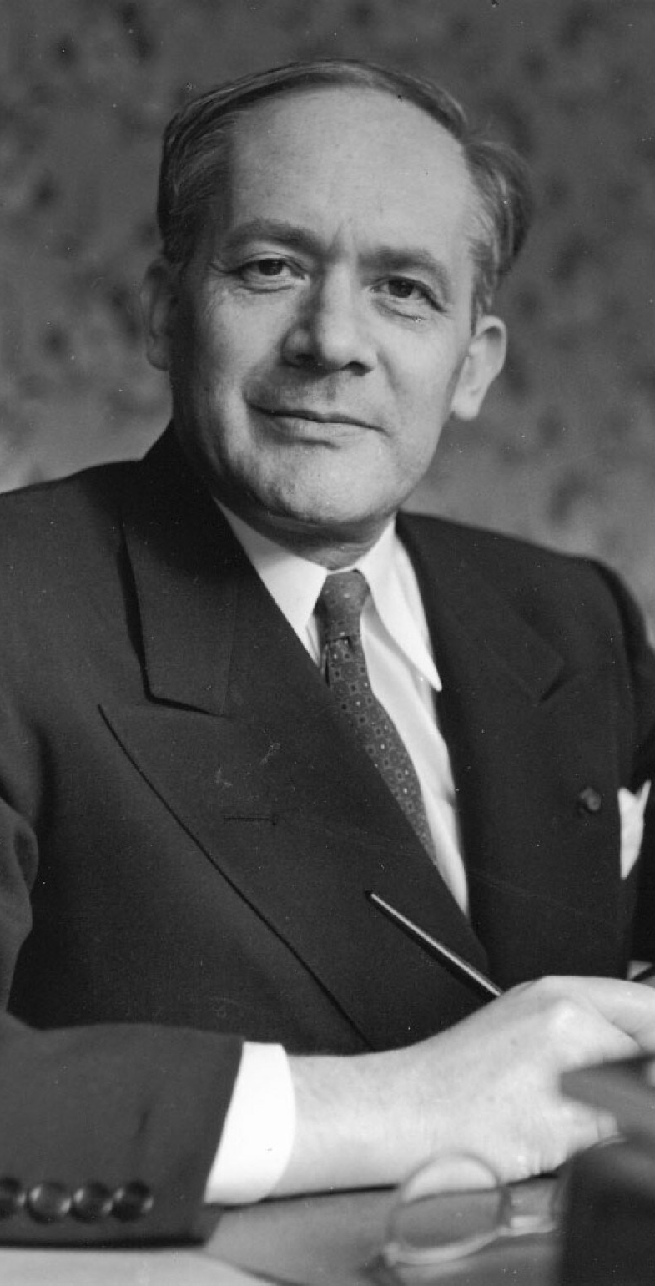
Cultural Genocide is Genocide
1948
Raphael Lemkin was a Polish-Jewish lawyer best known for his coinage of the term "genocide" and his instrumental work on the 1948 UN Genocide Convention.
Cultural genocide, while ultimately not included in the Convention, is included in Lemkin's genocide definition.
Genocide Watch similarly defines genocide according to Lemkin's vision and considers cultural genocide to be genocide.

Slide 26
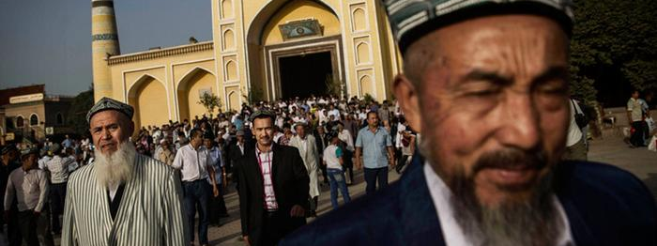
Religious Persecution Documented
2005 - Present
In 2005, Human Rights Watch reported on religious persecution of Uyghurs, making it difficult for Uyghurs to practice their religion.
HRW reported mandatory registration of religious groups, religious freedom being conditional on support for party leaders ensured through required annual political education seminars for Imam's, and the demolition of major Mosques.

Slide 27
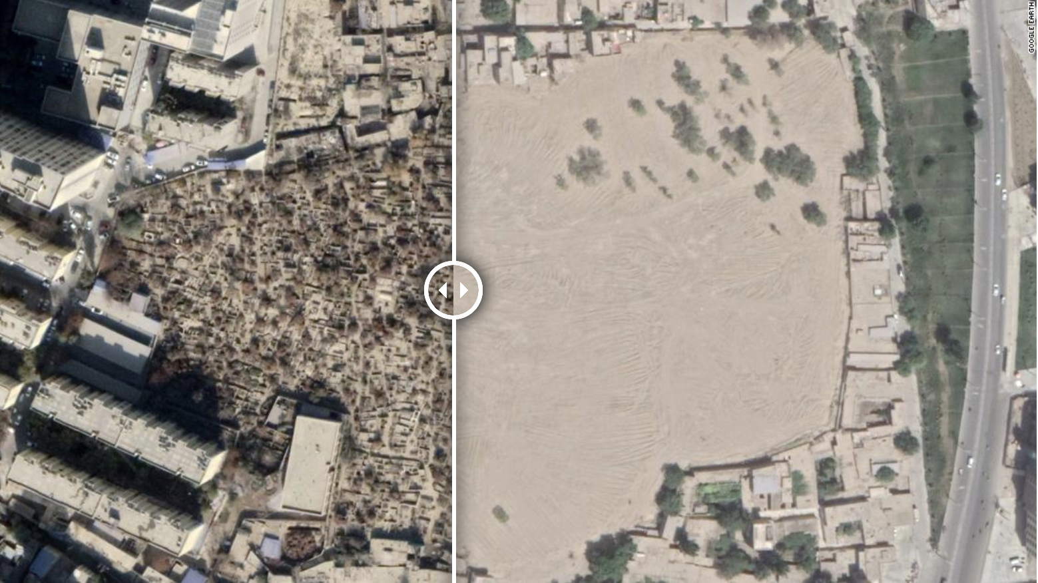
Destruction of Uyghur Cemeteries
2019
CNN reported on the destruction of Uyghur Cemeteries all across Xinjiang. Using satellite imagery, CNN identified more than 100 destroyed Uyghur graveyards.
The government acknowledged these destroyed cemeteries, claiming they were "relocated", though the relocated cemeteries have not been identified yet.

Slide 28
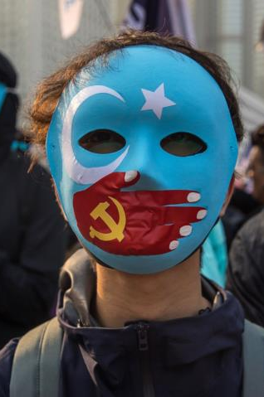
Forced Sterilization is Genocide
December 9, 1948 – Present
China's cultural genocide of the Uyghurs already met Genocide Watch's definition of genocide, but the recently unearthed CCP policy of forced mass sterilization of Uyghurs now also rises to genocide according to international law.
The 1948 Genocide Convention, to which China is a signatory, explicitly includes “imposing measures intended to prevent births within the group" as genocide.

Slide 29
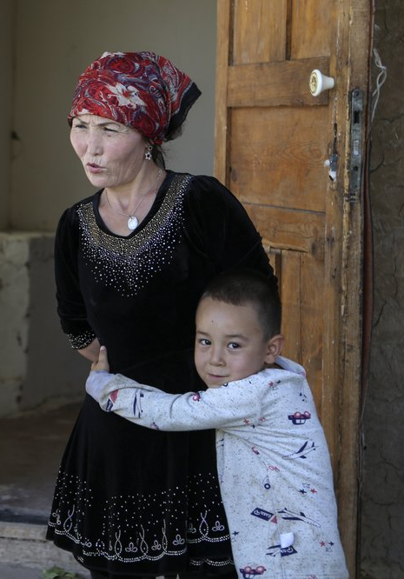
Uyghur Women Arrested For Having Too Many Children
2014 – Present
Along with the arrests of Uyghur men, women have also been targeted for having too many children.
Women who have three or more children are sent to detention centers as punishment. The only way to escape arrest is to pay a large fine that can be 3x the annual disposable income of the county.
Chinese officials raid the homes of Uyghur women in order to find hidden children. Women are threatened with detention if they do not register their children. Local governments reward those who report illegal births.

Slide 30
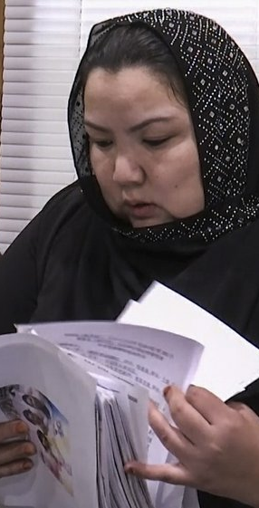
Sterilization Campaign Against Uyghur Women
2014 – Present
In 2014, the CCP began a massive campaign to subject thousands of Uyghur women to non-consensual pregnancy checks, insertion of IUDs, sterilizations, and abortions.
In the detention centers, women are given shots that prevent pregnancy or sterilize them completely. Pregnant women are forced to have abortions. Women are also forced to attend family planning lectures.
The use of IUDs and sterilization has fallen in China but risen in the Xinjiang region. The birth rate in the Uyghur regions of Xinjiang has fallen more than 60% since 2015.
Under Article II(d) of the Genocide Convention, preventing births within a group is evidence of genocide.

Slide 31
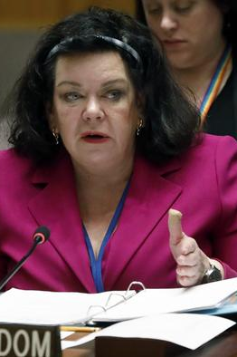
23 Countries Condemn China at UN General Assembly
October 29, 2019
British UN Ambassador Karen Pierce delivered a joint statement on the persecution of Uyghurs at the UN General Assembly on behalf of 23 countries, including the US.
The countries expressed shared concerns regarding reports of mass detention, restrictions on cultural and religious practices, mass surveillance, and other human rights violations.
They called on China to "uphold its national and international obligations to respect human rights," and to allow UN monitors access to detention centers.

Slide 32
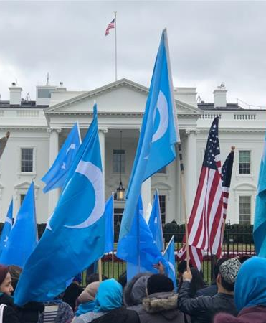
Uyghur Human Rights Policy Act
June 17, 2020
The Uyghur Human Rights Policy Act was signed into law on June 17, 2020.
The law authorizes the U.S. to impose sanctions and visa bans against Chinese officials responsible for human rights violations against Uyghurs and other Muslim ethnic groups.
The law also requires periodic reports be sent to Congress about human rights abuses against Uyghurs, and the protection of U.S. citizens and Chinese nationals from abuse or harassment by the CCP.

Slide 33
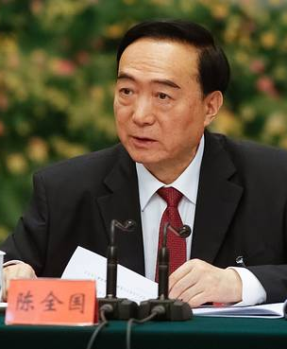
Chinese Senior Officials Sanctioned with Global Magnitsky Act
July 9, 2020
The U.S. Department of Treasury imposed targeted sanctions against four senior Chinese officials responsible for human rights violations in Xinjiang.
The officials added to the Global Magnitsky Act designations list included Chen Quanguo, Communist Party Secretary for Xinjiang, and Wang Mingshan, director of the Xinjiang Public Security Bureau.
The State Department's visa restrictions also prevent the four senior officials and their families from entering or accessing their assets in the U.S.

Slide 34

US Blacklists 11 Firms Over Treatment of Uyghurs
July 20, 2020
The U.S. Department of Commerce blacklisted 11 Chinese firms for their connection to human rights violations against Uyghurs in Xinjiang. The 11 firms joined 37 other blacklisted Chinese companies.
The blacklisted companies were involved in using forced labor of Uyghurs and other Turkic minorities. The sanctions prevent the Chinese companies from purchasing American technology or products.
The list of sanctioned companies included suppliers for major international brands such as Apple, Ralph Lauren, Google, etc.

Slide 35
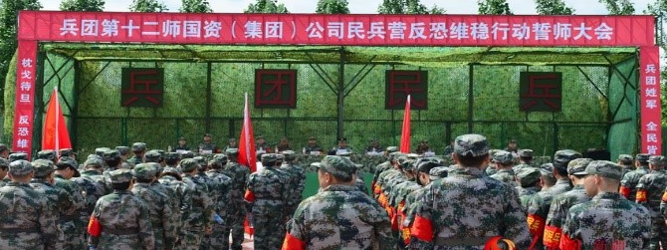
U.S. Sanctions Xinjiang Production and Construction Corps
July 31, 2020
The U.S. Department of Treasury sanctioned Xinjiang Production and Construction Corps (XPCC) and two senior officials under the Global Magnitsky Act for human rights abuses against Uyghurs.
XPCC is a paramilitary organization under the direct control of the Chinese government. It operates schools, hospitals, and prisons in Xinjiang. XPCC is involved with implementing mass surveillance, mass detention, and forced labor in Xinjiang.
This sanction is more than just symbolic as it puts economic pressure on XPCC and CCP.

Slide 36
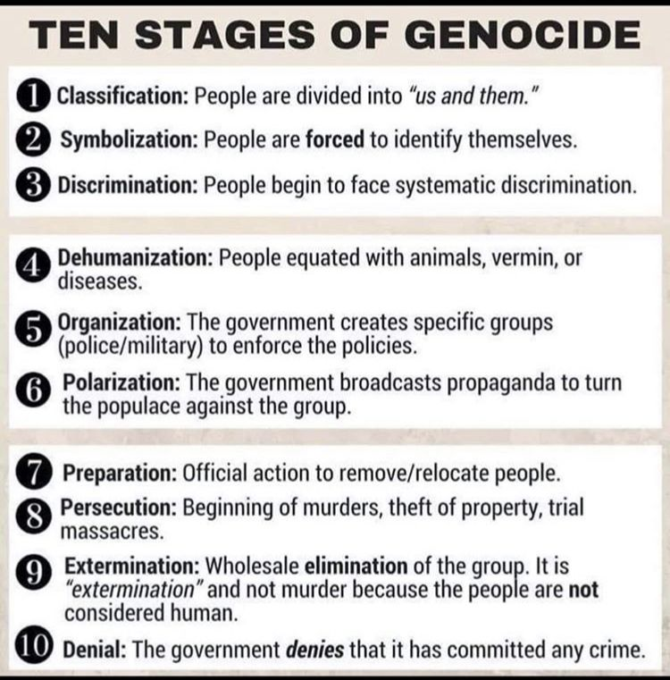
Ten Stages of Genocide
Dr. Gregory H. Stanton, Founding President of Genocide Watch, uses the Ten Stages of Genocide to describe and explain the genocidal process.
The stages are: (1) Classification, (2) Symbolization, (3) Discrimination, (4) Dehumanization, (5) Organization, (6) Polarization, (7) Preparation, (8) Persecution, (9) Extermination, and (10) Denial.

Slide 37
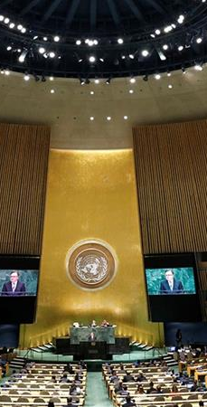
Conclusion
According to Genocide Watch's Ten Stages of Genocide, the CCP's genocidal campaign against the Uyghur minority in Xinjiang is a Genocide Emergency.
The Uyghur genocide has progressed to Stage 8: Persecution, Stage 9: Extermination, and Stage 10: Denial.
It is imperative that the international community act to stop the ongoing genocide and seek justice for the Uyghur victims before it is too late.
Genocide Watch recommends:
The U.S. Senate should pass the Uyghur Forced Labor Prevention Act to prevent the import of goods from Xinjiang.
The U.S. government should continue targeted sanctions against Chinese officials responsible for severe religious freedom violations.

