Slide 1
Country Profile
Oct 1960
Nigeria gained full independence from the British on October 1, 1960. Since independence, Nigeria has experienced significant periods of violence and instability, including a number of military coups, a bloody civil war from 1967-1970, sectarian conflict, and a brutal jihadist insurgency. Despite this turmoil, Nigeria today is a democratic republic (since 1999), has large pockets of stability throughout the country, and boasts the largest economy in Africa.

Slide 2
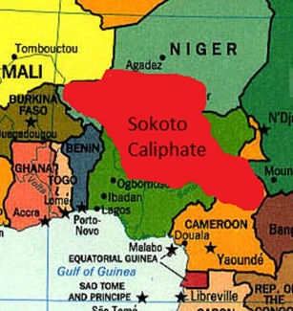
Spread of Islam in Northern Nigeria
1804 to 2020
Islam in Nigeria dates back to the 11th century when it was primarily adopted in the northeast of the country. In 1804, a Fulani scholar Uthman dan Fodio launched a jihad, further spreading Islam across Nigeria and creating the Sokoto Caliphate in 1812. The creation of the Caliphate involved the conversion and incorporation of other ethnic groups, including the Hausa people.

Slide 3
British Colonization
1914 to 1960
The British-owned Royal Niger Company began operating in present-day Nigeria in the late 19th century. The Company divided Nigeria into two protectorates: Northern Nigeria and Southern Nigeria. As the Royal Niger Company became increasingly profitable, the British government decided to combine these arbitrarily defined territories into a single colony on January 1, 1914.

Slide 4
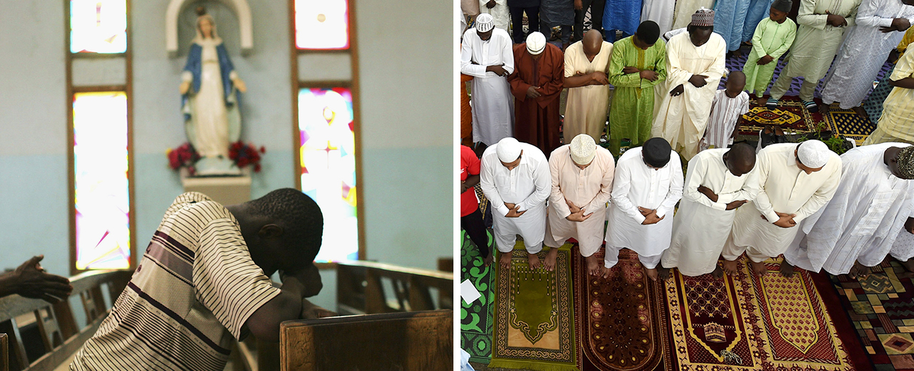
Nigeria's Religious Divide
1948 to 2020
The British-enforced amalgamation of northern and southern Nigeria has created a country deeply divided along ethno-religious lines. The north of the country is predominately comprised of Hausa-Fulani Muslims, while the south is mostly Berom Christians. Countrywide, there is a near-even split of religions, with 50% Muslims and 45% Christians.

Slide 5
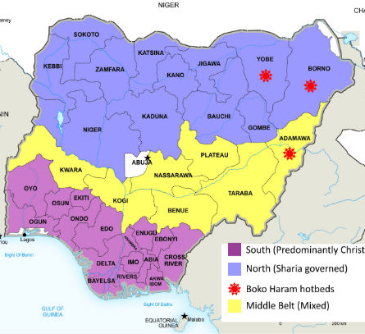
History of Religious Violence in Nigeria
1953 to 2020
The Middle Belt has long been a hotbed for communal, ethnic, and religious conflict due to its status as the most heterogeneous region of the country. An increase in religious tension at a national level has spilled over into the Middle Belt, as fears over the perceived "Islamization" of the country have sparked violence.

Slide 6
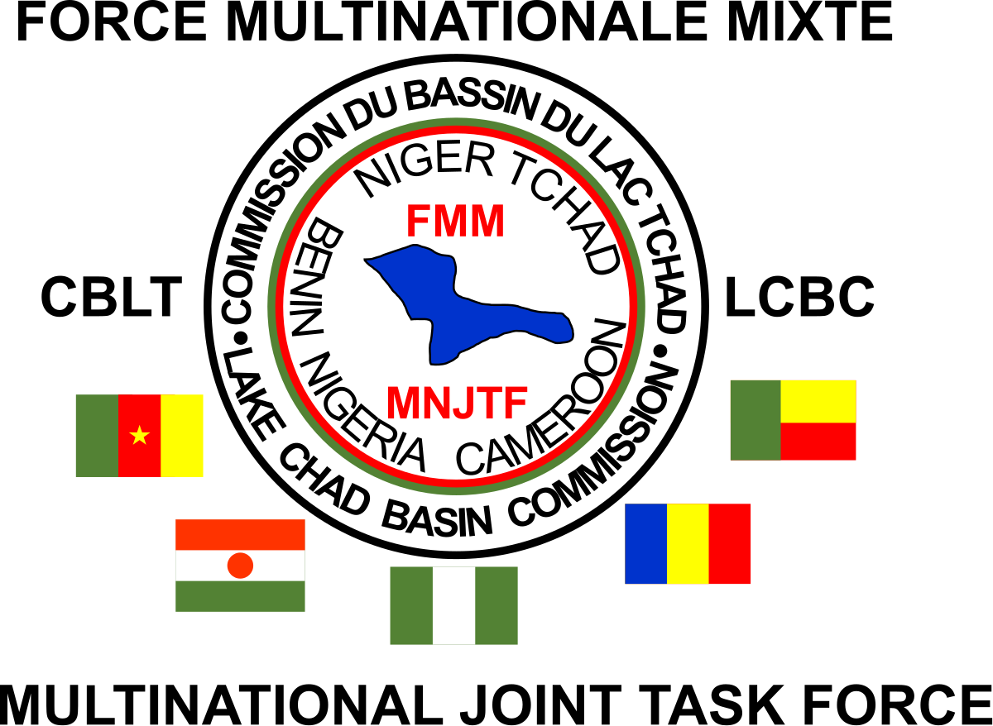
Multinational Joint Task Force
1998
Niger, Chad, and Nigeria formed the Multinational Joint Task Force in 1998 to protect free movement across borders and prevent terror activities. The task force's primary focus was the security of the Borno State.

Slide 7
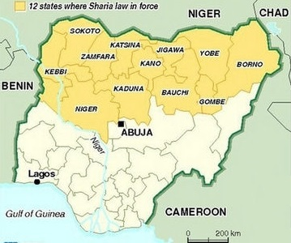
Implementation of Shari'a
Oct 27, 1999 to Dec 31, 2001
States in northern Nigeria began to implement Shari'a in 1999. By the end of 2001, 12 states were actively operating under an Islamic legal system. While popular among many devout Muslim residents in the north, this shift towards increased piety from a top-down level has deepened the religious divide in Nigeria, fostering fears of an "Islamization" of the country that set off a series of violent religious riots.

Slide 8
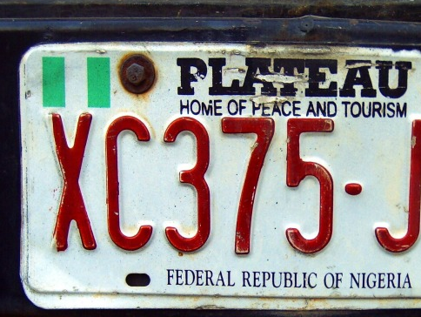
Religious Riots and Violence
2000 to 2010
A number of bloody religious riots shook the country from 2000-2010: Kaduna Riots (2000), Jos Riots (2001, 2008, 2010), Miss World Riots (2002), and Yelwa Massacres (2004). Thousands have been killed and tens of thousands displaced in these episodes of violence between Christians and Muslims as they battle over religious, cultural, and political influence across Nigeria.

Slide 9
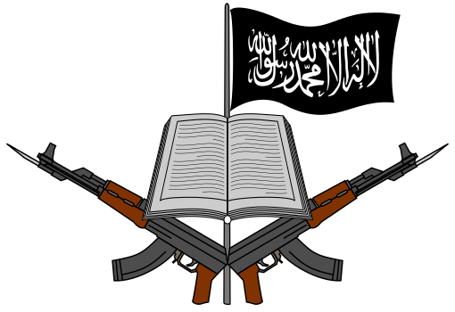
Founding of Boko Haram
In the context of a shift towards fundamentalist Islamic practices in northern Nigeria, radical cleric Mohammed Yusuf founded Boko Haram in Maiduguri, Borno state in 2002. Boko Haram espoused hardline Islamic teachings and opposed the presence of Western education, originally introduced by the British Empire, in northern Nigeria.

Slide 10
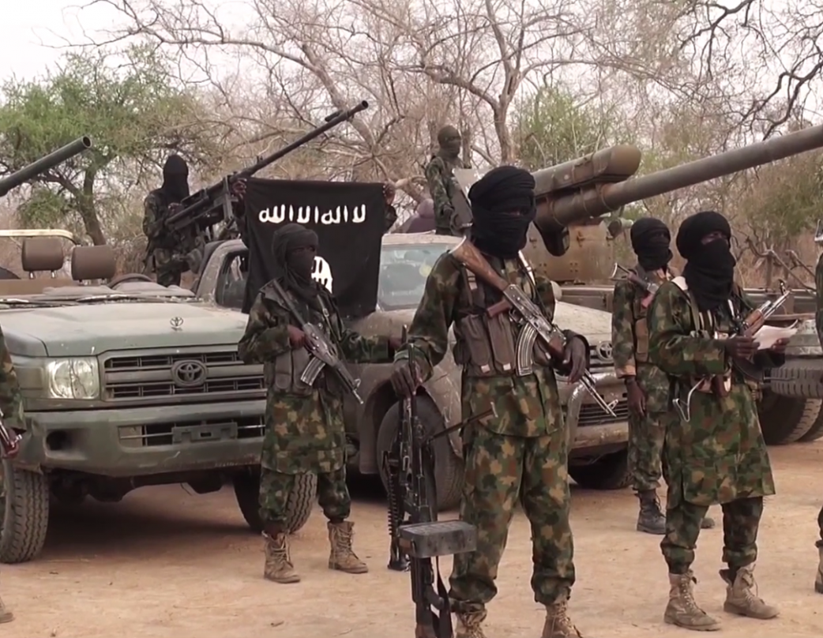
Boko Haram's Ideology
2008
Boko Haram is an indigenous Nigerian movement, but it also represents a trend in a global pattern of the proliferation of Islamist groups. As early as 2003, Boko Haram members began to refer to themselves as the Taliban, reflecting an ideological connection to the movement in Afghanistan, despite no direct links. Similar to the Taliban, Boko Haram was intent on creating a society based on Islamic law, in contrast to the secular Nigerian state.

Slide 11
Summary of Boko Haram Insurgency
Dec 2008 to Dec 2013
Boko Haram’s anti-government campaign intensified its violence following the 2009 death of its leader, Mohammed Yusuf. At the time, Boko Haram violence was predominantly aimed at security forces. Many civilians were not afraid of Boko Haram, as it did not directly target people who had not antagonized it. It was even able to generate some public support in opposition to an unpopular government within the target region. Over time, violence escalated, and the group’s definition of "legitimate" targets expanded substantially.

Slide 12
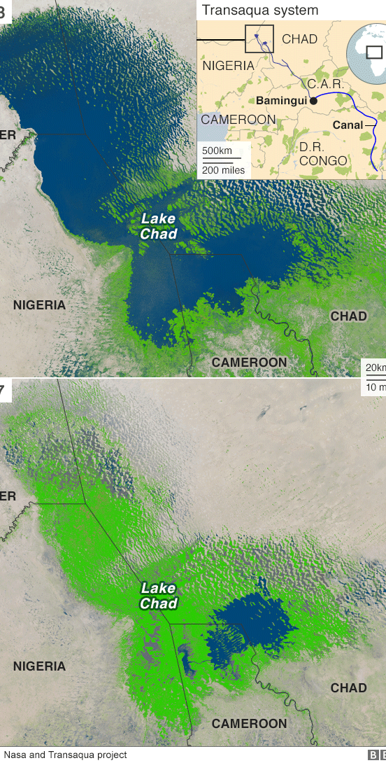
Recruitment in the Lake Chad Region
2009
The Lake Chad region is in many ways uniquely vulnerable to the spread of jihadism. Since the 1960s, Lake Chad has shrunk by 90% as a result of climate change-induced desertification. Of the 20-30 million people who relied on the lake to survive, as many as half are now faced with imminent famine and rely on humanitarian assistance to survive. This instability in the region has proven to be highly conducive to Boko Haram's recruitment efforts.

Slide 13
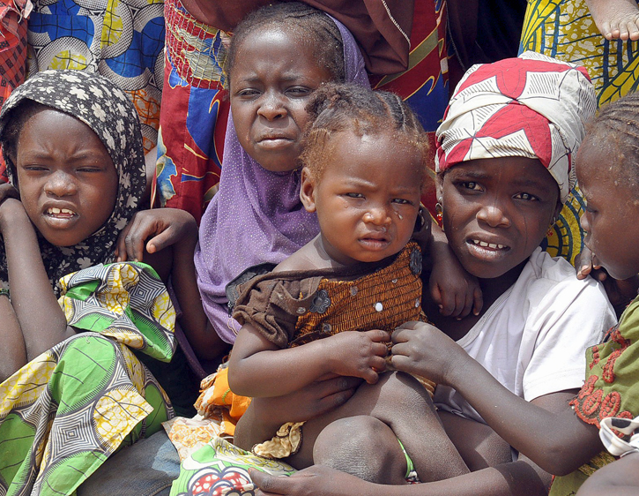
Humanitarian Consequences of Boko Haram's Insurgency
2009 to 2020
As a result of the ongoing violence in Nigeria, more than 7.7 million Nigerians are now in need of protection and humanitarian assistance. Millions of Nigerians are currently displaced and malnutrition, food insecurity, and gender-based violence are rampant. The widespread insecurity further aids the jihadist cause, who are better able to recruit from these severely underserved populations.

Slide 14
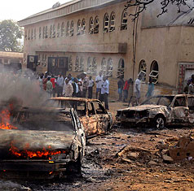
Boko Haram's Goals
2009
Boko Haram's central mission is to violently oppose the Westernization and secularization of Nigeria. In order to actualize this goal, Boko Haram has imposed a strict Shari'a-based system of local governance, attacked government soldiers, officials, and institutions, and targeted Christians and Muslims that they perceive to be "non-believers". Some of Boko Haram's most heinous attacks have targeted churches.

Slide 15
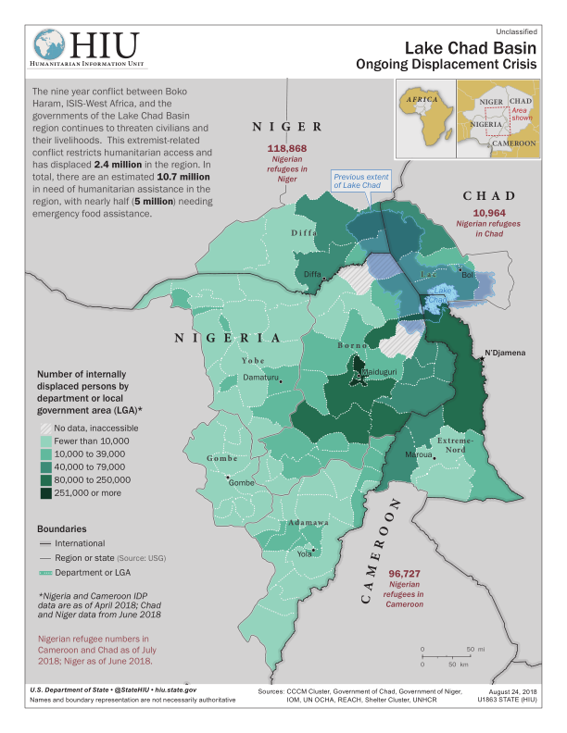
Impact of Boko Harm's Insurgency in Nigeria and the Lake Chad Region
2009
Boko Haram quickly became a ubiquitous presence in northeast Nigeria and the surrounding Lake Chad region. In 2015, the group received dubious recognition as the world's deadliest terrorist group, with the majority of attacks taking place in this region. Boko Haram has killed more than 27,000 people across Nigeria, Cameroon, Niger, and Chad.

Slide 16
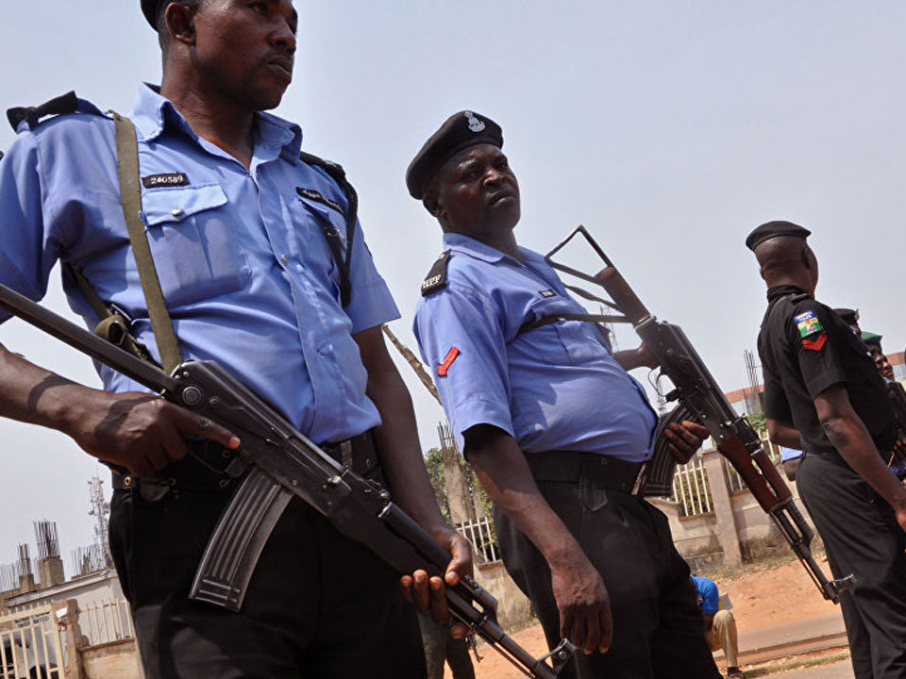
Outbreak of Violence in Bauchi
Jul 25, 2009
Following the arrests of several leaders of the group, Boko Haram members attacked and burned down a police station in Bauchi. The military and police responded by raiding neighborhoods. Fifty people were killed and 200 were taken into police custody.

Slide 17
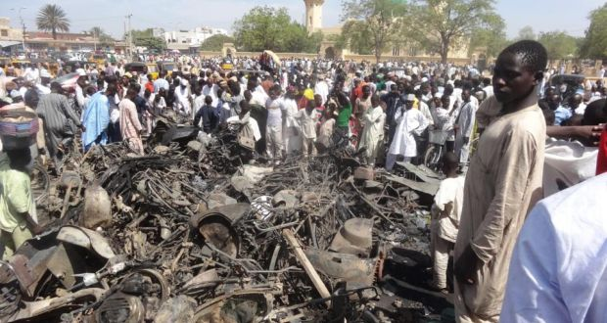
2009 Uprising
Jul 25, 2009 to Jul 30, 2009
The growing friction between the group and the security forces reached its climax in July 2009. Over five days, attacks perpetrated by both sides left more than 800 people dead in Borno, Bauchi, Yobe, and Kano states.

Slide 18
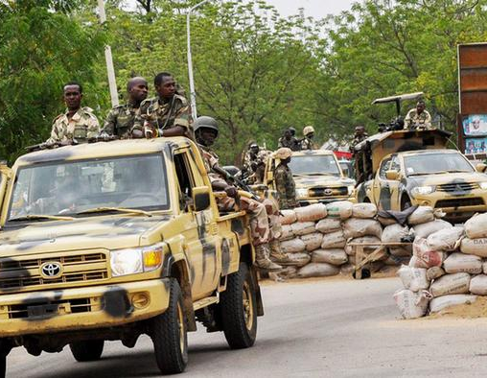
Military Intervention
Jul 26, 2009
Yusuf’s followers launched coordinated attacks on Maiduguri streets. They controlled large parts of the city, but the military intervened, killing dozens of the group’s members. Security forces captured Mohammed Yusuf and he was reportedly killed in police detention. After this incident, Boko Haram appeared to disband.

Slide 19
Violence Escalates Across the Country
Jul 26, 2009 to Jul 29, 2009
The events led to coordinated, deadly attacks launched by Yusuf’s followers on Maiduguri streets. Police headquarters, homes of police officers, and churches were targeted. The main prison was raided, freeing inmates and killing guards. Boko Haram controlled large parts of the city, but the military intervened with tanks and troops, killing dozens of the group’s members.

Slide 20
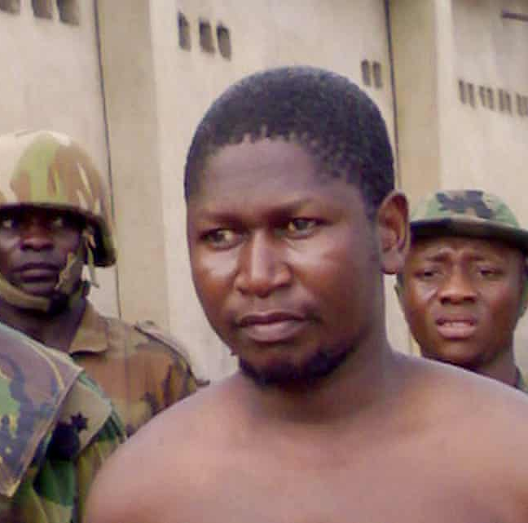
Yusuf's Execution
Jul 29, 2009
After being captured by security forces, Mohammed Yusuf was reportedly killed in police detention. After that incident, Boko Haram appeared to be disbanded.

Slide 21
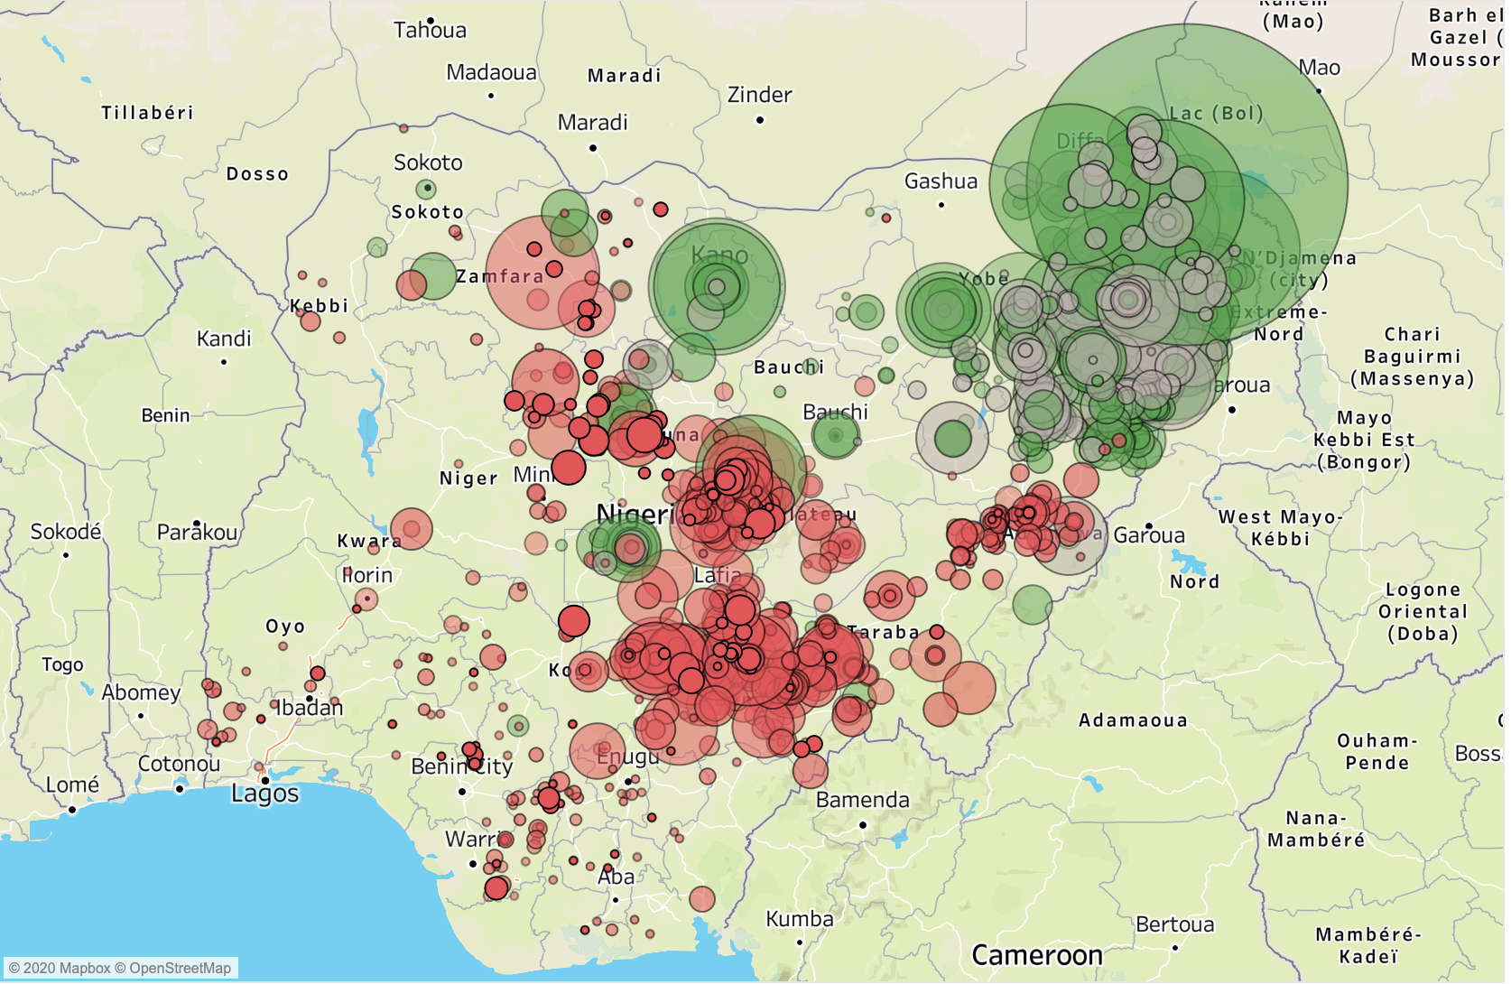
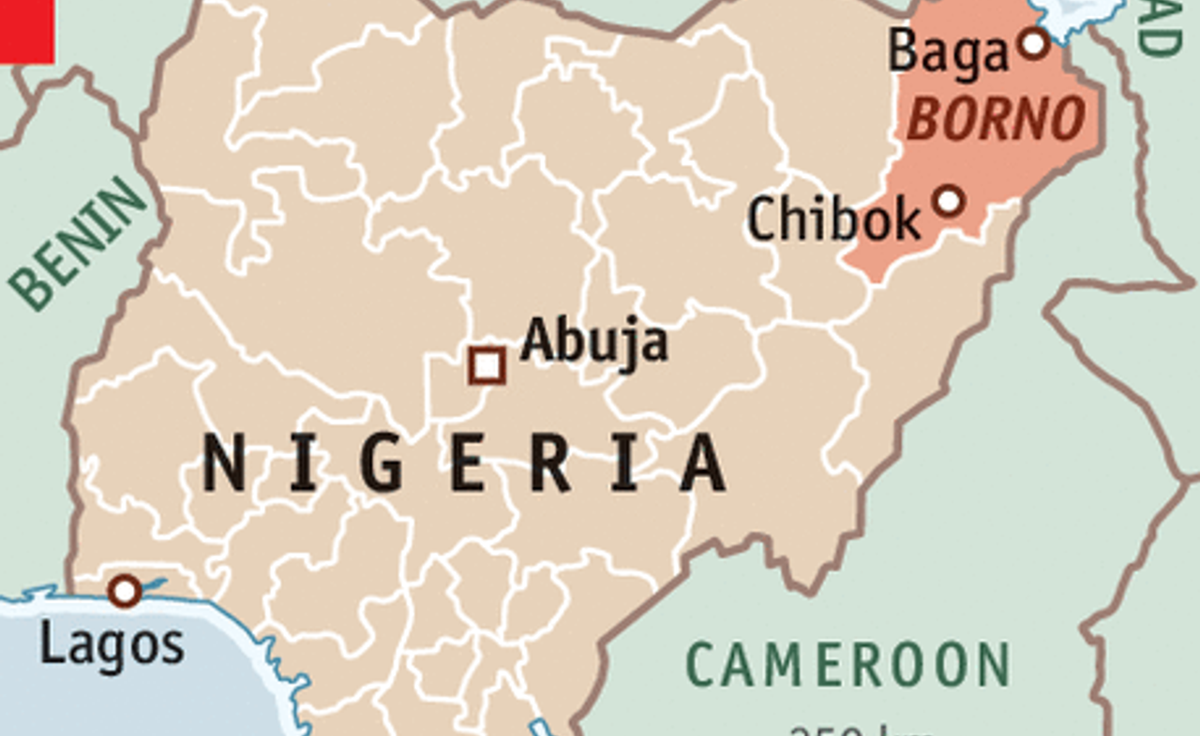
Borno State
2010
Borno state in northeast Nigeria has served as Boko Haram's stronghold since its formation. In 2015, Boko Haram took control over Borno state and parts of the neighboring areas to establish a caliphate. While Boko Haram lost much of its physical territory, the group continues to exert a commanding influence there, maintaining control through violence and fear.

Slide 22
2010 Resurgence
Jun 2010
After a year of regrouping, Boko Haram emerged under the leadership of Abubakar Shekau with a more militant agenda and brutal tactics. Shekau vowed to exact revenge and declared the “holy war” against the Nigerian government and Christians. They launched their first attacks in the state of Borno. Shekau had been mistakenly declared dead after July 2009 events.

Slide 23
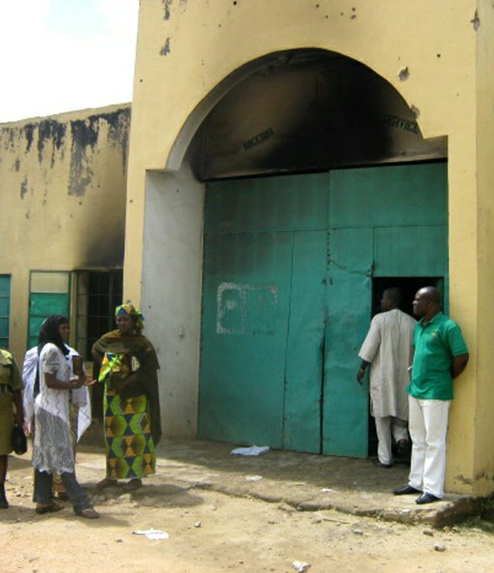
Bauchi Prison Break
Sep 6, 2010
Boko Haram militants attacked a jail in Bauchi and freed more than 700 inmates, many of whom belonged to the sect. Four people died in gunfire, including bystanders.

Slide 24
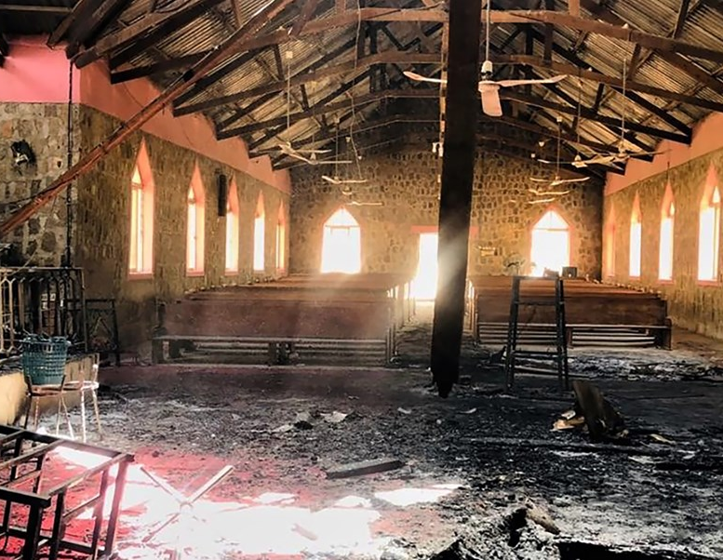
Christmas Attacks 2010
Dec 24, 2010 to Dec 31, 2010
Gunmen attacked two churches in the city of Maiduguri on Christmas Eve, killing a cleric and five other Christians. On the same day, a series of bombs detonated in Christian neighborhoods in Jos, leaving 33 dead. These were the first major bombings of the group, along with the following in Abuja on New Year’s Eve.

Slide 25
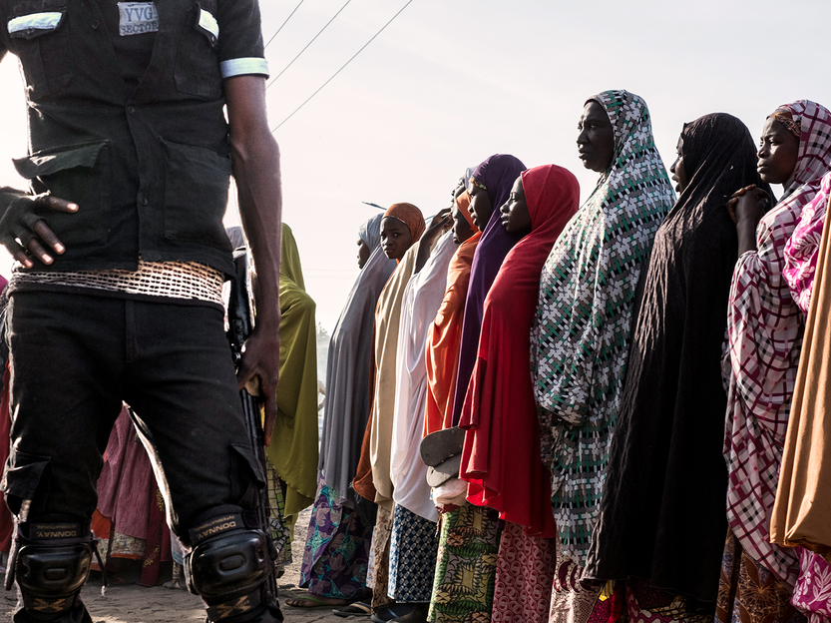
COIN Campaign
2010 to 2020
Nigerian government launched a counter-insurgency campaign against Boko Haram marked by arbitrary arrests, disappearances, and killings of civilians accused of being terrorists.

Slide 26
Ultimatum to Southern Christians
Jan 1, 2011 to Jan 11, 2011
Boko Haram issued a three-day ultimatum to southern Nigerians to leave the North. After the deadline passed, members of the group carried out a series of attacks on Christians and churches.

Slide 27
Independent National Electoral Commission Bombed
Apr 7, 2011
A bomb exploded at the offices of the Independent National Electoral Commission (INEC), an electoral management body that oversees the fairness of the elections in Nigeria, in Suleja. The blast killed 16 people.

Slide 28
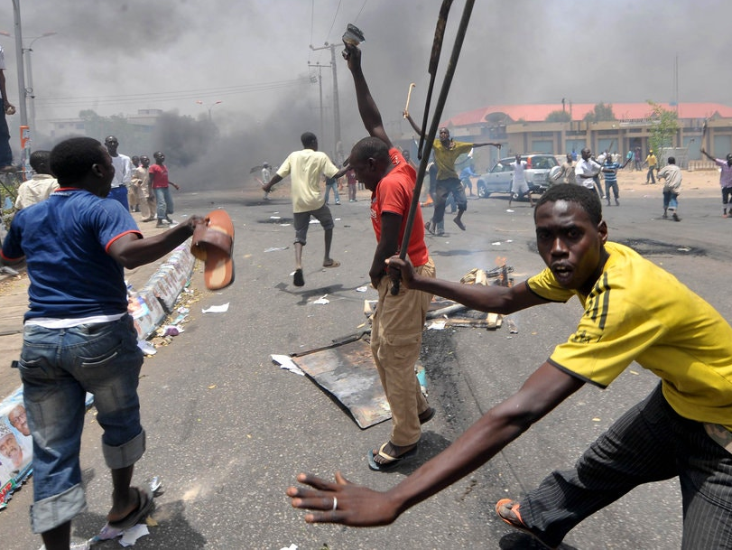
Goodluck Jonathan Elected
Apr 15, 2011
Goodluck Jonathan, a Southern Christian, won the presidential elections on April 16, amid violent protests. The elections were described as among the fairest in Nigeria’s history, but the aftermath left over 800 people dead. Muslim rioters targeted and killed Christians and members of ethnic groups from the South.

Slide 29
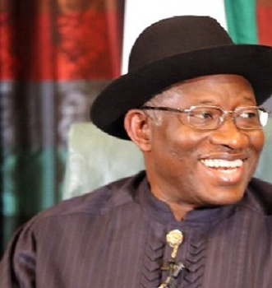
Bombings after Presidential Inauguration
May 28, 2011
Boko Haram carried out a series of bombings after Goodluck Jonathan’s Presidential Inauguration. In Bauchi, a blast at an army barrack killed 14 people.

Slide 30
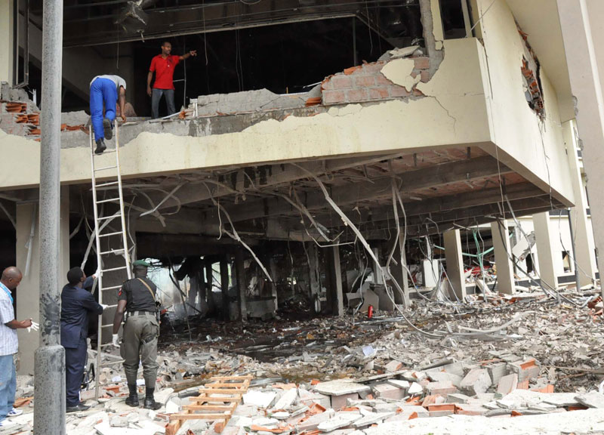
UN Building Bombed
Aug 25, 2011
A suicide bomber detonated an explosives-laden vehicle outside the U.N. headquarters in Abuja, killing 23 people and injuring over 100. This was the first high-profile international target within Nigeria.

Slide 31
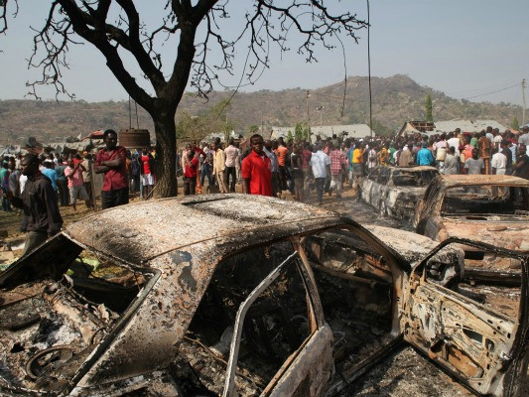
Attacks on Yobe, Damaturu and Borno
Nov 3, 2011
More than 100 died in multiple coordinated attacks in Yobe, Damaturu, and Borno states. Boko Haram militants utilize IEDs and vehicle-borne IEDs to target security forces, markets, and 11 churches.

Slide 32
Christmas Attacks 2011
Dec 24, 2011
On Christmas Day, a string of bombs struck several churches, leaving dozens dead and wounded in the cities of Madalla, Jos, Kano, Damaturu, and Gadaka. St. Theresa’s Church in Madalla reported the highest death toll after 43 worshipers and bystanders died in the explosion.

Slide 33
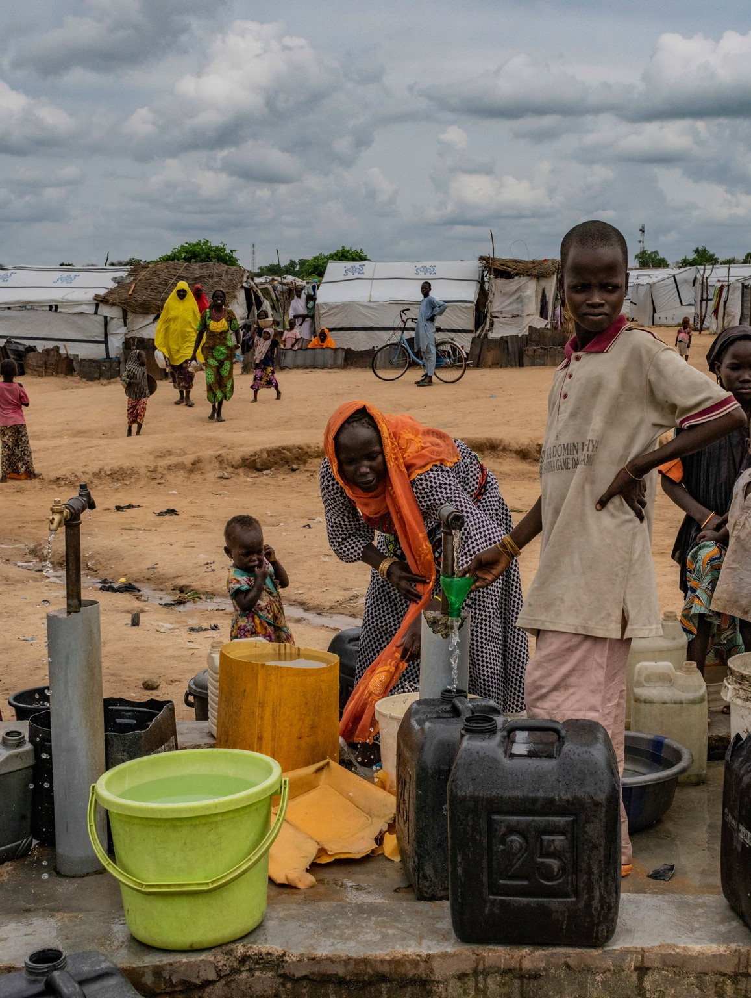
State of Emergency Declared 2012
Dec 30, 2011
President Goodluck Jonathan declared the state of emergency after a spate of Boko Haram attacks. It remained in effect for 15 months and affected 15 areas of 4 northern states. The regulations did not ameliorate the thread and the death toll significantly increased.

Slide 34
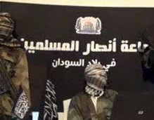
Ansaru's Excision
Dec 2011
A dissident faction that challenged Shekau’s leadership and methods emerged in January 2012, using the name of Ansaru. The militant Islamist group appointed Abu Usmatul Al-Ansari as its leader.

Slide 35
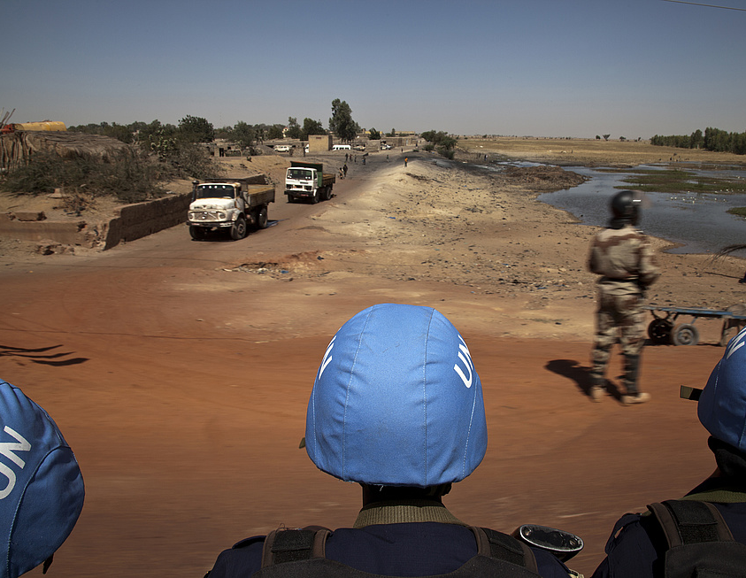
Instability Across the Sahel
2012 to 2020
Boko Haram has proven to be the first in a troubling series of armed Islamist groups across the Sahel. While Boko Haram has terrorized Nigeria, Niger, Cameroon, and Chad, groups that have expressed ideological salience to Boko Haram, such as Islamic State in the Greater Sahara, the Group for the Support of Muslims (JNIM), and Ansaroul Islam have launched insurgencies in Mali and Burkina Faso.

Slide 36
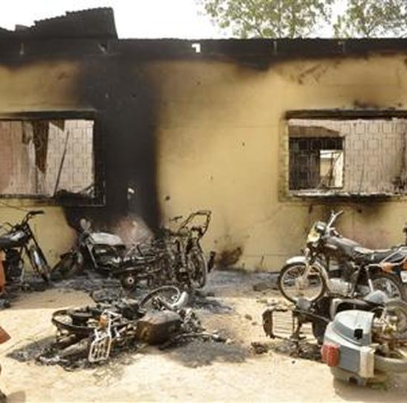
Attacks in Kano
Jan 19, 2012
On January 19th, Boko Haram perpetrated one of its deadliest attacks, leaving 185 dead in the city of Kano. The coordinated series of bombings and shootings mostly targeted police stations and government offices.

Slide 37
Easter Bomber
Apr 7, 2012
A suicide car bomber killed at least 41 people on Easter Day in Kaduna. The explosion occurred on a busy street nearby a Christian church, despite the great number of security forces displayed in the area.

Slide 38
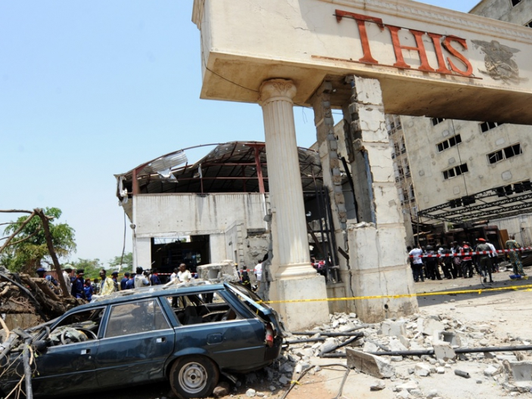
“ThisDay” Offices Bombed
Apr 25, 2012
Suicide car bombers targeted the offices of Nigerian newspaper ThisDay in Abuja and Kaduna. At least seven people were killed. The media outlet is broadly supportive of Christian President Goodluck Jonathan. The group threatened to attack other media.

Slide 39
Religious Clashes in Kaduna and Damaturu
May 2012
Suicide bomb attacks on churches in Kaduna State left at least 21 people dead. The bombing sparked reprisal killings in Kaduna and Damaturu. The state’s curfew failed to stop days of sectarian violence in which almost 100 people – both Muslims and Christians – died.

Slide 40
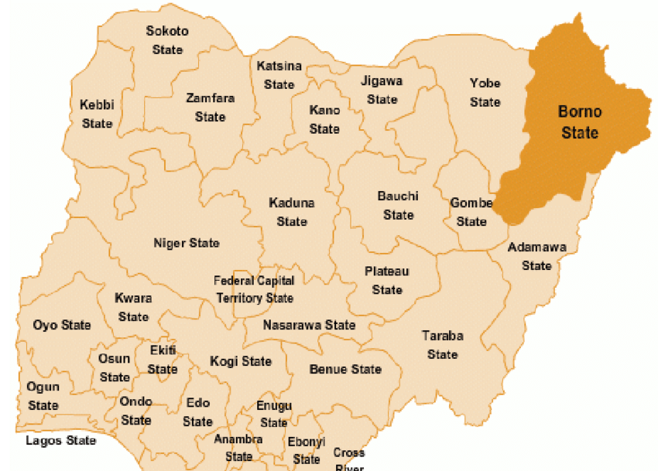
Borno State's Regional Impact
Jan 2013 to Jan 2014
Nigeria's Borno State borders Niger, Cameroon, and Chad. Boko Haram increased operations, including kidnappings, in northern Cameroon. Many of these kidnappings were coordinated with Ansaru, a splinter group of al-Qaeda

Slide 41
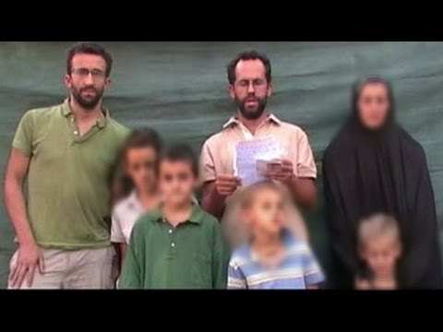
Boko Haram Kidnaps French Family
Jan 2013
Boko Hara kidnapped a family of seven French tourists in northern Cameroon. The group released the hostages, along with 16 others, two months later for $3.15 million.

Slide 42
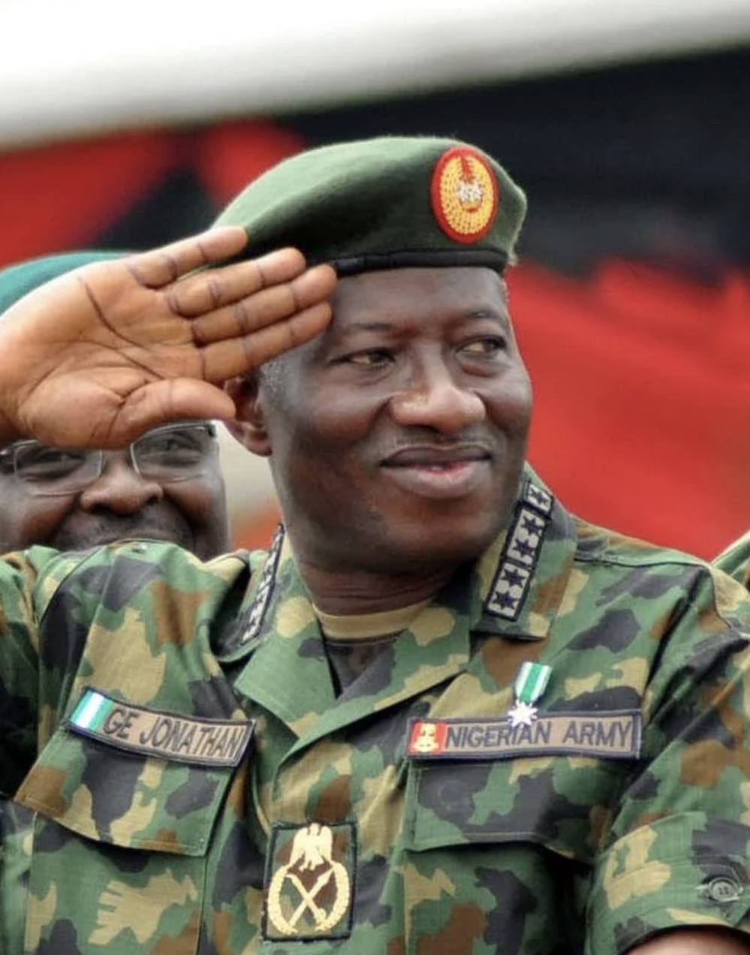
Government Offers Amnesty
Mar 2013
Nigerian President Goodluck Jonathan designated a high-level team to look into the possibility of granting the militants pardons. Before any offer was on the table, Shekau declared that Boko Haram members had done nothing for which they needed amnesty.

Slide 43
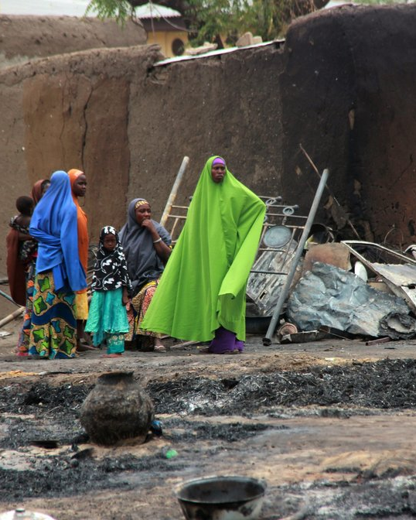
Baga Massacre
Apr 15, 2013 to Apr 17, 2013
Soldiers ransacked the town of Baga, burning more than 2,000 homes, and killing at least 183 people. The attack occurred after Boko Haram ambushed a military patrol outside Baga. One soldier died in the crossfire. Human Rights Watch corroborate these accounts with satellite images of the town.

Slide 44
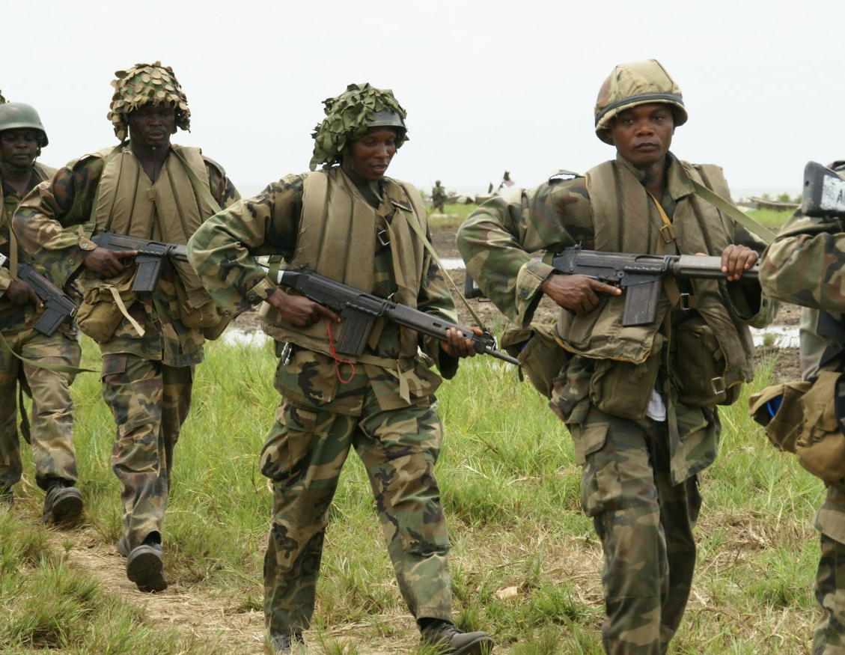
State of Emergency Declared 2013
May 13, 2013
Goodluck Jonathan declared a state of emergency in the states of Borno, Yobe and Adamawa. Amid increasingly violent attacks, the president described the latest assaults as “a declaration of war”, and promised to deploy more troops in the area.

Slide 45
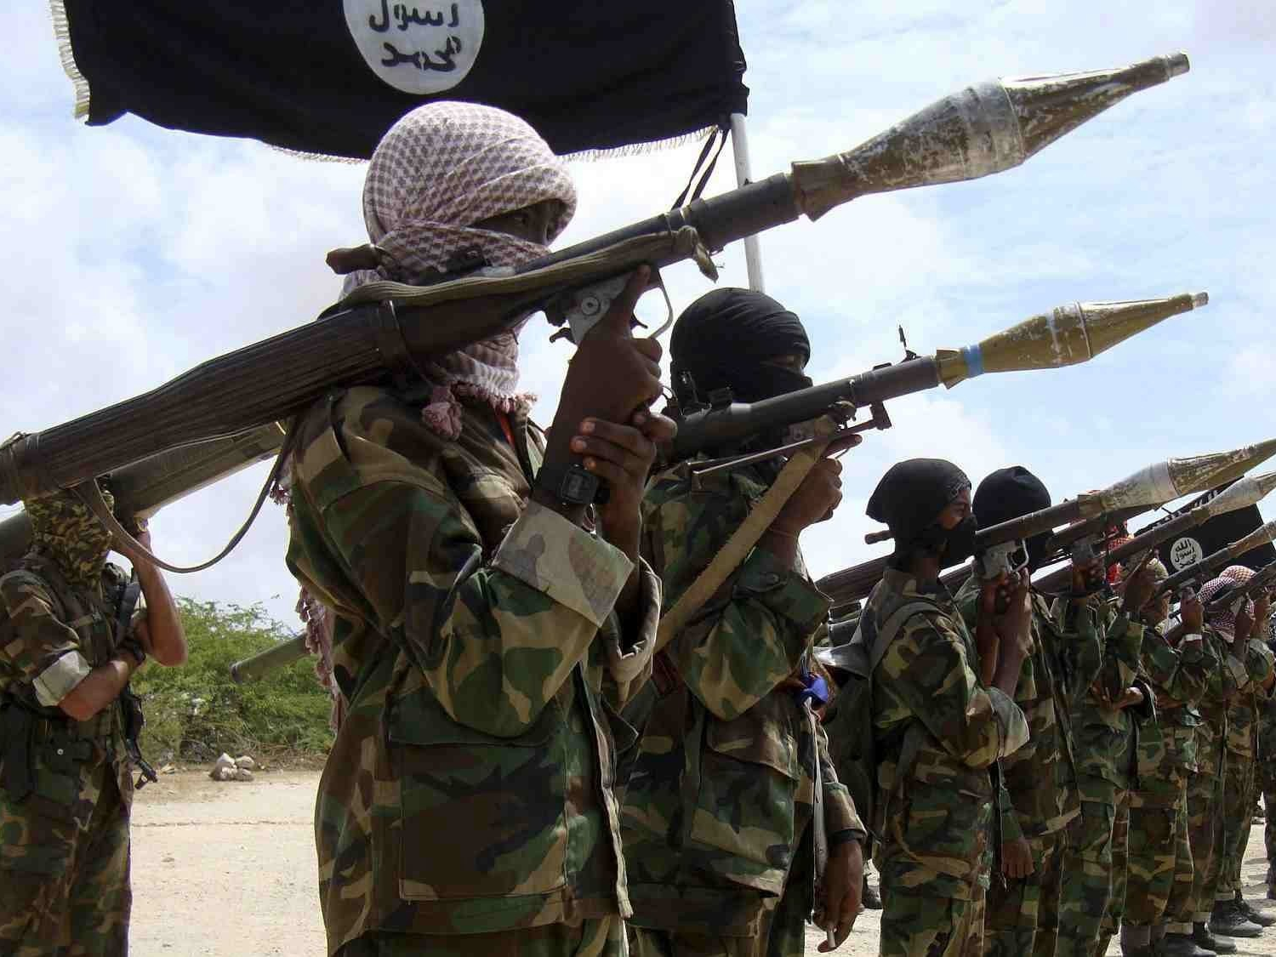
Terrorist Legal Designation
May 2013
The Nigerian President officially declared Boko Haram and Ansaru terrorist groups and banned them under Nigerian law. The new legal designation enabled authorities to prosecute anyone caught helping them under the Terrorism Prevention Act.

Slide 46
Western Recognition of Terrorist Group
Jul 10, 2013 to Dec 25, 2013
The United Kingdom was the first country to declare Boko Haram as a terrorist organization on July 10, 2013. The U.S. and Canada followed later that year on November 14 and December 24, respectively.

Slide 47
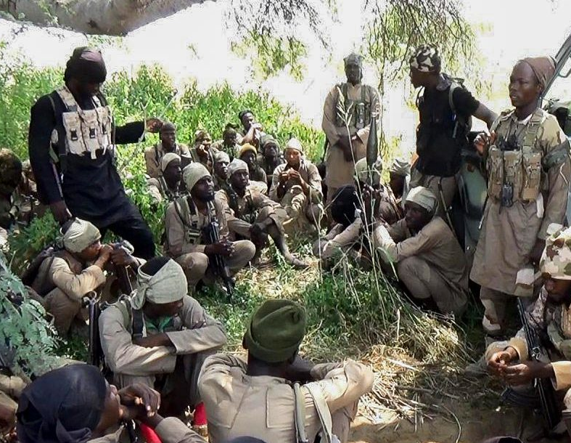
Abu Saad Killed
Aug 13, 2013
Nigeria’s Ministry of Defense confirmed the death of Momodu Baba, also known by his alias Abu Saad, second-in-command of the group. He was one of the “most-wanted” militant commanders and had a high bounty on this head.

Slide 48
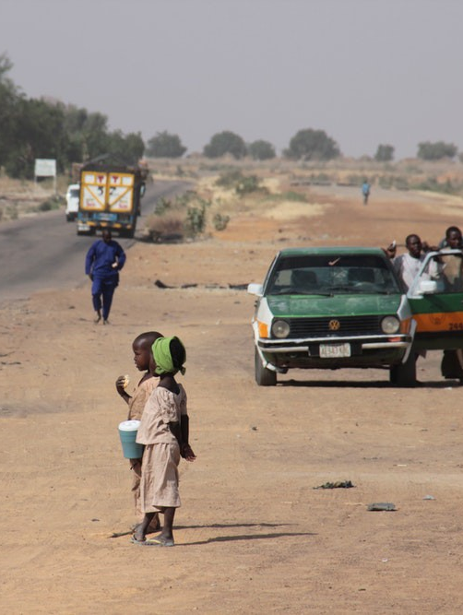
Benisheik Massacre
Sep 16, 2013
Boko Haram slaughtered at least 143 people in a roadside attack between the cities of Maiduguri and Damaturu. Several militants wearing army uniforms stopped traffic on a highway, dragged people out of their vehicles, and killed them.

Slide 49
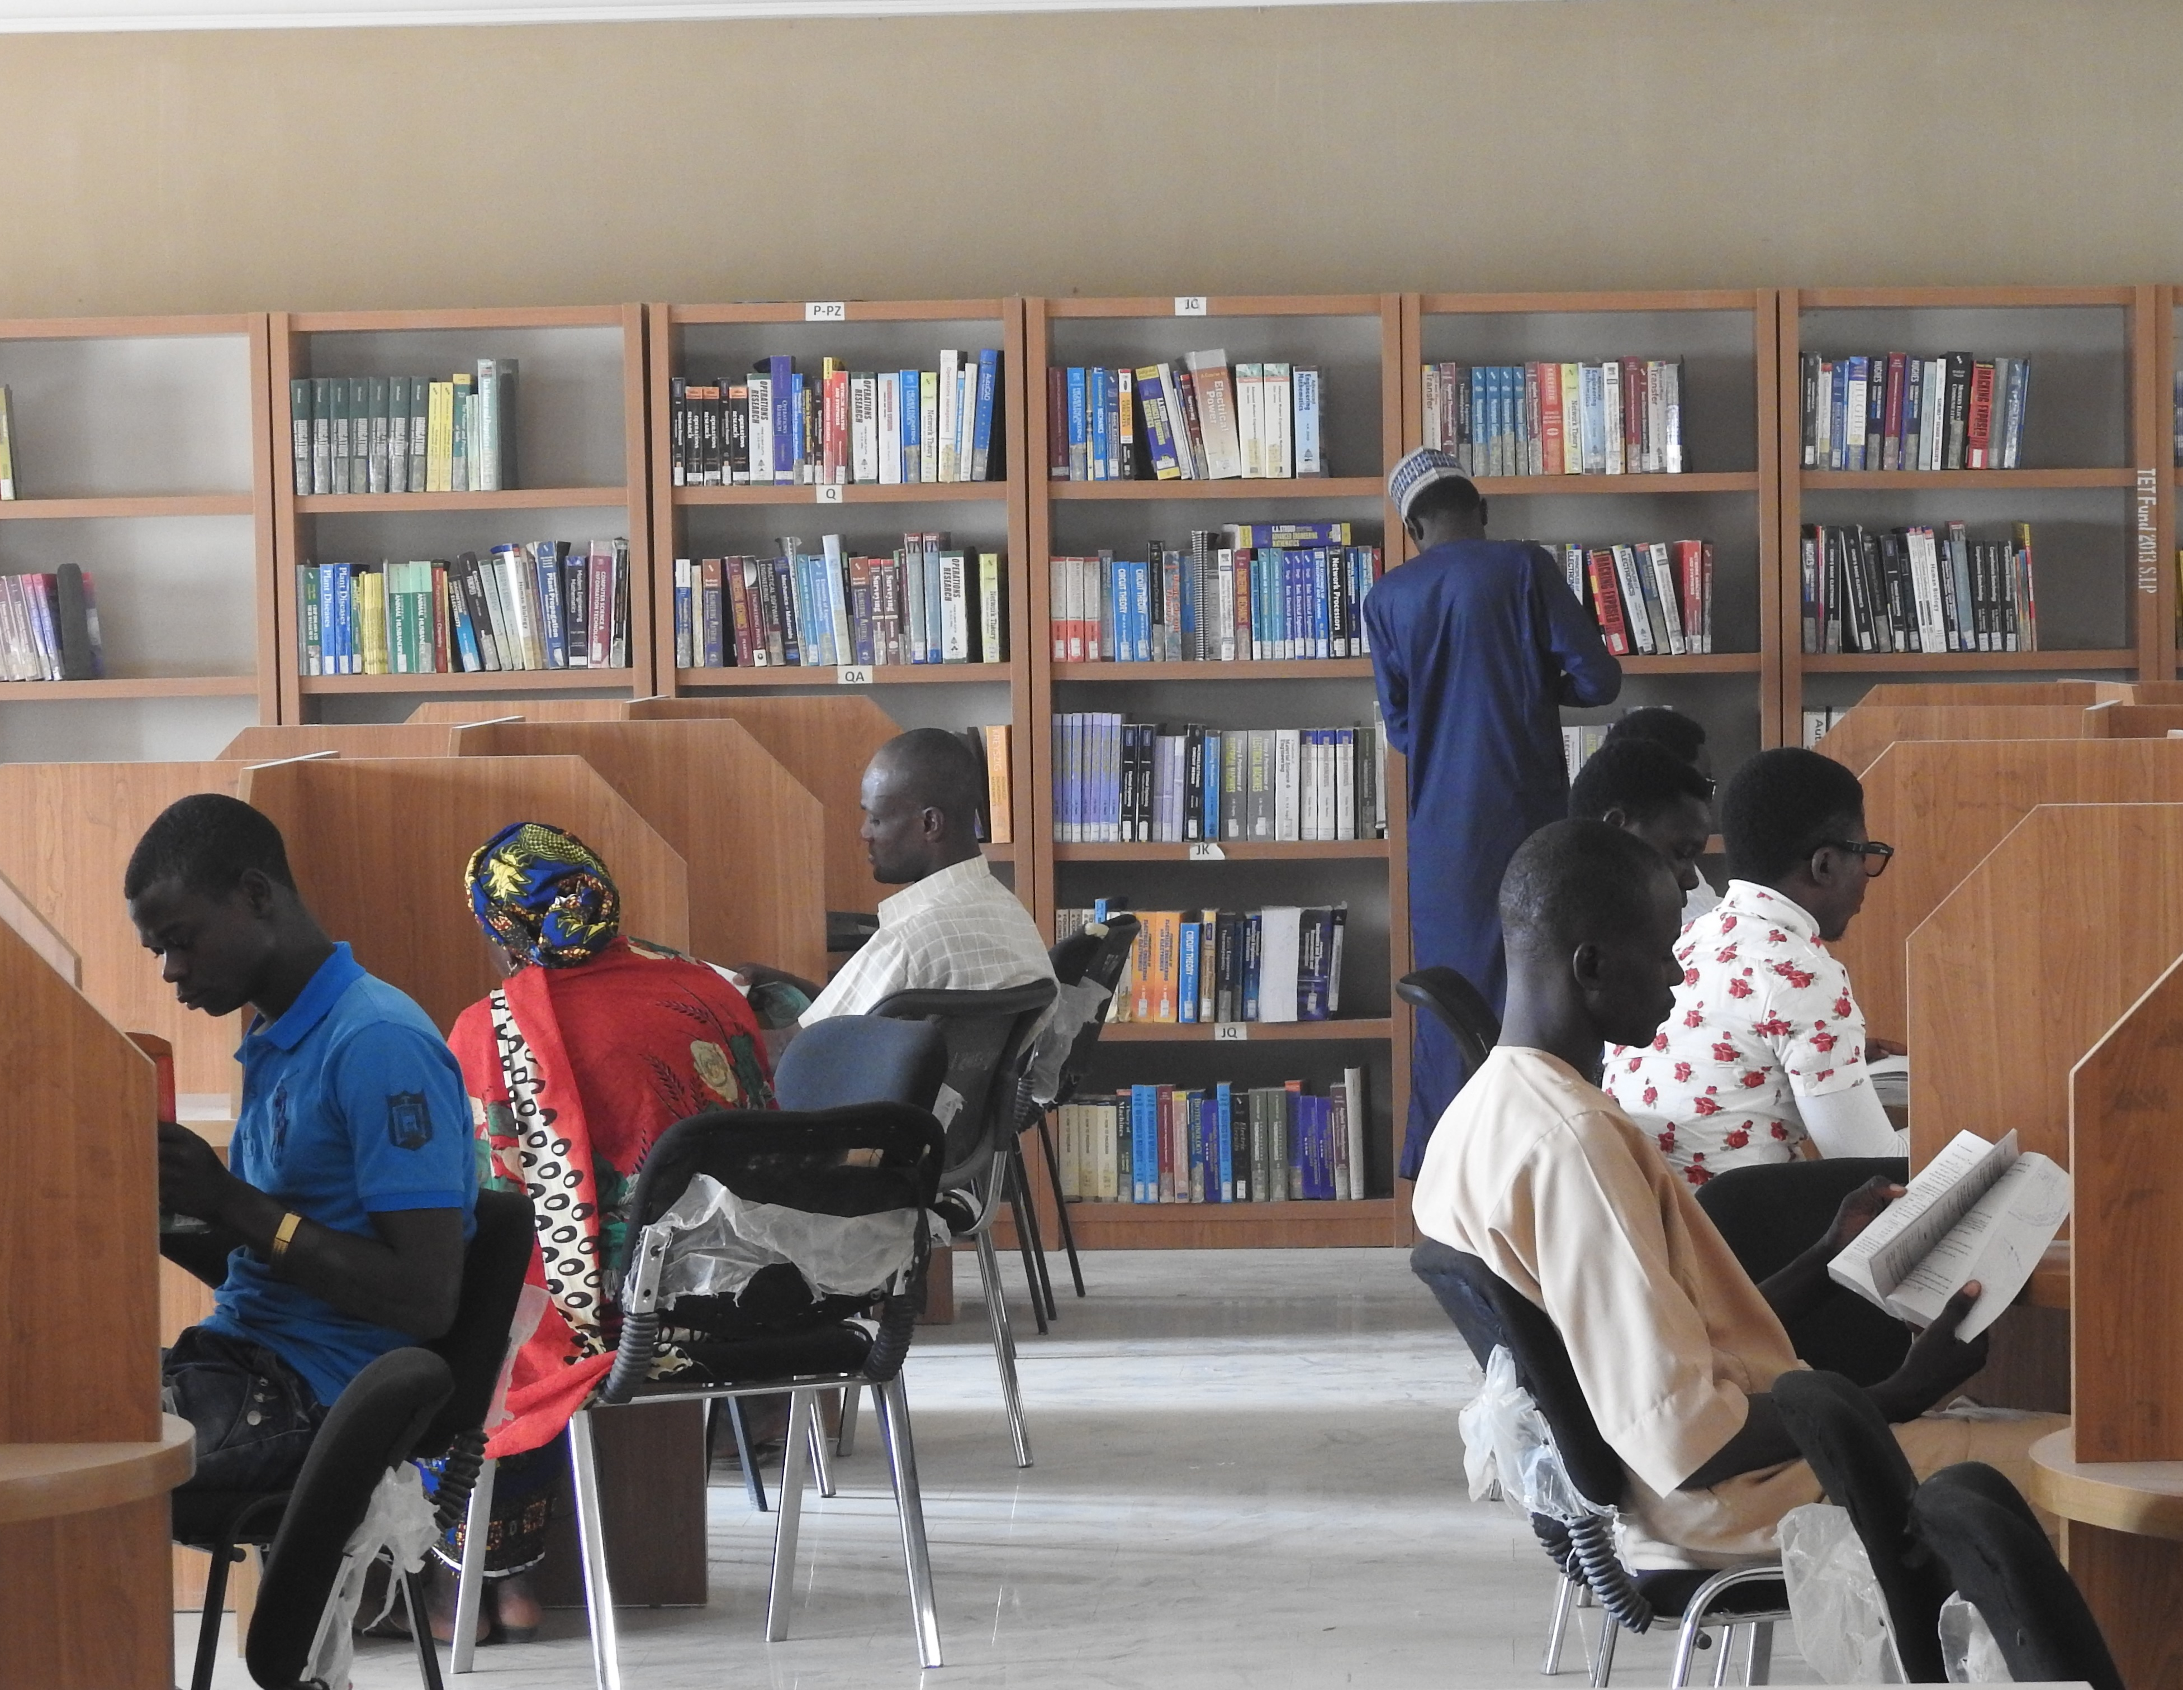
Gujba College Massacre
Sep 28, 2013
Dozens of gunmen from Boko Haram entered the student dormitories of the Yobe State College of Agriculture, killing over 40 students. The attackers broke into campus while students were sleeping and opened fire randomly in the darkness. Most of the victims were between the ages of 18 and 25.

Slide 50
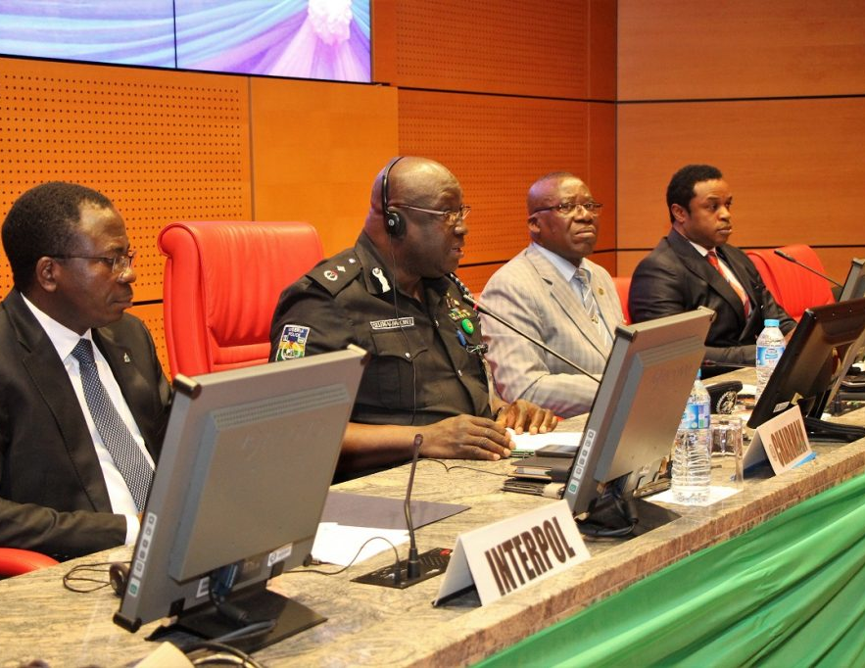
Joint Trans-Border Security Committee
Nov 2013
Nigeria and Cameroon signed the Joint Trans-Border Security Committee to conduct "coordinated but separate" border patrols. This was in response to Boko Haram hiding in Cameroon's foothills and the Cameroonian military's unwillingness to confront them.

Slide 51
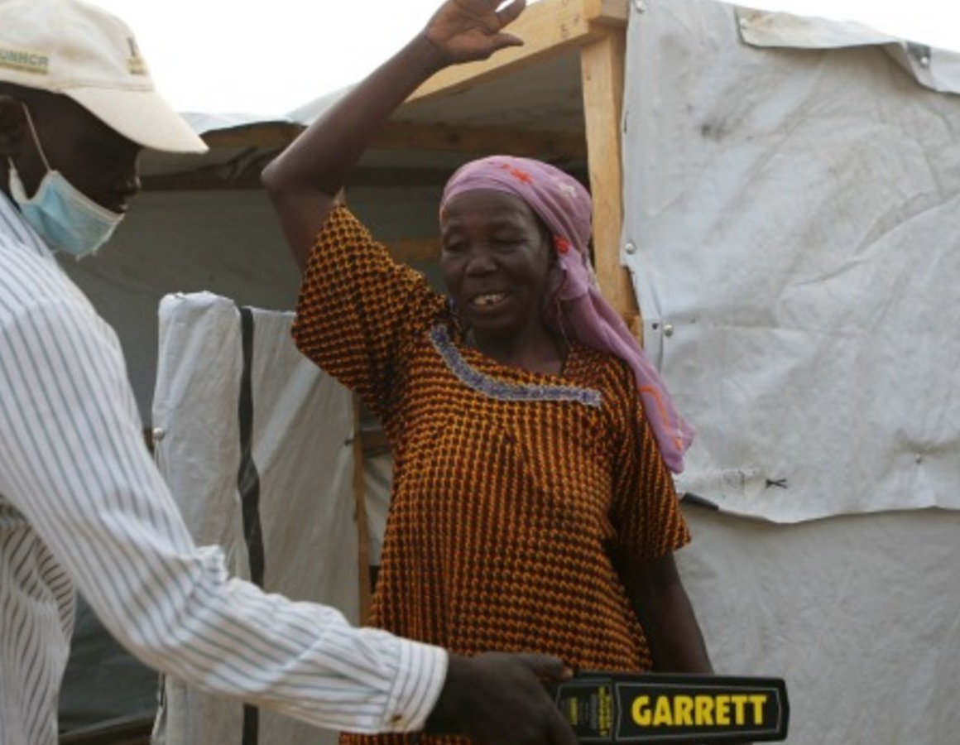
Terrorism and Use of Suicide Bombing
Since 2014, a hallmark of Boko Haram's violent insurgency is the kidnapping of women to forcibly deploy as suicide bombers. Between 2014 and 2018, 468 women and girls either successfully carried out suicide attacks or were arrested in the process. The 240 successful suicide attacks during this period killed 1,200 Nigerians and injured another 3,000.

Slide 52
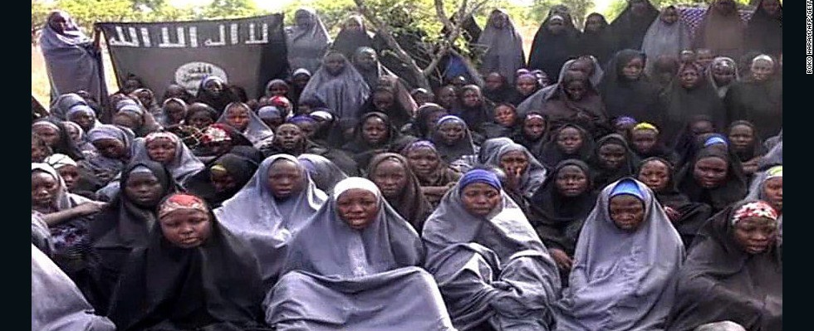
Summary of 2014 Events
In 2014, Nigeria saw a resurgence of Boko Haram bombings, massacres, and abductions. There were over 1,500 people killed in Boko Haram attacks and hundreds of women and children abducted in raids. Most notably was the April 2014 kidnapping of 276 Chibok schoolgirls by the militant organization, spurring an international media campaign to #BringBackOurGirls.

Slide 53
Market Bombing in Maiduguri, Borno State
Jan 14, 2014
30-40 people were killed in a Boko Haram coordinated bombing near a market in Maiduguri, Borno State.

Slide 54
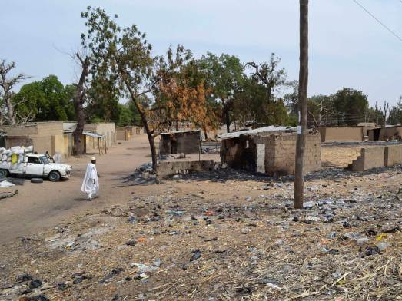
Attack on Kawuri Village
Jan 26, 2014
An attack by suspected Islamist Boko Haram insurgents on a northeast Nigerian village of Kawuri on Monday resulted in 85 people dead.

Slide 55
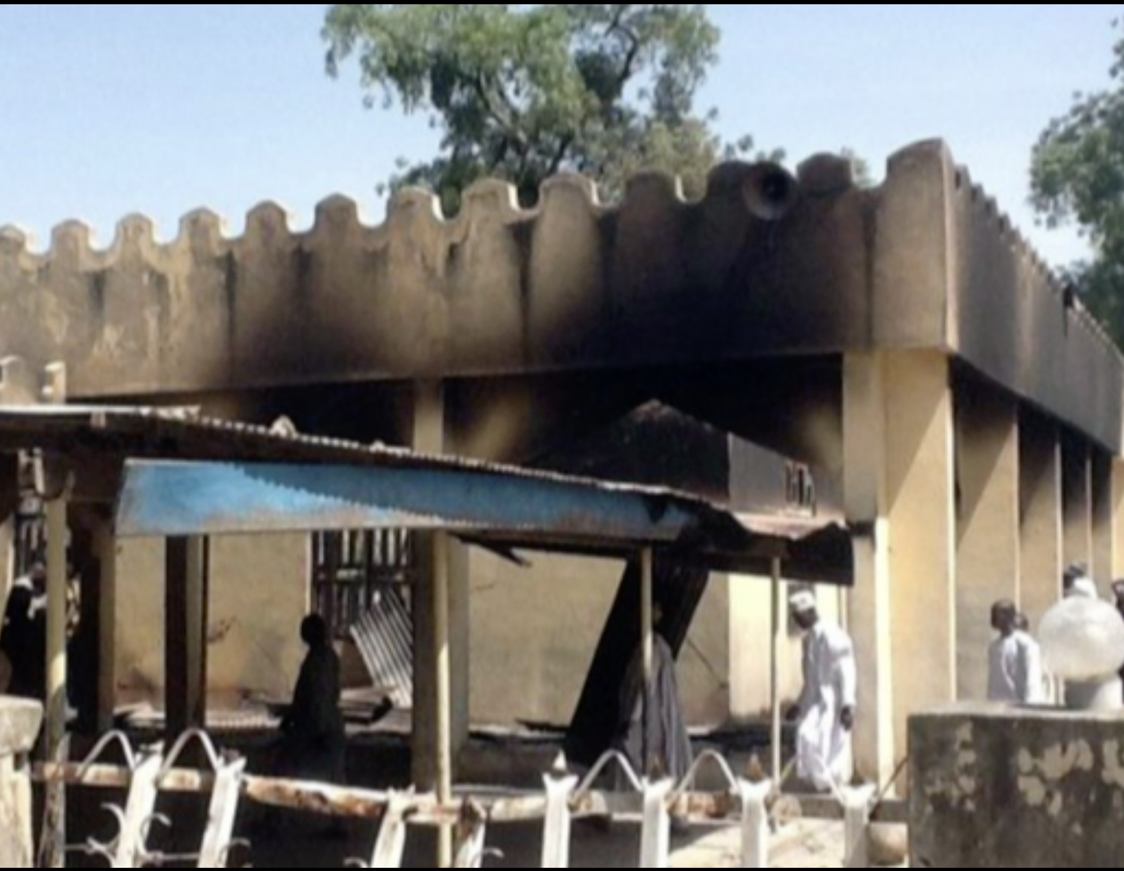
Konduga Massacre
Feb 11, 2014
Boko Haram militants attacked the Konduga village in northeastern Nigeria, which is predominantly Christian. 62 villagers were reportedly killed in the attack.

Slide 56
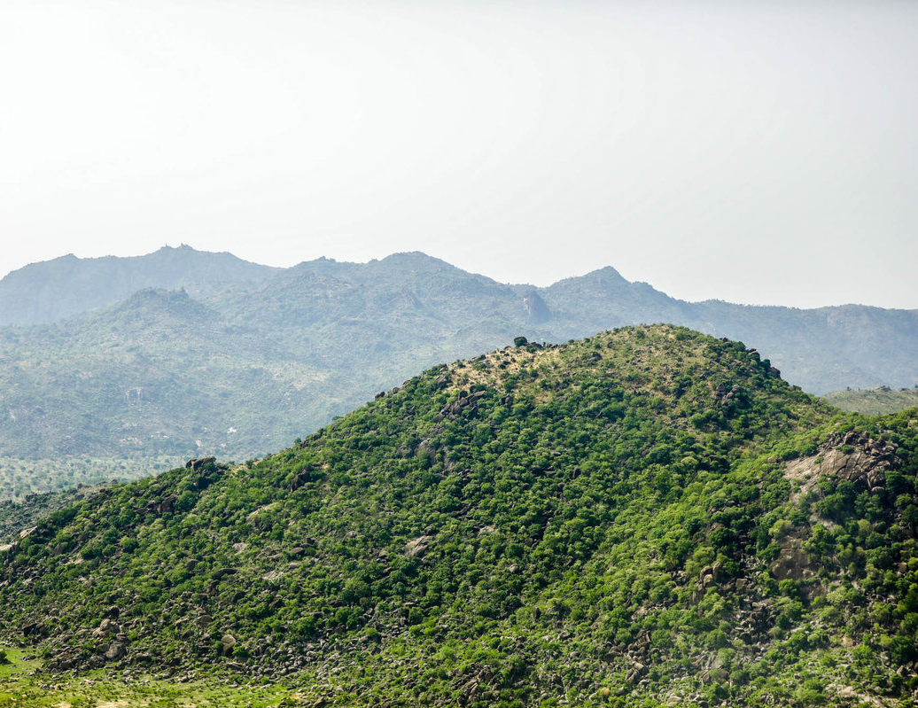
Attack on Izghe Village
Feb 15, 2014
Dressed in military uniforms, dozens of attackers raided the village. The gunmen reportedly rounded up a group of men in Izghe village and shot them, before going door-to-door and killing anyone they found. Some of their victims were shot; others had their throats slit. Estimates say that between 106 - 121 people were killed in the massacre.

Slide 57
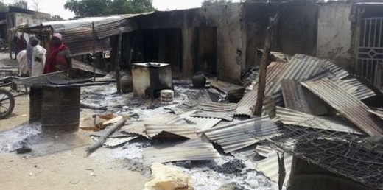
Izghe village burned in second attack
Feb 22, 2014 to Feb 24, 2014
Alleged Boko Haram gunmen killed several residents and burnt down Izghe after a similar attack a week earlier. Many people had fled after the first attack, but some elderly residents were still staying there. A resident in Izghe said that three women and a man were killed in the raid.

Slide 58
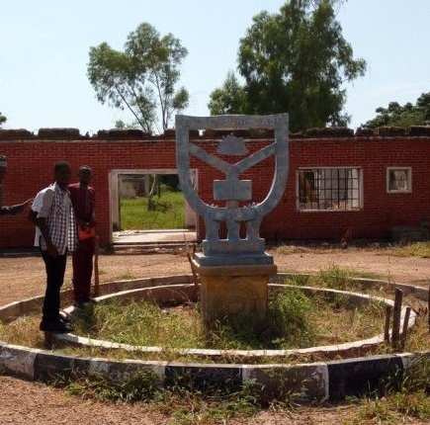
Attack on Federal Government college of Buni Yadi
Feb 25, 2014
Boko Haram gunmen killed 59 pupils at the Federal Government college of Buni Yadi, a boarding school in Yobe state, near the state’s capital city of Damaturu. The students were shot or burned to death.

Slide 59
Eastern Recognition of Terrorist Group
Mar 2014 to Dec 2014
New Zealand recognized Boko Haram as a terrorist organization in March 2014. Australia and the UAE followed later that year on June 26 and November 15, respectively.

Slide 60
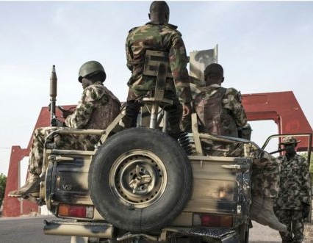
Nigerian military barracks attacked, detainees freed
On March 14, 2014, Boko Haram gunmen attacked the Giwa military barracks in Maiduguri, Borno state. They reportedly fought their way into the detention facilities and freed several hundred detainees.

Slide 61
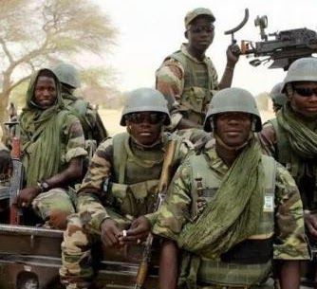
Amnesty International reports Nigerian military mass execution of detainees
After Boko Haram gunmen attacked the Giwa military barracks in Maiduguri, Borno state, the military recaptured many of the detainees. As the military regained control, more than 600 people, mostly unarmed recaptured detainees, were extra-judicially executed in various locations across Maiduguri.

Slide 62
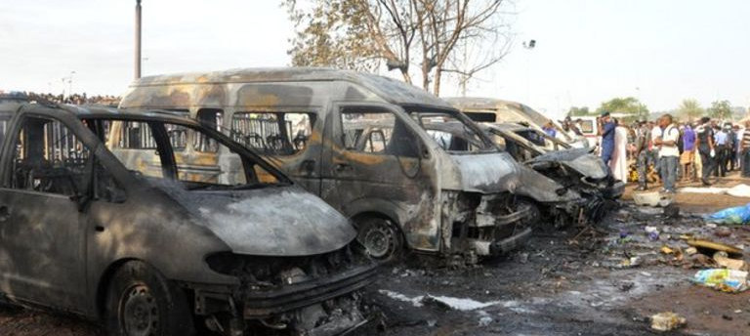
Bombing at bus station outside Abuja
Early in the morning on April 14, 2014, two bombs exploded at a crowded bus station in Nyanya, Nasarawa State. The Abuja Emergency Relief Agency confirmed that 71 people had been killed and 124 injured in the attack. Boko Haram claimed responsibility for the bombing six days after it occurred.

Slide 63
Chibok schoolgirls kidnapped
On the nights of April 14th and 15th, 2014, 276 mostly Christian female students were kidnapped from the Secondary School in the town of Chibok in Borno State, Nigeria.

Slide 64
U.S. Response to Schoolgirl Kidnapping
Apr 2014
The U.S. First Lady Michelle Obama publicly condemned Boko Haram's kidnapping of 276 schoolgirls from Chibok. She launched a global media campaign called #BringBackOurGirls.

Slide 65
Chibok Kidnapping Aftermath
Apr 2014 to Jan 2021
The Christian students were forced to convert to Islam and were then sold into marriage with members of Boko Haram. Many of the girls were trafficked from Nigeria into neighboring countries of Chad and Cameroon. In the 6 years following the kidnapping, many girls have been rescued or released and have returned home. Many returned with children or were pregnant from their forced marriages. 112 girls have yet to be recovered.

Slide 66
Car bombing in Nyanya
May 1, 2014
A car bomb exploded in New Nyanya, a town in Nasarawa State, Nigeria. The explosion killed at least 19 people and injured at least 60.

Slide 67
Militants attack twin towns
May 5, 2014 to May 7, 2014
On the night of May 5-6, 2014, Boko Haram militants attacked the twin towns of Gamboru and Ngala in Borno State, northeastern Nigeria. About 310 residents were killed in the 12-hour massacre and the town was largely destroyed.

Slide 68
Jos Bombings
May 20, 2014
Two bombs exploded in Jos, killing at least 118 people and injuring about 56 more. The first exploded in a busy market and the second outside a nearby hospital.

Slide 69
Buni Yadi Attack
May 27, 2014
Boko Haram gunmen attacked a Nigerian military base and adjacent police barracks in the northeastern town of Buni Yadi, killing 31 security personnel.

Slide 70
Gwoza Massacre
Jun 2, 2014
Militants, presumably from Boko Haram, dressed as soldiers massacred hundreds of predominantly Christian villagers in Goshe, Attagara, Agapalwa, and Aganjara. Witnesses said the militants killed between 400 and 500 people in the attacks.

Slide 71
Kummabza held hostage for four days
Jun 18, 2014 to Jun 23, 2014
Boko Haram militants held the village of Kummabza in Borno state hostage for four days. They abducted more than 60, including women and girls, and killed 30 men in the raid. Some of the kidnapped girls were between the ages of 3 and 12. After looting food supplies and abducting the hostages, the militants set the village on fire with petrol bombs and explosives.

Slide 72
Borno State attacks
Jun 20, 2014 to Jun 24, 2014
From June 20-23, 2014, a series of attacks occurred in Borno State, Nigeria. 91 women and children were kidnapped in the attacks and more than 70 people were killed. Between June 21-22, suspected Boko Haram militants attacked the villages of Chuha A, Chuha B, and Korongilim near Chibok. The attackers were met by military and vigilante resistance. The towns were destroyed and at least 40 villagers were killed in the fighting. On June 23rd, a bomb explosion at a college in Kano killed 8 people and injured about 20 others.

Slide 73
Kaduna and Abuja Attacks
Jun 23, 2014 to Jun 26, 2014
Between June 23-25, 2014, a series of attacks occurred in central Nigeria. On June 23-24, gunmen attacked a number of villages in Kaduna State, killing around 150 people. The attack was blamed on Fulani tribesmen. On June 25, 2014, a bomb exploded at the Emab Plaza in the national capital of Abuja, killing at least 21 people. In response to the bombing, the Nigerian military raided two militants camps on June 26th, killing more than 100 people.

Slide 74
Damboa raided by Boko Haram
Jul 17, 2014 to Jul 21, 2014
Scores of fighters armed with rocket-propelled grenades, explosives, and guns descended on the town of Damboa in the early evening of July 17th, residents and officials said. By the time the raid ended on July 20th, 66 residents had been killed and more than 15,000 had fled.

Slide 75
Battle of Kodunga
Sep 12, 2014
Boko Haram fighters attempted to capture the town of Konduga but were successfully repelled by Nigerian infantry through a combined assault of ground soldiers and aerial attacks. 100-200 Boko Haram fighters were said to be killed, while only a "handful" fled the battle, with most of the dead being beyond recognition.

Slide 76
Attack on Mainok market
Sep 19, 2014
Boko Haram militants attacked a rural market in the north-east Nigerian town of Mainok, killing dozens of people. Gunmen shot at traders and customers as they raided the busy market for food supplies.

Slide 77
Ceasefire agreement reached, Nigerian Government announces
Oct 16, 2014
The Nigerian government announced that it reached a ceasefire deal with Boko Haram that included the release of the remaining Chibok schoolgirls.

Slide 78
Boko Haram leader denies ceasefire deal
Nov 1, 2014
Boko Haram laughed off Nigeria's announcement of a ceasefire agreement, saying there was no such deal and that the schoolgirls abducted in April had been converted to Islam and married off. The group's leader also denied knowing the negotiator with whom the government claimed it worked out a deal, saying he does not represent Boko Haram. Boko Haram, in an online video

Slide 79
Creation of the African Coalition Force
Nov 30, 2014
Benin, Chad, Cameroon, Niger, and Nigeria created a coalition to resist Boko Haram. The coalition, announced by Cameroon's foreign minister, would include 3,500 soldiers.

Slide 80
Shift into North Cameroon
Dec 17, 2014
Boko Haram shifted their attacks to the far north region of Cameroon, beginning with an ambush of militants in Amchide. Cameroon's Rapid Intervention Battalion, an elite military force, launched a counterattack on Boko Haram.

Slide 81
Coalition of Military Forces
Jan 2015
Nigeria, Niger, Cameroon, and Chad launched a joint campaign against Boko Haram. Chad's army killed over 200 Boko Haram militants, sparking the terror group to take revenge on Cameroon civilians.

Slide 82
Summary of 2015 Events
2015 started violently for Nigerians as deadly raids on 16 villages in the northern part of the country killed as many as 2,000 people. Amnesty International said the attack was likely the deadliest Boko Haram attack yet. The African Union and others The Nigerian military was also able to rescue around 700 abducted women and girls from Boko Haram camps in the Sambisa Forest. In an audio recording posted online, Boko Haram pledges allegiance to ISIS.

Slide 83
Deadly raids on northern Nigerian villages
Jan 3, 2015 to Jan 6, 2015
As many as 2,000 people were killed in attacks on 16 villages in northern Nigeria. At least 30,000 people were displaced by the violence, and about 20,000 of those displaced were camped in Maiduguri city.

Slide 84
African Union provides troops for fight against Boko Haram
Jan 30, 2015
AU commission chair Nkosazana Dlamini-Zuma said the threat posed by the Islamist group required a "collective, effective and decisive response". She said it would conduct "military operations to prevent the expansion of Boko Haram and other terrorist groups' activities and eliminate their presence". The Multinational Joint Task Force (MJTF) would have an initial mandate of one year and provide 7,500 troops to back regional forces.

Slide 85
EU and others provide support to MJTF
Feb 9, 2015
The European Council of February 9, 2015, concluded that the growing regionalization of the Boko Haram threat required a collective and comprehensive response to defeat terrorism. The EU agreed to provide support through the African Peace Facility (APF). France and the US provided in-kind support to individual MNJTF troop-contributing countries (TCC's), while the UK mobilized £5 million which is channeled through the African Union Commission (AUC).

Slide 86
Nigeria Enlists Outside Help to Fight Boko Haram
Mar 2015
Nigeria hired hundreds of mercenaries from South Africa and Russia to fight Boko Haram. Nigeria hoped international aid would stop Boko Haram from hampering the March 28 election.

Slide 87
Boko Haram pledges allegiance to ISIS
Mar 7, 2015
According to an audio message said to be from Boko Haram's leader Abubakar Shekau, the extremist organization pledged allegiance to ISIS (Islamic State of Iraq and Syria). In the audio, which was posted online, the speaker says Boko Haram is announcing its "allegiance to the Caliph of the Muslims, Ibrahim ibn Awad ibn Ibrahim al-Husseini al-Qurashi," which is another name for ISIS leader Abu Bakr al-Baghdadi.

Slide 88
ISIS accepts Boko Haram's pledge of allegiance
Mar 12, 2015
The message, which was posted online by ISIS supporters, says that the caliphate, or Islamic State, has expanded to western Africa and congratulated "our jihadi brothers" there. The spokesman, Abu Mohammed al Adnani, encouraged people to join fighters in Africa if they couldn’t make it to Iraq or Syria.

Slide 89
Mass graves discovered in Damasak
Apr 25, 2015 to Apr 27, 2015
Hundreds of decomposed corpses were discovered buried in shallow graves in the streets of the northeastern Nigerian town of Damasak. The bodies were buried in 20 clearly marked mass graves. The town had recently been freed from Boko Haram's occupation by a joint Nigerian-Chadian military operation.

Slide 90
Nigerian troops rescue 450 women and girls
Apr 28, 2015 to May 1, 2015
450 women and girls were rescued as the military entered the Sambisa Forest in northeast Nigeria looking for Boko Haram camps. The schoolgirls abducted from Chibok were not among them.

Slide 91
Sambisa Forest: 234 more women and girls rescued
May 4, 2015
Nigerian troops rescued an additional 234 women and girls in the Sambisa Forest, adding to the 450 they found and rescued a week prior. None of the Chibok abductees were among them.

Slide 92
Summary of 2016 Events
In 2016, Boko Haram increasingly focused on the use of both male and female suicide bombers in upwards of 30 attacks throughout Nigeria and neighboring countries. The attacks killed hundreds of people. Sheikh Abu Musab al-Barnawi, the son of the group's founder who was killed by Nigerian security forces in 2009, became Boko Haram's new leader.
After a series of negotiations and videos proving life, 21 of the Chibok schoolgirls were released by Boko Haram to Nigerian authorities after two years in captivity.

Slide 93
Summary of 2017 Events
During 2017, Boko Haram continued its campaign of suicide bombers to inflict death, pain, and terror on the Nigerian people, as well as people in neighboring countries.
At the beginning of 2017, around 90 people were killed when a Nigerian fighter jet mistakenly bombed a camp for the internally displaced while executing an operation against Boko Haram militants.
Another 82 Chibok schoolgirls were released after more negotiations between Boko Haram and the Nigerian government. The Red Cross acted as a neutral intermediary to transport the girls to the government of Nigeria.

Slide 94
Summary of 2018 Events
On Feb 19, 2018, 110 schoolgirls were kidnapped from the Government Girls' Science and Technical College in Dapchi, Yobe State. On Mar 1, 2018, three International Committee of the Red Cross (ICRC) aid workers were abducted in an attack on a displacement camp in Rann, Borno State. On Mar 21st, 104 of the abducted Dapchi schoolgirls were released and returned home. On Sept 17th, the ICRC said abducted aid worker Saifura Hussaini Ahmed Khorsa, 25, had been killed. On Oct 16, Abducted midwife Hauwa Mohammed Liman was executed after a deadline for negotiations expired.

Slide 95
Attacks Spread Outside of Region
Jan 1, 2018 to Sep 21, 2019
Boko Haram launched attacks outside of its normal region of activity. Specifically, Boko Haram killed 24 soldiers in Burkina Faso, the nation's worst-ever terrorist attack.
In Mali, Boko Haram's spread of violence killed 1,540 people.

Slide 96
Refugee Report in Niger
Mar 13, 2018
A U.N. report showed that 129,000 people in the Diffa region of Niger were displaced by Boko Haram. An additional 108,000 Nigerian refugees fled into Diffa, creating a humanitarian crisis in the country.

Slide 97
UNICEF reports, more than 1,000 children kidnapped since 2013
Apr 13, 2018
Since 2013, more than 1,000 children have been abducted by Boko Haram in northeastern Nigeria, including 276 girls taken from their secondary school in the town of Chibok in 2014. Four years on from that tragic incident, more than 100 of the ‘Chibok girls’ had yet to be returned to their families, and the UN children’s agency continued to call for their release.

Slide 98
Amnesty International reports, women raped by Nigerian military rescuers
May 24, 2018
"Since early 2015, the Nigerian military has recaptured vast swathes of territory that had come under the control of Boko Haram in the north-east of the country. However, instead of “freeing” hundreds of thousands of people who had been trapped in these areas, the military has carried out systematic patterns of violence and abuse against this population, including war crimes and possible crimes against humanity. This report examines what happened to the group of people who fled or were forced from rural towns and villages that had been controlled by Boko Haram, as the military intensified its operations."

Slide 99
MJTF: Chad Basin Campaign
Nov 2018 to Mar 2020
The Chad Basin Campaign was a series of battles and offensives in the southern Chad Basin, particularly northeastern Nigeria, which took place amid the ongoing Boko Haram insurgency. The member states of the Multinational Joint Task Force (MJTF), namely Nigeria, Niger, Chad, and Cameroon responded to the increased insurgent activity with counter-offensives. These operations repulsed the rebels in many areas but failed to fully contain the insurgency.

Slide 100
Summary of 2019 Events
Violence continued in the northeastern region of Nigeria, resulting in hundreds of thousands of Nigerians being displaced. Many were forced into neighboring countries.
Nigerians continued to mourn the over 100 Chibok schoolgirls who were still missing as they reached the 5th anniversary of the kidnappings.
On July 27th, 65 people were killed in an apparent Boko Haram attack on a funeral in Northeastern Nigeria. A local official said 21 people were initially killed during the burial ceremony, and an additional 44 people were killed when villagers ran after the assailants.

Slide 101
Summary of Events Jan 2020 to July 2020
In Feb 2020, the MJTF had a partial victory against Boko Haram, ending the series of battles and offensives in the southern Chad Basin. Much territory was retaken from rebel forces, but insurgents retained a significant presence in the Chad Basin.
The fight against Boko Haram proceeded as its campaign of violence continued to displace, kidnap, and otherwise harm people.

Slide 102
The Ten Stages of Genocide
Dr. Gregory H. Stanton, Founding President of Genocide Watch, uses the Ten Stages of Genocide to describe and explain the genocidal process. The stages are: 1. Classification 2. Symbolization 3. Discrimination 4. Dehumanization 5. Organization 6. Polarization 7. Preparation 8. Persecution 9. Extermination 10. Denial The alarming situation in Nigeria has advanced to Stage 9: Extermination, due to a systematic campaign of violence by armed Islamist groups against civilians across Nigeria, with a particular targeting of Christians.

Slide 103
Conclusion and Recommendations
To prevent further genocidal massacres by Boko Haram and its ideological affiliates in Nigeria and beyond, Genocide Watch recommends that:
The US appoints a Special Envoy to investigate the ongoing genocide in Nigeria, both by Boko Haram and ideologically affiliated Fulani jihadists
The Nigerian government intensifies its efforts to combat Boko Haram and other affiliated groups, both militarily and through addressing the systemic issues that allowed these groups to take root, while ensuring that they do not commit atrocities themselves
Civil society receives training on documentation of atrocities to help build a case against the perpetrators

