Slide 1
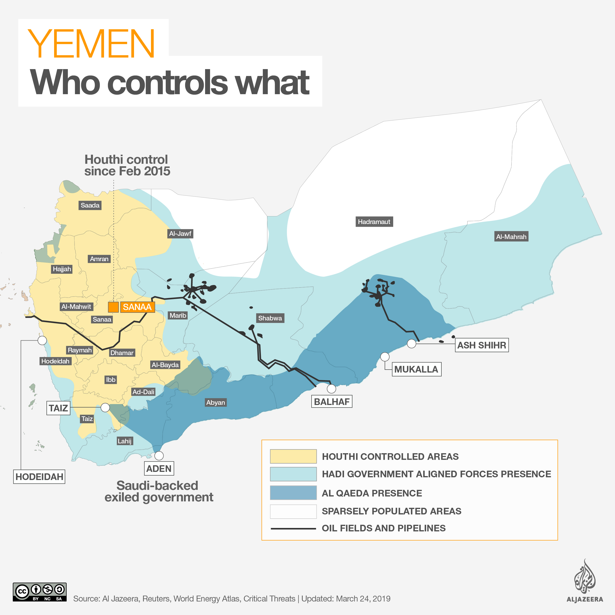
Key Findings
• The Houthi movement was formed by Hussein Badreddin Al-Houthi in 1991. The movement was created initially as a political-Islamic group influenced by the Zaidi sect of Islam.
• Al-Houthi's death in 2004 was a key event in the sudden rise of the Houthi movement, resulting in violent actions by the succeeding leaders.
• The Arab Spring's arrival in Yemen in 2011 led to numerous protests, pushing Ali Abdullah Saleh to end his 33-year presidential rule.
• Houthis took over Sanaa, the capital of Yemen in 2014. This resulted in the creation of the Saudi-led Coalition in support of Yemen's government.
• Iran's military support to Yemen's Houthis and the Coalition's military and intelligence support to Saudi Arabia continues to fuel the violence of the Yemen Crisis.
• The war between the Houthis and Saudi-led Coalition has severely affected the civilian population in Yemen. The people continue to experience famine, cholera, and thousands of casualties.
• In recent months, the Southern Transitional Council, backed by the UAE, has officially split from the Yemeni government, taken control of Aden, and declared self-rule. This further complicates Yemen's path to peace.
• Despite international labeling as a civil war, the Yemen Crisis has been recognized as genocide by Genocide Watch. This is important in determining whether legal action will be taken against both Saudi Arabia and the Houthis.

Slide 2
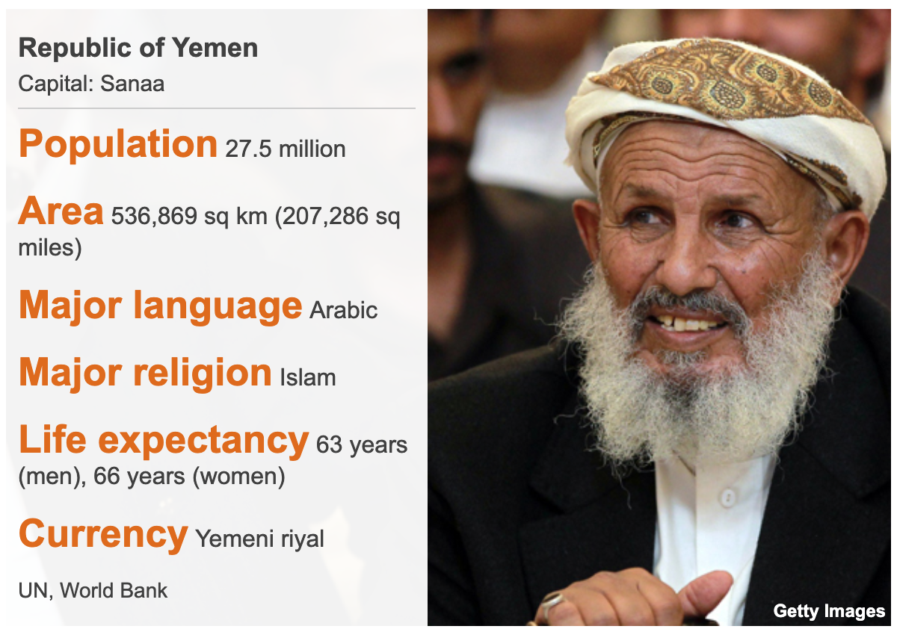
Yemen Country Profile
• 1839: South Yemen under British rule.
• 1969: Gained independence from Britain.
• 1990: North Yemen and South Yemen united as Ali Abdullah Saleh took power.
• 2012: Abdrabbuh Mansour Hadi named president after Saleh stepped down.

Slide 3

Houthi Movement Develops
January 1990
Hussein Badr al-Din al-Houthi created the movement in the 1990s. He sought to engage local youth and educate them on the history of Zaidism, a Shia sect. With the unification of Yemen, he wanted to ensure that Zaidism would maintain its dominance in the region.
Al-Houthi's family targeted young people through creating clubs and associations, mixing secular activities with religious revivalism.

Slide 4
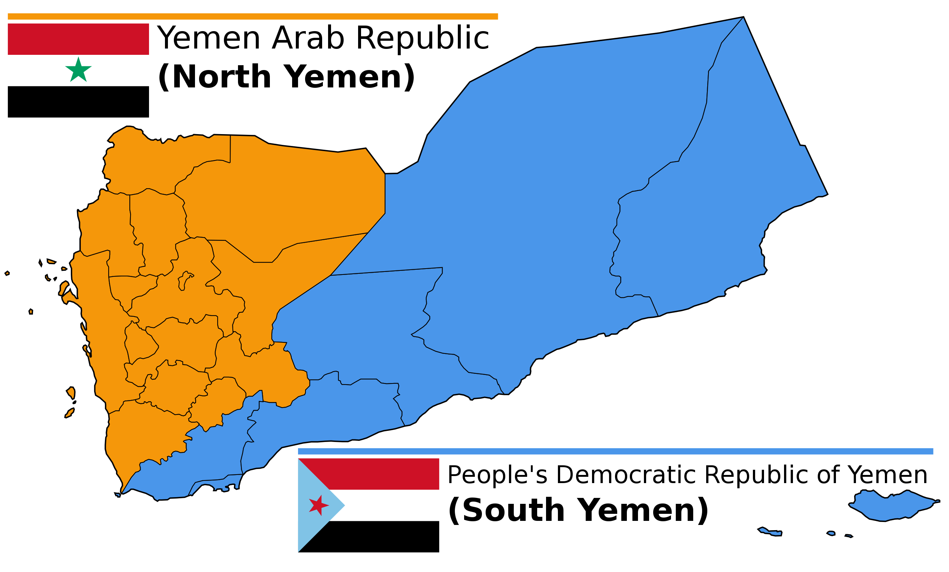
North and South Yemen Merge
May 1990
North and South Yemen merged in 1990. The two former parliaments voted for Ali Abdullah Saleh to become president.
North Yemen was influenced by western culture while South Yemen was socialist.

Slide 5
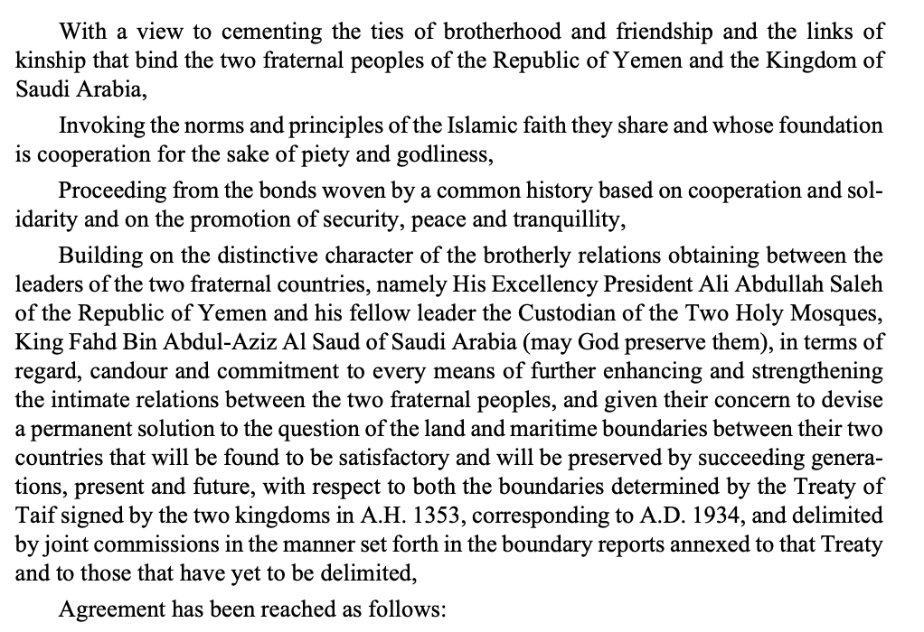
Yemen Signs Treaty of Jeddah with Saudi Arabia
June 12, 2000
Yemen and Saudi Arabia signed the Treaty of Jeddah. It resolved a prior border disagreement between the two countries.

Slide 6
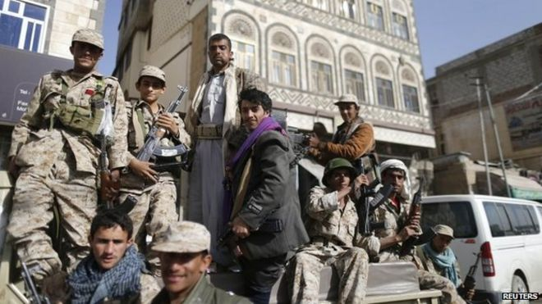
Houthi Clashes Increase
January 2004 to December 2010
Houthi rebels began entering military clashes in 2004. Previously, they primarily engaged in political fights, seeking autonomy from the Yemeni government.
Al-Houthi died during a military clash in 2004. After his death, the Houthis increased their paramilitary activities in the region.

Slide 7
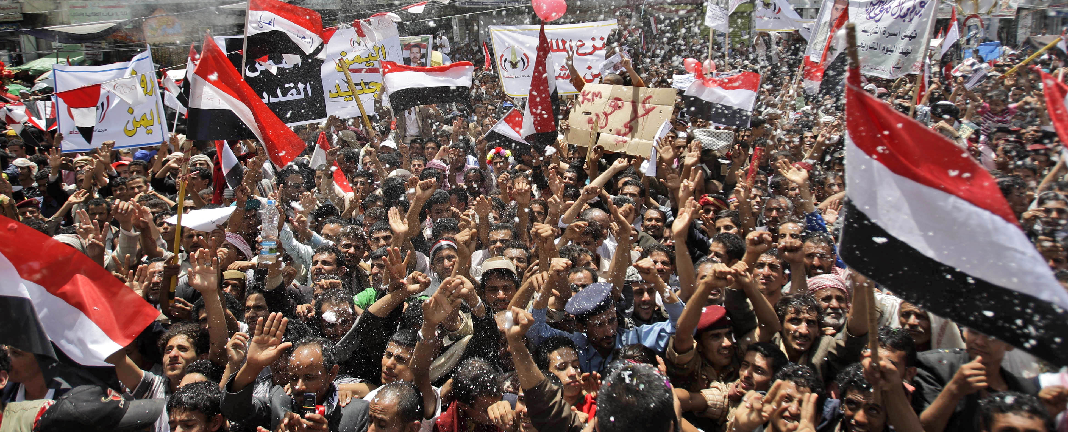
Arab Spring Reaches Yemen
January 2011 to February 2012
The Arab Spring started in January of 2011 in Yemen with protests against Ali Abdullah Saleh, Yemen's president of 33 years. It ended when Saleh's deputy assumed his role in February of 2012.

Slide 8
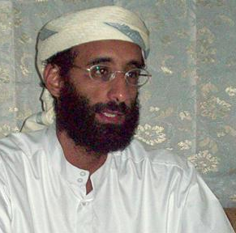
Al-Qaeda Gunmen Seize Zinjibar
May 29, 2011
Gunmen from Al-Qaeda captured Zinjiba, a Yemeni city. This occurred in the midst of Yemen's Arab Spring.

Slide 9
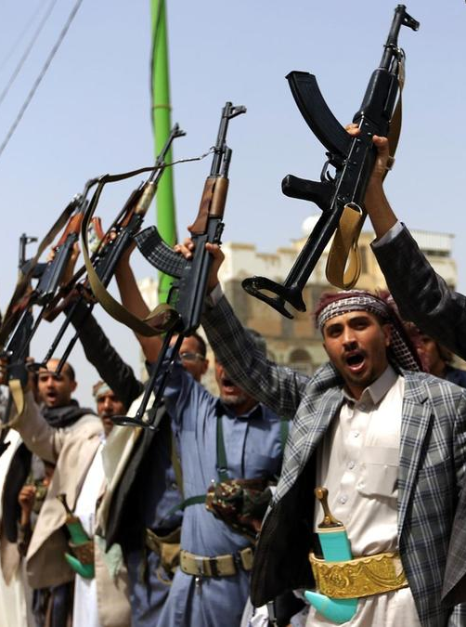
Iran Begins Providing Houthis with Military Support
January 2012
According to the Middle East Institute, "Evidence of Iranian intervention to support the Houthis, including with military assistance, began to grow in 2012. The United States also tracked Iranian Revolutionary Guards providing training and assistance to the Houthis in the Saadah governorate."

Slide 10
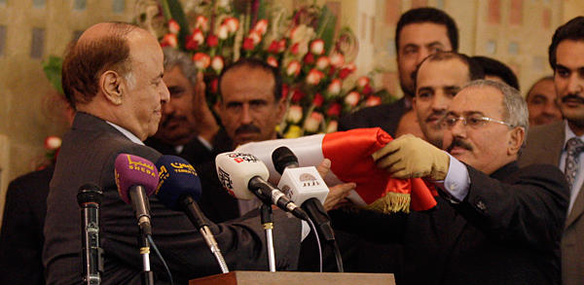
President Ali Abdullah Saleh Resigns
February 27, 2012
Yemen's president, Ali Abdullah Saleh, resigned after Arab Spring protests calling for his resignation. His deputy, Abdrabbuh Mansour Hadi, assumed his role through a deal that also gave Saleh immunity from prosecution.

Slide 11
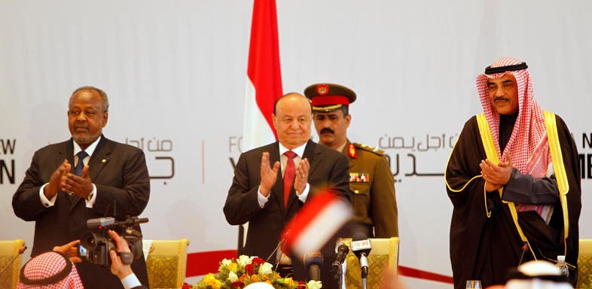
Yemen Holds National Dialogue Conference
January 21, 2014
Delegates ordered Hadi to change his cabinet and the Shura Council, the upper house of parliament, to increase the representation of individuals from areas with strong separatist movements.
President Hadi will oversee the committee drafting the new constitution and will stay president until the new constitution is completed.
One of the Houthi delegates was shot and killed on his way to the conference.

Slide 12
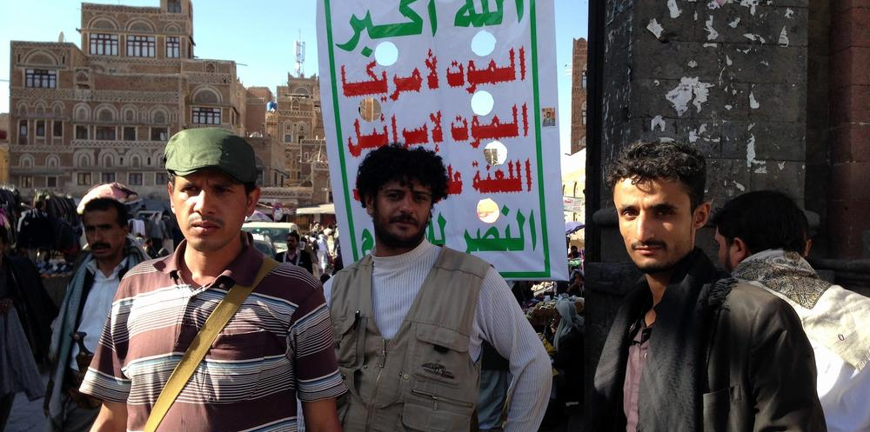
Houthi Rebels Gain Yemen Capital
In September 2014, the Houthis captured the Yemeni capital city of Sanaa.

Slide 13
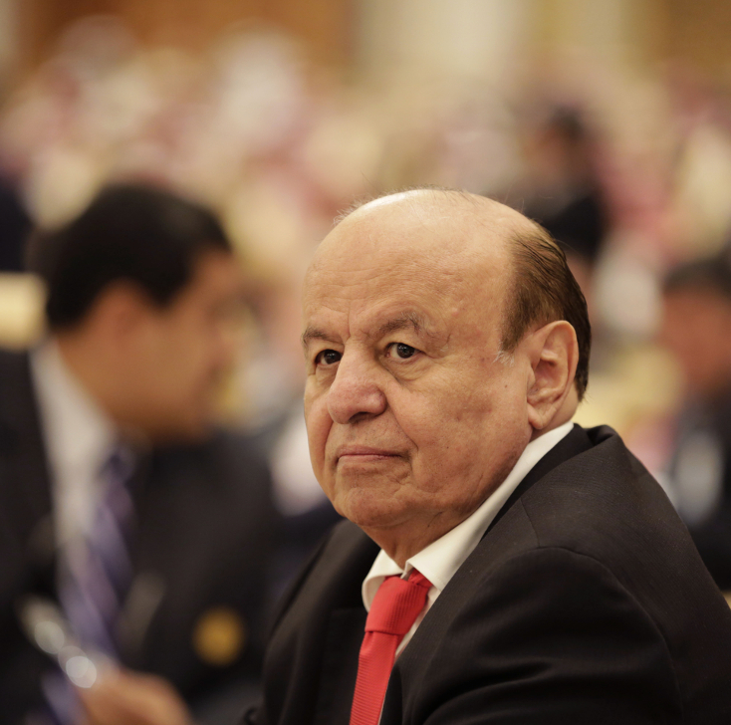
Attempt to Announce a New Federal Constitution
January 2015
Hadi tries to announce a new federal constitution opposed by the Iran-aligned Houthis and Saleh, who arrest him. He escapes, pursued by the Houthis, triggering Saudi intervention in March along with a hastily-assembled Arab military coalition.

Slide 14
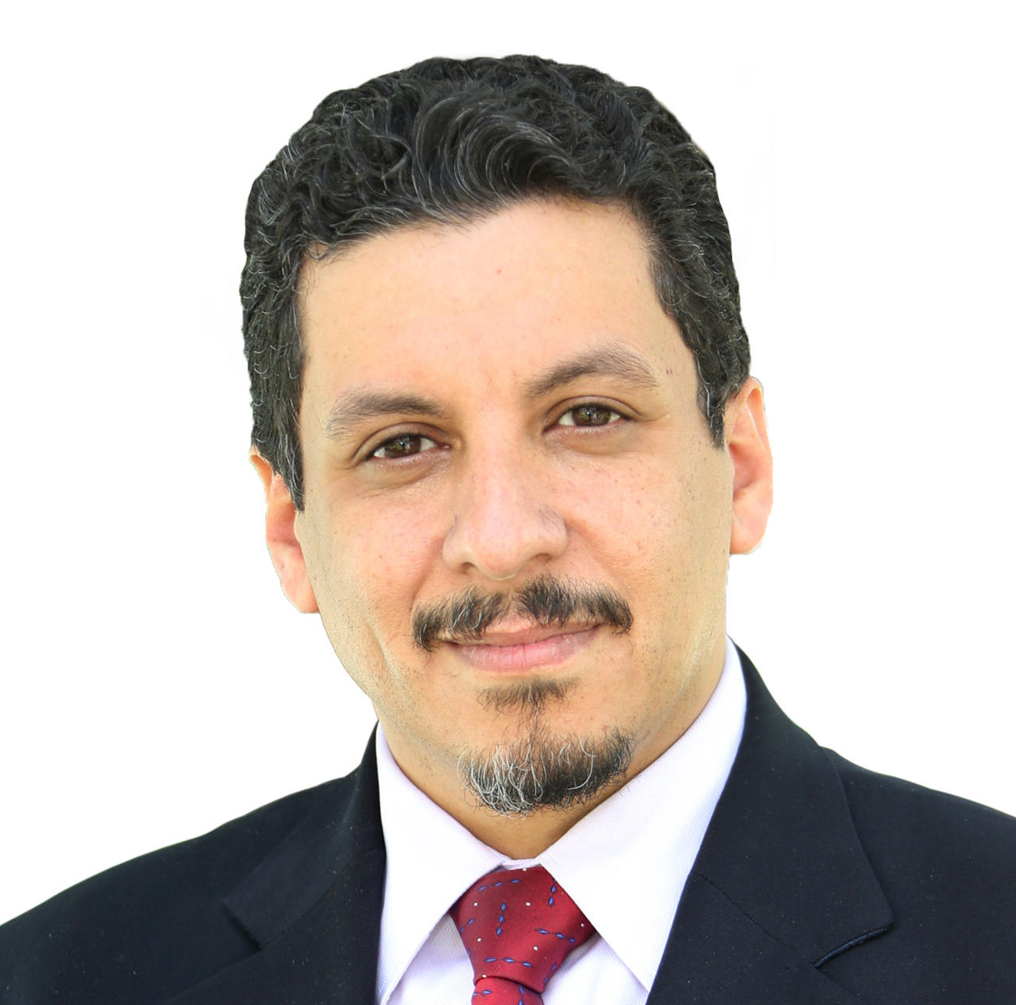
Houthi Rebels Abduct Aide to Yemen’s President
January 17, 2015
Houthis abducted Ahmed Awad bin Mubarak, a senior aide of Yemen's president.
According to the New York Times, the abduction occurred due to disagreements over a draft of Yemen's new constitution.

Slide 15
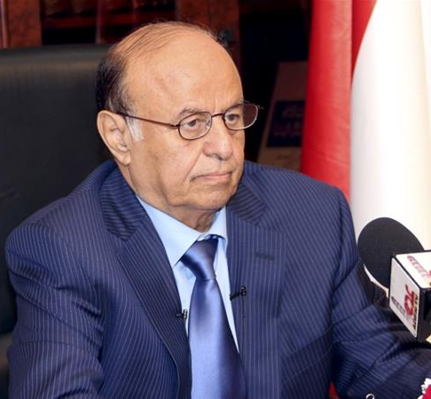
Yemen's President Flees Country
In March 2015, the president of Yemen, Abdo Rabbu Mansour Hadi, was forced to flee the country by Houthi rebels. The Zaidi Shia Houthis were supported by elements of Yemen’s military loyal to the country's former president, Ali Abdullah Saleh.

Slide 16
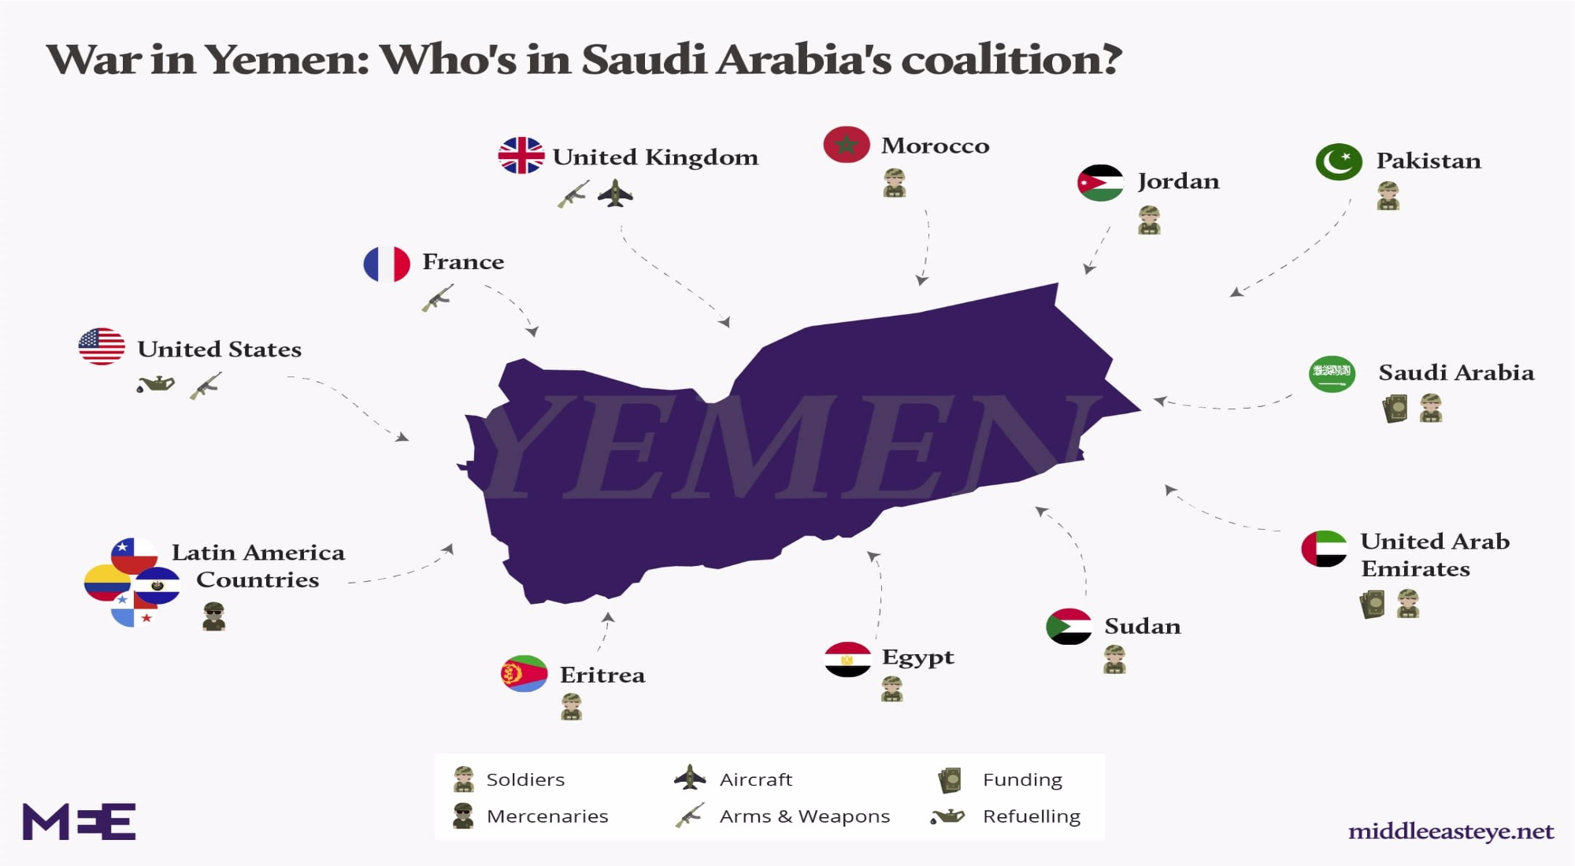
Saudi-led Coalition Formation
March 25, 2015
Saudi Arabia announced the formation of a coalition of ten mostly Arab states to launch air strikes with the stated objectives of stopping and rolling back the Houthis and reinstating Hadi.
The United States backed the coalition politically—albeit cautiously—and provided it with logistical and intelligence support.
Other countries that have been involved include the UAE, Bahrain, Kuwait, Qatar, Jordan, Sudan, Egypt, Turkey, Sudan, Eritrea, Morocco, France and the U.K.

Slide 17
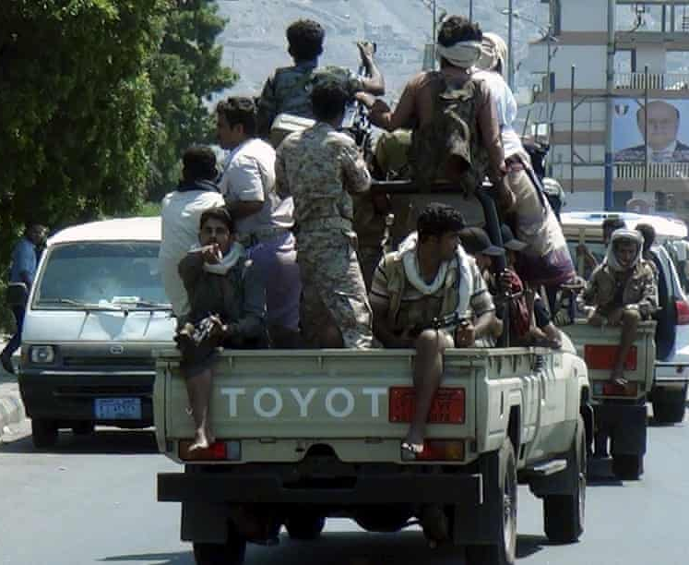
Saudi-led Coalition Bombs Houthi Rebels
March 26, 2015
"As Saudi Arabia began pounding the rebels with airstrikes, countries from the Middle East to Pakistan were said to be prepared to commit troops for a ground assault."
"The US was providing “logistical and intelligence support” to the Saudi-led forces attacking the rebels, the White House announced. Meanwhile the Saudi-owned Al Arabiya news channel said the kingdom had lined up 150,000 soldiers in preparation for a ground offensive, with Egypt, Pakistan, Jordan and Sudan also ready to commit troops."

Slide 18
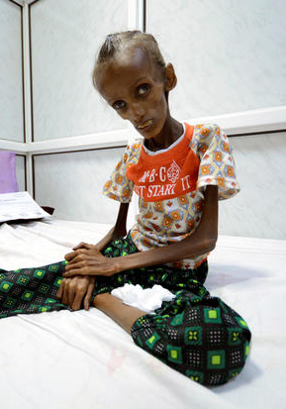
Famine in Yemen
January 2016 to December 2024
Yemen is facing an extreme famine causing many children and adults to experience high levels of malnutrition. The civil war sparked the famine with airstrikes destroying food production and distribution infrastructure and blockades deterring outside aid from flowing into the country.
It is determined that if the famine continues to spread at the same rate, the entire population of Yemen will be killed by 2024.
The inability to bring supplies into the country has increased the number of those civilians dying of starvation and cholera.

Slide 19

Netherlands Ends Arms Exports to Saudi Arabia
March 15, 2016
The Netherlands will no longer export weapons to Saudi Arabia. The bill follows through on an earlier EU decision which encouraged countries to stop selling weapons to Saudi Arabia.

Slide 20
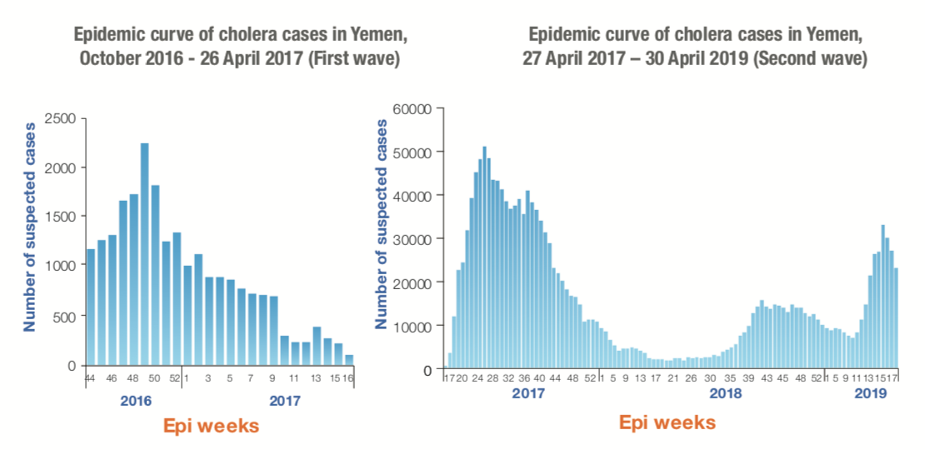
Cholera Outbreak in Yemen
September 2016 to September 2024
The Yemen civil war sparked a cholera outbreak in late-September 2016. The Yemeni population already faced high malnutrition rates and sub-optimal water and sanitation infrastructure. These structural weaknesses further limited local management of the outbreak. Often, the outbreak is separated into two waves with a downward trend from October 2016 - April 26, 2017 and a reversal starting on April 27, 2017.

Slide 21
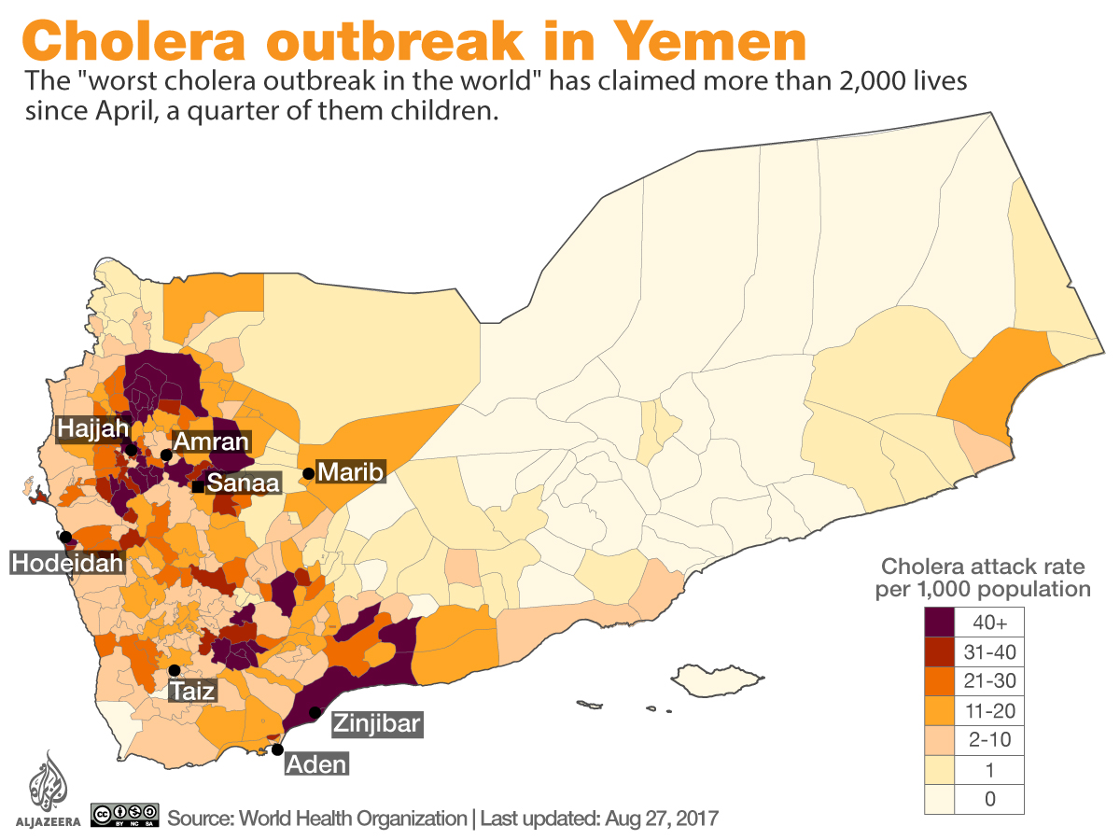
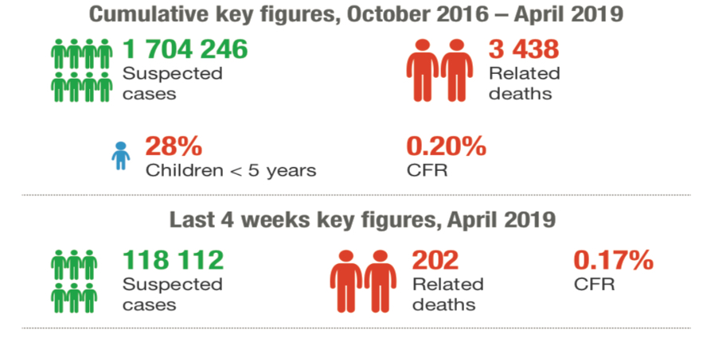

Slide 22
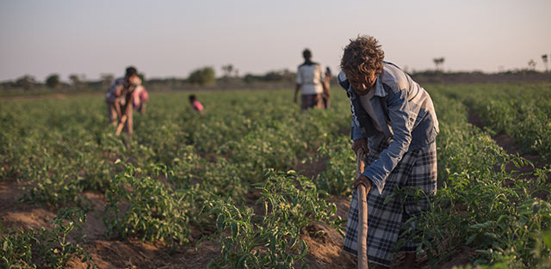
EU Contributes $13.5 Million to UN
January 11, 2017
The EU contributed approx. $13.5 millions to the Food and Agriculture Organization of the United Nations. The money will provide immediate agricultural support to more than 150,000 people and support research on the food security crisis.

Slide 23
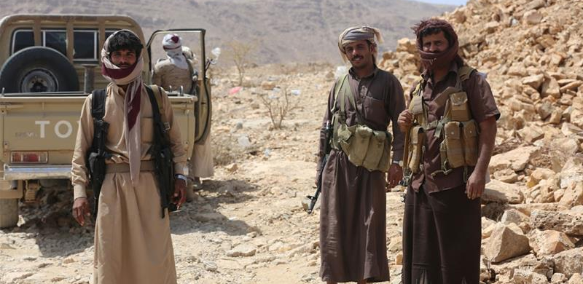
Houthis Attack UAE Military Ship
July 29, 2017
The Houthis attacked an Emirati military ship. The ship was carrying military equipment to the Mocha port in Yemen.

Slide 24
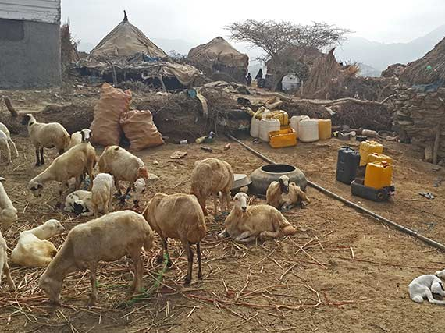
World Bank and FAO Launch $36 Million Aid Project
October 3, 2017
The World Bank and FAO launched a $36 million joint partnership with the purpose to serve approx. 630,000 people over a 3-year period. The project will focus on food-insecure individuals and increasing agricultural resilience.

Slide 25
First Global Declaration to End Cholera
October 4, 2017
The Global Task Force on Cholera Control (GTFCC) released its Declaration to Ending Cholera on 10/4/2017. This came after the completion of a related conference, hosted by the Merieux Foundation, held in Annecry, France. The declaration specifically references the Yemen cholera outbreak saying, "We avow that cholera outbreaks like the one in Yemen should not happen again,...". The GTFCC represents more than 50 organizations and countries with 35 members endorsing the declaration.

Slide 26

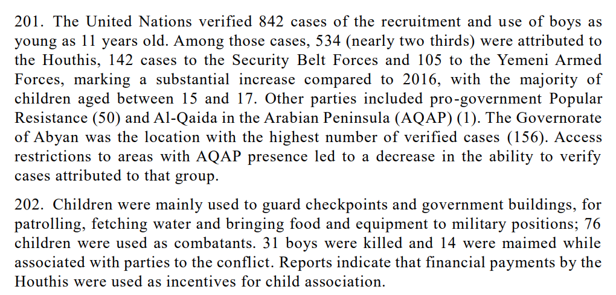
Houthis and Opposition Uses Child Soldiers
December 2017
The UN confirmed in a report that out of 842 cases of child soldier recruitment in Yemen, the Houthis recruited approximately two-thirds of them.

Slide 27
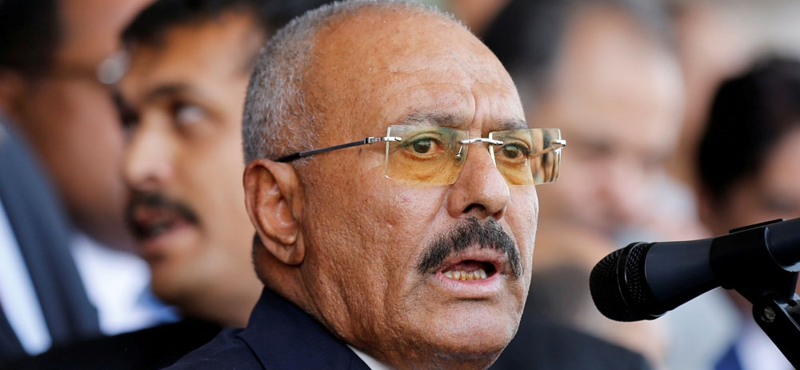
Former President Saleh Killed
December 4, 2017
Houthis killed Ali Abdullah Saleh, Yemen's ousted former president. Both the Houthis and the Yemeni government confirmed this killing.
According to Al Jazeera, " Saleh was killed by the rebels in a rocket-propelled grenade and shooting attack on his car at a checkpoint outside Sanaa."

Slide 28
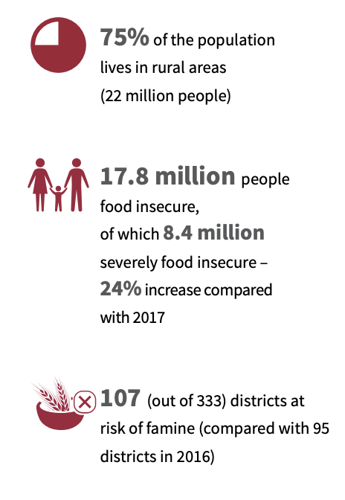
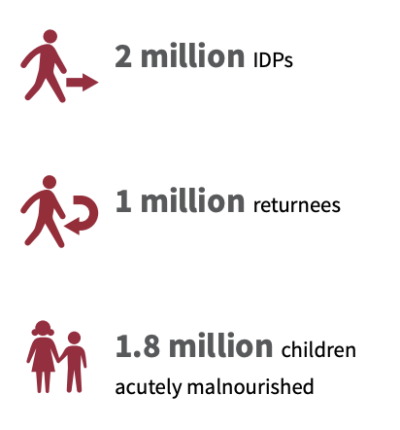
FAO Conducts 3-Year Plan of Action
April 2018 to Dec 31, 2020
FAO (Food and Agriculture Organization) released its long-term strategic plan which addressed food insecurity, nutrition, agricultural livelihoods. It is a dynamic document meant to guide the FAO's efforts in the region from 2018 to 2020.

Slide 29
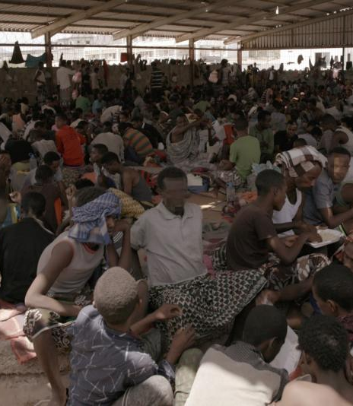
Yemeni Government Officials Torture Migrants
April 17, 2018
According to Human Rights Watch, "Yemeni government officials have tortured, raped, and executed migrants and asylum seekers from the Horn of Africa in a detention center in the southern port city of Aden. The authorities have denied asylum seekers an opportunity to seek refugee protection and deported migrants en masse to dangerous conditions at sea."
Former detainees allege government officials stole their "money, personal belongings, and documents provided by the United Nations refugee agency".

Slide 30
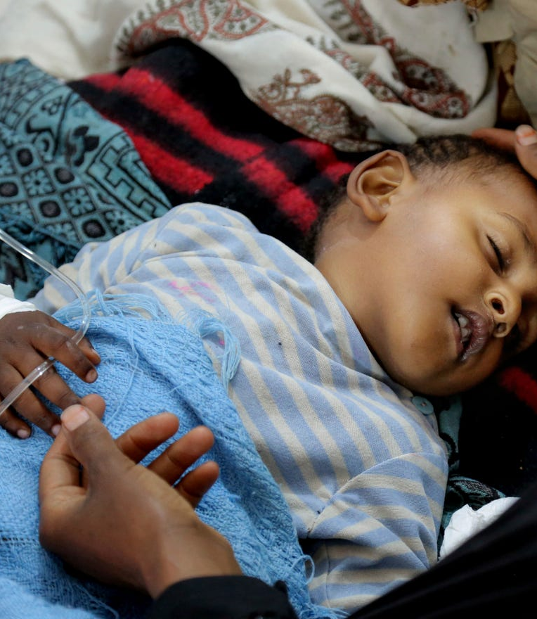
UN Starts Distribution of Cholera Vaccines
May 2018
The Houthis blocked the UN from distributing vaccines in July of 2017. An Associated Press report said the Houthis did so to receive some of the humanitarian aid, which was meant for civilians.
It is unclear if the UN acquiesced to their demands.

Slide 31
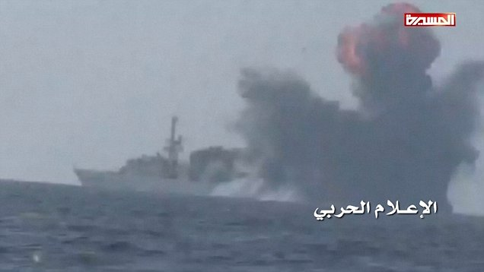
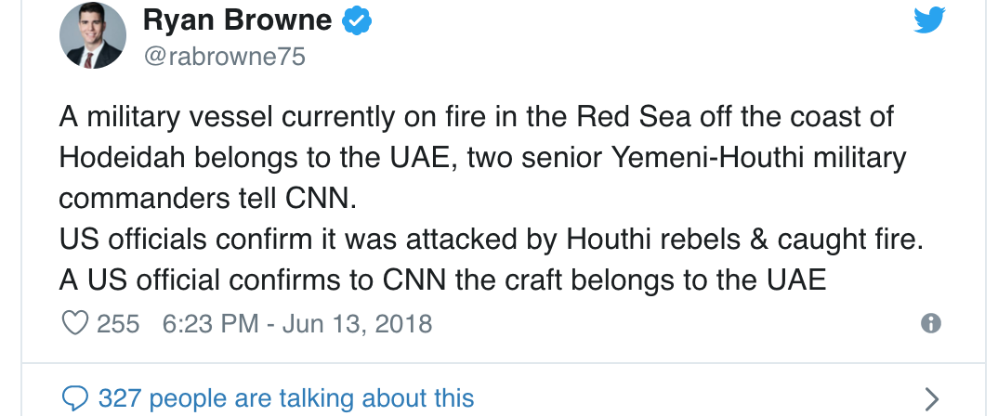
Houthis Destroy UAE Naval Vessel
June 13, 2018
The Houthis destroyed a UAE naval vessel with missiles. This comes after naval attacks from the Saudi-coalition in the al-Hudaydah area.

Slide 32
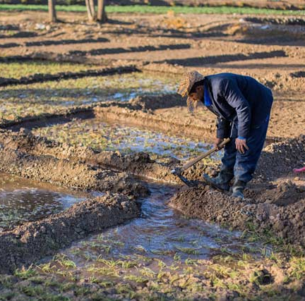
Kuwait Contributes $5 Million to UN
July 12, 2018
Kuwait contributed $5 million to the Food and Agriculture Organization of the United Nations to support the delivery of emergency agricultural interventions and to improve food insecurity in Yemen.

Slide 33
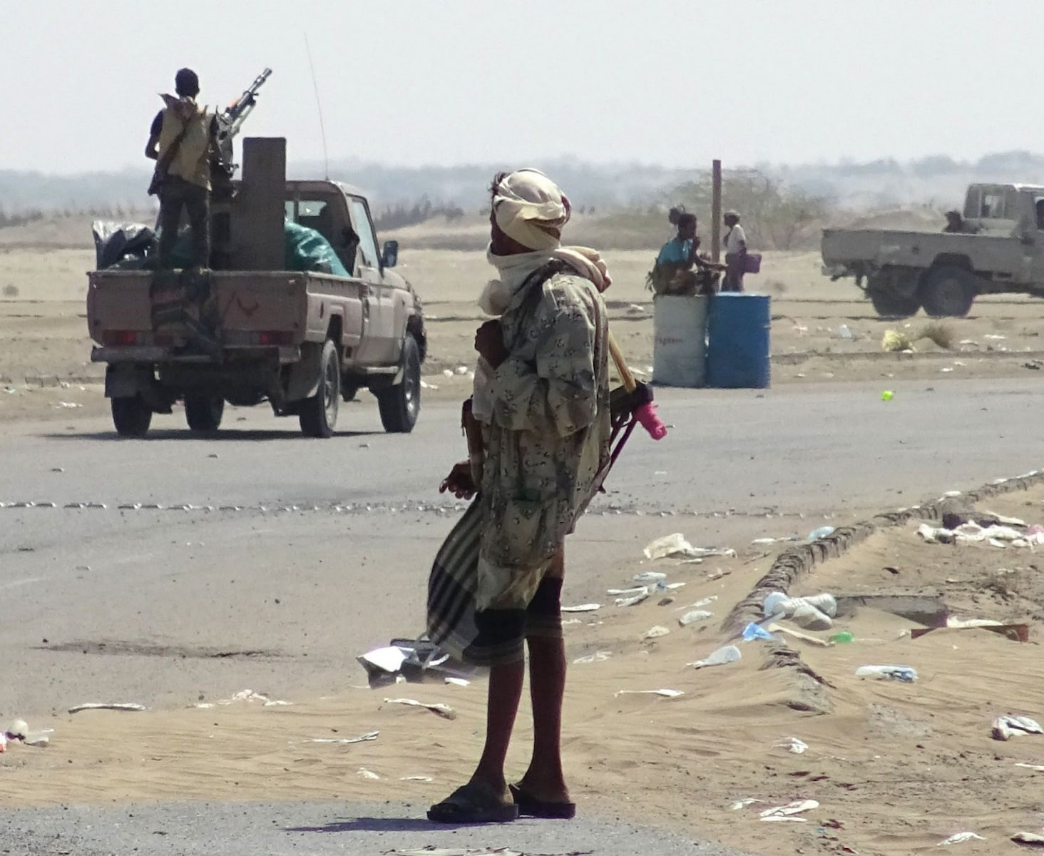
Report Released on International Crimes Committed in Yemen
August 2018
The Group of Regional and International Eminent Experts indicated in a report that, "all parties to the conflict in Yemen have perpetrated, and continue to perpetrate, violations and crimes under international law."
The United Nations Human Rights Council commissioned this report.

Slide 34
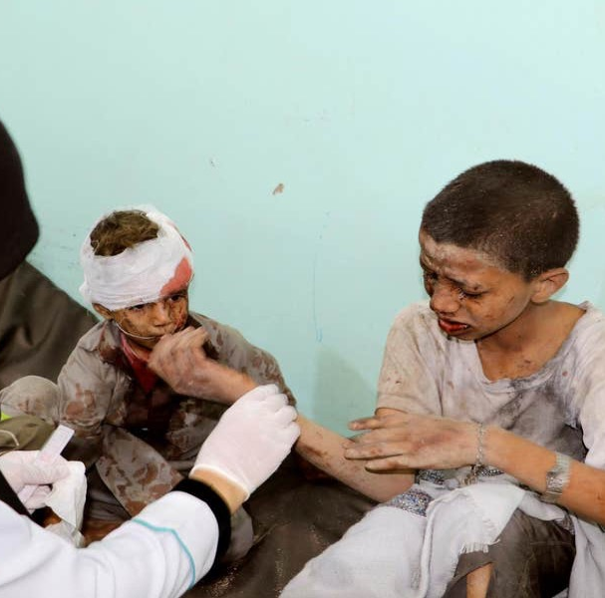
Saudi Arabia Strike Kills 40 Children
August 9, 2018
According to the Red Cross, 51 people died, including 40 children, from a Saudi-initiated attack on a school bus in Dahyan.
Videos of injured children renewed calls for Western countries to end arms sales to Saudi Arabia.

Slide 35
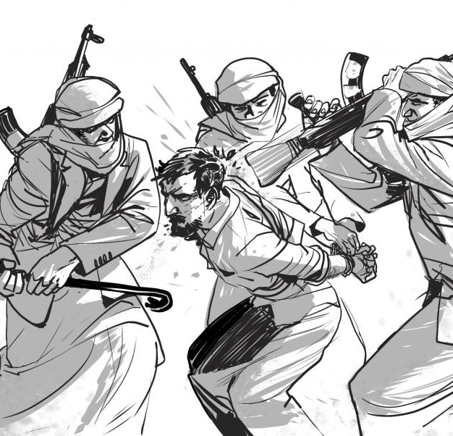
Houthis take Hostages
September 25, 2018
Human Rights Watch, an international non-government organization, documented 16 cases of Houthis illegally holding individuals hostage, in some cases to trade them for other hostages or to extort money from family members.

Slide 36
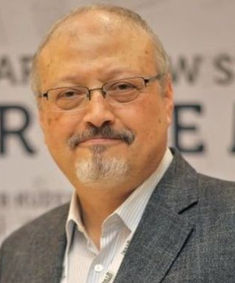
Saudi Journalist Jamal Khashoggi Killed
October 2, 2018
The royal family directed a group of Saudis to kill Jamal Khashoggi, a Saudi journalist who lived and worked in the US.
Information from the US intelligence community confirmed that the Saudi royal family ordered the killing. Khashoggi often wrote articles criticizing the royal family and their attempts to consolidate power.

Slide 37
EU Member States Cease Weapons Sales to Saudi Arabia
October 4, 2018
The European Parliament called on EU member states to suspend weapons sales to Saudi Arabia for its actions in Yemen. Moreover, it called for sanctions against parties obstructing humanitarian aid into the region.

Slide 38
Germany Halts Weapons Sales to Saudi Arabia
October 22, 2018
Following the death of Jamal Kashoggi, Germany will no longer export weapons to Saudi Arabia. The German government is also considering rolling back already-approved arm deals.

Slide 39
Switzerland Halts Weapon Parts Sales to Saudi Arabia
October 31, 2018
Switzerland will no longer sell spare weapon parts to Saudi Arabia. Switzerland already stopped exporting complete weapons to Saudi Arabia almost 10 years prior.
This decision is temporary and was made as a response to Saudi Arabia killing Jamal Khashoggi, a Saudi journalist living in America.

Slide 40

Norway Suspends Arms Sales to Saudi Arabia
November 9, 2018
Norway is no longer authorizing licenses to sell weapons to Saudi Arabia. It is unclear how this suspension will last. A Norwegian official said it was done in response to "recent developments" in Yemen.

Slide 41
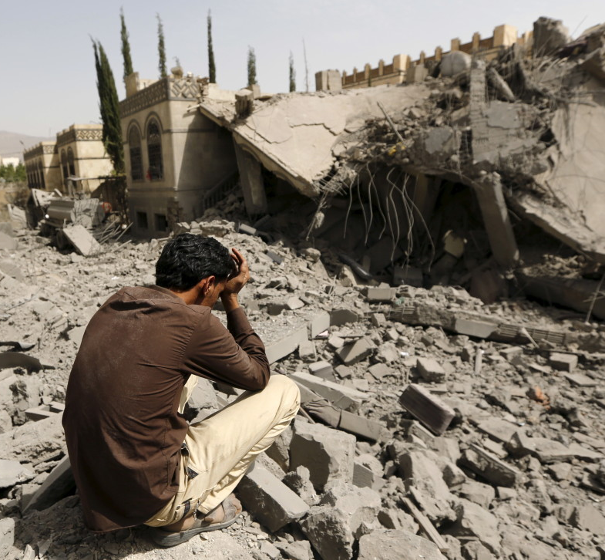
OHCHR Reports Over 6,000 Civilian Casualties
November 10, 2018
According to the Office of the United Nations High Commissioner for Human Rights (OHCHR), 6,872 civilians have been killed and 10,768 wounded in the Yemen civil war. The Saudi coalition wounded/killed the majority of the victims.

Slide 42
Denmark Votes to Ban Weapons Sales to Saudi Arabia
November 22, 2018
Denmark will no longer approve weapon sales to Saudi Arabia in response to the killing of Jamal Khashoggi.

Slide 43
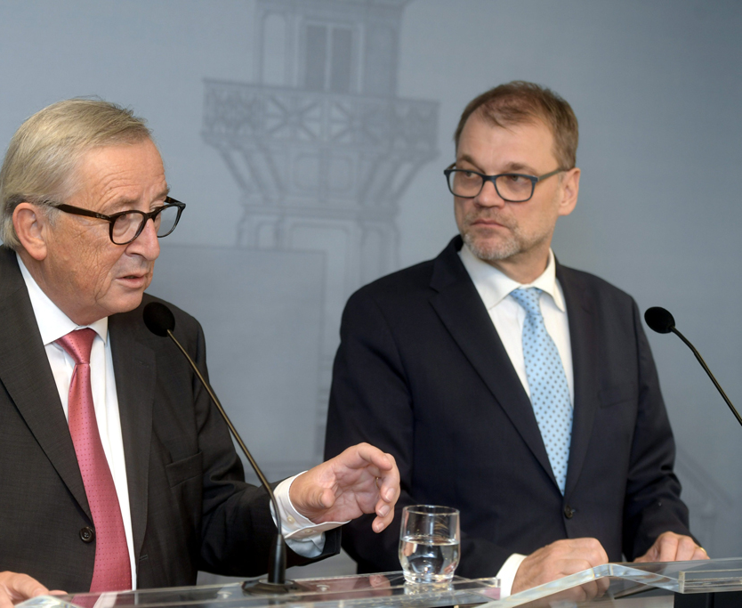
Finland Suspends Weapons Exports to Saudi Arabia and UAE
November 23, 2018
Finland will no longer approve arms deals to Saudi Arabia after the killing of Jamal Khashoggi.

Slide 44
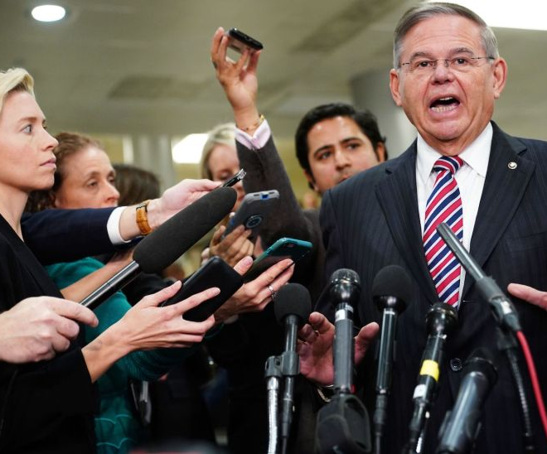
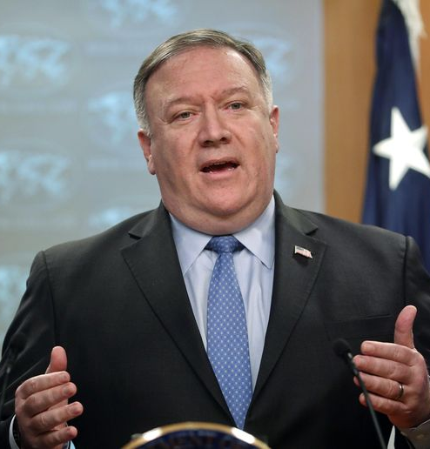
U.S. Senate Vote Against Trump's Military Support of Saudi Arabia and UAE
December 13, 2018
The Senate voted, 56-41, to stop selling weapons to Saudi Arabia. Although this measure didn't pass the House of Representatives, it marked a turning point in the US-Saudi Arabia relationship.

Slide 45
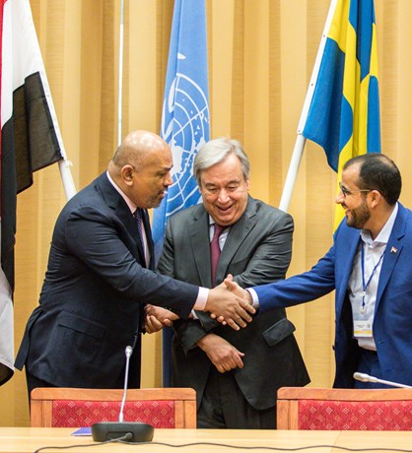
Stockholm Agreement Signed
December 13, 2018
There are three agreements under the Stockholm agreement: the Hodeidah Agreement, the Taiz Understanding, and a prisoner swap agreement. If followed, the Stockholm Agreement should lead to a ceasefire in al-Huydaydah and other important cities, an increase in humanitarian aid flowing into Yemen, and the release of about 15,000 prisoners.

Slide 46
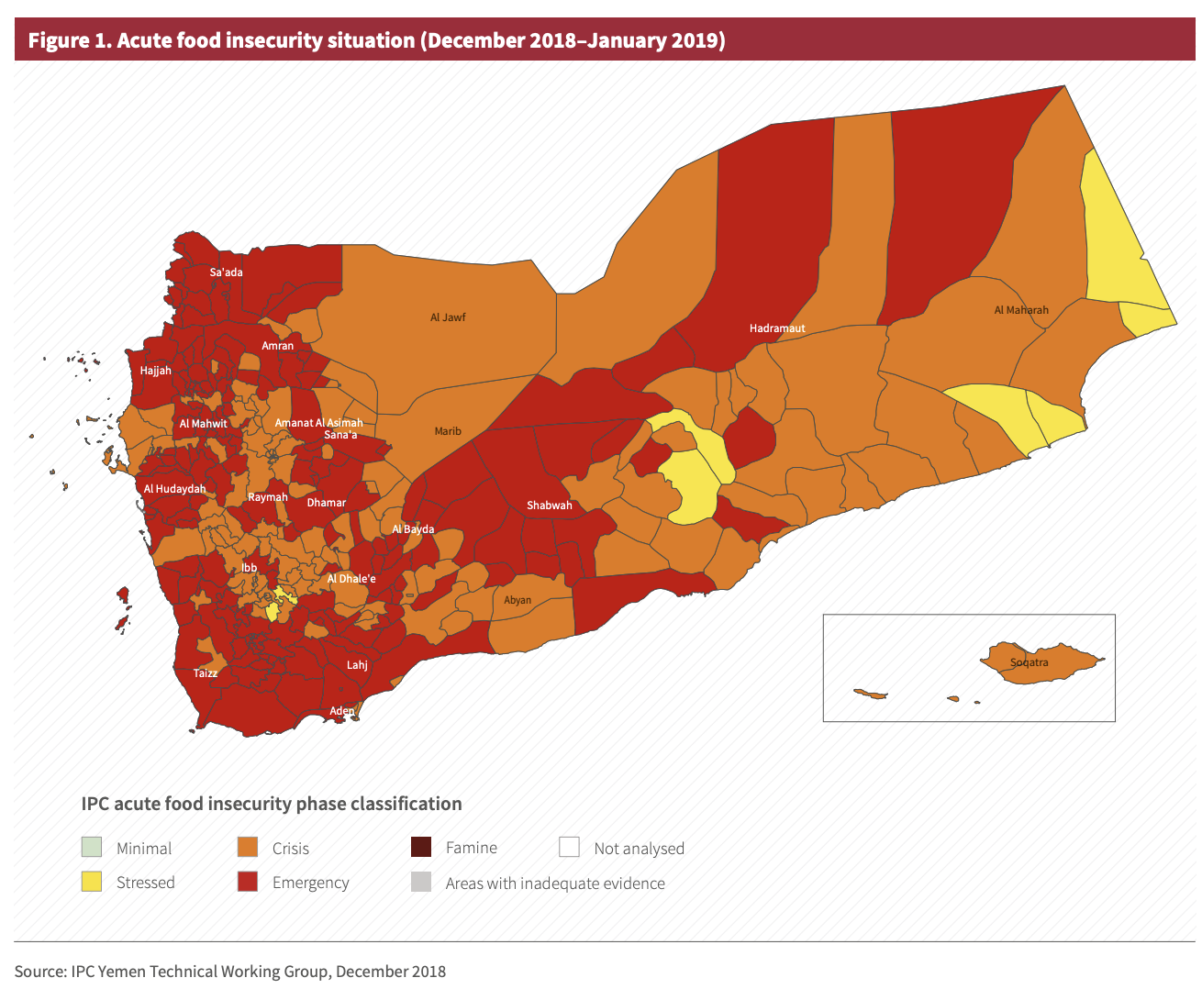
FAO Conducts Famine Prevention Plan
January 2019 to June 2019
The Food and Agriculture Organization of the United Nations released its Famine Prevention Plan for Yemen in January of 2019. Its objective is to assist 1.6 million people through cash transfers and agricultural livelihood assistance to improve food security and nutrition.

Slide 47
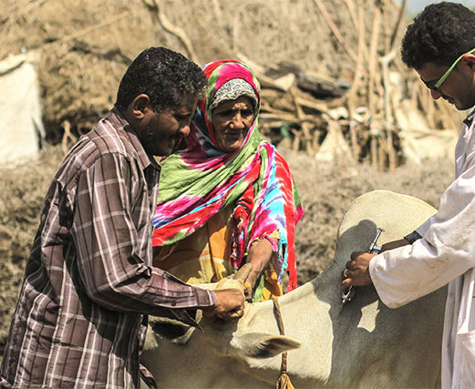
Japan Contributes $8 Million to UN
January 3, 2019
Japan and the Food and Agriculture Organization of the United Nations signed a funding agreement for Japan to contribute over $8 million dollars to support a 2-year plan aimed at reducing food insecurity and improving nutrition. Japan is the second largest contributor to the overall FAO budget.

Slide 48
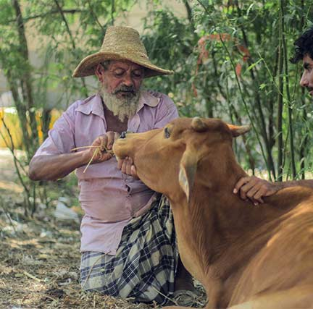
EU Contributes $6.7 Million to UN
February 4, 2019
The European Union and the Food and Agriculture Organization of the United Nations announced a new contribution from the EU of $6.7 million. The money will fund UN actions to monitor threats to food security and collect data on hunger and malnutrition in Yemen.

Slide 49
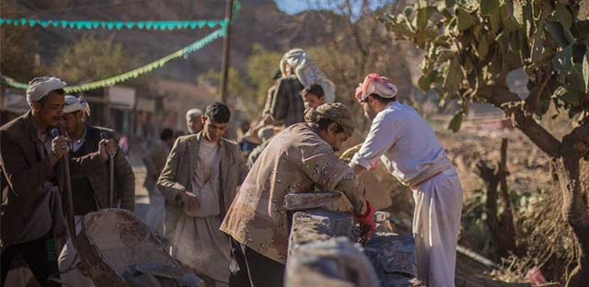
EU Contributes $40.8 Million to UN
March 25, 2019
The European Union contributed $40.8 million to the United Nations to support resilience-building work in Yemen. The funding agreement was signed in Amman, Jordan

Slide 50
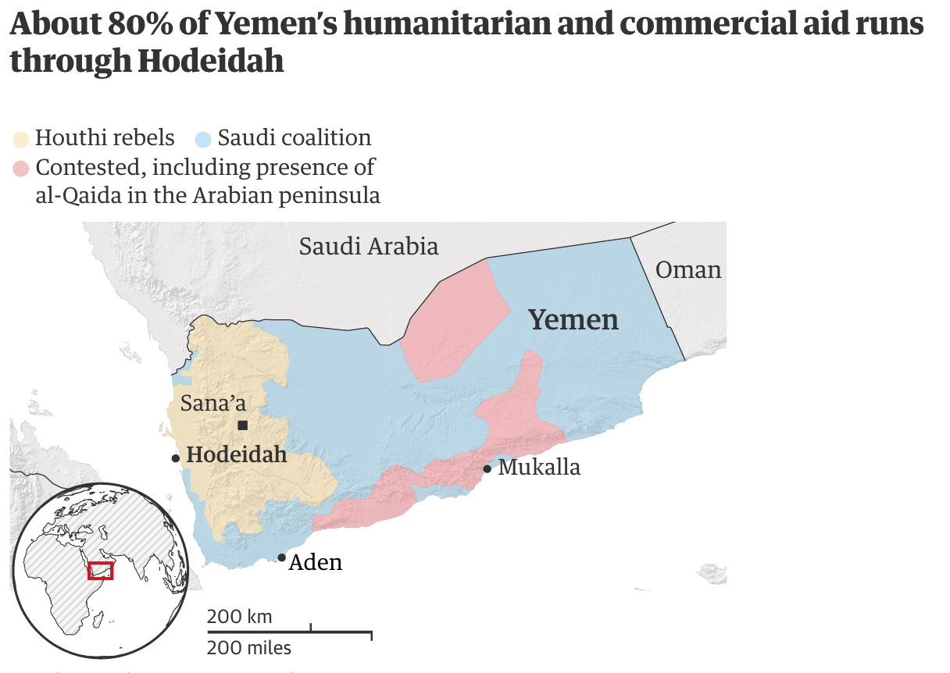
Houthis Agree to Withdraw from Hodeidah
May 11, 2019
The Houthis began to retreat from ports they previously captured. They agreed to do so under a ceasefire deal with the Yemen-Saudi coalition.
The UN will take over operating these ports moving forward.

Slide 51
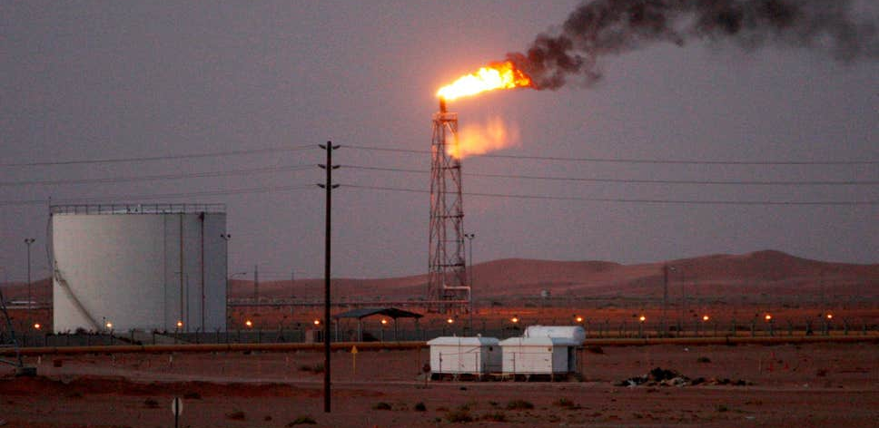
Houthis Strike Saudi Oil Pipeline
May 14, 2019
The Houthis launched multiple drone attacks on Saudi Arabian oil facilities.
The Saudi government said the drone attacks caused minimal damage on the facilities.

Slide 52
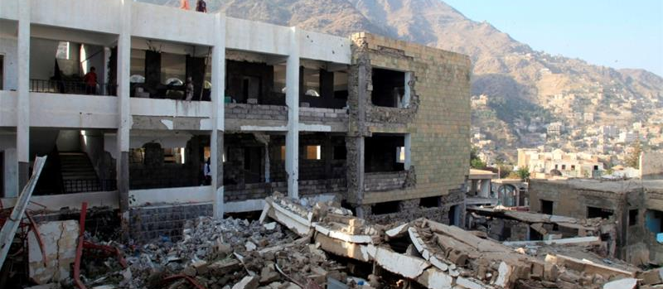
Saudi-UAE-led Air Attack Kills 9 Yemeni Civilians
May 25, 2019
According to an Al Jazeera report, "At least nine civilians have been killed in Saudi-led overnight air raids east of Yemen's third city of Taiz...". Of those nine, two were children.

Slide 53
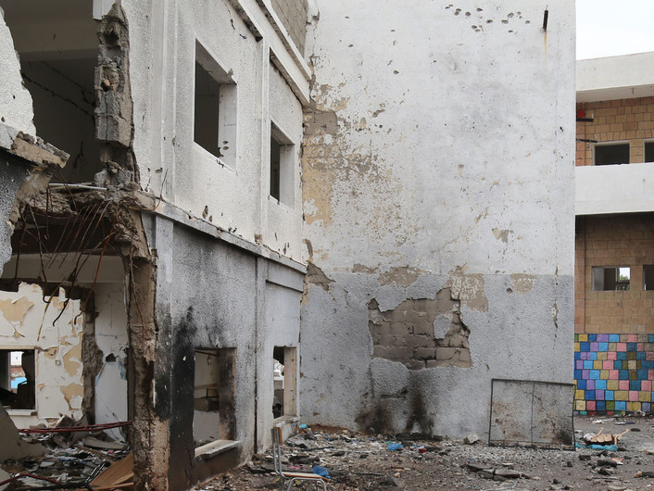
UNICEF Confirms 7,300 Children Killed or Injured
May 27, 2019
In a press release, the UNICEF confirmed that "at least 7,300 children were killed or seriously injured in Yemen amid clashes between supporters of Yemeni President Abd Rabbu Mansour Hadi and Houthi opposition groups." However, the agency believe the actual number may be much higher.

Slide 54
Saudi Arabia and UAE Donate $20 Million to WHO
May 27, 2019
Saudi Arabia and the UAE donated a $20 million grant to the World Health Organization to fund the UN's cholera outbreak management in Yemen.

Slide 55
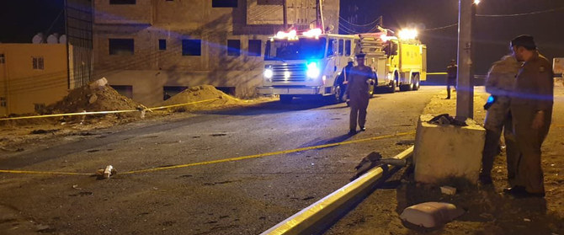
Houthis launch attack drones into Saudi Arabia
June 11, 2019
The Houthis launched attack drones on Khamis Mushait, a Saudi Arabian city. The Saudi government said they intercepted the drones.

Slide 56

Houthi Rebels Injure 26 People in Saudi Arabia
June 12, 2019
The Houthis attacked a Saudi Arabian civilian airport, injuring at least 26 people with eight sent to the hospital for treatment. Houthis sent missiles to the arrivals terminal at Abha airport.

Slide 57

Two Oil Tankers Attacked: Iran Suspected
June 13, 2019
The US alleges that Iran attacked two commercial oil tanks in the Gulf of Oman.

Slide 58

U.S. Secretary of State Keeps Saudi Arabia from Child Soldier List
June 18, 2019
Secretary of State Mike Pompeo blocked the State Department from including Saudi Arabia on a list of countries that recruit child soldiers.

Slide 59

Ten Stages of Genocide
June 2020
The Yemen Crisis is categorized as being in stages nine and ten: extermination and denial. Extermination because the Yemeni population is dying at the hands of rebel and government forces, both of which have deliberately targeted civilians in attacks. Denial because the rebel and government forces continue to ignore the fact that they are responsible for the deaths of these Yemeni civilians.

Slide 60


Over 90,000 Fatalities Confirmed in Yemen Crisis
June 18, 2019
According to the Armed Conflict Location & Event Data Project, "Over 90,000 fatalities [occurred in Yemen]...over the past four and a half years."

Slide 61

Iran Shoots Down U.S. Drone
June 20, 2019
A US spy drone was shot down by Iranians. Iran says it was in their airspace while the US says "...it was downed over international waters...".

Slide 62

Houthis Bomb Saudi Power Station
June 20, 2019
The Houthis say they fired missiles at a Saudi power station. The Saudi government says they fired "a projectile" at a desalination facility.
No was was injured and there was minimal damage to the attacked building.

Slide 63
UK Court of Appeal Rule Saudi Support Unlawful
June 20, 2019
In a historic ruling, the UK Court of Appeals ruled that the Britain's support of Saudi Arabia in providing billions of pounds in weapons has been unlawful in the Yemen Crisis.
For now, the British government cannot grant new licenses to Saudi Arabia that could be used in Yemen, and must re-evaluate its past export license decisions based on the new judgement. The UK government will appeal the decision, but will stop licensing arms that might be used by Saudi Arabia in Yemen with immediate effect.

Slide 64
UN Partially Suspends Food Aid
June 21, 2019
BBC News reported that "The UN has partially suspended aid to parts of Yemen controlled by Houthi rebels, accusing them of misappropriating supplies....The UN agency had warned that it would restrict deliveries if the rebels failed to agree to measures to prevent food being diverted by corrupt officials. It had previously said efforts to reach people in need were being blocked."
The World Food Programme (WFP) said it was a "last resort" action.

Slide 65

UN Releases Report on Yemen Children Deaths
June 28, 2019
The UN released a report June 28, 2019 stating that, "Over 7,500 children have been killed or wounded in Yemen in the last 5 1/2 years as a result of airstrikes, shelling, fighting, suicide attacks, mines and other unexploded ordinance."

Slide 66

Houthi Rebels Attack Al-Hudayda
June 30, 2019
Houthi rebels launched a "large-scale" attack on Yemen’s port city of al-Hudayda on June 30, 2019. The Saudi-led coalition said the attack targeted their forces and at least one soldier affiliated to them was killed and another injured.

Slide 67

UN Special Envoy to Revive Talks on Yemen
July 1, 2019 to July 14, 2019
The UN’s Special Envoy to Yemen, Martin Griffiths, traveled to Russia to revive political efforts to resolve the Yemen crisis. Griffiths then traveled to the UAE, Oman, and Saudi Arabia.

Slide 68

UAE Withdraws from Hodeidah
July 9, 2019
The United Arab Emirates confirmed it's withdrawal from Hodeidah, as well as a less extensive retreat from other regions of Yemen. The UAE will remain a part of the Saudi-led coalition, but chose to withdraw in order to support UN-led peace processes.

Slide 69

US Senate Fails to Override Trump's Vetoes of Weapon Sales Restrictions Bill
July 29, 2019
The legislation, vetoed by President Trump, would have limited the types of weapons that could be sold to Saudi Arabia and other countries. It was aimed at preventing further civilian casualties in Yemen. President Trump defended his veto, claiming that the move would weaken US relations with Saudi Arabia, a long-time ally, and harm US competitiveness.

Slide 70

Coalition Airstrike Kills 10 Civilians
July 29, 2019
Airstrikes by the Saudi-led coalition on a busy market in Sa'dah killed at least 10 civilians, including 2 children. At least 23 others were injured in the attack.

Slide 71

Houthi Missile Attack on Military Parade
August 1, 2019
Houthis used missiles and an armed drone to attack a military parade of pro-government forces, killing at least 36 people. While the Houthis claimed that the parade was part of preparations for a new attack on Houthi territory, the Yemeni government claimed it was merely a graduation ceremony for newly recruited soldiers.

Slide 72

Southern Separatists Seize Aden
August 10, 2019
Southern separatists effectively took over Aden, which has served as the temporary seat of the internationally recognized Yemeni government. President Hadi accused the separatists of staging a coup. Hundreds of civilians were wounded in the siege.

Slide 73

Saudi-led Coalition Aircraft Bombs Prison
September 1, 2019
At least 170 inmates were killed or wounded in an air raid on a Dhamar prison by the Saudi-led coalition.

Slide 74

UN Panel Says Both Sides Have Committed War Crimes
September 3, 2019
A UN panel declared both sides in the Yemeni conflict have committed war crimes including but not limited to arbitrary killings, rape, torture, and recruitment of child soldiers. Due to their provision of intelligence and logistical support, the UK, US, France, and Iran may also be culpable in these abuses. The panel has provided names of perpetrators gathered from 600 interviews with victims and witnesses, as well as other sources, to the UN Human Rights Chief.

Slide 75

Drone Attack on Saudi Aramco Facilities
September 14, 2019
Houthi armed forces claimed to have conducted a large-scale drone attack on two Saudi Aramco oil facilities: Abqaiq and Khurais. The attack disrupted half of Saudi Arabia's oil capacity. The origin of the attack is disputed however. A UN report claims that the Houthis did not carry out the attack. The United States and a number of European countries have blamed Iran, whose government has denied responsibility.

Slide 76

Saudi-led Coalition Conducts Airstrikes on Hodeidah
September 20, 2019
The Saudi-led coalition conducted airstrikes in Hodeidah to target Houthis' capacity launch remote-controlled attacks on Red Sea shipping activity. The Houthis claimed that the airstrikes were violations of the ceasefire established by the Stockholm Agreement and that they were a retaliatory effort for the attacks on Saudi Aramco oil facilities.

Slide 77

Saudi-led Coalition Airstrikes Kill 16
September 24, 2019
Airstrikes by the Saudi-led coalition in Qataba killed 16 civilians, including 7 children, and injured 9 others.

Slide 78

Houthis Release Detainees
September 30, 2019
Houthis released 290 detainees as part of the UN-led peace process. It is hoped that this move will lead to further releases on both sides. Prisoner swaps are part of the Stockholm Agreement.

Slide 79

Over 100,000 Fatalities Confirmed in Yemen Crisis
October 31, 2019
ACLED confirmed the death toll of the Yemen Crisis reached 100,000. This includes 12,000 civilians who were killed in directly targeted attacks.

Slide 80

Yemeni Government and STC sign Riyadh Agreement
November 5, 2019
Yemeni government and STC representatives signed an agreement in hopes of the power struggle between the two in Southern Yemen. The agreement calls for the formation of a new cabinet within 30 days, which would give equal representation to northerners and southerners. It would also put STC armed forces under the control of the Yemeni government.

Slide 81

UN Envoy reports an 80% decrease in Saudi-led Coalition Airstrikes
November 8, 2019 to
November 22, 2019
The UN Yemen envoy reported to the Security Council that Saudi-led coalition airstrikes decreased by nearly 80% over this two week period. There had even been 48-hour periods without airstrikes for the first time since the beginning of the conflict. Such de-escalation is a vital part of ongoing informal talks between the Houthis and Saudi Arabia.

Slide 82

Human Rights Organizations File Complaint to the ICC
December 11, 2019
A group of human rights organizations filed a complaint with the International Criminal Court claiming BAE Systems and other arms manufacturers based in Europe are complicit in alleged war crimes in Yemen due to their dealings with Saudi Arabia. The complaint cites 26 airstrikes on schools, hospitals, and civilians that killed 135 people and injured 181 others. BAE Systems, which is a large British arms manufacturer, is specifically listed in the complaint due to its role as the Royal Saudi Air Force's primary supplier of Eurofighter Tornado and Typhoon jet aircraft.

Slide 83

2020 Agreements and Violations
On April 25, the Southern Transitional Council declared self-rule in Aden and other southern provinces under its control. The STC complained that the Riyadh Agreement of November 2019 between itself and the Yemeni government was not being implemented.
The Socotra Truce was announced on May 2 following clashes between Yemeni government and southern separatists in Hadibo, the provincial capital of Socotra. Under the truce, checkpoints and military vehicles on both sides were to be removed and control of the island would remain with the governor.
On June 20, forces allied with the STC took control of Socotra. This increased tension between the Yemeni government and STC, leading to clashes in the Abyan province. A ceasefire was called on June 22 in this province, as well a a call for de-escalating tensions in other regions. The Yemeni government and STC are expected to resume talks to implement the Riyadh Agreement.

Slide 84

Houthi Missile Attack on Training Camp
January 18, 2020
A missile attack on a military training camp killed 130 Yemeni soldiers, one of the deadliest single attacks since the beginning of the war. The missiles hit the camp's mosque where evening prayers had begun. Yemeni armed forces have blamed the Houthis, but they did not claim responsibility.

Slide 85

UN Reports Houthis Block Humanitarian Aid
February 11, 2020
The UN reported that Houthis have blocked half of UN aid delivery programs as part of their effort to gain more control over the humanitarian aid and foreign monetary assistance being funneled into territories they control. Over 2 million civilians are directly affected by this blockage. As a result, some agencies, like the World Food Program, are considering cutting back their services. International donors have also become increasingly wary of their donations being misappropriated by Houthis.
Last November, Houthis demanded a tax of 2% of the operational budgets of all aid agencies operating in their territories. UN agencies refused, and the Houthis ultimately backed off of this demand.

Slide 86

Saudi-led Retaliatory Airstrikes Kill 31 Civilians
February 15, 2020
After Houthis claimed to have shot down a Saudi jet, the Saudi-led coalition conducted retaliatory airstrikes that killed 31 civilians and injured an additional 12.

Slide 87

Report Finds Health Workers Targeted at Least 120 Times
March 18, 2020
Physicians for Human Rights and Mwatana, a Yemeni human rights group, co-published a report that found that hospitals and doctors in Yemen were targeted at least 120 times between March 2015 and December 2018. This violence included airstrikes, ground attacks, military occupation, assaults on health workers, looting, and restrictions on humanitarian aid. The attacks killed at least 96 civilians and healthcare workers and injured an additional 230 civilians. Mwatana documented at least 35 attacks on hospitals, clinics, and vaccination centers carried out by the Saudi-led coalition.

Slide 88
Houthi Fighters Shell the Women's Section of a Taizz Prison
April 4, 2020
At least 5 women and one child were killed, and more than 11 others were wounded, when Houthi fighters bombed the women's section of a prison in the Al Mudhaffar District in Taizz. There were no reports of armed clashes nearby, nor any military presence near the prison. Michelle Bachelet, the UN human rights chief, suggested this attack might amount to a war crime.

Slide 89

Coalition Ceasefire to Help Combat Coronavirus
April 9, 2020 to April 23, 2020
Called before the first case of COVID-19 was identified in Yemen in order to halt the spread of the virus and facilitate efforts to find a political solution to the crisis. Houthis were suspicious of the ceasefire, calling it "a ploy."

Slide 90
STC Declares Self-Rule
April 25, 2020
Backed by the UAE, the Southern Transition Council declared self-rule and a state of emergency in Aden and the southern territories it controls. Many of the governorates refused to implement the state of emergency, further splintering Yemeni politics. The STC defended its actions, stating that the Riyadh agreement was not being implemented.

Slide 91

Southern Transition Council and Yemeni Government Sign Socotra Agreement
May 2, 2020
This truce was announced following clashes between Yemeni government and southern separatists in Hadibo, the provincial capital of Socotra. This move comes after the STC declared self-rule and instituted a state of emergency in the parts of the south under its control.

Slide 92

UN Officials Say Yemen's Healthcare System has Collapsed
May 22, 2020
As coronavirus continues to spread, aid workers in Yemen report that they are turning people away due to a lack of medical oxygen and personal protective equipment.

Slide 93

Houthis Claim to Have Killed 500 Saudi Soldiers
June 2020
Houthis claim to have killed 500 Saudi soldiers, captured an additional 2,000 soldiers, and seized a Saudi military vehicle convoy. At a press conference, Houthis showed photos and inconclusive videos. Saudi Arabia did not confirm this claim, nor could any other agency corroborate it.

Slide 94

UN Programs in Yemen Dangerously Underfunded
June 12, 2020
At a conference on June 2nd, international donors pledged $1.35bn for Yemen, despite the UN's fundraising target of $2.4bn. Without further funding, three-quarters of aid programs will be shut down.
The threat of COVID-19 is of concern with this funding shortage. While Yemen has reported 564 confirmed cases and 130 deaths, these numbers do not include cases from the Houthi-controlled north. Yemen also has very limited testing capacity at just 31 tests per million citizens. Yemen's malnourished citizens may have the world's lowest immunity levels, making them especially vulnerable to the virus.

Slide 95

UN Secretary General Antonio Guterres Drops Saudi-led Coaliton from Child Rights Blacklist
June 15, 2020
Secretary General Antonio Guterres removed the Saudi-led coalition from a "list of shame" of groups violating child rights, citing "a sustained significant decrease in killing and maiming due to airstrikes." The Houthis remain on this blacklist. A number of international actors have denounced this move. The Watchlist on Children and Armed Conflict claims the coalition was responsible for the death or injury of 222 children in Yemen last year.

Slide 96

Saudi-led Coalition Strikes a Civilian Vehicle
June 15, 2020
A Saudi-led coalition airstrike hit a civilian vehicle in northwestern Yemen, killing 13 people, including 4 children.

Slide 97

UK Accused of Ignoring Ban on Arms Sales to Saudi Arabia
June 21, 2020
The UK is accused of allowing licenses to Saudi Arabia to continue. BAE Systems, for example, has continued to export fighter jet components and aircraft maintenance.

Slide 98

Yemeni Government and STC Agree to a Ceasefire
June 22, 2020
Hadi's government and southern separatists agreed to a ceasefire in the Abyan province, which had become a hotspot of violence. The two parties will work towards implementing an earlier peace agreement.

Slide 99

Houthis Conduct Missile and Drone Strikes on Riyadh
June 23, 2020
Houthis claimed to have carried out missile and drone strikes on Riyadh, Saudi Arabia's capital. These attacks allegedly hit ministries and an air base, although Saudi officials only confirmed that they intercepted one missile. If true, this attack would be one of the largest committed by Houthis on Saudi soil and could further escalate the conflict between the two.

Slide 100
Houthis Launch Attack on Riyadh
June 23, 2020
The Houthis carried out ballistic missile and drone attacks on Riyadh. While Saudi officials announced they had intercepted one ballistic missile, they did not confirm reports that ministries and an air base were hit. If the Houthi claims are true, this is one of the biggest attacks by Houthis on Saudi soil and threatens to once again escalate the conflict.

Slide 101

UN Warns Oil Tanker At Risk of Exploding
June 26, 2020
The UN has warned that an abandoned oil tanker carrying more than one million barrels of crude oil tethered off of the Ras Issa port is at risk of exploding due to irreversible damage. If it explodes, it would cause significant damage to the environment and desalination factories. It would also interrupt international shipping routes. The UN has been trying to access the ship to inspect it for years, but because the Houthis control this territory, they have denied the UN access. Mohammed Ali al-Houthi has blamed the US and Saudi Arabia for not allowing them to sell the oil, claiming these countries would be responsible should the tanker explode.

Slide 102

Mwatana Report Documents Conditions in Yemen's Unofficial Prisons
June 30, 2020
Mwatana published a report that documented 1,605 cases of arbitrary detention, 770 cases of enforced disappearance, and 344 cases of torture carried out by all parties between May 2016 and April 2020 at 11 unofficial detention centers. The Houthis were found to be responsible for the majority of these human rights violations, followed by the UAE and affiliated forces and the Yemeni government.

Slide 103

Summary
• The Yemen Crisis continues to inflict major damage on the civilian population as disease, famine, and death claim thousands of lives.
• The international community supporting the Saudi-led Coalition are contributing to the ongoing violence and have not shown any sign of withdrawing their support.
• Houthi rebels are refusing to back down and are maintaining a firm foothold within Yemen.
• Southern separatists splitting from the Yemeni government has further splintered Yemen's political situation.
• As neither side in this conflict is attempting a peaceful resolution or ceasefire, it is likely the number of civilian deaths will increase as the war rages.

