Slide 1
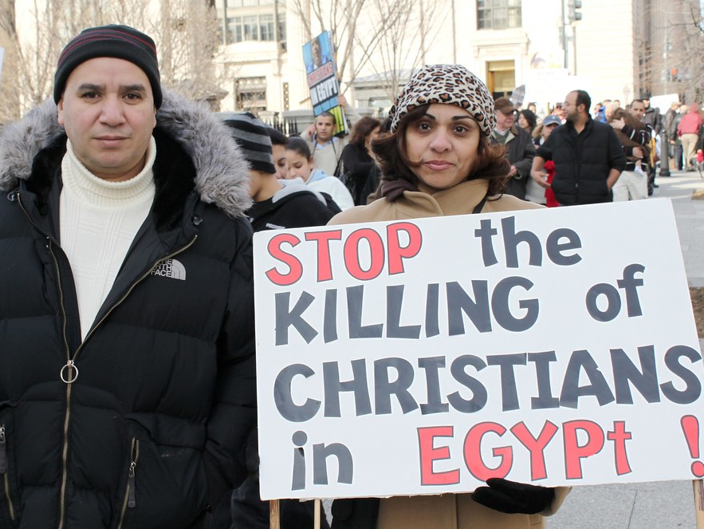
Persecution of Coptic Christians in Egypt
Coptic Christians in Egypt have been persecuted for decades, and it is imperative that this issue is brought to the attention of international leaders. Several attempts have been made on the lives of Coptic Christians in the country, and many Copts have died because of this. This presentation is a timeline of their oppression and killing, and we urge action to be taken to intervene and stop it.

Slide 2
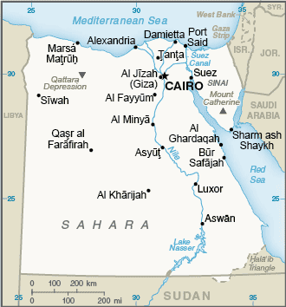
Country Profile
1517: Egypt absorbed into the Turkish Ottoman empire.
1882: Britain takes control of country.
1952: Coup brings Gamal Abdel Nasser to power.
2011: Arab Spring popular uprising topples President Hosni Mubarak.
2013: Coup ousts the Muslim Brotherhood's Mohammed Morsi, the country's first freely-elected president. Army chief Abdul Fattah al-Sisi takes over.
2014: Islamic State group intensifies insurgency in Sinai Peninsula.

Slide 3
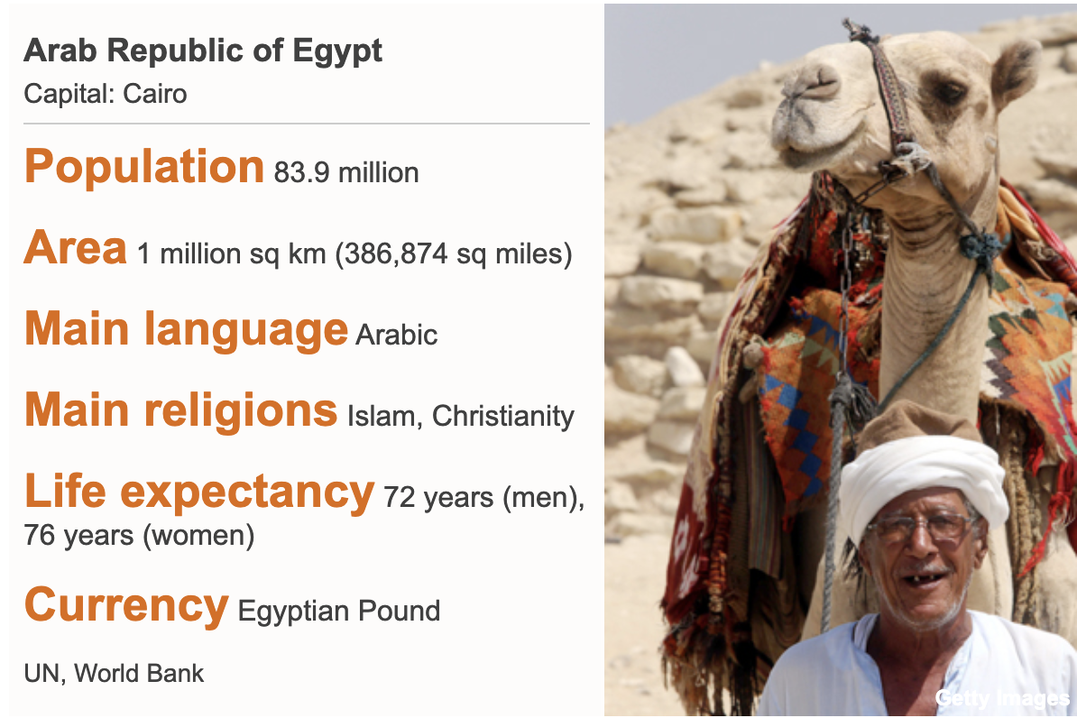
Demographic Information
Coptic Christians are the largest Christian community in the Middle East, making up a majority of Egypt's population of 9 million Christians.
Copts make up 10% of Egypt's population.
Most are concentrated in the Minya governorate, where one-third of the population is Christian. A significant proportion of attacks against Copts also occurs in this region.

Slide 4
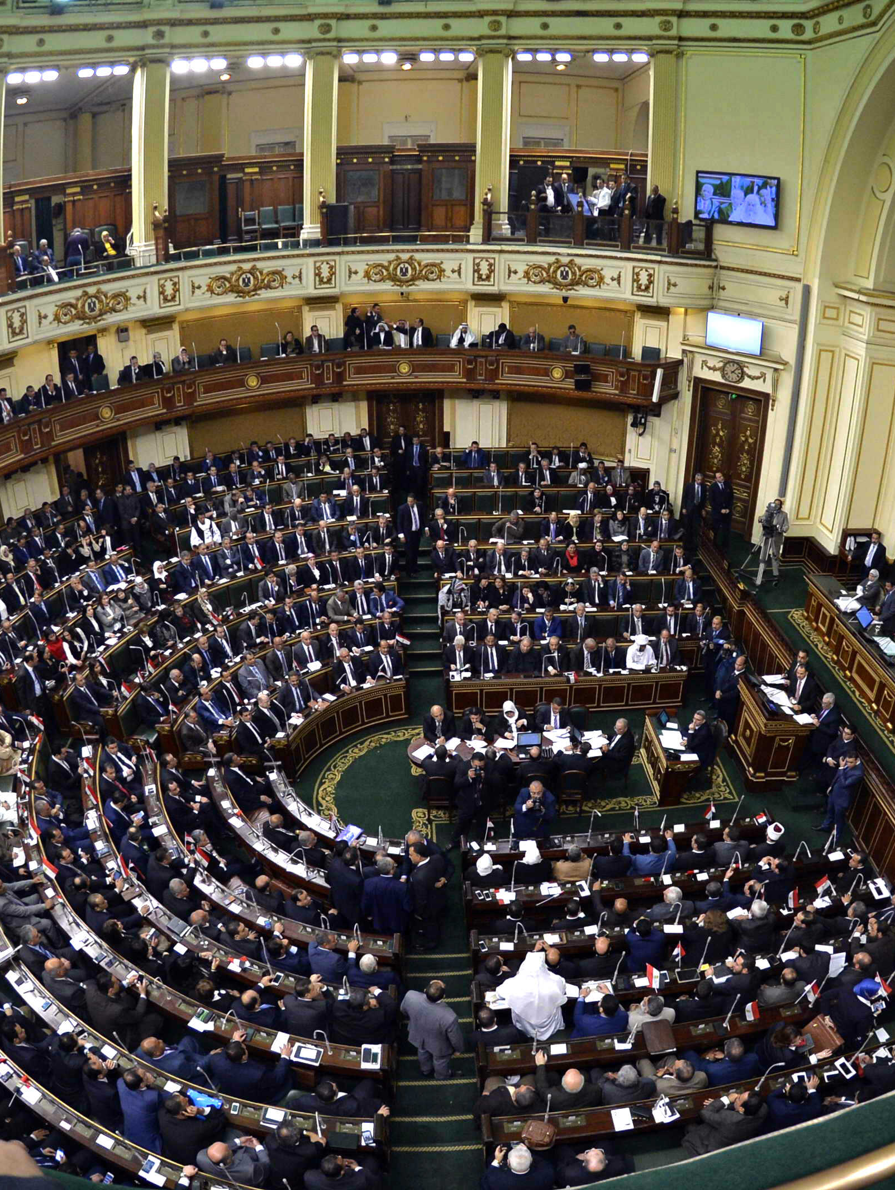
Political Inequity
Copts have faced discrimination and attacks since the time of their split from the broader Christian community.
They have very little political representation; Egypt's parliament has only 36 Christians out of its 596 members, 24 of which where awarded seats through the religion-based quota system.
Despite protections in Egyptian law, this has not translated to actual protection of Copts.

Slide 5
Ten Stages of Genocide
Dr. Gregory Stanton, Founding President of Genocide Watch, is the author of the Ten Stages of Genocide The stages are:
1. Classification
2. Symbolization
3. Discrimination
4. Dehumanization
5. Organization
6. Polarization
7. Preparation
8. Persecution
​9. Extermination
10. Denial
The status of Coptic Christians in Egypt is categorized as stage 8: persecution. Violence against Copts is largely carried out by terrorists and citizens; it is not state-sponsored. The current Egyptian government has verbally promoted unity but has done little to address the gap between the de jure and de facto rights of Copts, as well as that of other religious minorities. Further, despite the recent adoption of legal protections, Coptic Christians also face discrimination under the law.

Slide 6
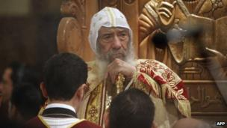
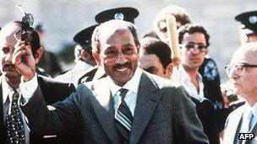
Sadat places Pope Shenouda III on house arrest
September 6, 1981 to October 6, 1981
Relations between President Sadat and the Coptic Pope Shenouda III deteriorated as the pope spoke out against Sadat's tolerance of the Muslim Brotherhood.
Their conflict led to the codification of restrictions on church construction.
In September 1981, Sadat rescinded his recognition of Pope Shenouda III as the leader of the church and placed him on house arrest.
Following Sadat's assassination on October 6th, this house arrest was lifted.
The relationship between the Coptic Orthodox Christian Church and the Egyptian government varies from leader to leader. This relationship also significantly influences the Egyptian government's policies toward Coptic Christians.

Slide 7

Coptic Orphans organization formed
January 2000
Coptic Orphans organization is formed in the 1990s. This organization assists in providing Coptic orphans living necessities and access to education.

Slide 8
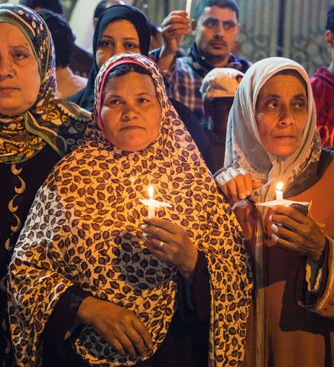
20 Copts killed in Kosheh
Jan 1, 2000
20 Copts are killed, two of whom are burned to death, in clash between Copts and Muslims, provoked by a Christian store owner and a Muslim shopper. The argument led to violent attacks and killings.

Slide 9

Copts create a flag to represent themselves
January 2005
"The Free Copts", a group of Coptic activists, created a flag to represent themselves. This flag is not officially recognized by the Coptic Orthodox Church of Alexandria.

Slide 10
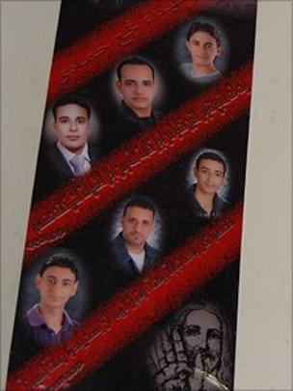
Drive-by Shooting
January 6, 2010
6 Copts coming home from Christmas Eve Mass were killed, as well as one Muslim off-duty police officer.
The killing sparked outrage, in part due to the fact that the government denied sectarian motivations behind the attack
This is one of two events in 2010 that led young Copts to distance themselves from the Mubarak regime.
Unlike in most other cases of violence against Copts, the perpetrators were prosecuted after 11 months.

Slide 11
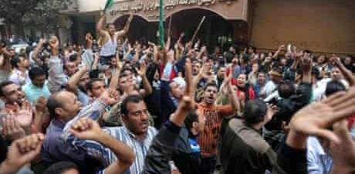
Police Shooting in Response to Protest
November 24, 2010
Hundreds of Copts gathered to protest the halted construction of a church in the Omraniya neighborhood.
Construction had ceased because the building was originally licensed to be a community center, not a church.
Police responded violently, killing one man, injuring 30, and arresting 93.

Slide 12
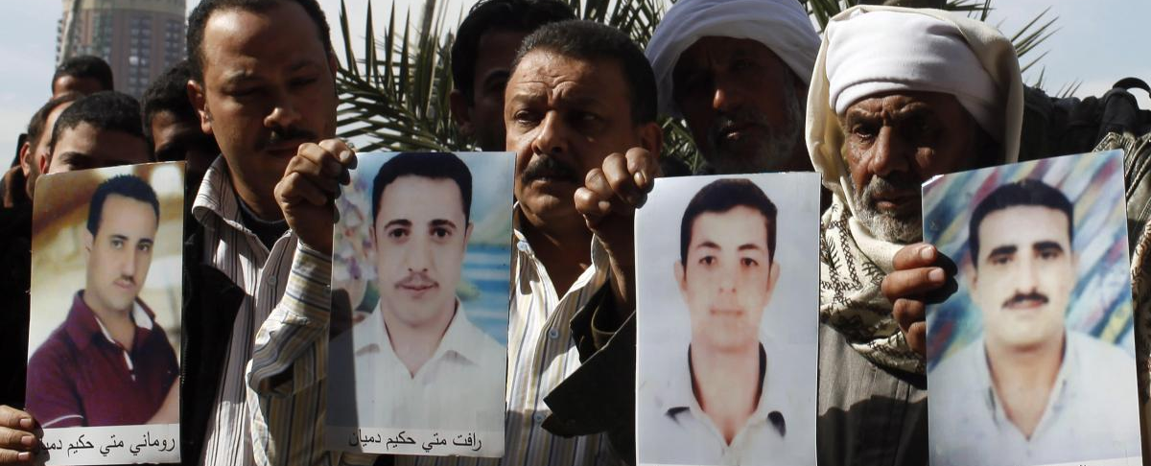
Copts Kidnapped and Held for Ransom
2011
In an attempt to hinder the uprisings against his regime, Mubarak's officials deliberately released prisoners.
These criminals targeted affluent Copts in Qena, Sohag, Minya, and Asyut, abducting them and demanding ransom from their families.
The state, rather than prosecuting these abductions, encouraged victims to reconcile with the perpetrators, leaving Copts unprotected by the state.
Such abductions continue to occur.

Slide 13
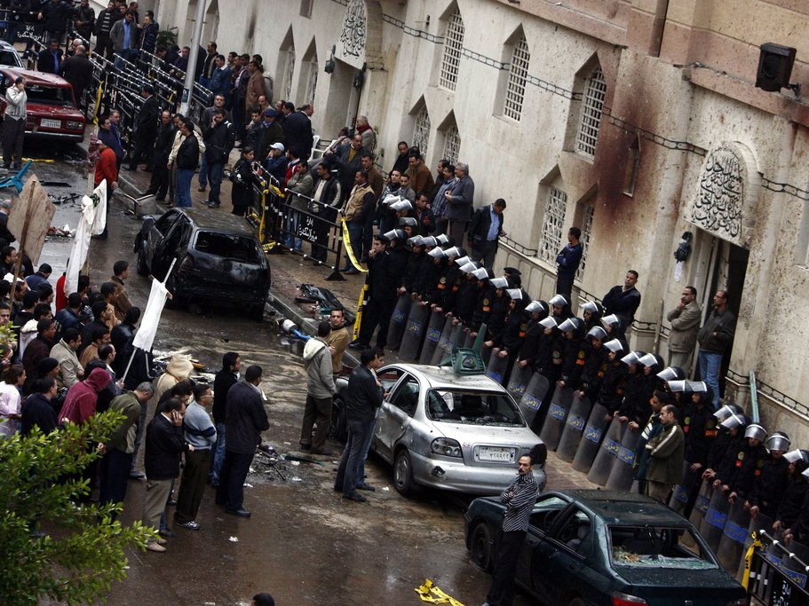
Alexandria Church Bombing
January 1, 2011
A suicide bomber killed 21 people and injured 96 at the end of the New Years' Mass
This was the first major attack with a high death toll in recent memory
Not only did security officers fail to stop the bombing, but they also stood aside as skirmishes broke out nearby.
Ruined the Mubarak administration's claims of protecting Christians
Marked the beginning of a period of increased violence against Copts.

Slide 14
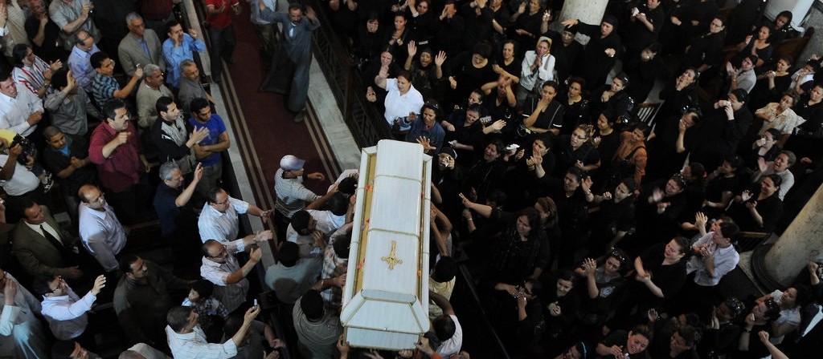
Clash in Helwan
Mar 4, 2011
Fighting left a church burned down and 13 dead over rumors of an interfaith marriage.
Thousands gathered to protest at Maspero to demand protection for Coptic communities and churches.

Slide 15
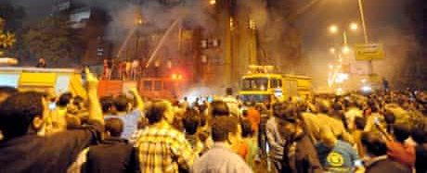
Clash in Imbaba
May 8, 2011
2,000 Copts and Muslims clashed in Imbaba, a low-income neighborhood in Cairo, over false rumors that a Christian woman was being prevented from converting to Islam
12 people were killed, 220 were wounded, and two churches were burned down

Slide 16
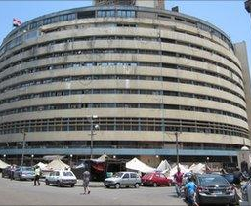
Maspero Massacre
October 9, 2011
Copts and Muslim supporters gathered at Maspero, the Egyptian Television and Radio Union, to protest the Supreme Council of the Armed Forces' (SCAF) complicity in violence against Christians following the arson of a church in Aswan
Army vehicles drove through the crowd, killing 27 civilians, mostly Copts
State TV claimed the protestors had initiated violence and encouraged viewers to reinforce the army
No member of the military was punished for this act, but 31 demonstrators were arrested

Slide 17
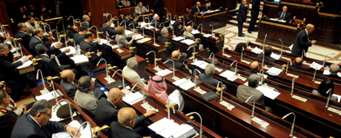
New Constitution Goes into Effect
January 18, 2014
Set up in the last months of Morsi's rule, this constitution grants absolute freedom of religion
However, it also establishes Islam as the official state religion and prohibits conversion to any other religion
Blasphemy is also punishable by harsh penalties under this constitution
Despite this establishment of de jure rights, de facto discrimination continues

Slide 18
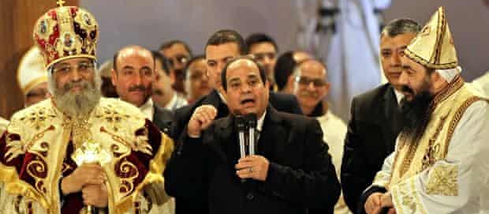
Sisi Attends Copt Christmas Eve Mass
January 6, 2015
President Abdel-Fattah al-Sisi became the first Egyptian President to attend a Copt Christmas Eve Mass.
Gave a speech emphasizing Egyptian unity.

Slide 19
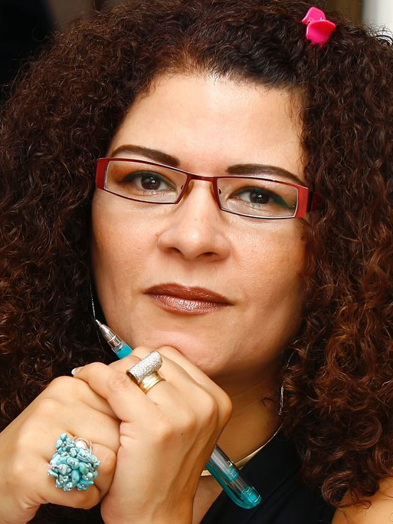
4 Coptic Teenagers convicted for blasphemy
February 25, 2016
Three teenagers were sentenced to 5 years in prison, and one to juvenile detention.
They appeared in a video allegedly mocking Muslim prayer, though they claimed the video was mocking ISIS beheading videos.
The sentencing follows two other prominent court cases for blasphemy against Fatma Naoot and Islam Behery.
This harsh punishment has been compared to the lack of legal consequences for many attacks against Coptic Christians.

Slide 20
Beating and Humiliation of 70-Year Old Coptic Woman
May 20, 2016 00:00
- Suad Thabet, a 70-year-old Christian woman in Minya was beaten and dragged naked through the streets by a mob of over 40 people.
- Her son had been suspected of having an affair with a Muslim woman.
- Some of the mob starting and beating her 79-year-old husband and her daughter-in-law while her children hid terrified behind the sofa.
- One man hit Thabet's son-in-law and stabbed her grandson in the shoulder.
- The mob then burned the house down with gasoline.

Slide 21
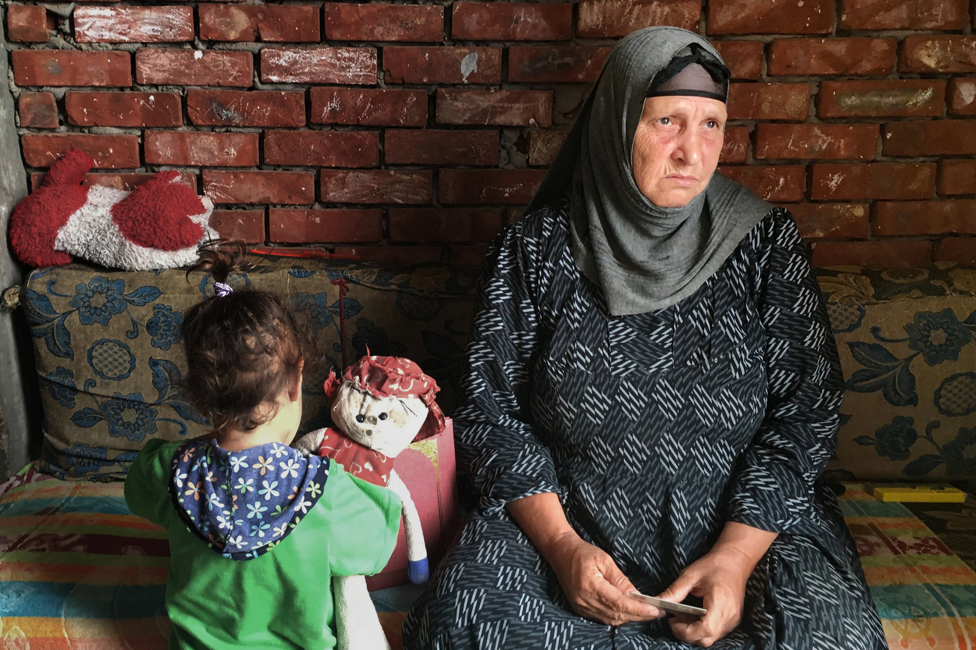

Slide 22
Mob Kills Young Christian Man and Wounds 3 Others
Jul 17, 2016 00:00
- In Tahna al-Gabal, a 27-year-old cousin of a priest was stabbed in the heart and his father, another family member and a female Copt neighbor were injured.
- This killing followed the escalation of an argument between some Muslim and Coptic children.
- According to Egyptian Initiative for Personal Rights (EIPR) religious freedoms researcher Ishak Ibrahim, this village had already seen increased tensions due to the restorations of a church building.

Slide 23
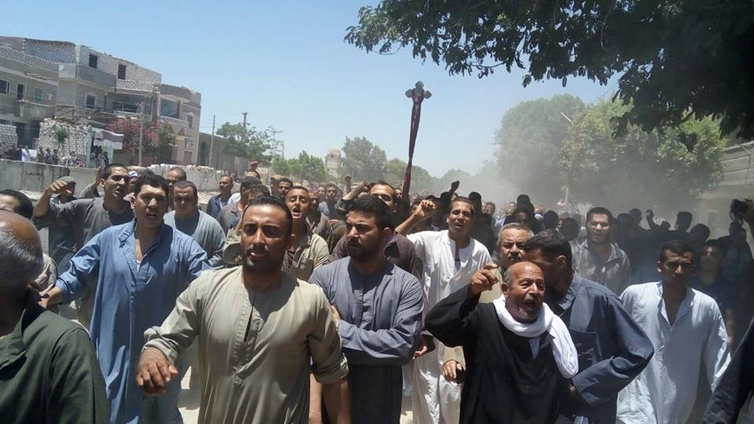

Slide 24
Law Discriminating Against Churches Passes
Aug 30, 2016 00:00
- The Egyptian parliament passes a law maintaining restrictions over the construction and renovation of churches.
- Governors can deny church-building permits and churches must be built “commensurate with” the number of Christians in the area.
- The government negotiated the law with Coptic Church leaders with almost no involvement of other members of the Coptic community.

Slide 25
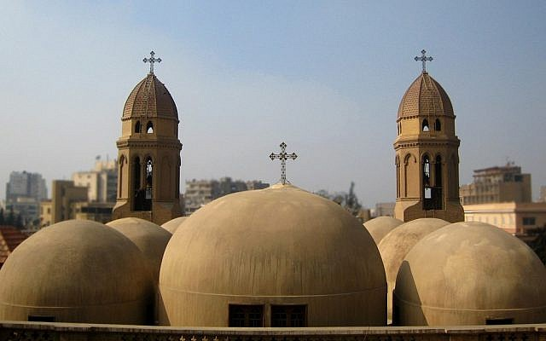

Slide 26
25 Coptic Christians Killed in Church Suicide Bombing
Dec 11, 2016 00:00
- A suicide bomber targeted a small church attached to St. Mark's Coptic Orthodox Cathedral in Cairo, killing 25 people and injuring almost 50 more people.
- An affiliate group of Islamic State later claimed responsibility for the attack.

Slide 27
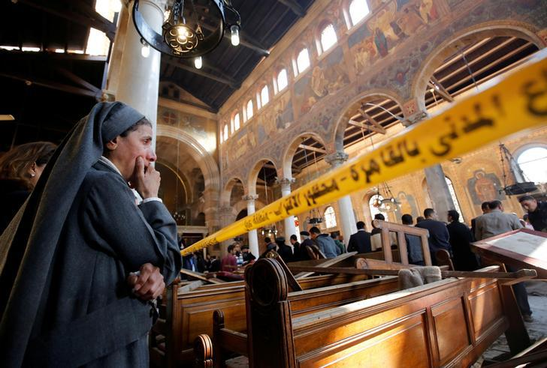

Slide 28
7 Coptic Christians Killed in North Sinai
Jan 30, 2017 00:00 to Feb 23, 2017 23:59
- A series of 7 separate attacks by armed groups in El-Arish led hundreds of Coptic Christians to flee the Sinai Peninsula to Ismailia city.
- The Deputy Director for Campaigns at Amnesty International’s regional office in Tunis, Najia Bounaim, argues that the Egyptian authorities had consistently failed to protect Coptic residents from violence in North Sinai.

Slide 29
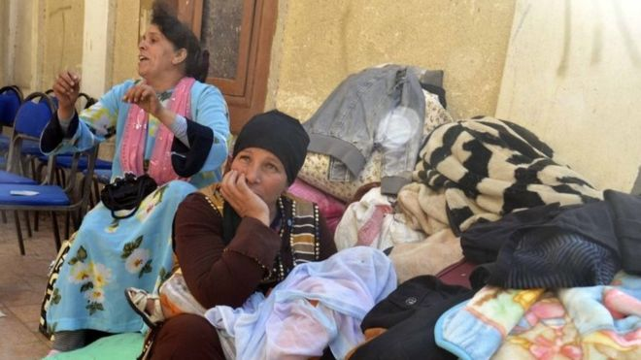

Slide 30
Islamic State Affiliate Claims Responsibility for December Bombing
Feb 19, 2017 00:00
- A Sinai affiliate of the armed group that calls itself the Islamic State shared a video in which it threatened Coptic Christians with their lives.
- It also claimed responsibility for the December 2016 bombing of a Cairo church.

Slide 31
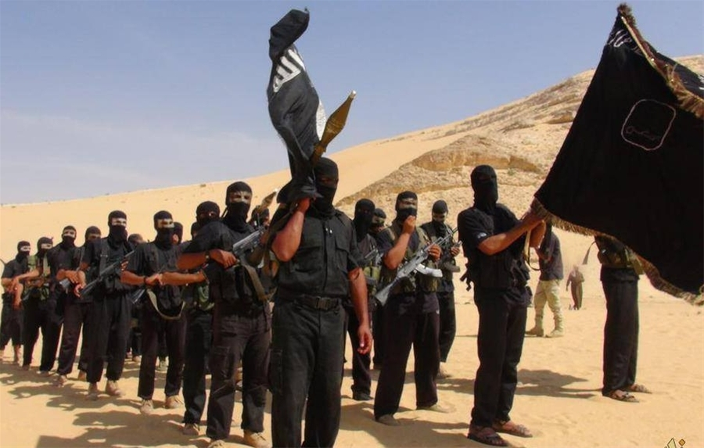

Slide 32
Palm Sunday Attack on Coptic Churches in Alexandria and Tanta
Apr 09, 2017 00:00
- 2 Coptic churches - one in Alexandria and another in Tanta, Nile Delta - were targeted by Islamic State suicide bombers during Palm Sunday services.
- The attacks killed 44 people and leading President al-Sisi to declare a state of emergency.
- Authorities announced the attacker in Alexandria to be an Egyptian citizen, Mahmoud Mubarak, a sign that the support base that ISIS and its affiliates was developing.

Slide 33
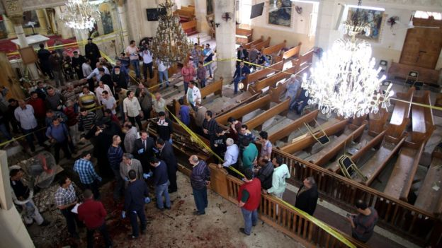

Slide 34
Egypt Declares State of Emergency after Church Attacks
Apr 10, 2017 00:00 to Jul 10, 2017 23:59
- Egypt's President Abdul Fattah al-Sisi announces a 3-month state of emergency after the 2 deadly attacks on Coptic churches.
- This allowed authorities to make arrests without warrants and search people's homes.
- It was approved by parliament 11 April 2017.

Slide 35
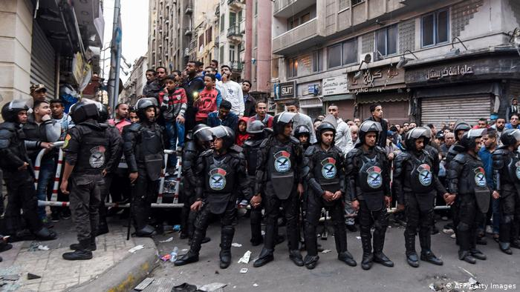

Slide 36
28 Killed in Gun Attack on Bus
May 26, 2017 00:00
- At least 26 Coptic Christians were killed in an attack by gunmen on a bus traveling to a Christian monastery near Minya, leaving 25 others injured.
- The perpetrators, claiming to be security officers, told the men to recite the Shahada, the Islamic declaration of faith .
- When the men refused, they opened fire.

Slide 37
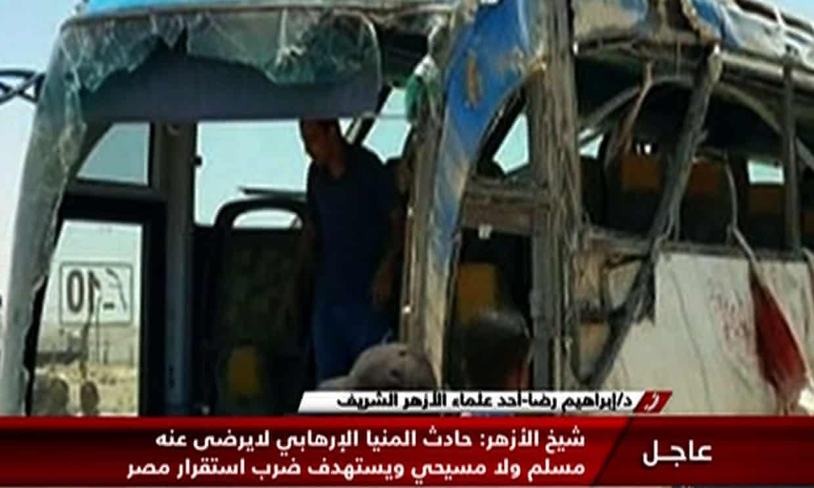

Slide 38
Attack on St. Menas Church Near Cairo
Dec 29, 2017 00:00
At least 9 people were killed in two attacks on Coptic Christians in Helwan district near Cairo.
- At least 6 civilians and a policeman were killed as a gunman tried to storm a church but was intercepted.
- He had previously attacked a Coptic-owned shop in the same area where he killed 2 brothers.
- So-called Islamic State (IS) claimed its "soldiers" were responsible.
- An initial report said 12 were killed by 2 attackers.

Slide 39
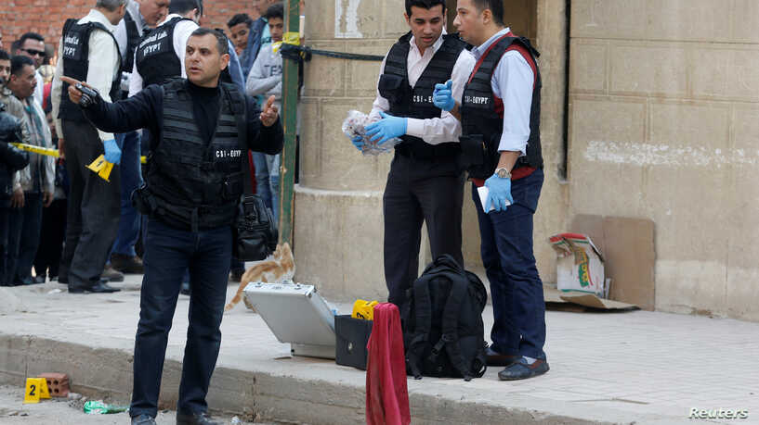

Slide 40
Police step up security measures
Jan 01, 2018 00:00 to Jan 07, 2018 23:59
- The Egyptian police stepped up their security measures around churches ready for the Coptic Christmas celebrations on January 7.
- They deployed officers outside Christian places of worship and set up metal detectors at larger churches.

Slide 41
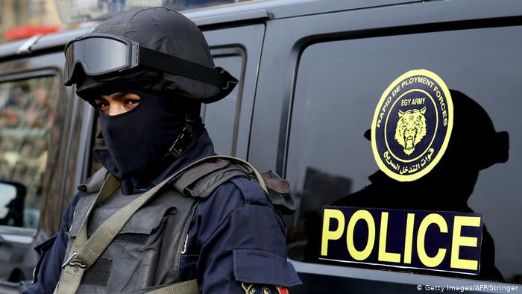

Slide 42
Sentencing of 17 attackers on Coptic Christians to death
Oct 11, 2018 00:00 to Oct 11, 2018 23:59
- Seventeen people were sentenced to death by an Egyptian military court for their involvement in the bomb attacks on Coptic Christian churches in 2016 and 2017.
- A further 19 people jailed for life.
- Islamic State (IS) said its militants were behind the suicide bombings.

Slide 43
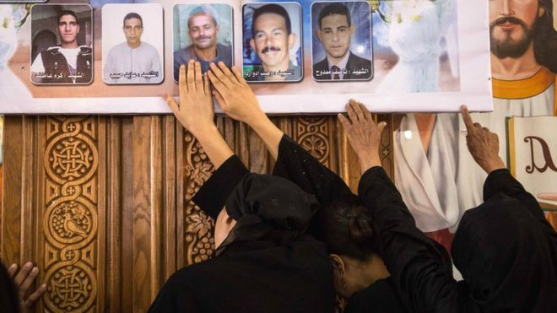

Slide 44
Gunmen ambush bus carrying Coptic Christians
Nov 02, 2018 00:00 to Nov 02, 2018 23:59
- Islamist gunmen killed at least 7 Coptic Christian pilgrims and wounded at least 16 in another ambush on 2 buses claimed by the Islamic State.
- These attacks ended a year of major attacks on Copts in Egypt.

Slide 45
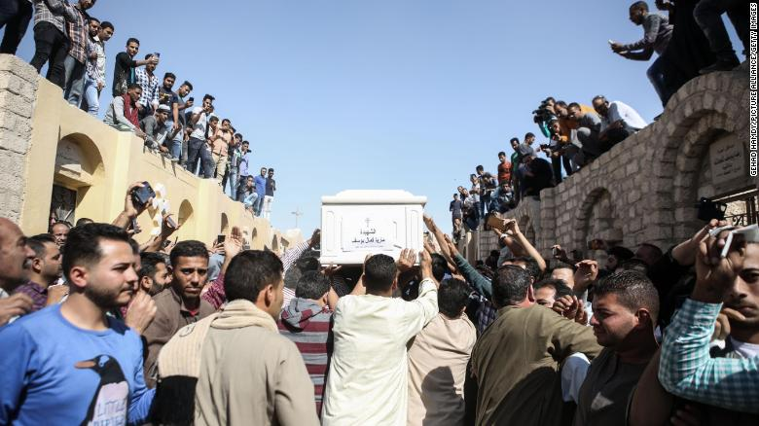

Slide 46
Coptic Christian Activist Arrested on Terrorism Charges
Nov 23, 2019 00:00 to Nov 23, 2019 23:59
- Coptic rights activist Ramy Kamel was arrested as part of a government crackdown on the opposition.
- He was accused of joining a terror group, receiving foreign funding and broadcasting false information.
- He is a founding member of Maspero’s Youth Union (MYU), a Coptic human rights organisation.
- He has advocated for the protection of Coptic identity and for the Coptic language to be taught in schools.
- He has also criticized security solutions to conflicts and church-building laws.

Slide 47
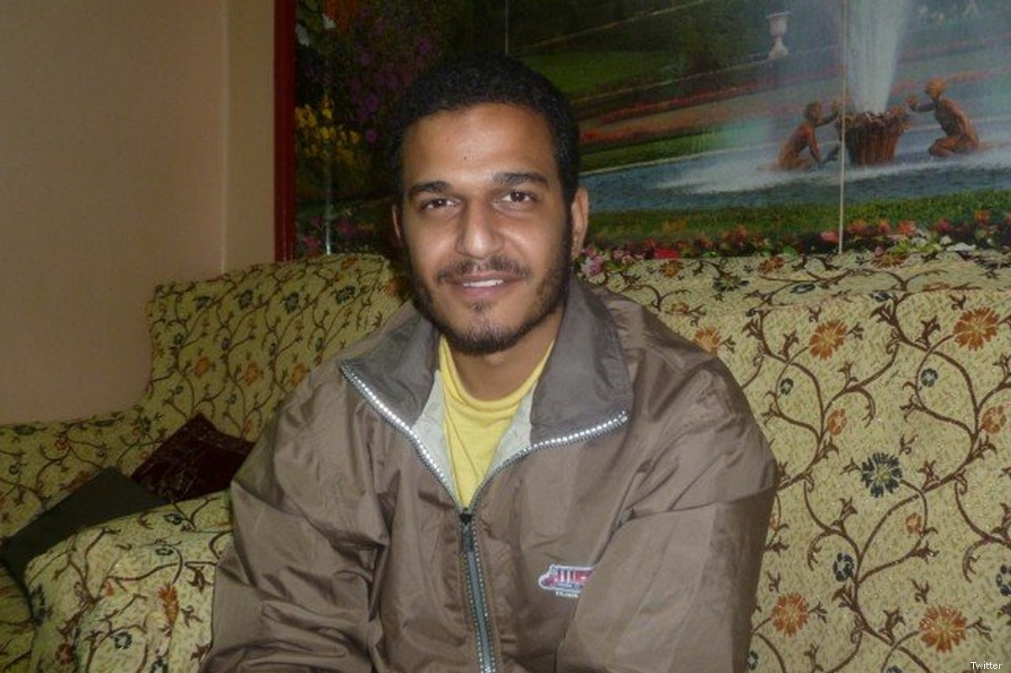

Slide 48
Conclusion
Jan 01, 2020 00:00
The persecution of Coptic Christians in Egypt has been ongoing with little tangible change in the level of insecurity that the minority group is subjected to. Indeed, violent attacks against Copts are sporadic and perpetrated not by the state, but by terrorists groups and mobs while the government claims to support them. However, until the government truly ends the political, social and cultural discrimination against Coptic Christians, the state will continue to create the climate to facilitate further persecution.

Slide 49
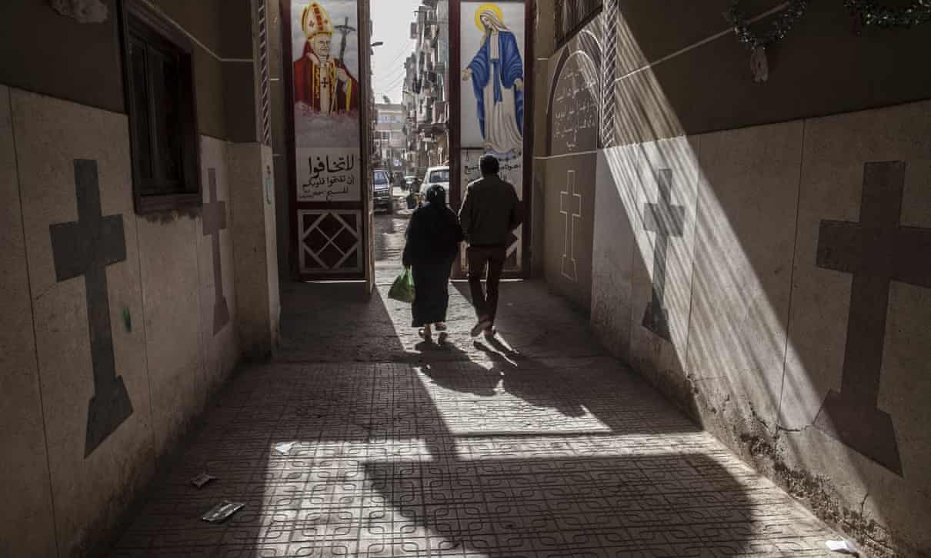

Slide 50
Egyptian Security Foil Attack on Copts
Apr 14, 2020 00:00
- Egyptian security forces foiled a possible terrorist plot against Coptic Christians, killed 7 suspected militants in a shootout.
- The suspected terrorist cell was planned for their attack on Coptic Christians to coincide with Easter celebrations on April 19.

Slide 51
