Slide 1
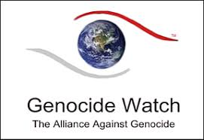
Srebrenica Genocide
Genocide Watch

Slide 2
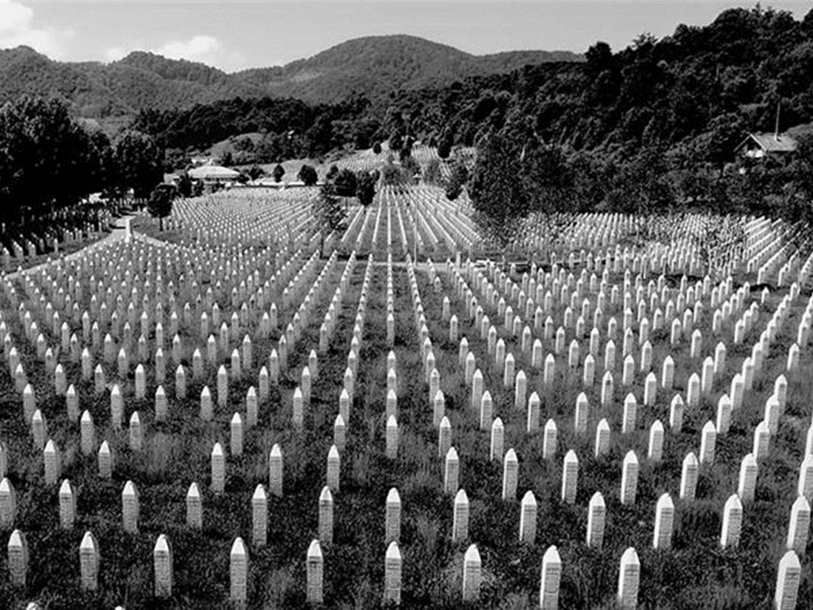
Summary of Events
Apr 1992 to Nov 1995
Before the collapse of Yugoslavia in the early 1990s, the Republic of Bosnia and Herzegovina was one of the most ethnically diverse Republics within Yugoslavia. The population included Bosnian Serbs, Bosniaks (Bosnian Muslims), and Bosnian Croats.
After Yugoslavia began to collapse in 1991, the Republic of Bosnia-Herzegovina voted in a referendum to declare its independence on March 1st, 1992. The Bosnian Serb ethnic community opposed this and declared an autonomous Serb region, which would later become Republika Srpska.
With the support of Slobodan Milošević and the Serbian government in Belgrade, Bosnian Serbs led by Radovan Karadžić began a campaign of genocide against Bosniaks within the autonomous Serb region.
During the Bosnian War that lasted from April 1992 until November 1995, approximately 100,000 people died, 80% of whom were Bosnian Muslims. It is estimated that as many as 20,000-60,000 women were raped as a form of sexualized violence.
The Srebrenica Genocide took place in July 1995 over the course of three days. Considered the worst mass murder in Europe since WWII, 8,372 Bosniak men and boys were systematically exterminated by the Bosnian Serb Army, and 25,000 women, children, and elderly were deported.

Slide 3
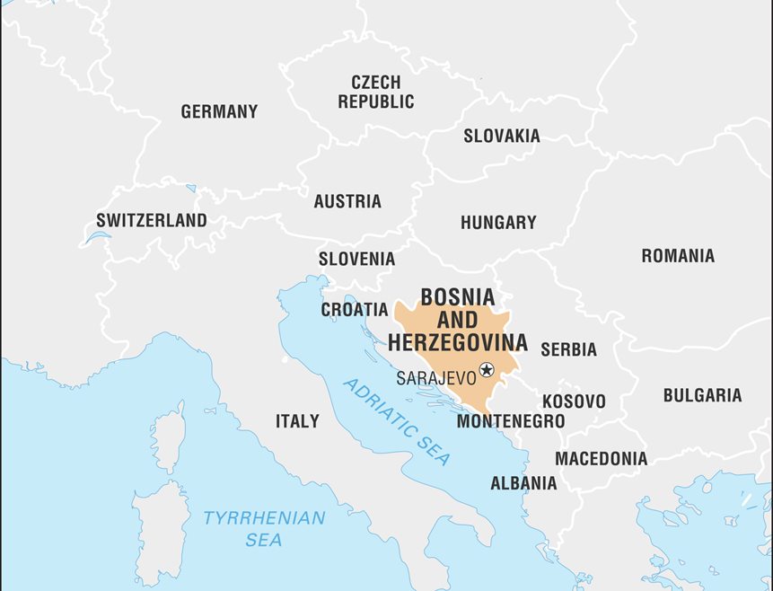
Bosnia-Herzegovina Country Profile
Bosnia-Herzegovina is a Southeastern European country located in the Western Balkans. There are two political entities in control of the country: Republika Srpska (Bosnian Serb Republic) and the Federation of Bosnia-Herzegovina. The capital of Bosnia-Herzegovina is Sarajevo. Population: 3.5 million Major Languages: Bosnian, Croatian, and Serbian Major Religions: Christianity, Islam

Slide 4
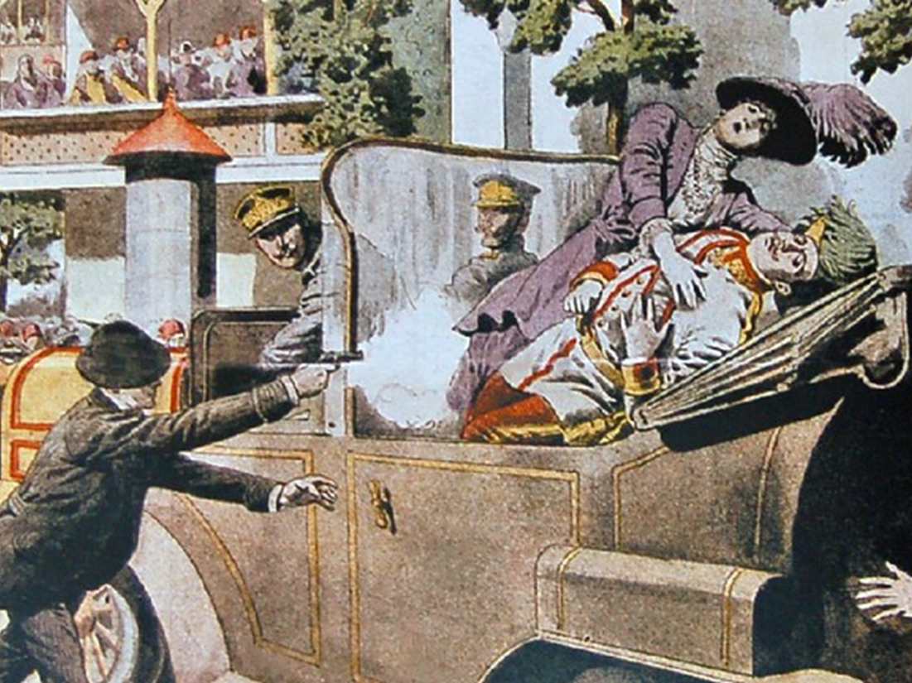
Pre-1990's Timeline
1908 - Bosnia-Herzegovina was annexed to Austria-Hungary. 1914 - In an attempt to end Austro-Hungarian rule in Bosnia-Herzegovina, a Bosnian Serb student, Gavrilo Princip, assassinated Austrian Archduke Franz Ferdinand in Sarajevo. This assassination led to the outbreak of WWI. 1918 - Following the collapse of Austria-Hungary after WWI, Bosnia-Herzegovina joined the Kingdom of Serbs, Croats, and Slovenes (later renamed Yugoslavia). 1941 - Yugoslavia was conquered by Germany in WWII and Bosnia-Herzegovina was annexed by the Nazi Croatian puppet regime. Death camps were set up to exterminate thousands of Serbs, Jews, and Romanis. 1945 - Under the leadership of Josip Broz Tito, Bosnia-Herzegovina was liberated from Nazi rule and became one of six republics under the new state of the Socialist Federal Republic of Yugoslavia. 1945-1991 - Bosnia-Herzegovina was part of the Socialist Federal Republic of Yugoslavia.

Slide 5
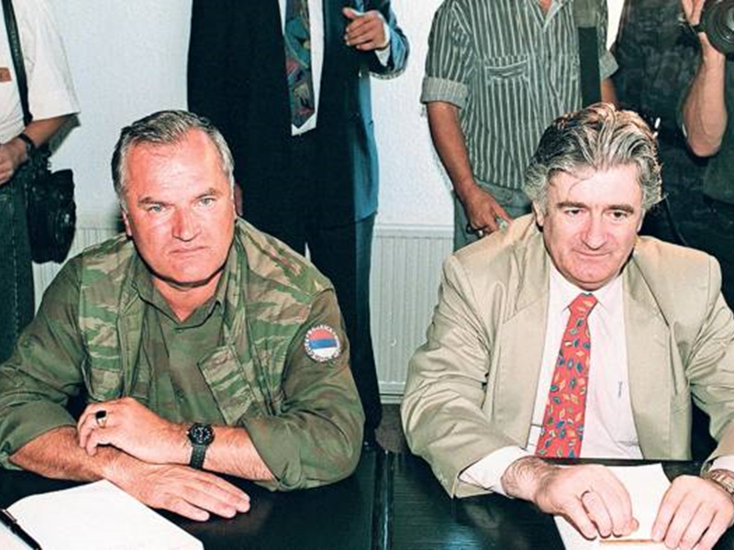
Post-1990's Timeline
1991 - As communism fell and Yugoslavia began to break up, multi-party elections were held throughout Bosnia-Herzegovina. 1992 - January - Serb members of parliament established the Serbian Republic of Bosnia-Herzegovina (renamed Republika Srpska). 1992 - March - Bosnia-Herzegovina declared independence after a referendum. The referendum was boycotted by a majority of Serbs. 1992 - EU recognized Bosnia’s independence. War broke out and Serb forces assumed control of Bosnia-Herzegovina. 1995 - Srebrenica, a UN Safe Area, was overrun by Bosnian Serb forces led by General Ratko Mladic. 8,372 Bosniak men and boys were massacred, and 25,000 women, children, and elderly were forcefully deported. 1995 - August - NATO began bombing Republika Srpska, forcing Bosnian Serbs to negotiate a settlement. 1995 - December - The Dayton Peace Accord was signed, bringing an end to the war. 1996 - The International Criminal Tribunal for the former Yugoslavia (ICTY) began work in The Hague. 2001 - Bosnian Serb General Radislav Krstić was found guilty of genocide and sentenced to 46 years in jail. 2002 - Serbian President Slobodan Milosevic was charged with 66 counts of genocide and war crimes in Bosnia, Croatia, and Kosovo. 2007 - The International Court of Justice (ICJ) ruled that the 1995 Srebrenica massacre constitutes genocide, but Serbia was cleared of direct responsibility. 2016 - UN tribunal found Radovan Karadžić guilty of genocide and war crimes and sentenced him to 40 years in jail. 2017 - Ratko Mladić was found guilty of genocide and crimes against humanity and sentenced to life imprisonment.

Slide 6
Ten Stages of Genocide
Stages 1, 2, 3, 4: Classification, Symbolization, Discrimination, Dehumanization Bosniaks were called Turks, Balije (a slur for Bosnian Muslims), terrorists, and Islamic extremists. They were forced to wear armbands and tie white flags to their doors to be identified. Islam was portrayed as violent and totalitarian. Stage 5, 6, 7: Organization, Polarization, Preparation The Yugoslav People’s Army made a plan to exterminate the Muslim people. Military equipment was stored in locations in Croatia and Bosnia. A secret police force was armed and trained from local Serbs. Serb commanders systematically raped Bosniak women and minors. Bosniaks were believed to pose a threat to the "Greater Serbia" project. Negative public opinion and torture of Bosniaks were justified by Serbian leadership. The media broadcasted propaganda to marginalize Bosniaks. Weapons were distributed to the Serb population throughout 1990 and 1991. Stage 8: Persecution Intellectual and influential Bosniaks were the first to be executed. Death lists of Bosniaks to be killed were made. Serb troops arrived in each town to torture and kill non-Serbs. Bosniak properties were confiscated. Around 50,000 Bosniak and Croat women and children were raped in 1992-95. Around 200,000 people were deported to concentration camps. Many starved while being targeted by snipers and shelling. Boys and men in Srebrenica were separated from the rest of the population and taken to remote locations where they were executed. Stage 9: Extermination On July 11, 1995, General Ratko Mladic claimed Srebrenica for Serbs and entered the town with Serb forces He announced there would be “revenge against the Turks.” Citizens fled to Srebrenica, a UN safe zone, but the peacekeepers were unable to protect them. Stage 10: Denial Serb forces tried to conceal the killings by reburying bodies in numerous mass graves across Bosnia. 66% of Serbs in Republika Srpska deny the genocide. The genocide is denied by current politicians and leaders as well.

Slide 7
Founding of Socialist Federal Republic of Yugoslavia
1945 to 1992
After World War II in 1945, the Socialist Federal Republic of Yugoslavia (SFRY) was founded and comprised of six socialist republics. The six socialist republics included the SR Bosnia-Herzegovina, SR Croatia, SR Macedonia, SR Montenegro, SR Serbia, and SR Slovenia.

Slide 8
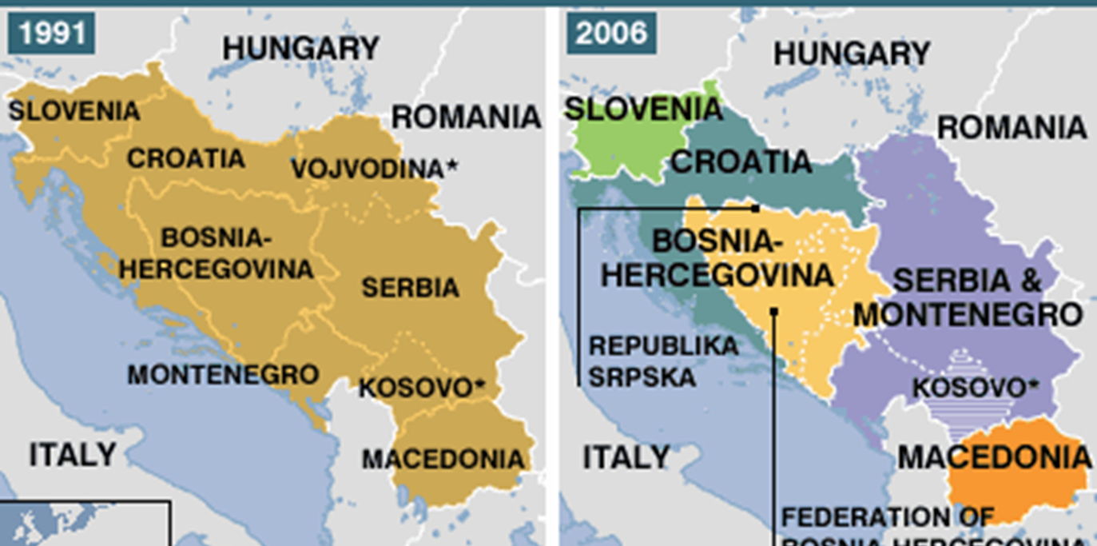
Break-up of Yugoslavia
1990 to 1992
In the 1980s, the economy of Yugoslavia began to decline, leading to widespread dissatisfaction. In early 1990, multi-party elections were held in Slovenia and Croatia. Multi-party elections were held in Bosnia-Herzegovina, leading to new parties representing Bosniak, Croat, and Serb populations.

Slide 9
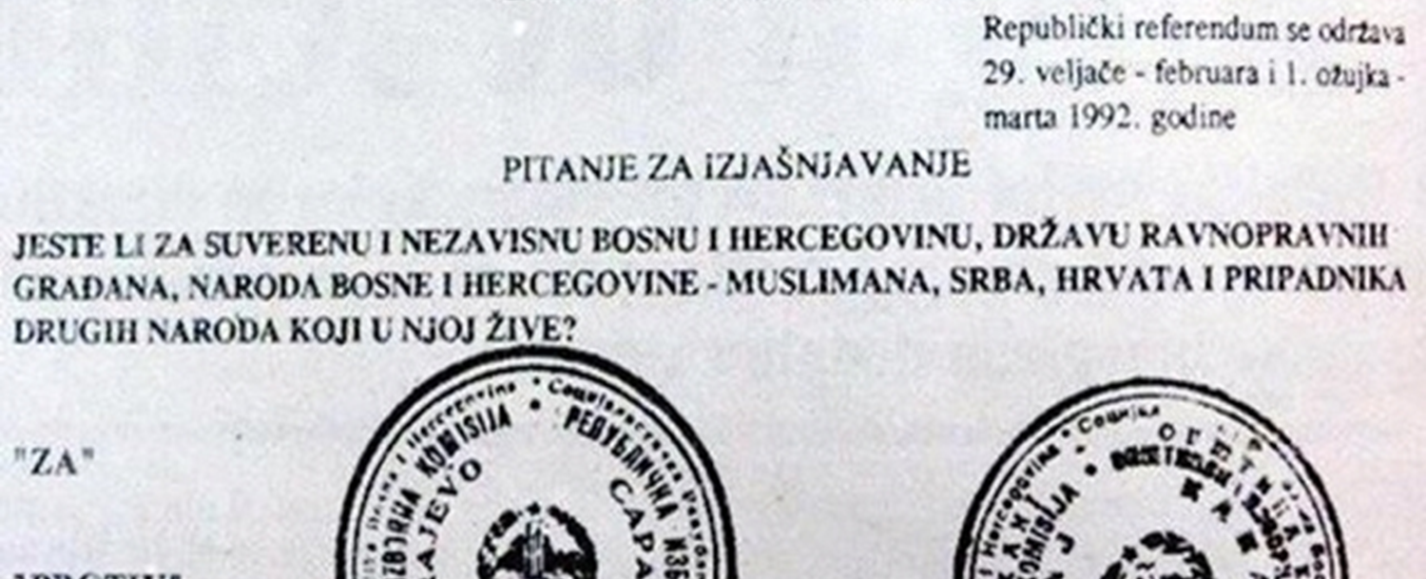
Independence Referendum
February 29, 1992 to March 1, 1992
A referendum was held between February 29 - March 1, 1992, to determine if Bosnia-Herzegovina should stay within Yugoslavia or call for independence. Only Croats and Bosniaks voted while Bosnian Serbs boycotted the referendum. More than 99% of the voters voted for independence.

Slide 10
Independence of Bosnia-Herzegovina
March 3, 1992 to April 6, 1992
On March 3, 1992, Alia Izetbegovic, the president of the Republic of Bosnia-Herzegovina, declared independence. Bosnia-Herzegovina's independence was recognized by the international community on April 6, 1992. Shortly after independence was recognized by the international community, Bosnian Serb forces began shelling Sarajevo.

Slide 11
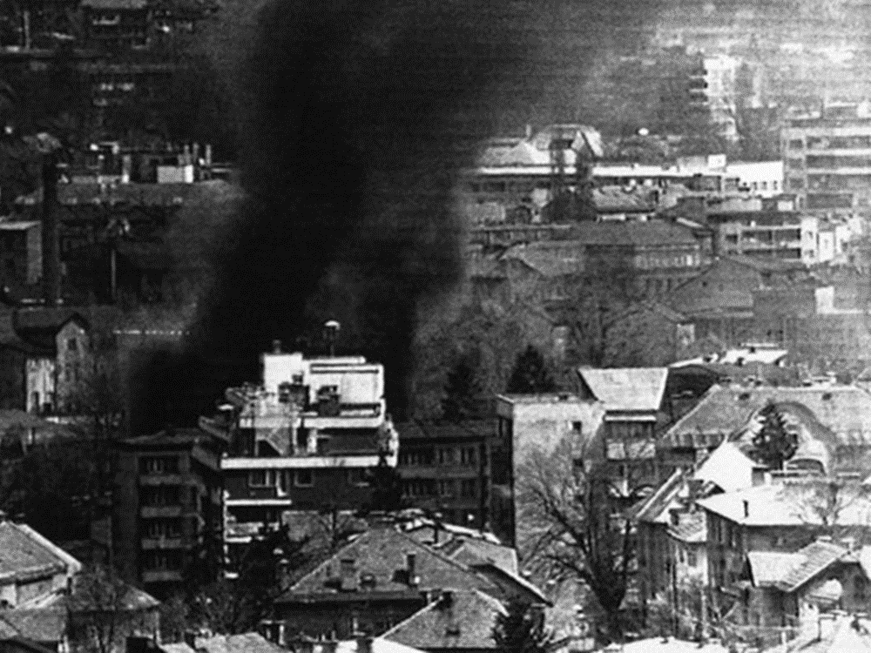
Siege of Sarajevo
Apr 5, 1992 to Feb 29, 1996
On April 5, 1992, Bosnian Serb forces laid siege to Sarajevo, the capital of Bosnia-Herzegovina. The Siege of Sarajevo lasted 44 months, the longest siege of a capital in modern warfare. 13,000 Bosnian Serb forces surrounded Sarajevo, hiding in the hills and mountains. From these positions, snipers constantly attacked residents. Residents of Sarajevo were forced to arm and defend themselves from attacks. They were constantly running low on food, electricity, heat, and water. The siege officially ended on February 29, 1996, after the signing of the Dayton Agreement.

Slide 12
Markale Market Massacres
Feb 5, 1994 to Aug 28, 1995
During the Siege of Sarajevo, two attacks were carried out at Markale Market, Sarajevo's historic city center. On February 5, 1994, one 120-millimeter mortar shell was fired into the marketplace, killing 68 people and wounding 144. On August 28, 1995, 18 months later, five mortar shells were fired into the marketplace. This attack killed 43 people and wounded 75. As a result of these attacks, NATO launched airstrikes against Bosnian Serb forces, ending the war.

Slide 13
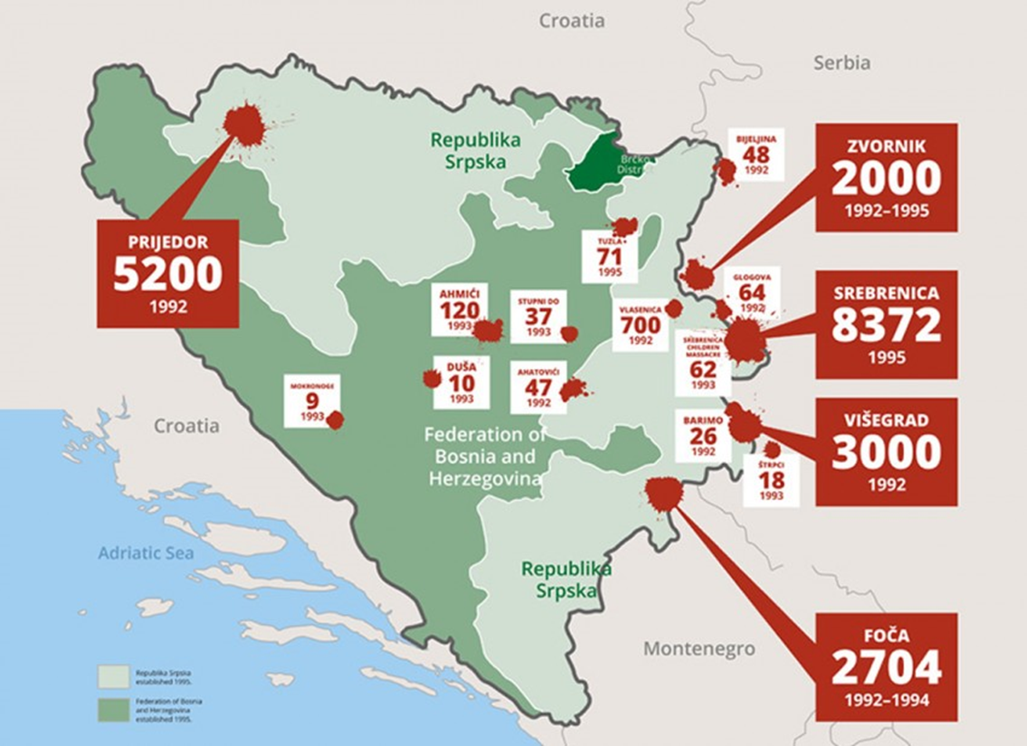
Mass Atrocities During the Bosnian War
Apr 1992 to Dec 1995
Under the command of Ratko Mladić, Bosnian Serb Forces (VRS) and units of the Yugoslav People's Army (JNA) took control of two-thirds of Bosnian territory in six weeks. VRS continued assaults across Eastern Bosnia in 1992. The Army of the Republic of Bosnia-Herzegovina was ill-prepared and lacked supplies which were controlled by Serb forces. While Serb forces laid siege to towns, they also committed mass atrocities such as rapes, executions, and mutilations.

Slide 14
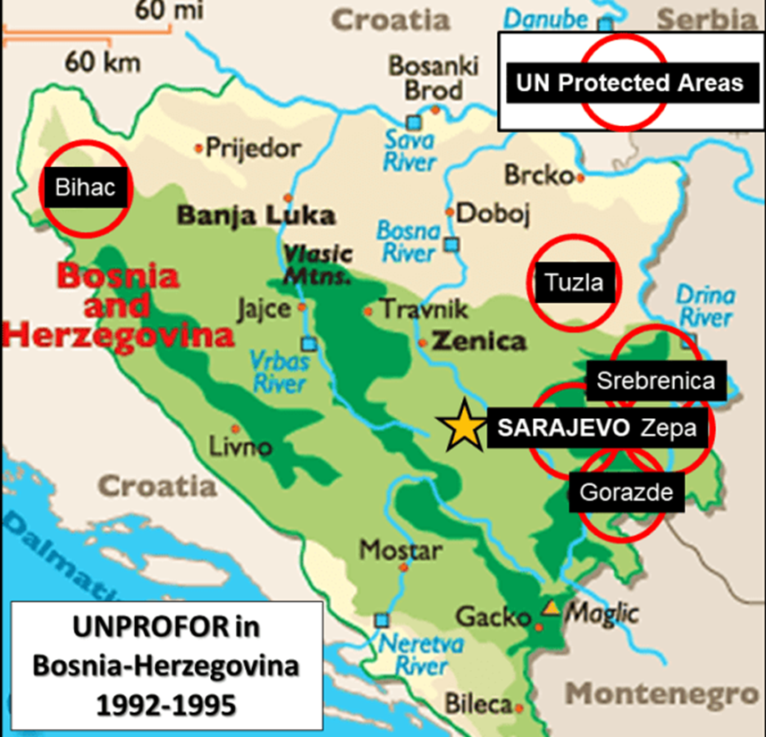
The Myth of UN Safe Areas
1993 to 1995
On April 16, 1993, the U.N. passed Resolutions 819 and 824 to set up safe areas in Srebrenica as well as five other towns in Bosnia. The safe areas were meant to protect Bosniaks from attacks, but quickly became easy targets for Serb forces. Of the 34,000 troops requested by the UN, only 7,600 were provided to protect the safe areas. Although UN peacekeepers provided some basic humanitarian aid and deterrence, they failed to prevent the killings of Bosniaks. Notably, two of the six safe areas fell to Serb forces, while Srebrenica's entire male population was exterminated.

Slide 15
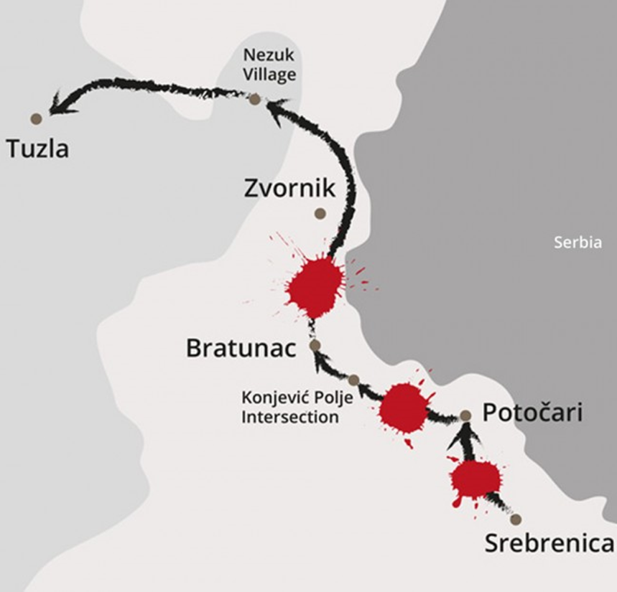
The Death March
Jul 11, 1995 to Jul 16, 1995
On the night of July 11, 1995, as VRS soldiers prepared to enter Srebrenica, 15,000 Bosniak men planned to embark on a long journey North-West to the free Muslim territory of Tuzla. The 15,000 men, named "The Column," gathered in Šušnjari and Jaglić to set off into the forests. VRS forces attempted to coax the men out from the forests by posing as UN peacekeepers. They were encouraged to call out to relatives. All those who were captured were slaughtered. The men crossed 70 miles facing gunfire, minefields, and Serb forces along the way. Many had no food or water. Of the 15,000 men who set off on the journey, over two-thirds were captured and killed. Only 3,000 survived to reach Tuzla.

Slide 16
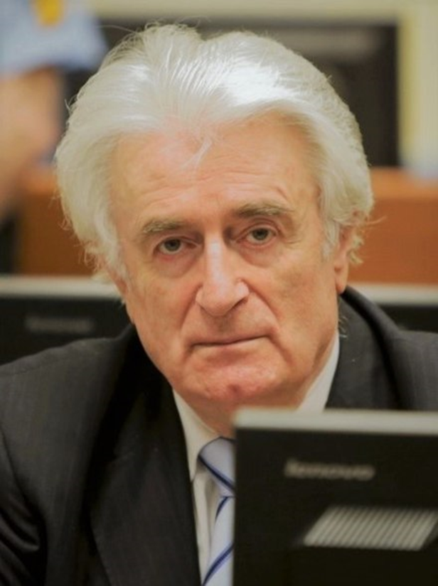
Proof of Intent to Exterminate the Bosniaks
Apr 1992 to Dec 1995
Radovan Karadžić issued “Directive 7 of the Supreme Command” in the spring of 1995 ordering the VRS “to create an unbearable situation of total insecurity, with no hope of further survival or life for the inhabitants of Srebrenica." The motivating force behind the fighting was to achieve a “Greater Serbia,” by uniting all territories populated by Serbs. This Serbian nationalist ideology was championed by Slobodan Milošević, the former President of Serbia.

Slide 17
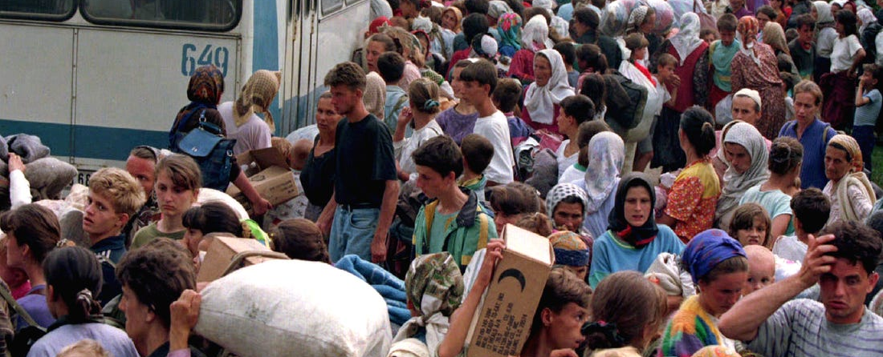
Srebrenica Genocide
Jul 11, 1995 to Jul 16, 1995
The Srebrenica Genocide occurred between July 11-16, 1995 and resulted in the mass murder of 8,372 Bosniak men and boys, and the deportation of 25,000 women, children, and elderly. In March 1995, Radovan Karadžić issued Directive No. 7 to be carried out by Chief of the Bosnian Serb Army, Ratko Mladić, which commanded his forces to exterminate the inhabitants of Srebrencia. On July 6th, Bosnian Serb forces began advancing towards Srebrenica, setting fire to villages, and forcing many to flee to the nearest UN base in Potočari. The observation posts surrounding Srebrenica began to fall as UN peacekeeping troops fled Srebrenica. The VRS faced no resistance from Dutch troops as they entered the UN base in Potočari.

Slide 18
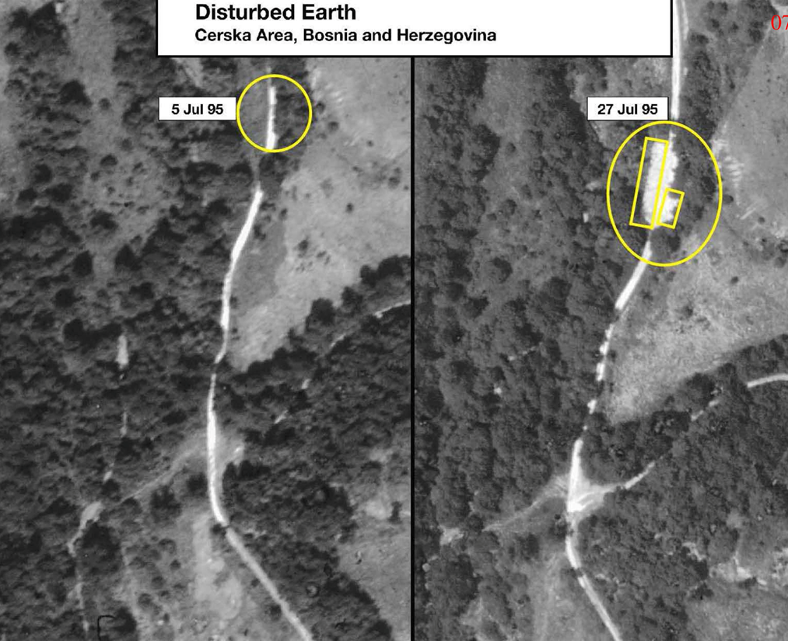
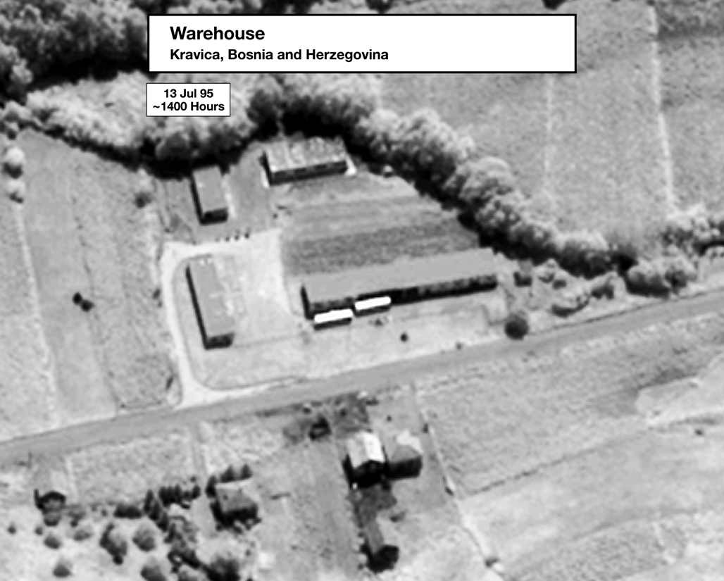
July 13, 1995: First Mass Executions
Jul 13, 1995
On July 13, 1995, the first large-scale mass execution of the Srebrenica Genocide took place in Cerska Valley. 150 men between the ages of 14-50 were killed by VRS soldiers. That same day, 1,300 men were killed in a warehouse in Kravica. VRS soldiers used hand grenades, rifles, and anti-tank weapons.

Slide 19
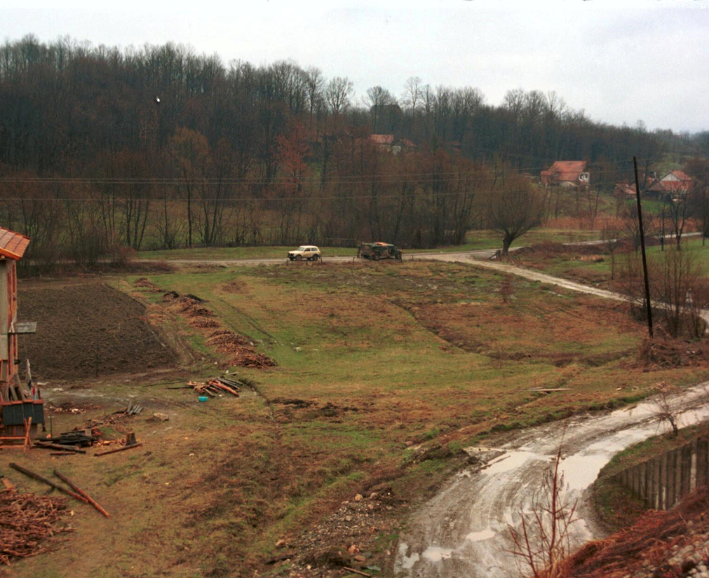
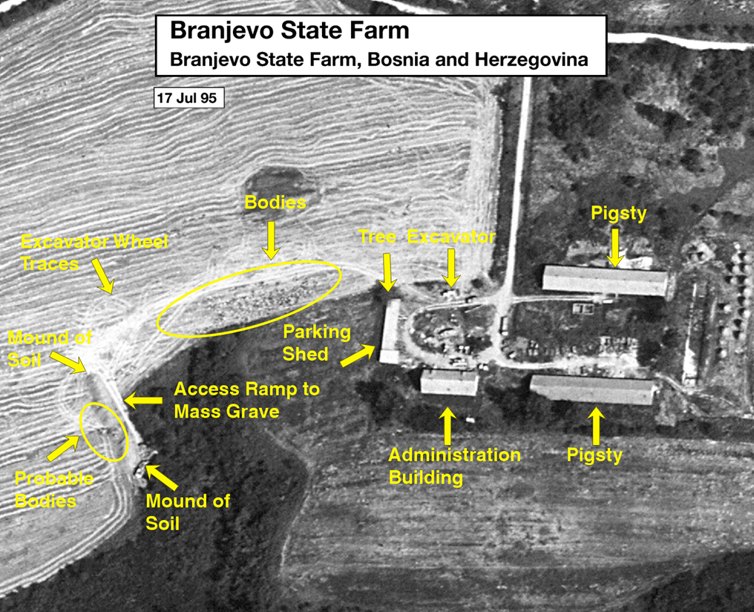
July 14, 1995: Second Mass Executions
Jul 14, 1995 to Jul 16, 1995
On July 14th, 1,000 prisoners were detained in the gymnasium of the Grabavci school in the town of Orahovac. The men were blindfolded and executed nearby. On July 14th, 1,200 prisoners were taken to a gymnasium in the village of Pilica and denied food or water. On July 16th they were transported to Branjevo Military Farm where they were tortured and killed. An additional 500 men were killed in the Pilica Culture Center.

Slide 20
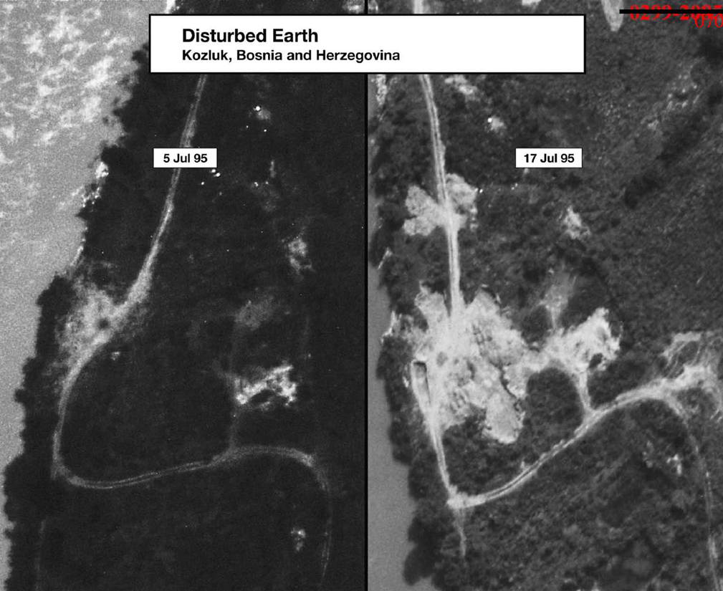
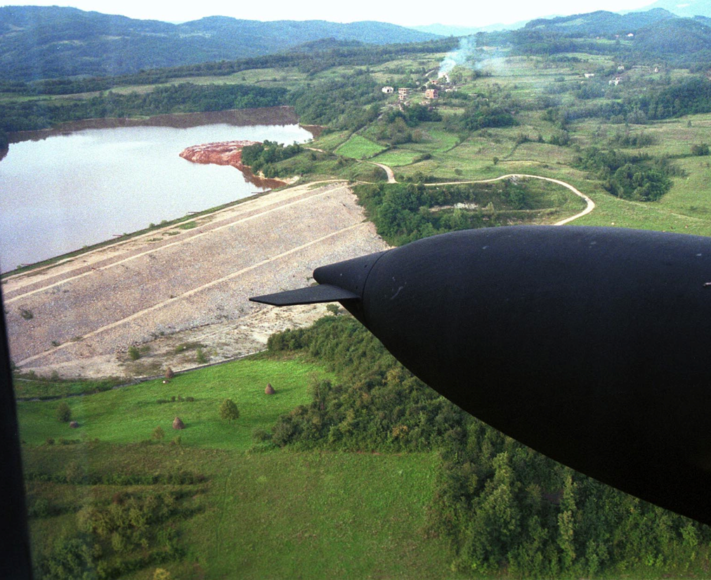
July 15-16, 1995: The Final Mass Executions
Jul 15, 1995 to Jul 16, 1995
Between July 14th and 15th, more than 1,000 men were taken to a school in Petkovci and tortured with no food or water before being shot and killed in a nearby dam. Between July 15th and 16th, the final execution of 1,000 men took place in the village of Kozluk. Small scale executions continued.

Slide 21
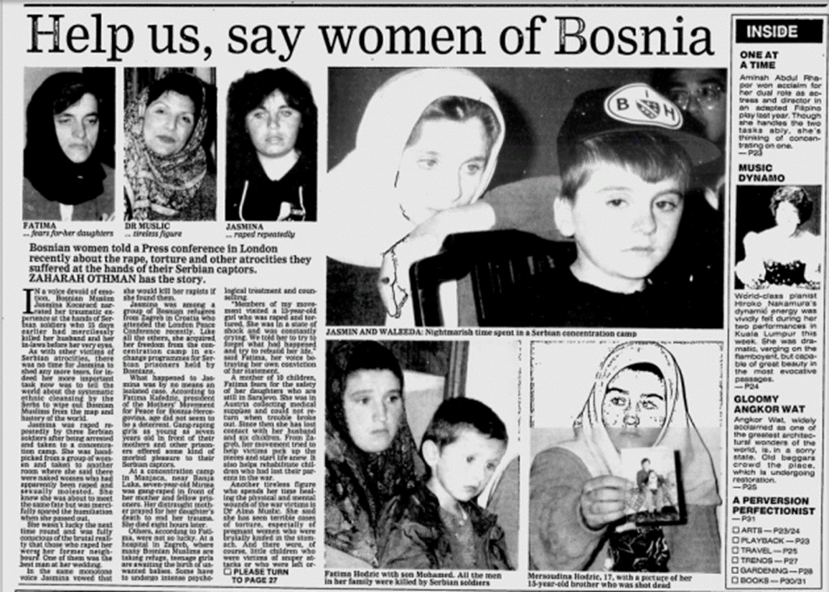
Foča Rape Camps
Apr 1992 to Jan 1994
Many locations in Eastern Bosnia, including Foča, was attacked by Serbian forces. Bosniak houses and buildings were looted and burnt down. Men and women were separated and kept in detention centers. Women were removed from detention centers and repeatedly raped and kept as sex slaves. These atrocities were committed with the approval of local Serbian authorities. Rape and sexual torture were integral to the genocidal campaign and were used by the Serbs to humiliate their enemies and destroy their communities. It is estimated that 12,000-15,000 women and children were raped during the war, mostly Bosniak women.

Slide 22
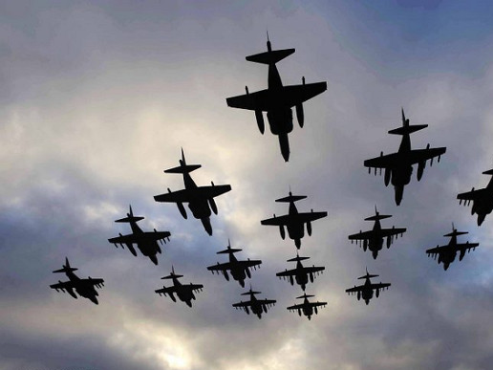
The End of the War
Feb 1994 to Dec 1995
NATO became actively involved in the war on February 28, 1994, when it shot down four Serb aircraft. In May 1995, NATO conducted airstrikes against the Serb stronghold of Pale where VRS forces were positioned. In the summer of 1995, Bosnian Serb forces began to lose the war as Bosniak and Croat ground forces recaptured Serb-occupied territories. This momentum was used by the US to give the Bosnian Serbs an ultimatum: stop shelling UN safe areas and reach a peace agreement, or NATO would continue conducting airstrikes. On September 14, an agreement was signed by Radovan Karadžić and Ratko Mladić, leaders of the Bosnian Serbs, to end the siege of Sarajevo.

Slide 23
The Dayton Agreement
Nov 21, 1995
In October of 1995, after the atrocities committed by Bosnian Serb forces became heavily publicized, world powers pressured the leaders of the Bosnian Serbs, Bosniaks, and Croats to go to Dayton, Ohio to come to peace agreements. The Dayton Peace Agreement, signed on November 21, 1995, officially ended the Bosnian War and created the modern structure of Bosnia and Herzegovina. Bosnia and Herzegovina is now composed of two entities, The Federation of Bosnia and Herzegovina, and Republika Srpska. Bosnia and Herzegovina is mainly composed of Bosniaks and Croats while Republika Srpska is composed of Bosnian Serbs.

Slide 24
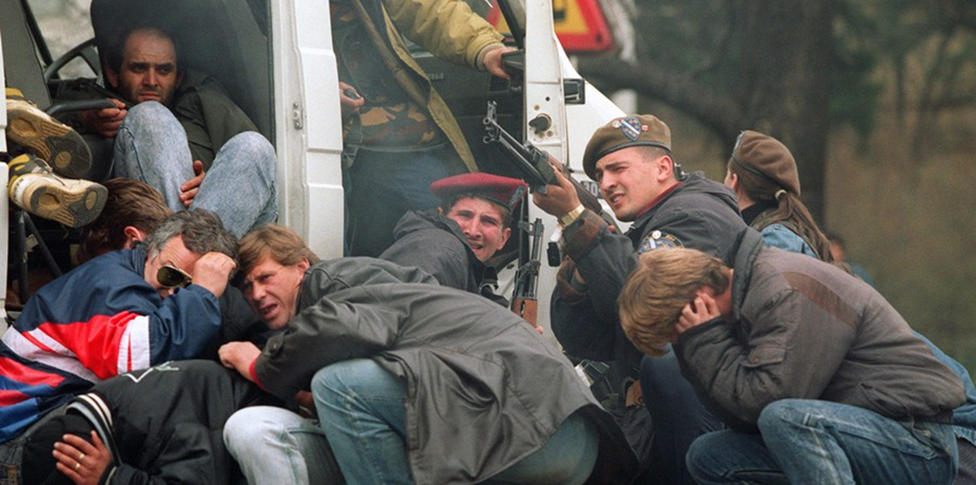
Casualties of War
1992 to 1995
After four years of conflict, 100,000 Bosnians were dead, 2.2 million had been displaced, and tens of thousands of women and children had been raped.

Slide 25
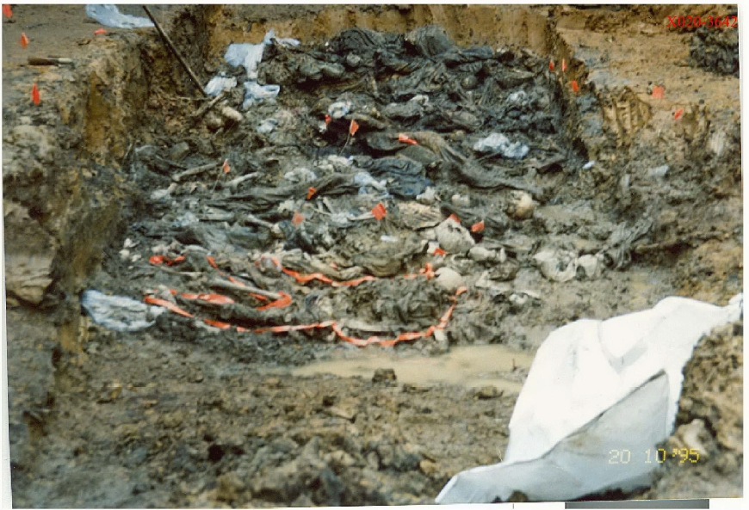
"Asanacija" Cover-Up of Genocide
Aug 1995 to Nov 1995
To hide their crimes, the VRS systematically exhumed bodies from primary graves and then reburied the dead in smaller secondary or tertiary gravesites under the cover of night. This process was called asanacija, meaning “cleanup.”

Slide 26
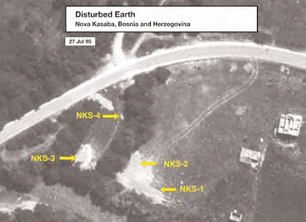
First Evidence of Genocide
Aug 1995
In August 1995, US Secretary of State Madeline Albright released the first evidence of the crimes committed in Srebrenica to the international community. She revealed aerial photos that showed recently dug mass graves in Nova Kasaba. David Rhode, an American journalist, visited the location identified in the photographs and found a decomposing human leg sticking out of the ground, as well as various personal effects.

Slide 27
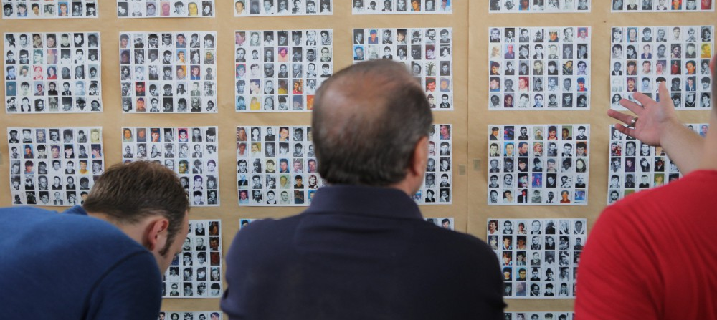
Ongoing Search for Missing Persons
Aug 1995 - Present
A meticulous investigation took place in Srebrenica after the initial findings. So far, 94 mass graves have been discovered in Srebrenica, and the remains of over 6,900 victims have been identified. The remains of 1,700 victims are still missing. Usually, only partial remains can be recovered, identified, and prepared for burial at the Srebrenica Memorial Cemetery in Potočari.

Slide 28
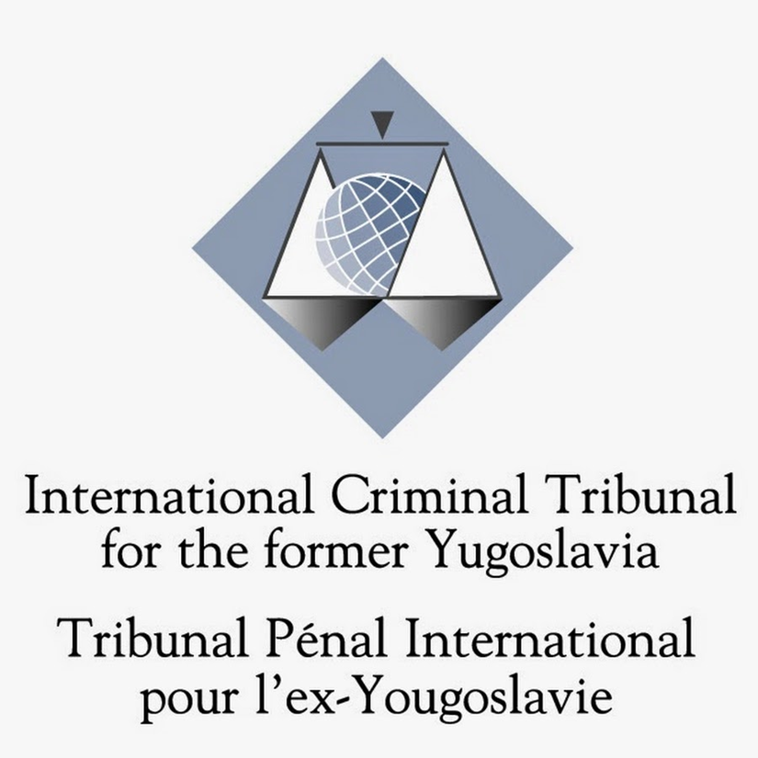
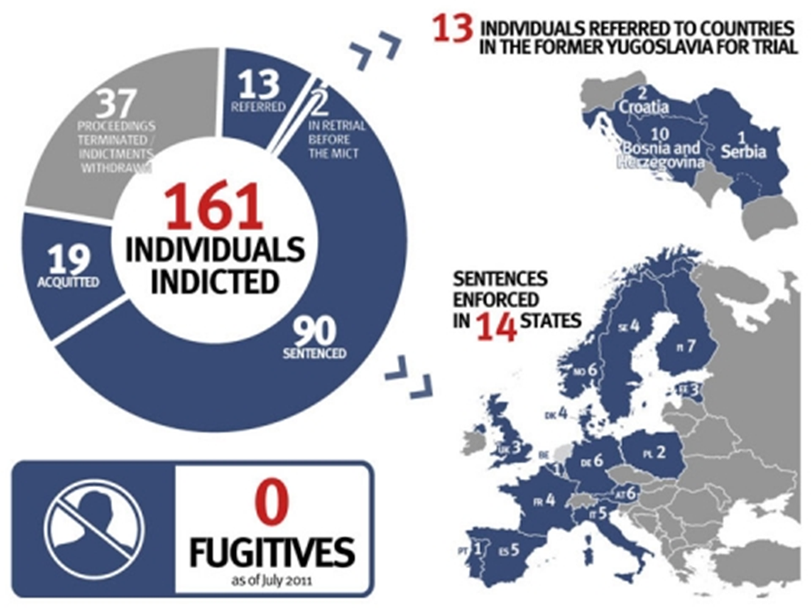
The International Criminal Tribunal for the Former Yugoslavia (ICTY)
May 1993 to Dec 2017
The International Criminal Tribunal for the Former Yugosolvia (ICTY) was established by the UN Security Council in May 1993 to prosecute mass killings and violations of international law, at The Hague, Netherlands. The ICTY was the first international tribunal since the Nuremberg Trials in 1945-46 and was the first tribunal to prosecute genocide and other war crimes. The ICTY would eventually indict 161 individuals of crimes, including the President of Republika Srpska, Radovan Karadžić, and Commander of the VRS, Ratko Mladić, who were indicted on charges of genocide and crimes against humanity for their atrocities in Srebrenica. The ICTY ceased to exist after December 2017, leaving its residual functions to the International Residual Mechanism for Criminal Tribunals (IRMCT), established in 2010.

Slide 29
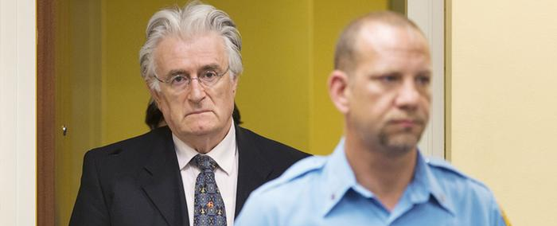
Radovan Karadžić Case
1995 to 2016
Radovan Karadžić was the leader of the Serbian Democratic Party of Bosnia and Herzegovina. He was President of the party from July 1990 to July 1996. He is considered one of the main architects of the genocide. Prosecutors at the ICTY said that Karadžić was responsible for the 44-month siege of Sarajevo and the genocide of more than 8,000 Bosnian men and boys in Srebrenica. Karadžić was jointly indicted along with Ratko Mladić in 1995, but evaded arrest until he was captured in Belgrade, Serbia, in 2008. He was indicted on two counts of genocide; five counts of crimes against humanity; four counts of violations of the laws or customs of war. Karadžić was sentenced to 40 years imprisonment on March 24, 2016.

Slide 30
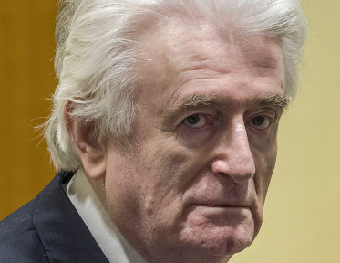
Radovan Karadžić Sentence Increased to Life Imprisonment
Mar 20, 2019
Karadžić appealed his 2016 verdict in which he was sentenced to 40 years for the Siege of Sarajevo and the Srebrenica Genocide. On March 20, 2019, UN appeals judges rejected his request and extended his sentence as a result of the gravity of his crimes and the weight of his responsibility. His sentence was increased from 40 years to life imprisonment. This decision was the final ruling and cannot be appealed any further.

Slide 31
Slobodan Milošević Case
2001 to 2006
Slobodan Milošević was Serbia's party leader and President from 1989-1997. From 1997-2000, he was the President of the Federal Republic of Yugoslavia. Milošević was arrested by Serbian authorities on April 1, 2001 and extradited to the ICTY on June 29, 2001 for trial on charges of genocide, crimes against humanity, and war crimes. The trial began on February 12, 2002 but suffered several delays due to Milošević's poor health. On March 11, 2006, he was found dead in his prison cell. The proceedings were terminated.

Slide 32
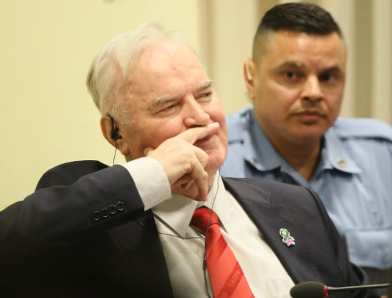
Ratko Mladić Case
1995 to 2017
Ratko Mladić was the commander of the Army of Republika Srpska (VRS) during the Bosnian War (1992-1995). He is considered one of the main architects of the genocide. On July 25, 1995, the ICTY indicted Mladić on two counts of genocide, five counts of crimes against humanity and four counts of violations of the laws or customs of war. Mladić fled to Belgrade, where he lived freely under the protection of Slobodan Milošević, until Milošević was extradited to The Hague in 2001. On May 26, 2011, after 16 years on the run, Mladić was captured by Serbian authorities in Lazarevo, a village in Northern Serbia. He was later extradited to The Hague. In May 2012, he went on trial for war crimes. In November 2017 Mladić was found guilty of 10 of 11 charges and sentenced to life in prison.

Slide 33
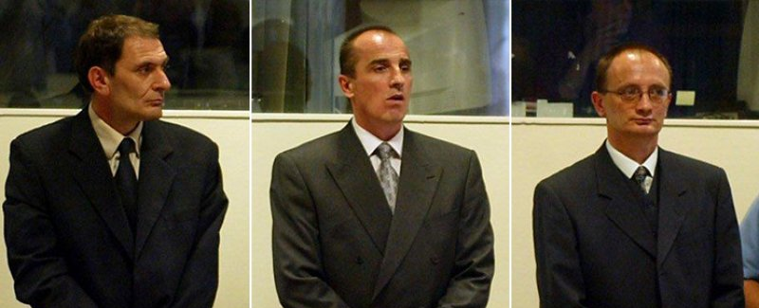
Foča Investigation
2001
According to the ICTY, rape was systematically used by the military as an instrument of terror. Dragoljub Kunarac, Radomir Kovač, and Zoran Vukovič are three men who played a prominent role in organizing and maintaining rape camps in Foča. All three men were convicted of rape, enslavement, and torture by the ICTY in 2001. This was a landmark case in which sexual enslavement and rape were recognized as crimes against humanity.

Slide 34
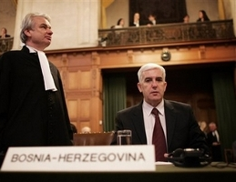
The ICJ Acquits Serbia of Genocide
Feb 26, 2007
The International Court of Justice (ICJ) acquitted Serbia of committing genocide in Bosnia and Herzegovina on February 26, 2007 but found it guilty of failing to prevent genocide in Srebrenica. Although Serbia was acquitted, the ICJ concluded that the VRS had “the necessary specific intent to destroy in part the group of Bosnian Muslims (specifically the Bosnian Muslims of Srebrenica) and that accordingly acts of genocide were committed by the VRS.”

Slide 35
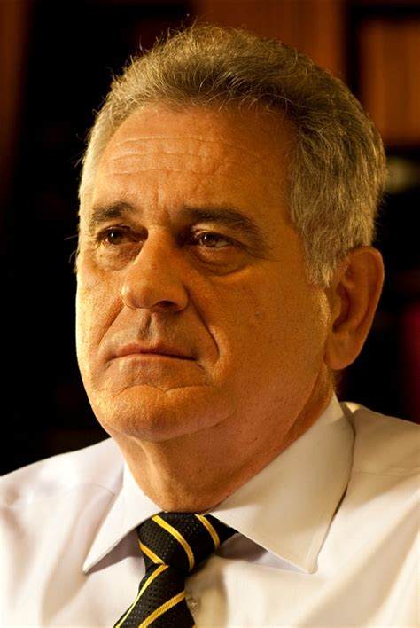
Denial of Genocide by Bosnian Serbs
1995 to Present
Many Serbians still deny the Srebrenica Genocide by significantly deflating the number of victims, undermining international courts, or glorifying war criminals. Some have also claimed that victims are alive and have left Srebrenica. Government officials (including the current mayor of Srebrenica), citizens, and reports claim that the Red Cross, the US, and Britain conspired to plant bodies and inflate reported deaths in the Srebrenica massacre. In 2012, then President of Serbia, Tomislav Nikolić, claimed: “there was no genocide in Srebrenica”.

Slide 36
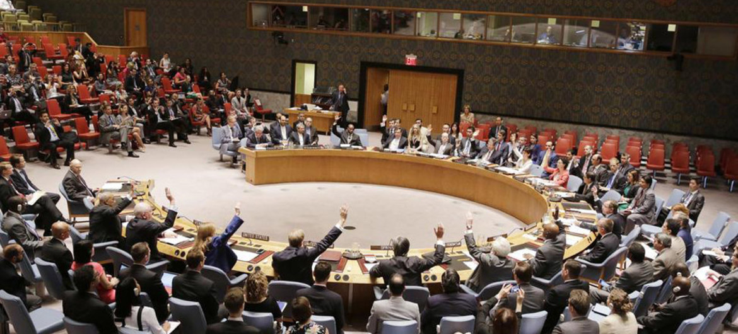
International Denial of Genocide
1995 to Present
In 2015, the UN Security Council rejected a resolution that would formally recognize the 1995 atrocities in Srebrenica as a genocide. China, Angola, Venezuela, and Russia voted against the resolution. Russia echoes Serbian claims that the ICTY harbored an anti-Serbian bias.

Slide 37
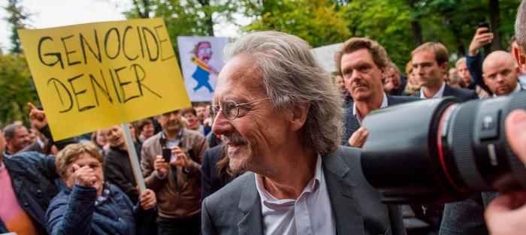
Peter Handke and the Nobel Prize in Literature
2019
In recent news, Peter Handke, an Austrian playwright won a Nobel Prize in Literature in 2019. Peter Handke is a known denier of the Srebrenica Genocide. He claims that Bosniaks massacred themselves, then blamed the Serbs. The controversial decision of giving him a Nobel Prize sparked anger and outrage from Bosnians and the international community.

Slide 38
Srebrenica-Potočari Memorial and Cemetery
May 2001 to Present
In October 2000, then UN High Representative Wolfgang Petritsch decided to build the Srebrenica-Potočari Memorial Center in Potočari. The Srebrenica-Potočari Memorial Complex was established in May 2001. The site was officially opened by former US President Bill Clinton on September 20, 2003, and 600 sets of remains were buried. Each year, new remains are buried. As of September 2019, 6,643 victims’ remains have been buried.

Slide 39
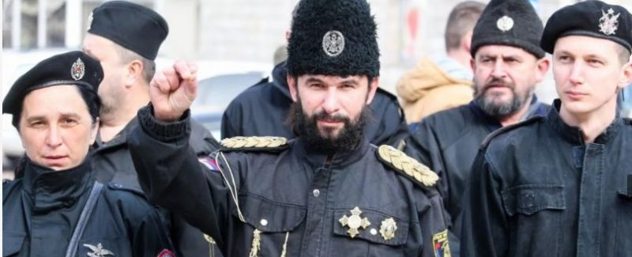
Hate Crimes During Srebrenica Anniversary
Jul 5, 2005 to Jul 11, 2009
On July 5, 2005, days before the 10th Anniversary of the Srebrenica Genocide, two bombs were found at the memorial site. If they had exploded, they would've killed and injured more than 50,000 people. On July 12, 2007, a group of men in Chetnik, former Serbian paramilitary forces, uniforms marched on the streets of Srebrenica. On July 11, 2009, a slew of hate crimes occurred: a mosque was vandalized, Bosnia’s national flag was torn from the Bratunac town-hall building and desecrated, and Serb nationalists marched through the streets.

Slide 40
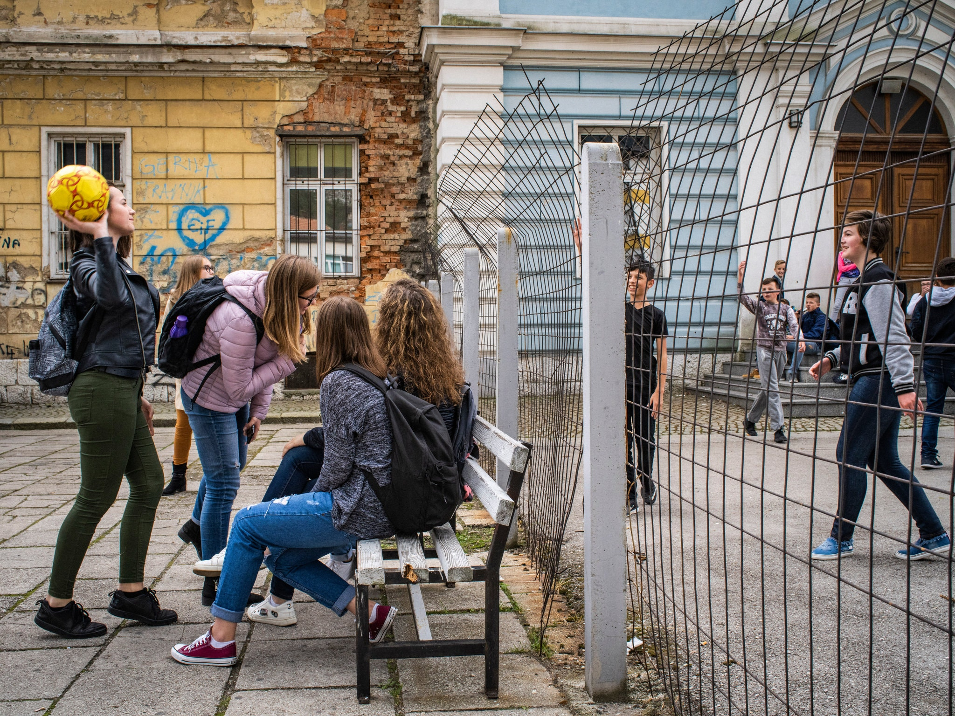
Conclusion
1995 to Present
As a result of the Srebrenica Genocide and Bosnian War, ethnic tensions between Bosnian Serbs, Bosnian Croats, and Bosniaks continue to divide the nation.
Presently, communities provide separate services depending on ethnicity. There are separate fire brigades, garbage collection companies, hospitals, bus stations, and nightclubs. Students attend segregated schools.
Although the Dayton Peace Agreement ended the Bosnian War, the decision to split Bosnia-Herzegovina into two separate entities has only fostered more division.

